Slide 1
Welcome to
A-Level Psychology at
St Ambrose College
Please feel free to contact
Mrs Boulton
Miss Wagstaff
(Psychology Teachers)

Slide 2
Why study Psychology?
Psychology is the scientific study of the human mind and behaviour - how we think, feel, act and interact individually and in groups.
Psychology is concerned with all aspects of behaviour and with the thoughts, feelings and motivations underlying that behaviour.
You will enjoy Psychology if you are the type of person who is interested in ‘the human condition’ and like to think analytically.

Slide 3
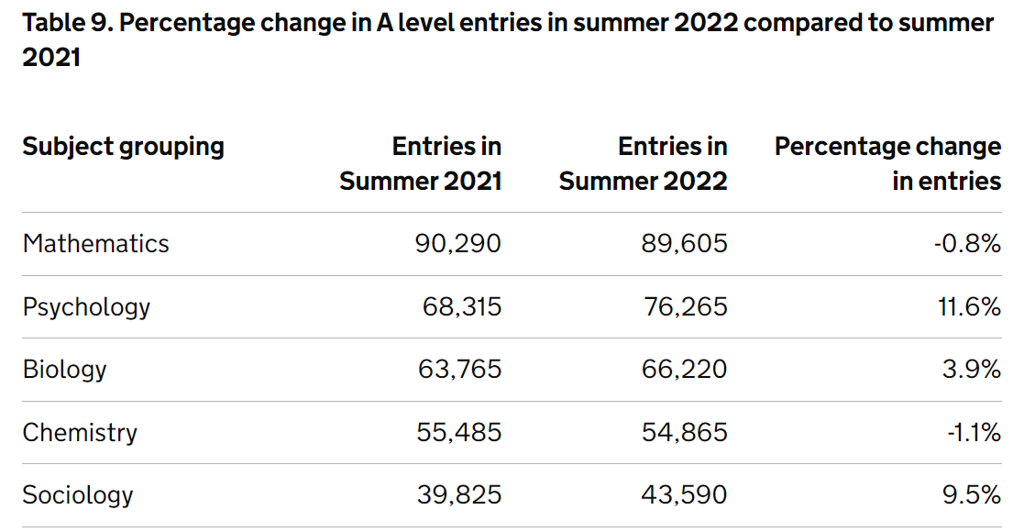
Who would A Level Psychology suit?
The diversity in the topics covered in A-Level Psychology make it an ideal choice for many students.
If students are considering University or a higher apprenticeships, then Psychology is a great foundation for developing the skills needed to enable them to make that next step.
Psychology is one of the most popular A-levels nationally (76,265 last year!)

Slide 4
At a Glance
In taking this qualification, students can develop their ability to:
interpret scientific results.
analyse source material.
make sense of human behaviour.
research scientifically.
evaluate research and theories.
write effectively.

Slide 5
What will I study?
Year 12
Paper 1 Topics
Social Influence
Memory
Attachment
Psychopathology
Paper 2 Topics
Approaches
Biopsychology
Research Methods
Year 13
Paper 3 Topics
Issues and Debates
Relationships
Schizophrenia
Forensic Psychology

Slide 6
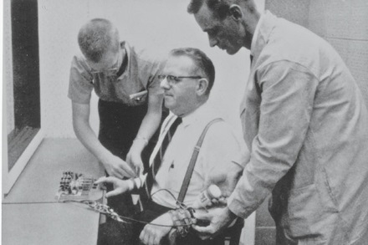
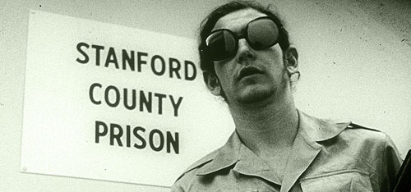
Social Influence
Why do people change their behaviour in different situations?
Would you harm another person because you were told to?
Why do some people rebel?
How does social change happen?
Historical and real-life cases are used as examples throughout
(Suffragettes, BLM, Nazi obedience, smoking ban and changes in the mental health act etc)
Paper 1

Slide 7
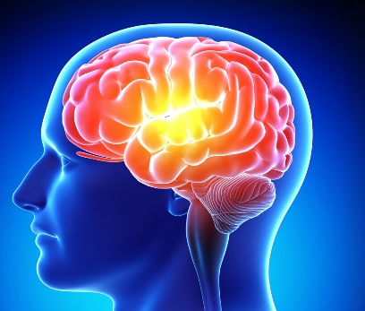
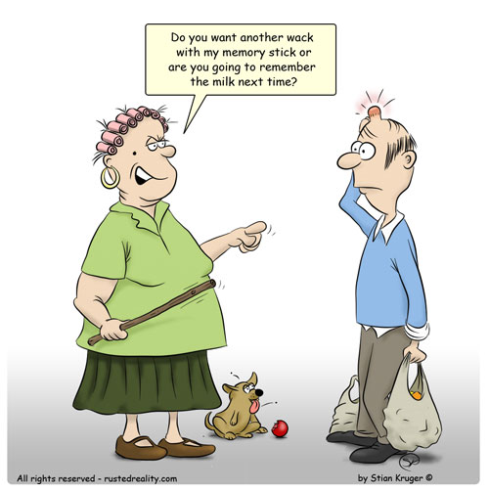
Memory
Paper 1
How do we store our experiences?
Is memory reliable?
What factors affect forgetting?
How does research inform the legal system? (EWT, the police interview system)

Slide 8
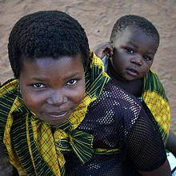
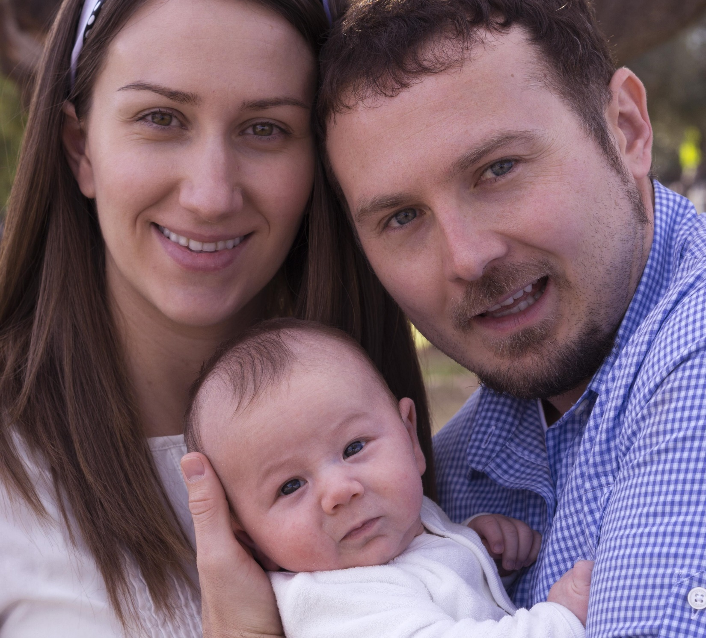
Attachment
Paper 1
Why is there a need for us to attach to people?
How do we make these attachments?
Is there a crucial time during which we must bond during infancy?
How similar is animal attachment to human attachment?
What are the consequences of being deprived of good quality attachment in infancy?

Slide 9
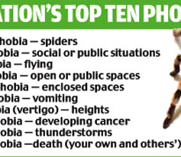
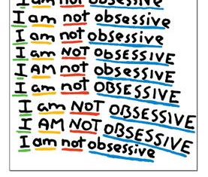
Psychopathology
How do we diagnose mental illness?
How do we explain and treat
Phobias – (Behaviourism)
Depression – (Cognitive)
OCD – (Biological)
Are these treatments appropriate?
Are these treatments effective?
What is the impact of the economy on offering the most effective and appropriate treatment for those who experience mental illness?
Paper 1

Slide 10
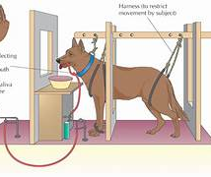
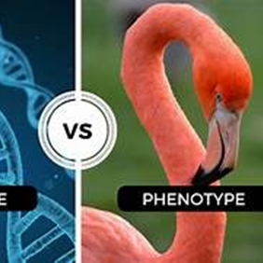
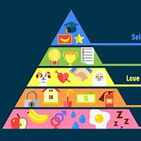
Approaches
Paper 2
Understand the main perspectives in Psychology
Biological
Behaviourism
Cognitive
Psychodynamic
Humanistic

Slide 11
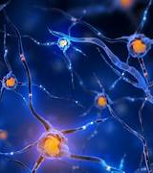
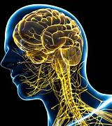
BioPsychology
Paper 2
How do neurons communicate?
What are the different regions of the brain responsible for?
How do we measure activity in the brain?
How does the central nervous system respond to the fight or flight response when we perceive a threat?
How does the body process the environmental stimuli to regulate our sleep/wake cycle?

Slide 12
Research Methods
Paper 2
How to design experiments, observations, self-reports and correlations
Strengths and weaknesses on research methods
How to calculate descriptive and inferential statistics
What are the issues surrounding experiments on people?
Is Psychology a science?

Slide 13
Paper 3
Year 13
Schizophrenia:
We learn how it is diagnosed and the difficulties surrounding this, how to explain the causes of the disorder and what treatments are available and find out what life is like for someone with schizophrenia.
Forensic Psychology:
We seek answers to how/why people become offenders looking at biological and psychological explanations. Following this we learn how the UK deals with offenders and whether the rehabilitation in our prison system is effective enough.
Relationships:
We explore the evolutionary explanations of the factors affecting attraction, and several theories to explain relationship maintenance and breakdown. Finally, we look at the similarities and differences of virtual relationships.
Issues and debates:
Nature/Nurture, freewill/determinism, reductionism/holism etc

Slide 14
Assessment
Paper 1 Topics
Social Influence
Memory
Attachment
Psychopathology
Paper 2 Topics
Approaches
Biopsychology
Research Methods
Paper 3 Topics
Issues and Debates
Relationships
Schizophrenia
Forensic Psychology
How many exams? 3 written exams
How long? Each is 2 hours
Weighting? Each is marked out of 96, so each paper is a 1/3 of the overall mark.
Question types: MCQ, Short answer and extended writing

Slide 15
Entry Requirements
Applicants who wish to study 3 A levels and a supplementary subject will require a minimum Attainment 8 Score of 60pts to include at least a Grade 5 in Mathematics and English Language.
Applicants who wish to study Psychology must have a minimum of Grade 7 in either Biology, Chemistry or Physics
Thursday 8th February 2024

Slide 16
Who would A Level Psychology suit?
Advertising and Marketing
Medicine
Educational Psychology
Teaching
Probation Services
Clinical Psychology
Occupational
Health
Recruitment
Forensic Psychology
Police
Law
Social Work
Sport Psychology
Psychotherapy/Counselling
Neuroscience
www.bps.org.uk/careers

Slide 17
Which other A Level subjects does it complement?
It links closely with:
Biology
Mathematics
English
PE
History
Other complimentary subjects: Business , Art, Geography, Chemistry, also great for those doing the EPQ

Slide 18
Opportunities in Psychology

Slide 19
Finally, a word from a few students…
I knew going into Psychology that it would be my favourite subject to study and it was! Some of what I learnt will definitely come in handy during my training as a medic. I will make sure to keep it in my long term memory because I'm not ready to let go of Psychology yet! Y13
I was a bit unsure at the very beginning of the year about what subjects would be best for me. I chose Psychology in the end as I have always wanted to learn more about myself and others and how all our behaviours and thoughts are formed.
I really love the subject as it is nothing like any subject I have ever done before. Every topic is extremely fascinating and broadens our understanding of ourselves, which I enjoy most of all.
I love all the topics we study; however, I am especially enjoying learning about social influence as I feel that this is a vital part of everyone's lives. I'm excited to research deeper into it and learning about fascinating areas of the topic that I never thought about in the past, to increase my knowledge.
Y13
I’m really looking forward to continuing my (Psychology) studies. ‘The Psychologist in waiting’…
Y13

Slide 20
Thank you for listening
Please feel free to contact Mrs Boulton or Miss Wagstaff
(Psychology Teachers)

