Slide 1
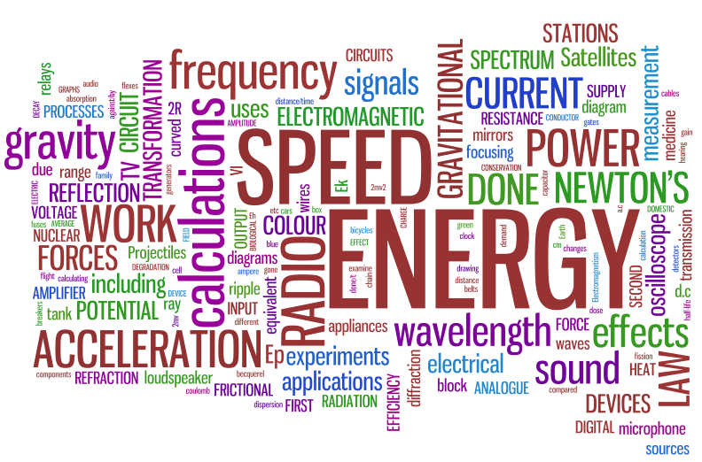
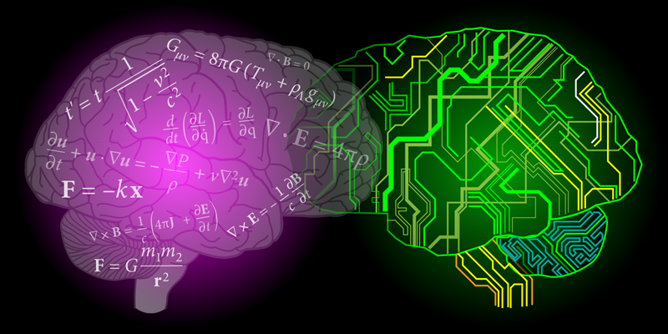
Why Study A-Level Physics?
Sixth Form Open Evening: 2023-4

Slide 2
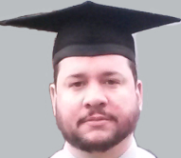
Hello and welcome to the presentation ...
From selecting this talk, I presume you are interested, or at least mildly curious (!), in how or why Physics may be an A-level for you.
I hope to explain why you might want to choose physics and the course requirements and structure over the next few minutes.
Dr. Gardener, Head of Physics.

Slide 3
Because you enjoy it …
Physics A-level is designed to follow on from GCSE Physics (Separate or Combined-Trilogy). If you have enjoyed your Physics GCSE, you will appreciate the greater level of detail and understanding developed at A-level.
There will be some new areas to cover, but you will also re-visit familiar topics in more depth.
Physics investigates the ‘Laws of the Universe’ ... Who doesn’t want to understand more?

Slide 4
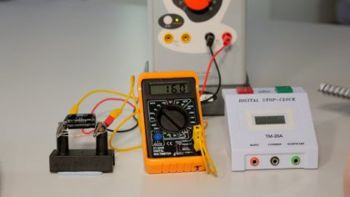
For the practical ...
There is a comprehensive practical element to A-level Physics, with students required to complete 12+ practical experiments (“PAGs”) - at least 6 per year.
Practical understanding will also be assessed during the written exams. The PAGs contribute to the Practical Skills qualification as part of the A-level (your exam grade + a ‘Pass/Fail’).
Typically 15% of lessons and tests would be related to practical tasks, including student-led investigations and a research essay in year 13.

Slide 5
For the future ...
A-level Physics is a good choice for students considering STEM careers (Science, Technology, Engineering and Maths), but Physicists find roles in many areas – industry, transport, law, business and economics, government, astronomy, robotics … it keeps doors open!
Studying Physics will prepare students for many careers, apprenticeships and/or degrees, as it develops a number of very desirable skills.

Slide 6
For your career ... ?
A-level Physics is usually a required A-level to study courses in all types of Engineering and Physics …
It is also recommended (or desirable) for Architecture, Biochemistry, Biology, Chemistry, Medicine, Dentistry, Nursing, Architecture, Computer Science, Geography, Environmental Science, Maths, Materials Science, Pharmacy, Surveying ….
A Physics degree boosts your expected pay by 30% (behind only Medicine, Law and Engineering) PWC Report 2005

Slide 7
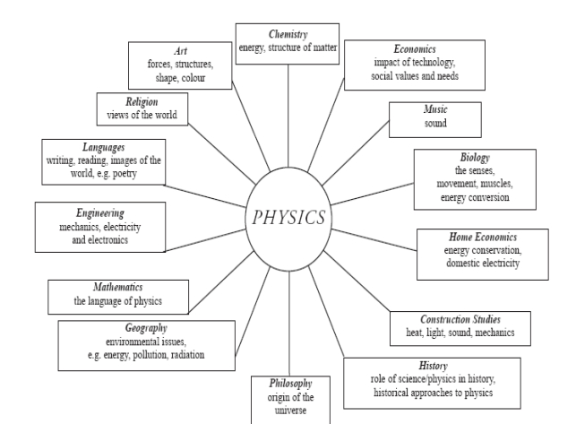
Because it fits ...
Physics fits well with other Science A levels and many students take Physics in combination with at least one of Biology, Chemistry and/or Mathematics and Further Maths.
Physics also works well with Computer Science and DT.
More and more, physics is seen as an enabling A-level.

Slide 8
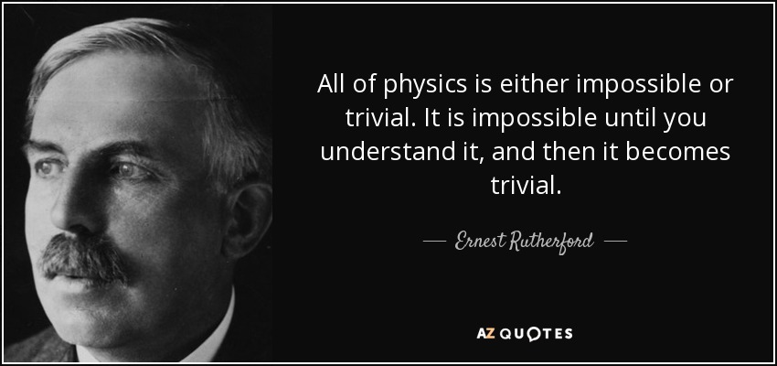
For the challenge ...
A-level Physics is designed to be rigorous, while maintaining fair and balanced question papers. This includes testing synoptic understanding, knowledge of ‘How Science Works’ and providing stretch and challenge. It is not easy; you will be tested by your studies!
The problem-solving skills developed will be applicable to many career pathways in or outside science.

Slide 9
For the next step ...
Our results are consistently above the National average.
Approximately 80% of our students got their first choice University in 2023, despite the government push on lowering grades.
Destinations include Oxbridge, Russell Group and top US Universities, via the Sutton Trust program.
Former students are studying for top degrees in science, engineering, medical fields, computer sciences etc.
Become the leaders for your generation!

Slide 10
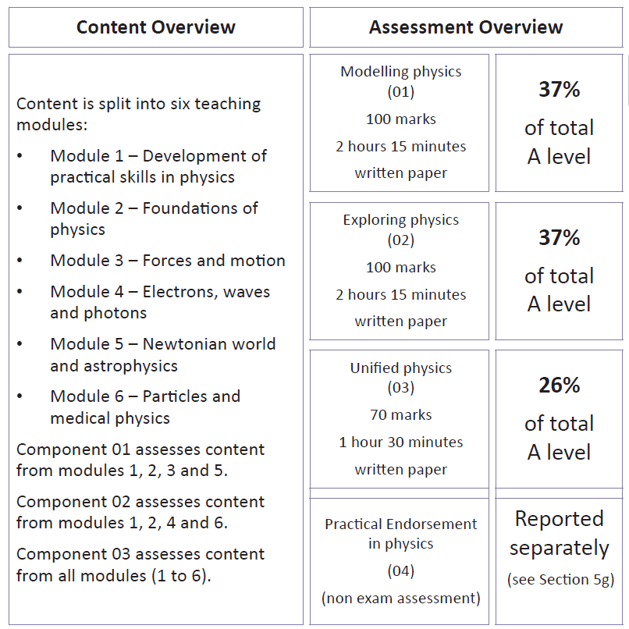
Physics A
Course Structure
OCR Physics A; content led; a ‘traditional’ course;
6 modules – 5 taught, 1 practical skills;
3 exams at end of year 13, plus practical component Pass/Fail.

Slide 11
Think it’s for you?
You will need at least a grade 7 in GCSE Physics.
The high level of numeracy required suggests that you will also have a grade 7+ in GCSE Mathematics. A-level Maths is recommended.
Be prepared to work hard. From day one you will be challenged; you will not grasp every concept immediately; you will have to work hard independently outside of lessons.
But this is excellent preparation for university, too!
Not sure? Students should talk to their physics teacher or myself!

Slide 12
We Support You ...
Kerboodle – full online textbook (plus physical copies), resources, assessments and is OCR-produced.
We have three specialist physicists as teachers – including those with post-graduate / doctoral experience - who are happy to advise as well as teach you. We have a dedicated physics technician for practical support.
Support for Oxbridge, Early Entry and Russell Group applications, including course advice, mock interviews and exam preparation.
Questions? Come talk to us in school, or email:
dragardener@st-ambrosecollege.org.uk

