Slide 1
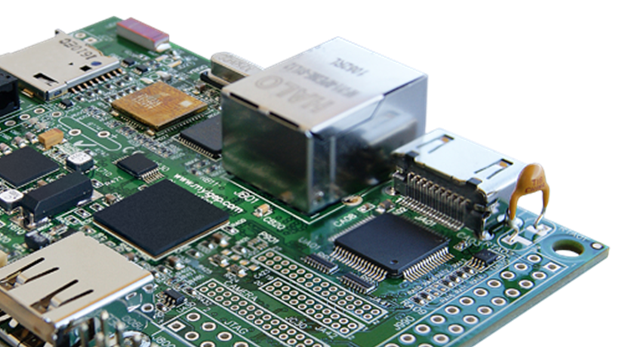
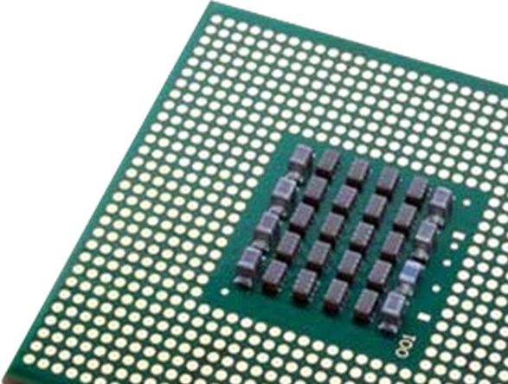
“Computer Science is no more about computers than astronomy is about telescopes.” - Edsger W. Dijkstra

Slide 2

Why choose Computer Science?
Technology is embedded in every aspect of our lives.
Computer Science is being used to help solve many of the world's biggest problems

Slide 3


Slide 4

Entry Requirements
Maths
Grade 7
Computing
Grade 6

Slide 5
The Qualification
OCR A Level Computer Science
Linear Course so all the content is examined at the end of two years
Content overlaps/builds on the content covered in the GCSE
Paper 1 – Computer Systems
40% of A Level
2 hours 30 minutes
140 marks
Paper 2 – Algorithms and Programming
40% of A Level
2 hours 30 minutes
140 marks

Slide 6

What does the course cover?
Internal computer components
Cyber security
Data representation
Effect of digital technology on society
Programming
Networking and the Internet
Software development

Slide 7
Year 13 – The Project
Non-exam assessment
75 marks
20% of A Level
Create solution to a problem
Independent research
Any Language
Examples…
Complex Games (e.g. may involve playing against the computer)
Simulations
Automated scheduling/timetabling
Online multi-user websites
Robotics
Mobile Apps/Games

Slide 8
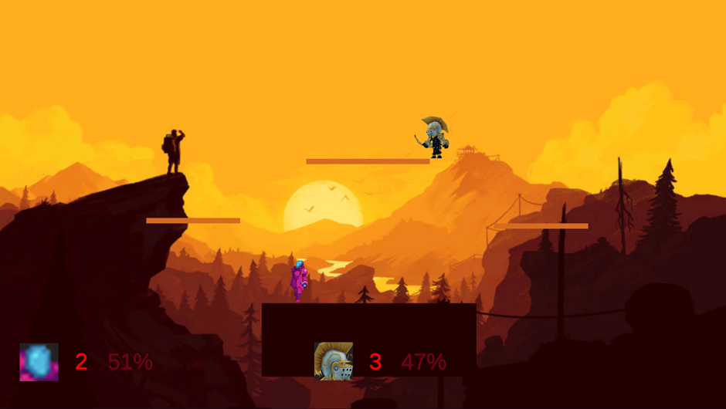
Past Projects
Hive Lighting style system
2D and 3D Computer Games
Poker/Chess Tutorial/Games
Networked Games
Work Experience Mobile App
DJ Software
Software for Parents Business
Stock Control Systems

Slide 9

Results
 | % of A* to A Grades | % of A*/B Grades | % of A* to E Grades
2025 | 60 | 95 | 100
2024 | 47 | 87 | 100
2023 | 43 | 86 | 100
2022 | 46 | 77 | 100

Slide 10
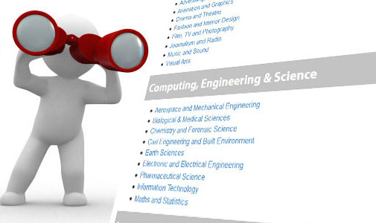
Subject Links
Maths
Further Maths
Physics
Design and Technology
Business

Slide 11

Degrees
Many universities offer computer science, software engineering, or computing degrees either on their own or as a ‘joint honours’ program.
More specialist degrees, such as telecommunications engineering, hardware engineering, cyber security analyst, games programming, IT and business, also benefit from A-level computing.
Computing is also useful for the application of any
science or engineering-based degree, as it provides
opportunities for practical problem solving and logical thinking.

Slide 12

Sutton Trust
Successfully had one student receive a full scholarship to Princeton University to study Computer Science last year – he started at the University September 2023
Two more students applying this year.

Slide 13
Cyber First
CyberFirst offers students a real choice after A Levels or whilst at University.
A CyberFirst Bursary offers undergraduates £4,000 per year financial assistance and paid cyber security training each summer to help kick start their career in cyber
A CyberFirst Degree Apprenticeship allows undergraduates to earn whilst they learn, ready for a job with GCHQ
Summer Placements
https://www.ncsc.gov.uk/cyberfirst/bursary

Slide 14
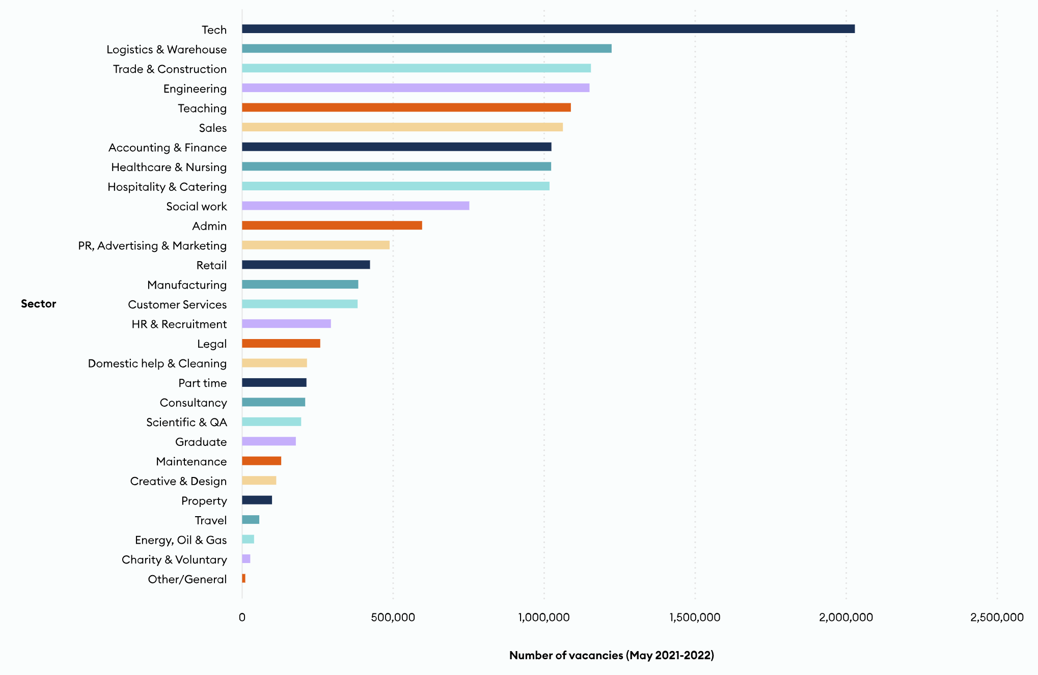

Growth in this sector is predicted to continue to grow!
Did you know the computer games industry is bigger than the film and music industries combined?
Number of vacancies by industry
Notes:
Over 36% of jobs in the digital tech economy are in non tech occupations, like Product Management, User Experience, People, and Sales
https://stagetechn.wpengine.com/people-and-skills-report-2022/#tech-job-vacancies

Slide 15
Types of Careers
Software developer
Systems engineer
Database administrator
Games developer
Information systems manager
Project Manager
Cyber Security
IT consultant
Multimedia programmer
Network engineer
Systems analyst
Systems developer
Web Developer
App Developer

Slide 16

Opportunities
Numerous ways the boys can boost CV and University personal statement content
  Mentor boys from years 10 and 11
  Run lunchtime clubs
  Open Days
  Complete any number of programming courses
  Research, Research, Research

Slide 17

Where to get more information
Thank you for listening. If you have any questions feel free to ask now or you can put them in an email
mrdsweeney@st-ambrosecollege.org.uk
OCR Exam board website:
https://www.ocr.org.uk/qualifications/as-and-a-level/computer-science-h046-h446-from-2015/

