Slide 1
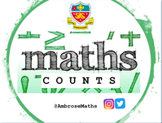
Welcome to the Maths Department
1) Why study Maths beyond GCSE
2) Options for studying Maths in 6th form
3) Future Study and Careers

Slide 2
Mathematics in The Sixth Form
2023 ‘A’-Level Maths Results:
OVERVIEW - MATHEMATICS A-LEVEL 2023
Grade | A* | A | B | C | D | E | U | Total
Total | 10 | 21 | 11 | 7 | 7 | 0 | 1 | 57
% | 18 | 37 | 19 | 12 | 12 | 0 | 2 | 100
Cmltv % | 18 | 55 | 74 | 86 | 98 | 98 | 100 | 100
2023 ‘A’-Level Further Maths Results:
OVERVIEW - FURTHER MATHS A-LEVEL 2023
Grade | A* | A | B | C | D | E | U | Total
Total | 4 | 3 | 5 | 1 | 0 | 0 | 0 | 13
% | 31 | 23 | 38 | 8 | 0 | 0 | 0 | 100
Cmltv % | 31 | 54 | 92 | 100 | 100 | 100 | 100 | 100

Slide 3




Why study Mathematics?
Leads to versatile qualifications
well-respected by employers and higher education
Develop key employability skills
e.g. problem-solving, communication,
logical reasoning and resilience
Increase knowledge and understanding
of mathematical techniques and their applications​
$$\sqrt[y]{x}$$
CV
£
Support the study of other A levels
Excellent preparation
for a wide range of university courses
Stimulating and challenging courses

Slide 4
What are the options?
A level Mathematics
  Extends GCSE Maths and introduces new ideas
A level Further Mathematics
Taken in addition to the ordinary A level
Adds breadth/depth
Level 3 Core
Maths
  Develops maths skills and knowledge to focus on applied problem solving
Which should you choose?

Slide 5
What is covered in A level Mathematics?
All of the content in the A level Mathematics qualification is compulsory. We study the Edexcel exam board.
Pure Mathematics
66%
Statistics
17%
Mechanics
17%
Grade 7 at GCSE is the minimum grade required to gain entry onto the A level Course

Slide 6
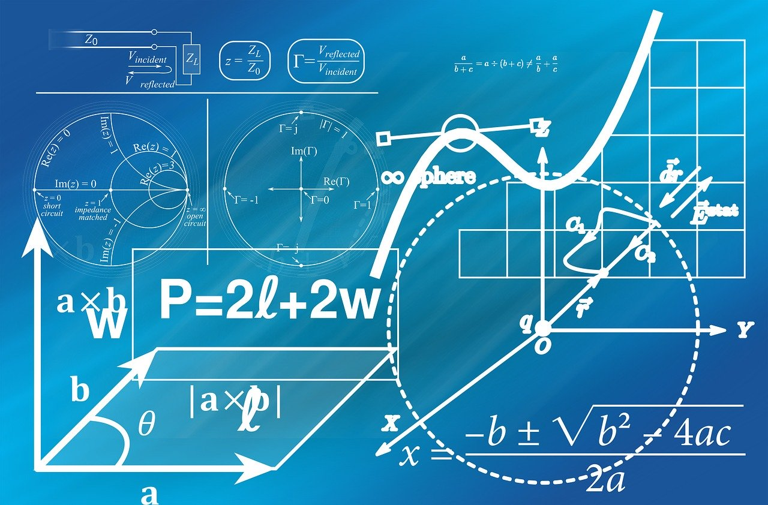
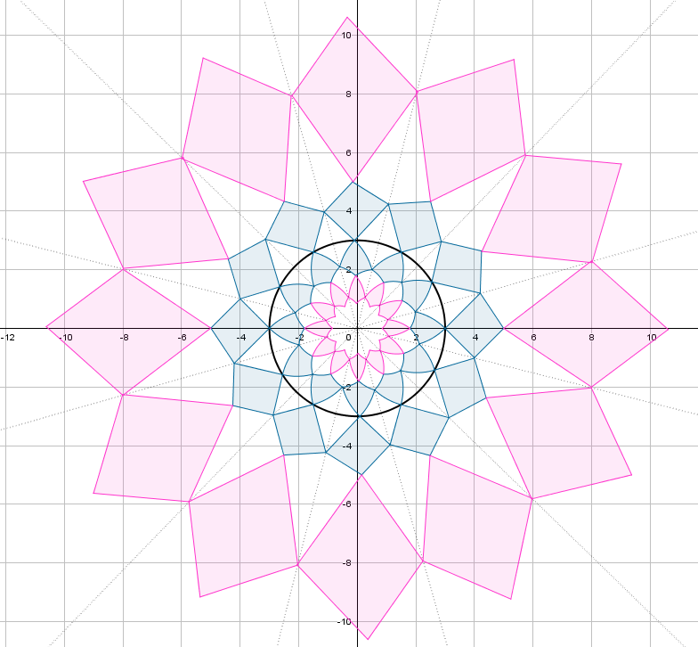
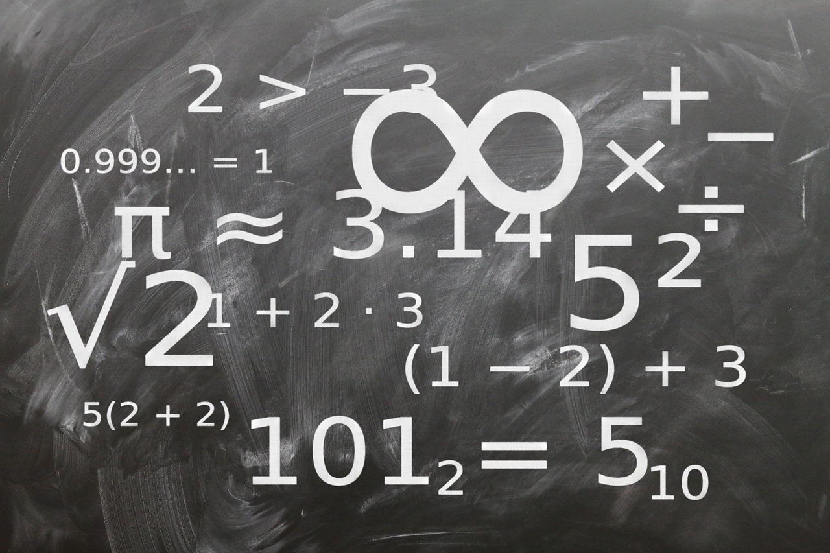
What is Pure Mathematics?
Methods and techniques which underpin the study of all other areas of mathematics, such as, proof, algebra, trigonometry, calculus, and vectors

Slide 7



What is Statistics?
Reaching conclusions from data and calculating the likelihood of an event occurring.
Notes:
Images: https://pixabay.com/en/flood-danube-sandbag-park-139000/
Https://pixabay.com/photos/car-accident-clash-rome-highway-2165210/
https://pixabay.com/illustrations/analysis-statistics-chart-graphic-810025/

Slide 8



What is Mechanics?
The modelling of the world around us, the motion of objects and the forces acting on them.
Notes:
https://pixabay.com/photos/water-drop-liquid-splash-wet-1759703/
https://pixabay.com/illustrations/world-globe-earth-planet-blue-1303628/
https://pixabay.com/photos/golf-golf-course-grass-sport-green-3685616/

Slide 9
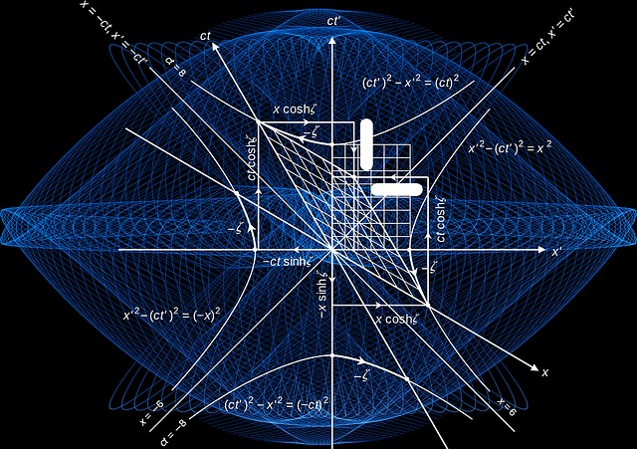


What is Further Mathematics?
Further Mathematics is an additional A level qualification taken in addition to an A level in Mathematics.
Notes:
https://pixabay.com/illustrations/mathematics-formula-physics-school-1230074/
https://pixabay.com/illustrations/fractal-art-3d-fractals-3206739/
https://pixabay.com/illustrations/geometry-mathematics-cube-1023843/

Slide 10
What is covered in Further Mathematics?
Further Maths A level
Pure Mathematics (50%)
Additional Statistics and Mechanics (50%)
This course is studied in addition to the A level as it builds on the Maths learnt in the ordinary A level.
It is ideally suited to students who achieved a grade 8 or 9 at GCSE, and a high grade in the Further Maths GCSE.
Notes:
There is still a lot of Pure mathematics content

Slide 11


What is Core Maths?
Versatile qualification equal in size to an AS level
Maths you will face in life and in the workplace
A course that will develop valuable mathematics skills
$$\sqrt[y]{x}$$
CV
£
Supports the learning of maths in other courses
Excellent preparation for university
For any student with at least a GCSE Mathematics grade 4
Core Maths is a one year course, with the examination taken at the end of Year 12

Slide 12

Many subjects use maths
Biology
Physics
Business studies
PE
Maths
Economics
Chemistry
Engineering
Design & Technology
Business
Geography
Computing
Sociology

Slide 13
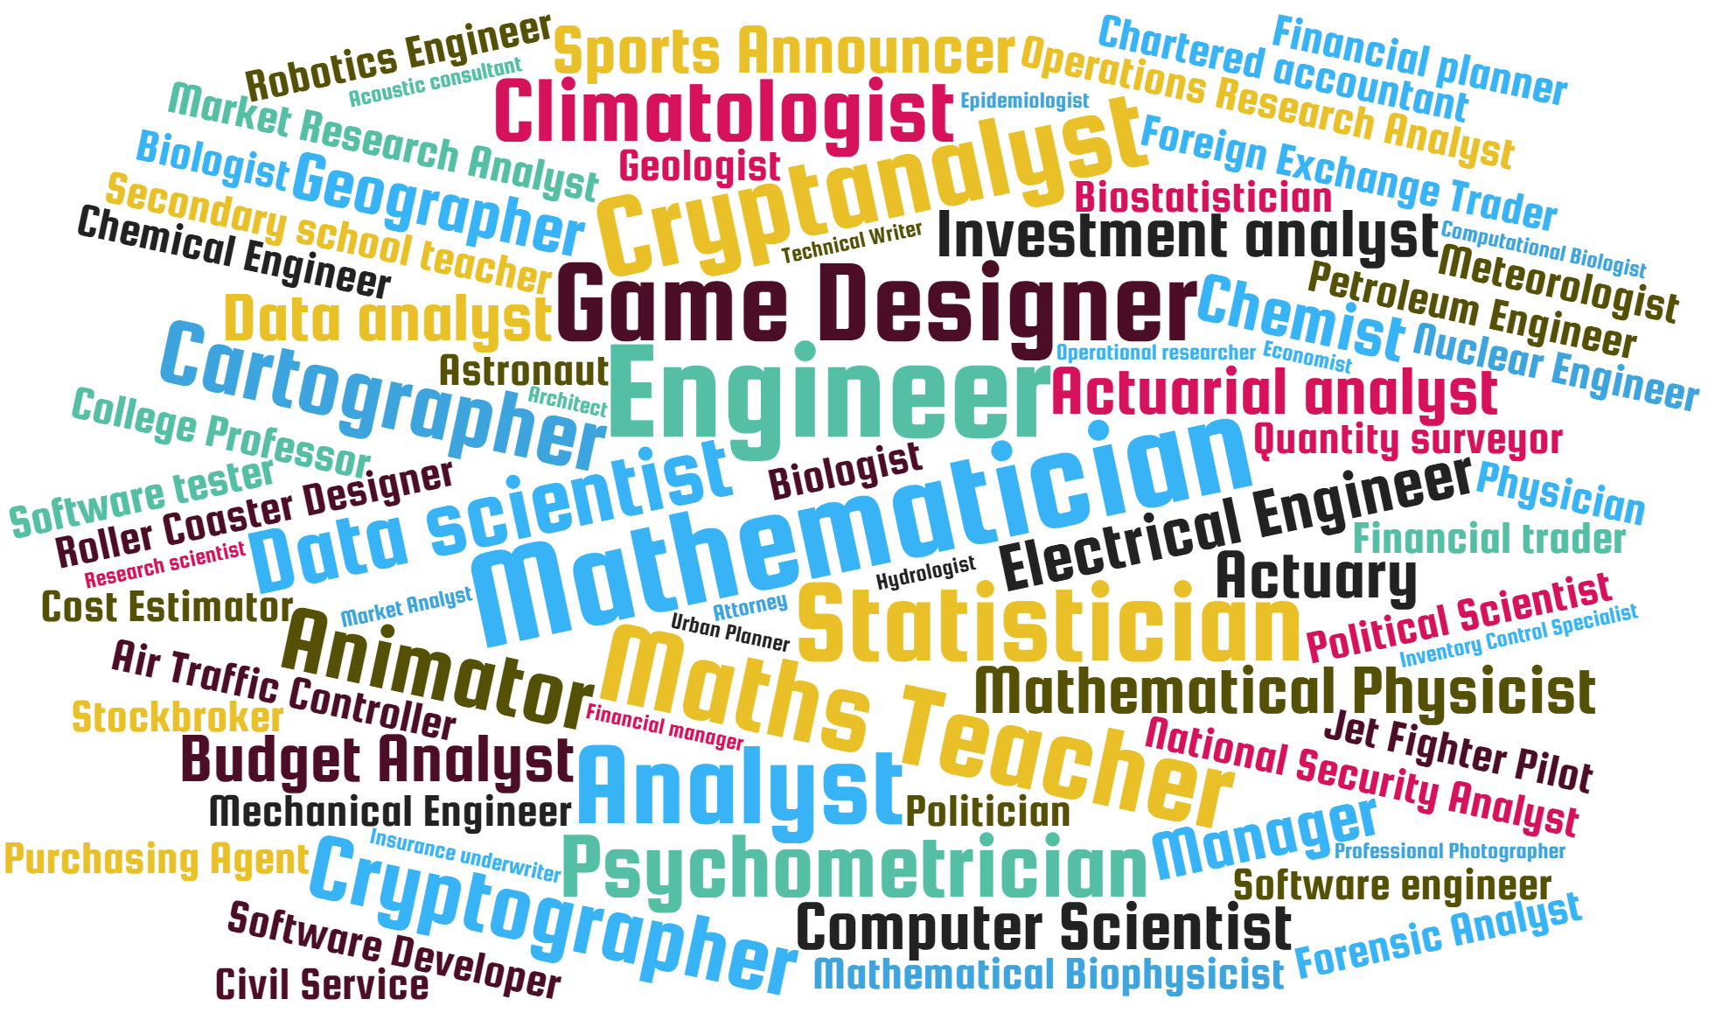
What are the career opportunities?

Slide 14
What are the career opportunities?
“…analysis highlights the economic value of good mathematical skills and of higher level qualifications… There is compelling evidence of continued wage returns of up to 11% to A level Mathematics.”
Rethinking the Value of Advanced Mathematics Participation
http://www.nottingham.ac.uk/education/documents/research/revamp-final-report-3.1.17.pdf
Notes:
Image created on Powerpoint by TR

Slide 15
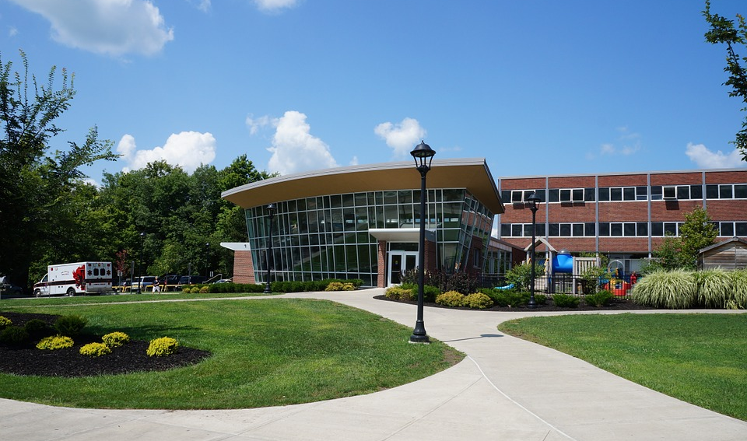
University entry requirements
Look at the entry requirements on an individual university’s website for the degree subjects that you might be interested in.
In some cases a qualification in Core Maths or or A level Mathematics/Further Mathematics will reduce the grades required for entry to a degree course in a related subject
Visit www.ucas.com for additional information
Notes:
Image: https://pixabay.com/en/college-campus-building-university-75535/

Slide 16
Any Questions?

