Slide 1
Spanish A-LEVEL
ST AMBROSE COLLEGE, NOVEMBER 2024

Slide 2
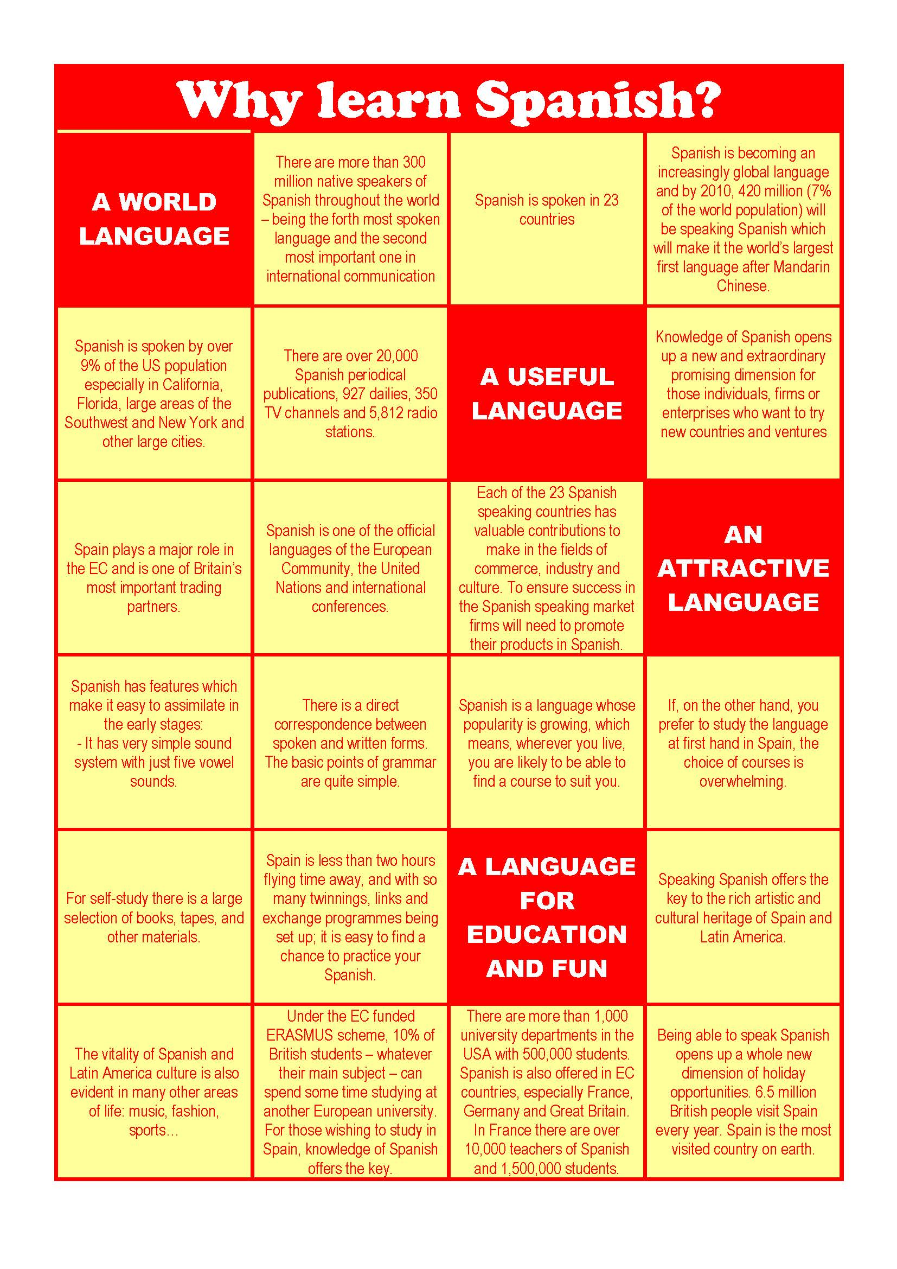
WHY Spanish?

Slide 3
AQA Spanish
A-level a two year course with exam at the end
Grading structure: A*-U
Prescribed list of literary works and films
Importance of grammar and translation

Slide 4
A-level Spanish content (1) - AQA
Modern and traditional values (Los valores tradicionales y modernos)
Cyberspace (El ciberespacio)
Equal rights (La igualdad de los sexos)
Modern day idols (La influencia de los ídolos)
Spanish regional identity (La identidad regional en España)
Cultural heritage (El patrimonio cultural)

Slide 5
A-level Spanish content (2) - AQA
Cultural heritage or cultural landscape (El patrimonio cultural)
Today's youth, tomorrow's citizens (Jóvenes de hoy, ciudadanos de mañana)
Monarchies, republics and dictatorships (Monarquías, repúblicas y dictaduras)
Popular movements (Movimientos populares)
Immigration (La Inmigración)
Racism (El Racismo)
Integration (La Convivencia)

Slide 6
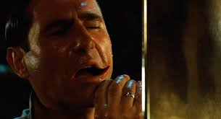
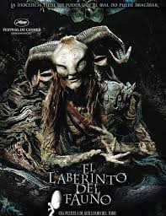
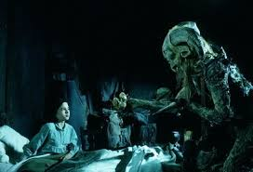
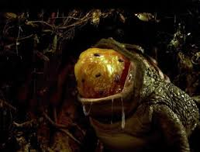
Film – El Laberinto del Fauno (Pan’s Labyrinth) (Guillermo del Toro)
In the Spain of 1944, the bookish young stepdaughter of a sadistic army officer escapes into an eerie but captivating fantasy world.

Slide 7
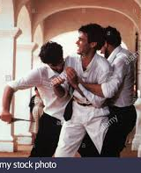
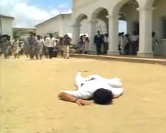
Literature – Crónica de una muerte anunciada (Chronicle of a Death Foretold) by Gabriel García Márquez
In a small town on the northern coast of Colombia, on the morning after the biggest wedding the town has ever seen, Santiago Nasar, a local man and mostly upstanding citizen, is brutally murdered outside his own front door.

Slide 8
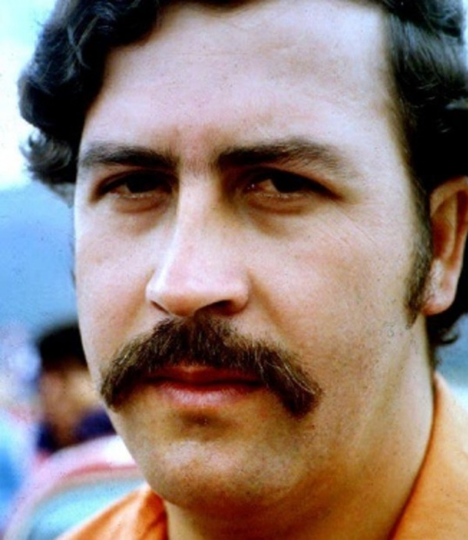
Individual research project
Main section of speaking exam
Student chooses own area of interest
Must relate to Spanish or Latin American culture
Some examples of projects…
Pablo Escobar – hero or villain?
Real Madrid vs Barcelona – just football?
Gaudí and his influence of contemporary architecture

Slide 9
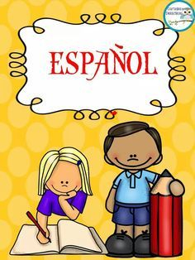
Assessment
Paper 1 – Listening, reading and translation (50%)
Paper 2 – Writing (literature and film) (20%)
Paper 3 – Speaking exam (30%)
EXCELLENT RESULTS

Slide 10
Lesson activities
Lesson activities
Discussion from spoken and written texts
Listening with audio and video (gap fill, matching, questions, summary, multi-choice, true/false, etc)
Translation both ways
Grammar exercises (pattern drills, gap fill, etc)
Studying film and literature
ICT-based tasks
Whole class oral work
Information gap pair work
Task-based activities
Games
Extensive reading
Individual research (reading and listening)
Preparing for assessment
Essay writing and technique

Slide 11
Other Information
Importance of independent work
Support in KS3 Lessons
One-to-one speaking practice
Work experience trip

Slide 12
Students words about A Level Spanish
‘Lessons are very engaging with a mix of different activities’
‘Topics are related to current world affairs’
‘It’s given me the opportunity to study the language but also grasp an understanding of real world issues in the Spanish-speaking world’
‘I am excited about the ability to live and work in the Spanish-speaking world’
‘I enjoy the varied homework that we are set’
‘The smaller classes mean that there is more opportunity for interaction with the teacher and other students’
‘My favourite thing about Spanish A level is when we do debates!’

