Slide 1
Why A Level Chemistry?
“I would highly recommend Chemistry at St Ambrose as it has some of the best resources, there is always plenty of support and probably one of, if not the best departments in the school.”
(Year 13 student who joined St. Ambrose only in year 12)
“Able to ask thoughtful questions and be given answers that I can understand. The teachers also can have a laugh with us, making you feel at ease during the lessons.”
(Year 13 student who joined St. Ambrose only in year 12)
Sixth Form Open Evening 2024
“The notes are incredible and very well put together - extremely useful for revision
All chemistry teachers have different perspectives and give useful tips and tricks to approaching questions.”
(Year 13 student)
“Out of the sciences, I would recommend chemistry the most as the subject covers interesting and rewarding topics and the support from all teachers is second to none.”
(Year 13 student)

Slide 2
Because you enjoy it
“A fun subject with practicals.” Year 13 student.
“The content was very engaging and I enjoyed talking to and being with my teachers and classmates.”
Year 13 student.
Chemistry A level is designed to follow on from GCSE Chemistry. (And Combined Science Chemistry)
There is a greater emphasis on formulas, equations and chemical calculations
Re-visit familiar topics like Rates of Reaction and Bonding and Structure
Notes:
If you have enjoyed the Chemical content of GCSE you will probably appreciate the greater level of detail needed at A level.

Slide 3

For the future
A good (and often required) choice for students considering careers in the health and clinical professions, including medicine, veterinary science, nursing, dentistry and forensic science.
Prepares students for numerous other careers as it develops a number of desirable skills, (allowing you to keep your options open!)
Follow the QI code above for further information on the careers that Chemistry can lead to.
“I think its a really interesting and challenging course, as well as being very useful when pursuing many different careers, and its also very well supported by teachers so if you’re struggling its very well managed”
Year 13 Student

Slide 4
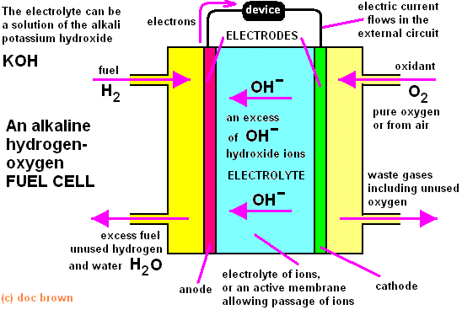
For the challenge
“It is a challenging a level, and not for the faint hearted however it is engaging, well-resourced and fun.”
(Year 13 student)
A-level Chemistry is designed to be rigorous, while maintaining fair and balanced question papers. This includes testing synoptic understanding, knowledge of How Science Works and providing stretch and challenge.
The problem-solving skills developed will be applicable to many career pathways in or outside science

Slide 5
For the extra and super-curricular
Cambridge Chemistry Race in year 12 at Cambridge or Oxford University
C3L6 - Chemistry Challenge in year 12
Chemistry Olympiad in year 13
On going prizes available for completing the weekly “Chemistry Challenge”
Fortnightly “Chem Race” at Chem Soc
Practical work at Lancaster University

Slide 6
Because it fits
Chemistry fits well with other Science A levels and most boys take Chemistry in combination with at least one of Biology, Physics and Mathematics.
There is some overlap in content with Biology A level and also with Physics .

Slide 7
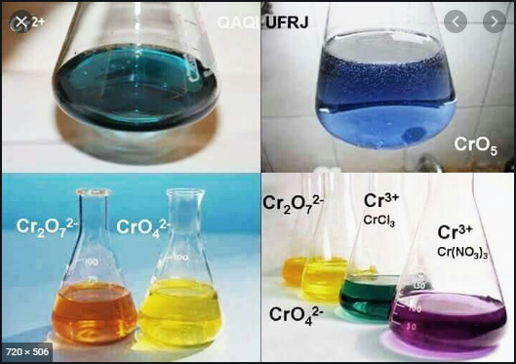
For the practical
Students are required to complete a number of standard practical experiments (at least 7 per year) along with many other practicals that we also carry out.
The required practicals are assessed during the written exam papers.
Typically 15% of lessons would be related to practical tasks and double lessons are assigned.

Slide 8
For the teaching
“Great Teachers, lots of help available.”
Year 13 Student
“it’s led by good teachers who know how to teach.”
Year 13 Student
We are fortunate to possess a very experienced and settled staff.
All A level teachers have in excess of 20 years experience teaching AQA Chemistry at A level.
You will be taught by 2 teachers from Dr Berry, Mr Elwell or Mr Gwyer
“The support from all teachers is second to none.”
Year 13 student.
“The (Excellent ) availability of chemistry teachers outside of lessons to give people help.”
Year 13 student.
“The teachers are great.”
Year 13 Student

Slide 9
Think its for you?
“It is a challenging a level, and not for the faint hearted however it is engaging, well-resourced and fun.”
(Year 13 student)
You will need at least a grade 7 in GCSE Chemistry or 7,7 in Combined Science
The high level of numeracy required suggests that you will also have a grade 7 in GCSE Mathematics.
Be prepared to work hard.

Slide 10
Group Sizes
Currently around 60 boys in 3 groups in year 13 and 40 in year 12.

Slide 11
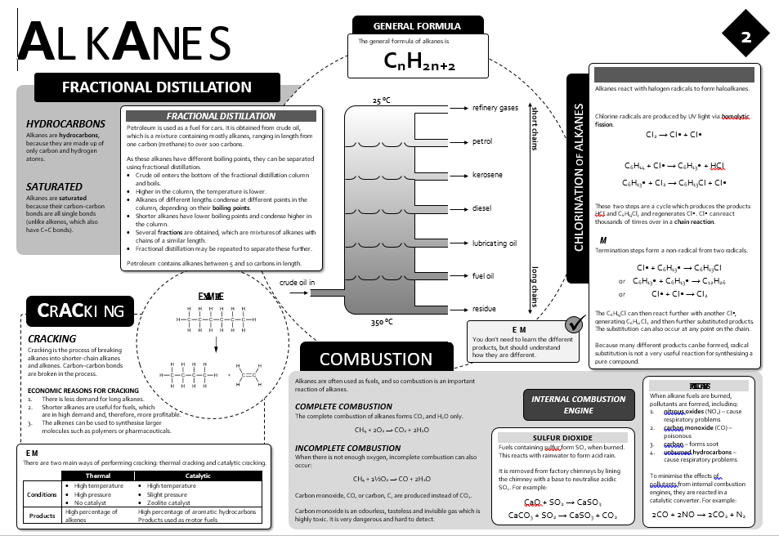
Course Structure
A Level
Paper 1 Physical and Inorganic Chemistry (105 marks) 2 hours
Paper 2 Physical and Organic Chemistry(105 marks) 2 hours
Paper 3 Any content (90 marks) 2 hours
12/14 compulsory practicals to be assessed in the written papers
ALL EXAMS IN SUMMER SESSION
“Well resourced lessons, teachers are supportive, homework supports progress, lessons are engaging, good atmosphere in lessons..”
(Year 13 student)

Slide 12
A-level assessment in more detail
Paper 1: Inorganic and Physical chemistry | + | Paper 2: Organic and Physical chemistry | + | Paper 3: Practical skills, data handling and synopsis
Content Inorganic chemistry Relevant practical skills Relevant physical chemistry topics eg: Atomic structure Amount of substance Bonding Energetics Equilibria Acids and bases Redox |  | Content Organic chemistry Relevant practical skills Relevant physical chemistry topics eg: Amount of substance Bonding Energetics Equilibria Kinetics |  | Content All content All practical skills
Questions 105 marks, with a mixture of short and long answer questions |  | Questions 105 marks, with a mixture of short and long answer questions |  | Questions 40 marks of questions on practical techniques and data analysis 20 marks of questions testing across the specification 30 marks of multiple choice questions
Slide 9
Copyright © AQA and its licensors. All rights reserved.

Slide 13
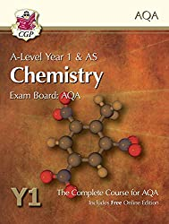
Support
“Well layed out and very enjoyable. Flipped learning is a great model.” (Year 13 student)
Self-completion notes and past exam questions on TEAMS
Flipped learning for all lessons
Regular assessment using past paper questions
After ALL tests there are videos that students watch and make notes on; of a teacher going through each question
Individual intervention questions based on strengths and weaknesses
After-school help sessions
Drop in clinic available on Monday lunchtime
Individual support as and when needed – just ask
Email: drrberry@st-ambrosecollege.org.uk
Flipped Learning
“It's good to read the notes before hand and get it all explained in lesson rather than writing it down and listening to it at the same time.”
(Year 13 student)

