Slide 1

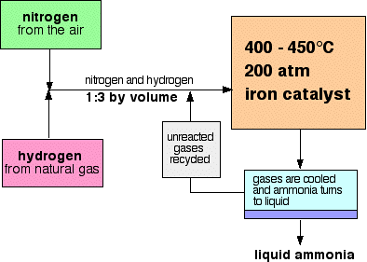
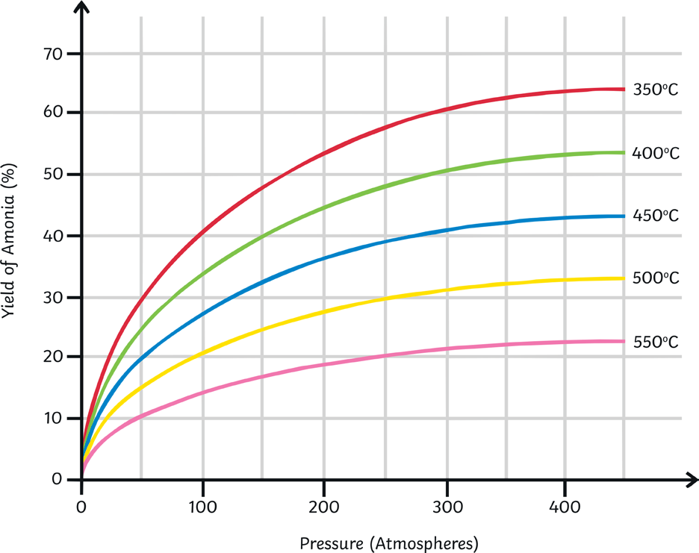
C10 - Using Resources – Part 3 – TRIPLE only
4.1 The Haber Process
4.2 NPK Fertilisers
The Haber Process combines nitrogen from the air with hydrogen derived mainly from natural gas (methane) into ammonia
Contain the elements nitrogen, phosphorus and potassium
Used to improve the agricultural productivity
Are formulations containing specific amounts of salts of the elements
REVISE SECTION C6 part 2 – reversible reactions and equilibria as you are VERY LIKELY to be asked about it with respect to the Haber process.
Ammonia from the Haber process is used to make some of these salts
KNOW the temperature, pressure and catalyst
Ammonium nitrate - NH₄NO₃ - and ammonium sulfate - (NH₄)₂SO₄ - are examples of fertilisers that contain the essential element nitrogen.
Ammonium phosphate - (NH₄)₃PO₄ - contains the elements nitrogen and phosphorus.
Potassium nitrate - KNO₃ - contains the elements potassium and nitrogen.
The raw materials for fertilisers need to be mined. The minerals needed to make fertilisers are extracted from the earth’s crust.
Potassium chloride and potassium sulfate are a source of potassium ions and are used as fertilisers. Phosphate rock is insoluble and so cannot be used in fertilisers, but it does contain phosphorus which when reacted with acid, will produce soluble compounds.
Phosphate rock when reacted with nitric acid produces calcium nitrate and phosphoric acid.
Phosphate rock when reacted with sulfuric acid produces a mixture of calcium sulfate and calcium phosphate which is called single superphosphate.
Phosphate rock when reacted with phosphoric acid produces calcium dihydrogen phosphate also called triple superphosphate.
By taking the liquid ammonia away the equilibrium shifts to make more ammonia!
Reversible reaction so some gases are unreacted – these are recycled
Temperature – 450
Higher would result in less ammonia, BUT lower would make the reaction too slow !
Pressure - 200
Higher would result in more ammonia, but would need expensive equipment and lots of energy.

Slide 2
1 | Write the word and symbol equations for the manufacture of ammonia from nitrogen and hydrogen
2 | What are the sources of the Nitrogen and Hydrogen used in the Haber process?
3 | What temperature and pressure are used in the Haber process?
4 | What is iron used for in the Haber process?
5 | Why is a higher temperature NOT used in the Haber process?
6 | What happens to the unreacted nitrogen and hydrogen in the Haber process?
7 | What 3 elements are present in NPK fertilisers?
8 | Name 2 fertilisers that contain the element nitrogen?
9 | Name a fertiliser that contains phosphorous and another one that contains potassium
10 | At higher pressure, more ammonia would be made in the Haber process. Why is a higher pressure NOT used?
Haber process | Process used for the manufacture of ammonia
Ammonia | Compound formed from nitrogen and hydrogen with the formula NH₃
Fertiliser | Use to improve the growth and yield of crops
NPK Fertiliser | Fertilisers that contain the key elements – Nitrogen, Phosphorous and Potassium
Formulation | A mixture of substances where each substance is present in a precisely defined amount

