Slide 1

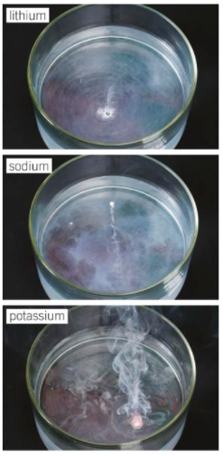
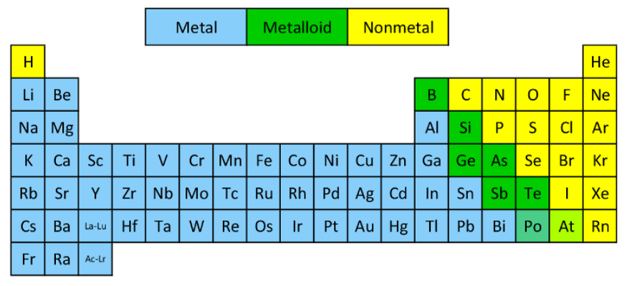
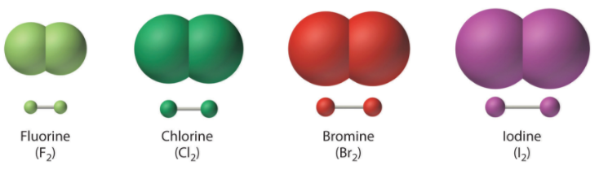
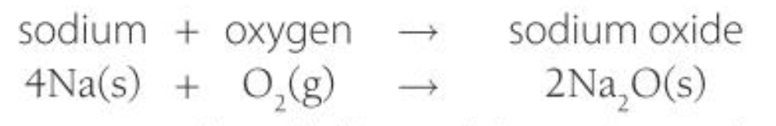
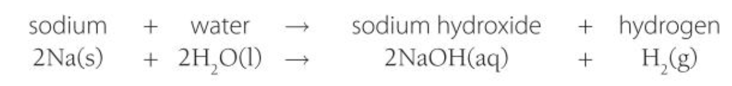
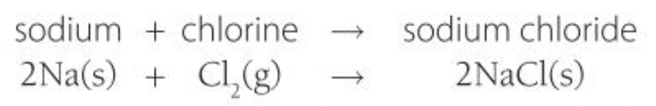
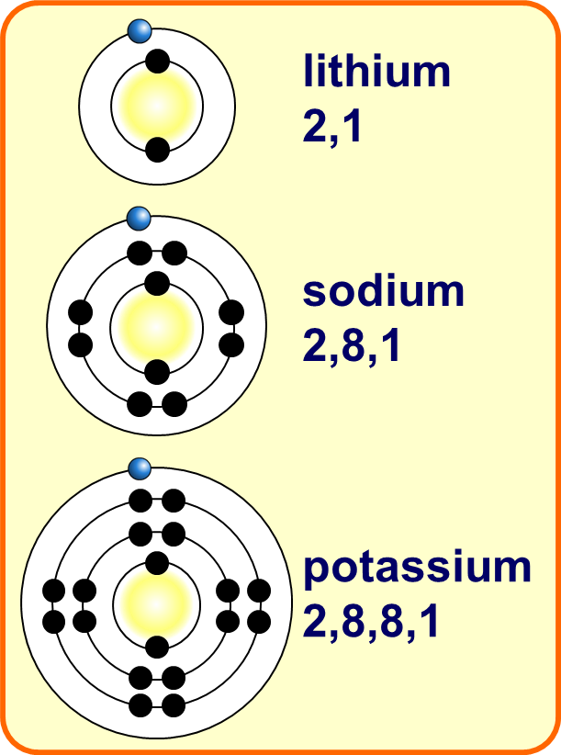
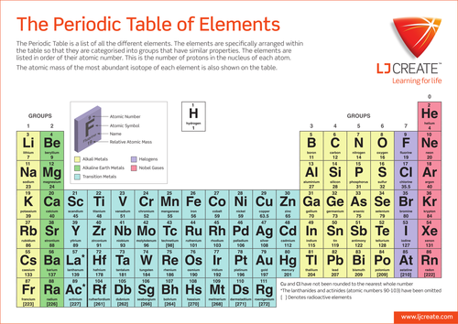
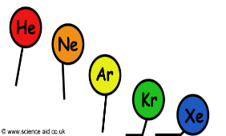
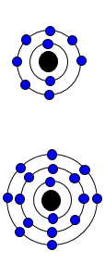
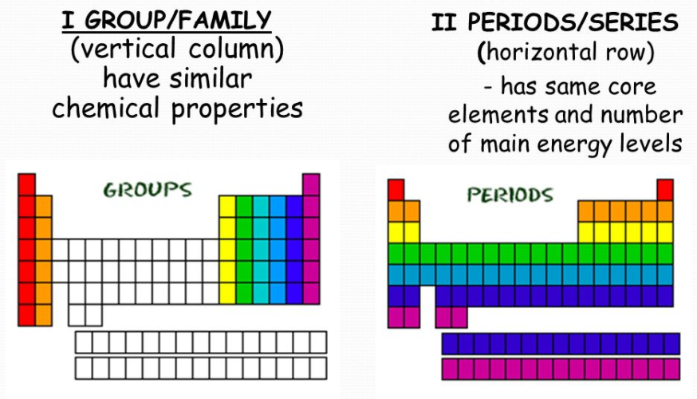
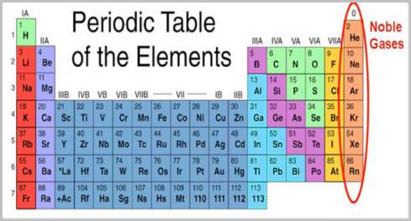
C1 Part 2- The Periodic Table
2.3 Metals vs Non-metals
2.5 Group 1
2.1 & 2.2 History
Non-metals: Many electrons in outer shell so form negative ions.
Low melting and boiling points.
Alkali Metals
Very reactive (due to single electron in outer shell)
2.6 Group 7
Early periodic tables arranged in order of atomic weight
Halogens
Very reactive (due to having 7 electrons in outer shell)
☹ Some elements were in the wrong groups so didn’t follow the pattern
Metals
React with oxygen to form oxides
React with water to form the hydroxide and hydrogen
React with chlorine to form chlorides
Non- metals
Exist in pairs as molecules (diatomic molecules)
React with metals to form white solid crystals
React with non-metals to form small molecules
Boiling point and melting point increase DOWN the group
Mendeleev left gaps for undiscovered elements.
☺ The elements were discovered that filled the gaps and proved him right.
Metals: Few electrons in outer shell so form positive ions.
Hard, high melting and boiling points.
☺ Isotopes were discovered which explained why order based on weight didn’t work.
Modern periodic table – order of atomic (proton) number.
Elements with similar properties in columns (groups).
Elements in same group have the same number of electrons in their outer shell and so have similar chemical properties.
2.4 Group 0
Noble gases.
Unreactive (due to full outer shell)
Trends in the Periodic Table
Halogens get MORE reactive
Increasing atomic mass
Alkali metals get MORE reactive
Increasing boiling point

Slide 2
1. | How are elements arranged in the periodic table?
2. | What does the group number tell you about the atoms in that group?
3. | How was the periodic table originally organised?
4. | How did Mendeleev improve the periodic table?
5. | How did the discovery of isotopes affect the periodic table?
6. | What is the difference between a metal and a non-metal?
7. | State the name of group 0, group 1 and group 7
8. | Describe the properties of the elements in group 0
9. | Explain why group 0 elements have the properties they do.
10. | How does the reactivity change in group 1?
11. | Describe how the properties of group 7 elements changes as you go down the group
Alkali metals | elements of group 1 of the Periodic table
Atomic number: | The number of protons in the atom.
Metals | Found on the LHS of the periodic table. Form positive ions.
Non-metals | Found on the RHS of the periodic table. Form negative ions.
Group | vertical column of elements in the Periodic table with similar properties and the same number of outer shell electrons
Ion | an electrically charged particle containing different numbers of protons and electrons
Isotope | atoms that have the same number of protons but different number of neutrons i.e. they have the same atomic number but a different mass number
Molecule | particle made from atoms joined together by a covalent bond
Noble Gases | the elements in Group 0 of the Periodic Table (including helium, neon, argon)
Period | row of elements in the Periodic Table with the same number of electron shells
Periodic Table | an arrangement of elements in order of increasing atomic number, forming groups and periods
Diatomic Molecule | a molecule containing two atoms
Displacement reaction | a reaction where a more reactive element takes the place of a less reactive element in a compound
Halogens | elements in Group 7 of the Periodic table (including fluorine, chlorine, bromine and iodine)

