Slide 1

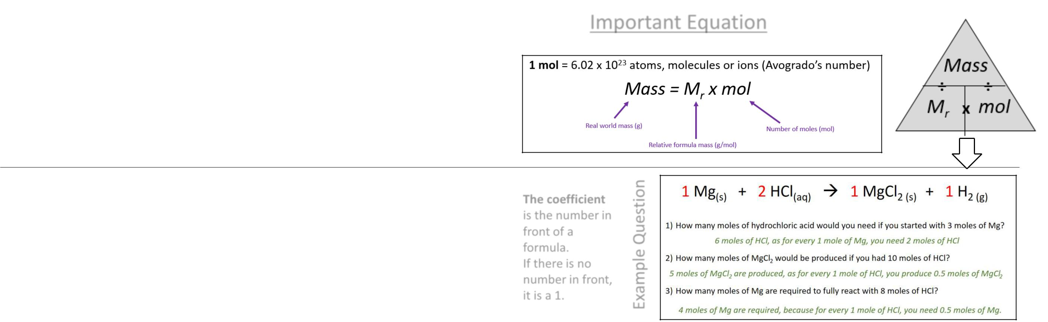
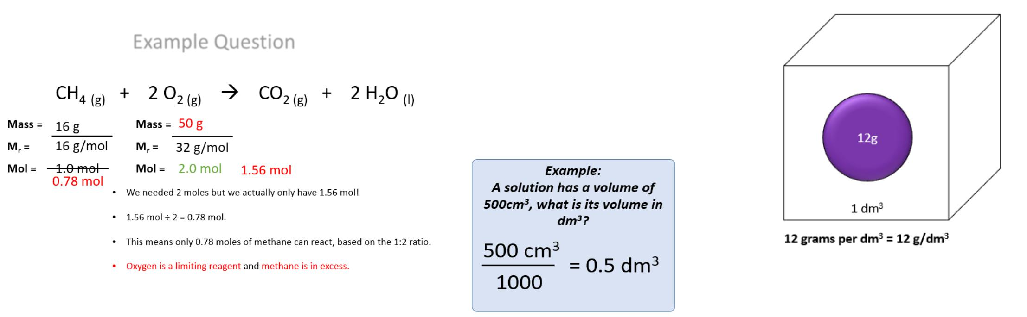
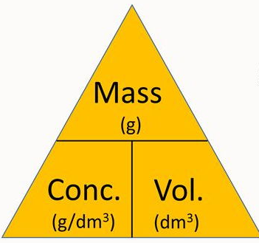
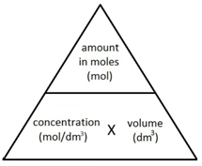
C3 - Quantitative Chemistry – Higher Tier - Part 2
2.2 Amounts of Substance in Equations
The masses of reactants and products can be calculated from balanced symbol equations.
2.4 Limiting reactants
In a chemical reaction involving two reactants, it is common to use an excess of one reactant to ensure that all of the other reactant is used up. The reactant that is completely used up is call the limiting reactant because it limits the amount of product that can be made.
Chemical equations can be interpreted in terms of moles. For example
shows that one mole of magnesium reacts with two moles of hydrochloric acid to produce one mole of magnesium chloride and one mole of hydrogen gas
The coefficient is the number in front of a formula. If there is no number in front, it is a 1.
The coefficient shows the ratio of how many moles of each compound will react
2.5 Concentration of solutions
Chemists use decimetres to measure concentrations.
1 dm³ = 1000 cm³
Concentration = Quantity of solute ÷ volume.
So to convert cm³ into dm³ you just have to
divide by 1000

Slide 2
1. | State what the coefficient in a chemical equation is?
2. | Explain how a chemical equation tells you the ratio in which moles of substances will react?
3. | Define “limiting reactant”?
4. | Explain what is meant by “in excess”?
5. | How many cm³ are in 1 dm³?
6. | How would you convert cm³ to dm³?
7. | What would happen when the limiting reactant in a chemical reaction is used up?
8. | What is the mathematical formula for calculating concentration?
9. | What are the 2 different units for concentration?
10. | What is the concentration of a solution that contains 10 grams of solute in 0.5dm³ of solvent?
Relative atomic mass | The average mass of atoms of an element, taking into account the mass and the amount of each isotope it contains.
Relative formula mass | The sum of the relative atomic masses of all the atoms in the formula.
Mole | Measurement of the amount of a substance.
Avogadro constant | The number of atoms, molecules or ions in one mole of a given substance (6.02x10²³).
Thermal decomposition | Reaction where high temperature causes a substance to break down into simpler substances.
Excess | When the amount of a reactant is greater than the mount that can react.
Limiting reactant | The reactant in a reaction that determines the amount of products formed. Any other reagents are all in excess and will not react.

