Slide 1

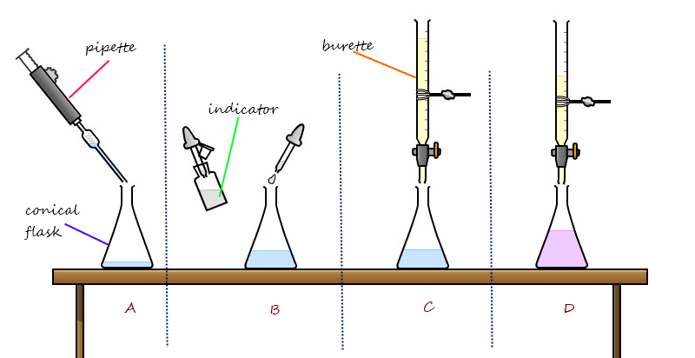
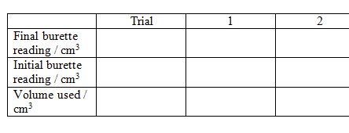
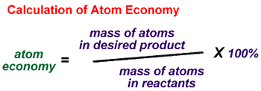

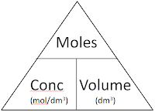
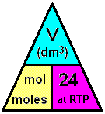
C3 - Quantitative Chemistry – Part 3 – TRIPLE only
3.1&3.2 Percentage Yield & Atom Economy
Titrations (Required Practical)
Percentage Yield
Atom Economy
The volumes of acid and alkali solutions that react with each other can be measured by titration using a suitable indicator.
The amount of product made is called the “yield”.
Usually we do not make as much product in a chemical reaction as our reacting mass calculations suggest
Measures how much of the starting materials (reactants) become USEFUL products
Burette measures a variable volume
All volumes to 2 dp
Add a few drops of indicator
High atom economy is important for sustainable development and economic reasons
Because:
DROPWISE near endpoint
Reaction is not complete
Product is lost
Different reactions happen
Pipette measures a set volume
Endpoint when 1 drop changes the colour
5.1 Volumes of Gases
4.1 Titration calculations
1 mole of ANY gas at room temperature (and pressure will take up a volume of 24dm³
Example:
2NaOH(aq) + H₂SO₄ (aq)→ Na₂S0₄ (aq) + 2H₂O(l)
It takes 12.20cm³ of sulfuric acid to neutralise 24.00cm³ of sodium hydroxide solution, which has a concentration of 0.50mol/dm³ . Calculate the concentration of the sulfuric acid in mol/dm³
Conc = moles
volume
 | 2NaOH | + | H₂SO₄ | → | Na₂S0₄ | + | 2H₂O
Ratio | 2 | : | 1
Con | 0.50 |  | Ans = 0.49
Vol | 24.00/1000 |  | 12.20/1000
Mol | 0.012 | ÷2 | 0.006
Volume = moles
conc
The MOLAR volume
Concentration of acid:
0.006 mol x (1000/12.2) dm³ =0.49mol/dm3
Moles = conc X volume
0.5 mol/dm3 x (24/1000) dm³ = 0.012 mol of NaOH
Ratio is 2:1 so DIVIDE moles of NaOH by 2

Slide 2
1. | Give the mathematical formula for calculating the percentage yield of a reaction.
2. | Give 3 reasons why it is very rare to achieve 100% yield.
3. | If 25g of a substance are made and the theoretical yield was 75g, what was the percentage yield?
4. | In a reaction where there is only one product, what is the atom economy? Explain why.
5. | In 6 bullet points describe how to carry out a titration.
6. | How many moles of methane gas are there in a volume of 48dm³
7. | What is the mathematical formula for calculating the concentration of a substance in mol/dm³
8. | What is the mathematical formula for calculating the volum of a substance in dm³
9. | How do you convert cm³ to dm³
Avogadro constant | the number of atoms, molecules, or ions in a mole of any substance (i.e., 6.02 × 10⁻²³ per mol)
Mole | the amount of substance in the relative atomic or formula mass of a substance in gram The symbol for the unit mole is mol
Concentration | the amount of a substance dissolved in a given volume of liquid
Titration | A process used to accurately calculate the volume of one substance needed to fully react with another.
Titre | The volume added from the burette in a titration
Burette | Used to accurately measure variable volumes of liquids
Pipette | Used to measure a set volume o a liquid
Indicator | Changes colour with one drop of reactant when the reaction is at it’s endpoint
End point | The point at which an acid has exactly neutralised and alkali and NEITHER is in excess.
Molar volume | The volume that 1 mole of any gas occupies at room temperature and pressure = 24dm

