Slide 1

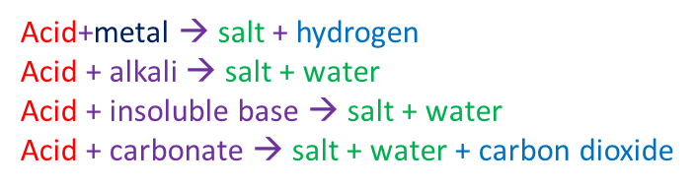
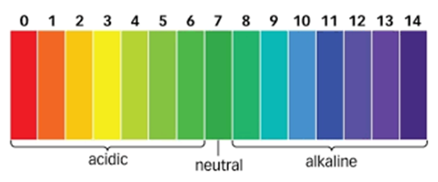
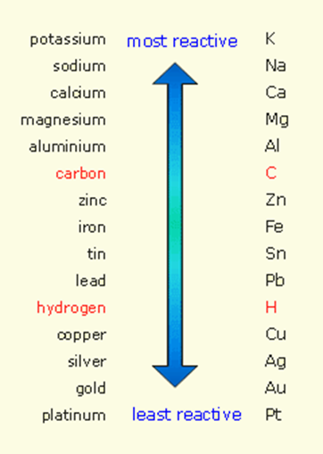
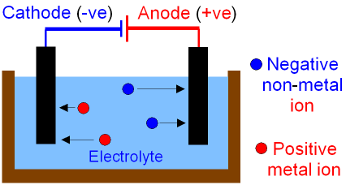
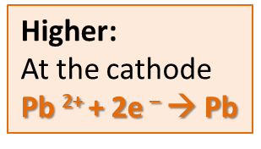
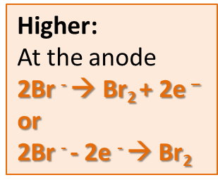
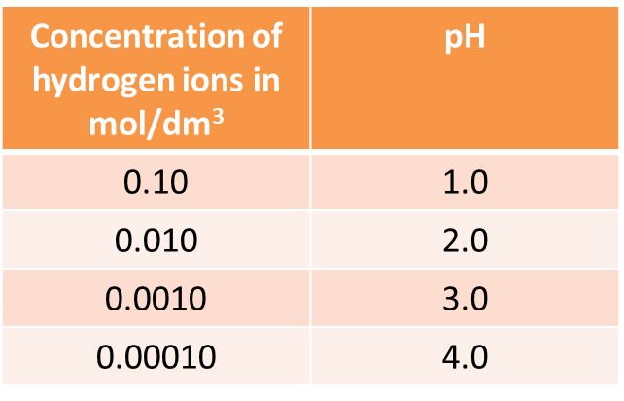
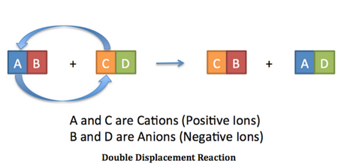
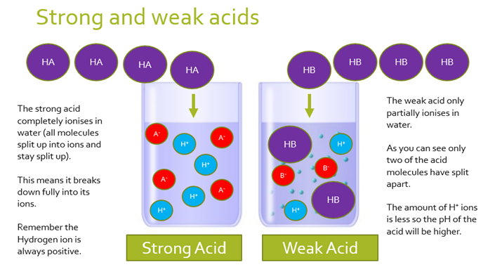
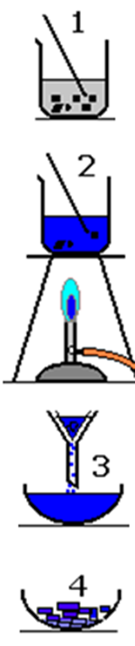
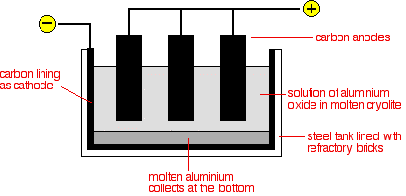
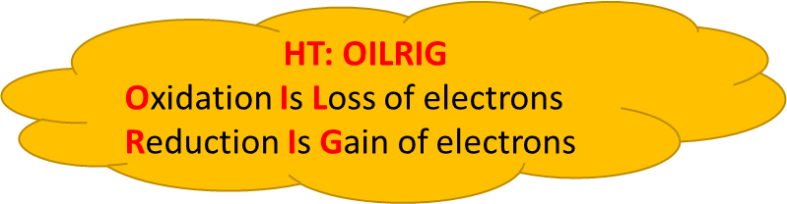
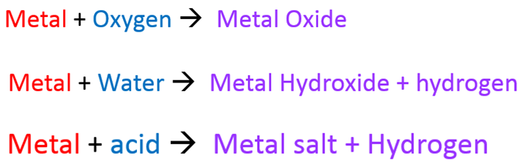
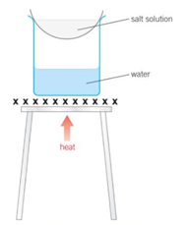
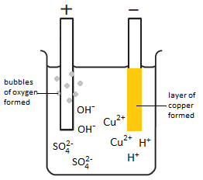
C4 Chemical Changes part 1
2.1-2.3 Reactions of acids
2.4 Neutralisation
1.1 Displacement reactions and metal extraction
3.1 Electrolysis
..of molten:
HT: OILRIG
e.g. 2HCl + Mg → MgCl₂ +H₂
Magnesium is oxidised
Mg → Mg²⁺ +2e⁻
Acids produce H⁺ ions
Alkalis produce OH⁻ ions
H⁺_{(aq)} + OH⁻_{(aq)} → H₂O_{(l)}
Hydrochloric Acid → Chlorides
HCl
Nitric Acid → Nitrates
HNO₃
Sulphuric Acid → Sulphates
H₂SO₄
HIGHER ONLY
HIGHER ONLY
HT: Strong and Weak acids
Reactivity depends on tendency to form metal ion
RP: Preparation of a dry sample of a soluble salt
..to extract aluminium:
A more reactive metal will DISPLACE a less reactive metal
Oxygen goes to anode → Carbon electrode reacts with it → CO₂ (needs replacing)
Choose correct acid
Add base to excess
warm
Cyolite reduces the melting point
Evaporate off water
..of solutions:
Unreactive metals can be found in the Earth as themselves (eg Gold)
At the anode:
Halide (Gp7)
Oxygen
At the cathode:
Least reactive
Carbon Reduction: Extracting metals less reactive than carbon –
Oxygen is taken away = reduction
Filter off excess

Slide 2
1. | What is produced when metals react with oxygen? Give an example
2. | What happens to a metal when it reacts with different substances?
3. | How are unreactive metals found?
4. | How are metals less reactive than carbon extracted?
5. | How are metals more reactive than carbon extracted?
6. | What are oxidation and reduction reactions?
7. | Describe electrolysis
8. | Which ion moves to which electrode in electrolysis?
9. | Draw an labelled diagram of the set up needed for simple electrolysis
10 | What is produced when a metal reacts with an acid?
11 | What makes a chemical an acid?
12 | State the general equation for the reaction between an acid and an alkali
13 | Describe the steps to make a soluble salt
Reactivity series | An arrangement of metals in order of reactivity
Displacement reaction | Reaction where a more reactive element takes the place of a less reactive element in a compound
Oxidation | A reaction in which a substance loses electrons (gains oxygen)
Reduction | Reaction in which a substance gains electrons (loses oxygen)
Ore | A rock from which a metal can be extracted for profit
Acid | Solution with a pH less than 7; produces H⁺ ions in water
Alkali | Solution with a pH more than 7; produces OH⁻ ions in water
Aqueous | Dissolved in water
Strong acid | Acid in which all the molecules break into ions in water
Weak acid | Acid in which only a small fraction of the molecules break into ions in water
Dilute | A solution in which there is a small amount of solute dissolved
Concentrated | A solution in which there is a lot of solute dissolved
Neutralisation | A reaction that uses up some or all of the H⁺ ions from an acid
Electrolysis | Decomposition of ionic compounds using electricity
Electrolyte | A liquid that conducts electricity
Discharge | Gain or lose electrons to become electrically neutral
Inert electrodes | Electrodes that allow electrolysis to take place but do not react themselves

