Slide 1




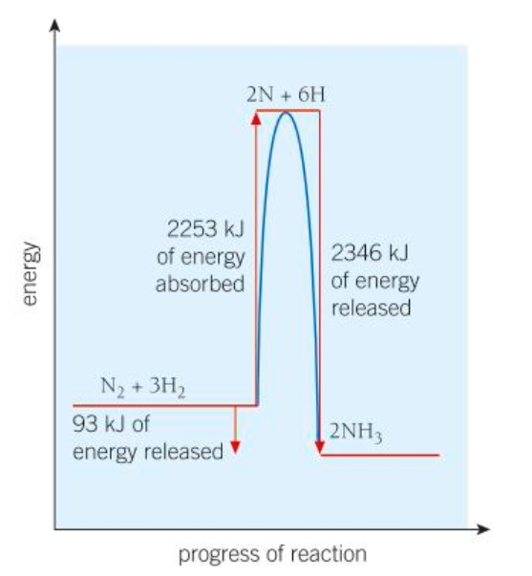

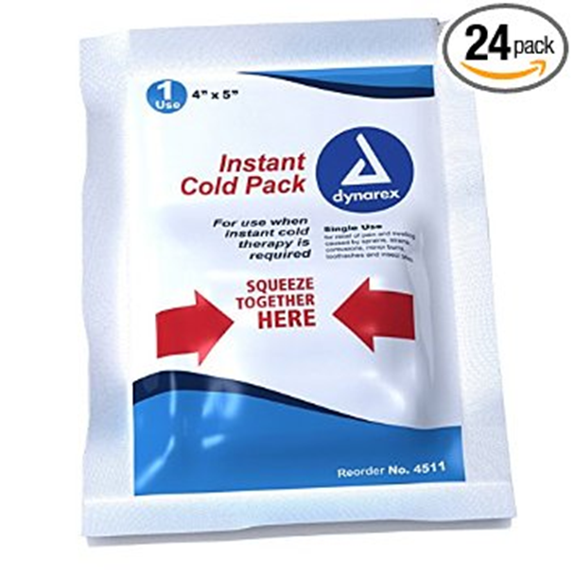
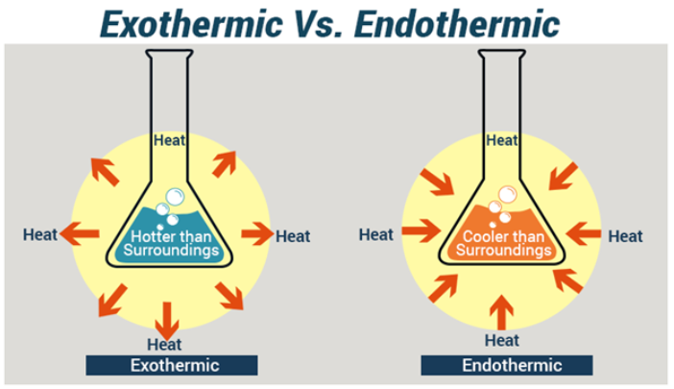
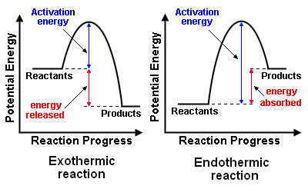

C5 Energy Changes
1.1 Uses
1.3 Bond energy Calculations (HT)
HIGHER ONLY
1.1 Exothermic vs Exothermic
Self heating cans, hand warmers
More energy comes OUT making bonds
In some reactions more energy comes OUT than goes in
Chemicals react in an exothermic reaction and give OUT heat energy.
More energy goes IN breaking bonds
The reactants have more energy than the products.
Cool packs for sports injuries
Calculate the energy change in a reaction using average bond energies. Bond energy is the amount of energy needed to break one mole of a particular bond.
e.g. combustion, oxidation, neutralisation.
Add together the bond energies for all the bonds in the reactants – this is the ‘energy in.
Bond | Bond Energy / kJ/mol
H-H | 436
Cl-Cl | 243
H-Cl | 432
Chemicals react in an Endothermic reaction and take IN heat energy – therefore cooling the surroundings.
Add together the bond energies for all the bonds in the products – this is the ‘energy out’.
Calculate the energy change = energy in – energy out
1.2 Reaction Profiles
Worked example – an exothermic reaction
Hydrogen and chlorine react to form hydrogen chloride gas:
H−H + Cl−Cl → 2 × (H−Cl)
Energy in = 436 + 243 = 679 kJ/mol
Energy out = 2 × 432 = 864 kJ/mol
Energy change = in – out = 679 – 864 = –185 kJ/mol
The energy change is negative, showing that energy is released to the surroundings in an exothermic reaction.
In some reactions more energy goes IN than comes out.
Products at HIGHER energy than reactants
The products have more energy than the reactants.
Products at LOWER energy than reactants
Activation Energy is the energy needed to start a reaction.
e.g. thermal decomposition

Slide 2
1. | What is an exothermic reaction?
2. | State examples and uses of exothermic reactions
3. | What is an endothermic reaction?
4. | State examples and uses of endothermic reactions
5. | Define activation energy
6. | Draw and label the reaction profile for an exothermic reaction
7. | Draw and label the reaction profile for an endothermic reaction
8. | HT ONLY – Describe an exothermic reaction in terms of bond energies
9. | HT ONLY – Describe an endothermic reaction in terms of bond energies
Exothermic reaction | Reaction where thermal energy is transferred from the chemicals to the surroundings and so the temperature increases
Endothermic reaction | Reaction where thermal energy is transferred from the surroundings to the chemicals and so the temperature decreases
Activation energy | The minimum energy particles must have to react – measured on an energy diagram from the level of the reactants to the peak of the line
Reaction Profile | A diagram that shows how the energy changes during a chemical reaction from reactants to products
Energy Change | Always measured on the energy diagram from the level of the reactants to the level of the products

