Slide 1

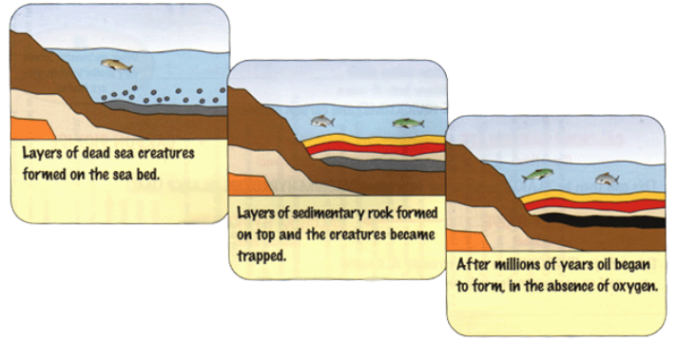
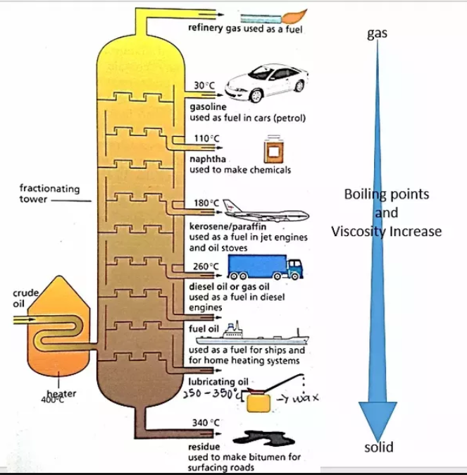
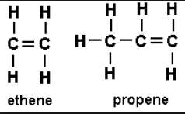

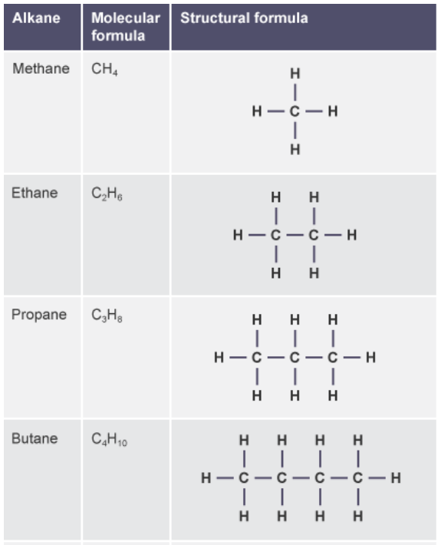
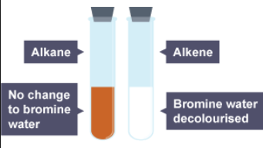

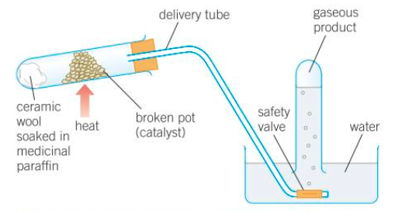
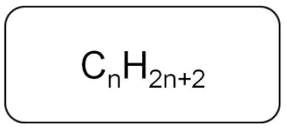
C7 part 1 – Organic Chemistry
1.2 Fractional Distillation
1.3 Combustion
1.1 Hydrocarbons
Combustion (burning) is a reaction with oxygen
1.4 Cracking
How do we separate the mixture of hydrocarbons to use them?
Crude Oil is made from the remains of living sea creatures decayed in mud millions of years ago
A reaction with oxygen is called ‘oxidation’
The larger molecules from fractional distillation are less useful. We can break them down into smaller, more useful molecules.
Works by evaporation and then condensation.
When hydrocarbons burn a lot of energy is released.
Cracking produces a mixture of alkanes and alkenes.
Complete combustion of hydrocarbons the only products are carbon dioxide and water
It is a FINITE resource
Smaller molecules burn most easily
Alkenes have some double bonds.
They turn bromine water colourless.
They are used to make polymers.
It is made of a mixture of Hydrocarbons.
Hydrocarbons are made of Hydrogen and Carbon only.
Complete combustion only happens if there is plenty of oxygen
The main hydrocarbons in Crude Oil are alkanes
General equation
Complete combustion of propane
Heat the crude oil to evaporate it.
The gases rise up the column.
The different fractions condense at different temperatures.
Lower Boiling points (smaller chains) are at the top
The apparatus for cracking
Catalytic cracking – catalyst and 500ºC
The general formula for an alkane is -
Steam cracking – steam and 850ºC

Slide 2
1 | What is crude oil?
2 | What is a hydrocarbon?
3 | State the general formula for an alkane
4 | Draw the structure of the first 4 alkanes
5 | How is crude oil separated into its different fractions?
6 | How does chain length affect the properties of hydrocarbons?
7 | Write a word equation to represent combustion
8 | What is cracking?
9 | What are the products of cracking?
10 | What are alkenes used for?
11 | What is the test for alkenes?
Hydrocarbon | A molecule made of hydrogen and carbon atoms only
Crude oil | A mixture of a very large number of compounds.
Mixture | Two or more elements or compounds that are not chemically joined together.
Alkanes | A group of saturated hydrocarbons with the general formula C_{n}H_{2n+2}
General formula | This shows the number of atoms of each element in a substance which has ‘n’ carbon atoms.
Saturated | Molecule containing no double bonds.
Unsaturated | Molecule containing double bond(s).
Fractional distillation | A method of separating the different hydrocarbons in crude oil by using the fact that they have different boiling points.
Boiling point | The temperature at which the liquid boils and evaporates or the gas condenses.
Volatility | The tendency of a liquid to turn into a gas.
Viscosity | How easily a liquid flows.
Flammability | How easily a fuel burns.
Complete Combustion | When a hydrocarbon fuel is oxidised and energy is released. The carbon and hydrogen are oxidised, producing carbon dioxide and water.
Cracking | The process of using heat to turn large hydrocarbons into smaller, more useful molecules.
Alkenes | A group of unsaturated hydrocarbons, with the general formula C_{n}H_{2n}
Unsaturated | When hydrocarbons like alkenes have a double bond and so have the potential to bond with extra hydrogen atoms.
Bromine water | Used to test for alkenes – turns from orange to colourless.
Polymers | A long molecule made of lots of monomers joined together.

