Slide 1

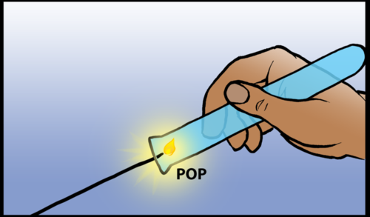
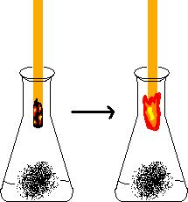
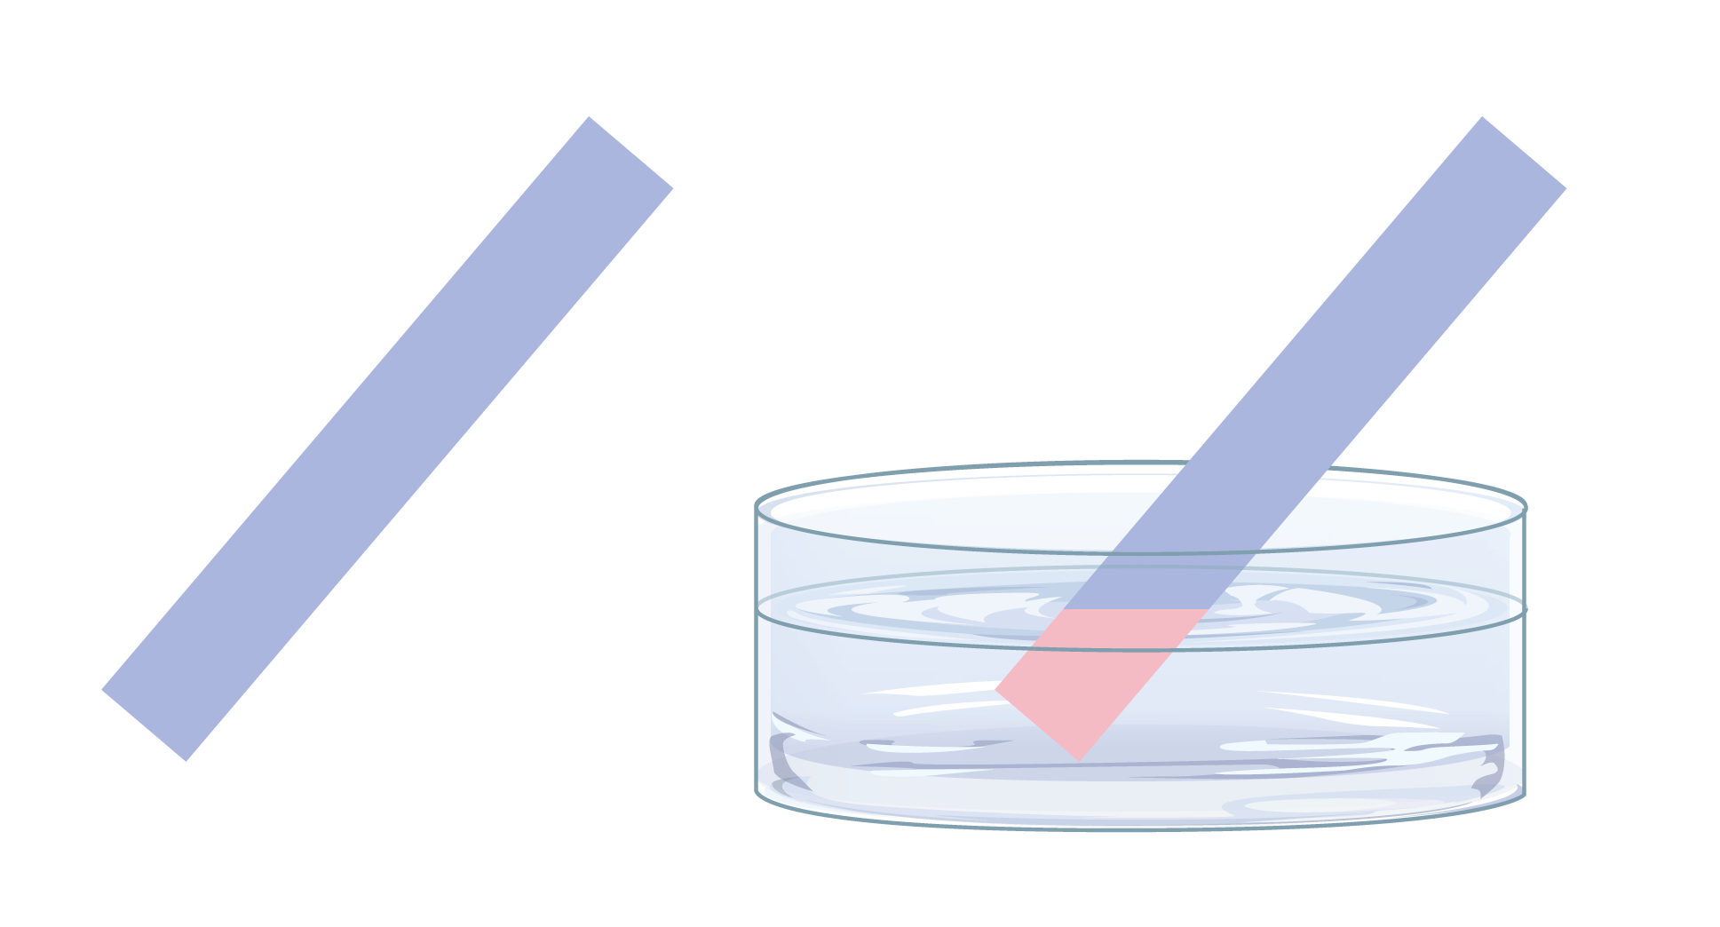
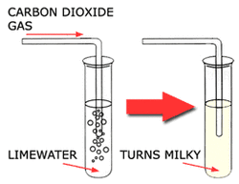
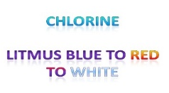
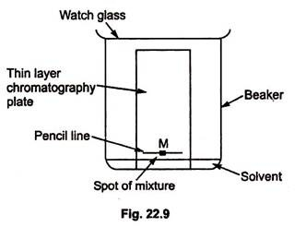
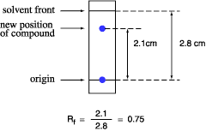
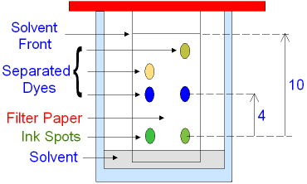
C8 part 1 Chemical Analysis
2.1 to 2.4 Gas tests
1.1 & 1.2 Pure substances and mixtures
Oxygen – relights a glowing splint
Pure substance | A single element or compound not mixed with any other substance.
Mixture | More that one substance, mixed but not chemically bonded together
Formulation | A mixture that has been designed as a useful product. Many formulations are complex mixtures in which each chemical has a particular purpose.
Hydrogen –a lighted splint causes a squeaky pop
Pure substances melt and boil at specific temperatures. Heating graphs can be used to distinguish pure substances from impure.
Carbon dioxide – bubble it through limewater which then goes cloudy
Examples of Formulations: Fuels, cleaning agents, paints, medicines and fertilisers
1.3 Chromatography
Chlorine – Damp blue litmus paper goes red then white
A technique that can be used to separate mixtures and the identify substances.
R_{f} = Distance moved by the substance
Distance moved by the solvent
Stops the solvent evaporating
Required Practical
Draw a pencil line to show where the solvent gets to
The stationary Phase – solvent and dyes move up
Doesn’t “run”
NOT drawn in pen
MUST be below pencil line
The mobile Phase – moves up the paper
Pure substance - only one spot above origin
Mixture – more than one spot above origin

Slide 2
1 | Define a pure substance
2 | Describe a method to find out if water is pure
3 | What is a formulation?
4 | Describe the process used in chromatography
5 | State the equation for the Rf value in chromatography
6 | Why should the start line in chromatography be drawn in pencil?
7 | Describe the test for hydrogen
8 | Describe the test for oxygen
9 | Describe the test for carbon dioxide
10 | Describe the test for chlorine
Pure substance | A single element or compound not mixed with any other substance.
Formulation | A mixture that has been designed as a useful product. Many formulations are complex mixtures in which each chemical has a particular purpose.
Pure | A substance that has nothing added to it.
Chromatography | A technique used to separate mixtures.
Stationary phase | The material the sample travels on but which doesn’t move itself e.g. paper
Mobile phase | The solvent which moves the sample. The more soluble the sample is in the solvent, the further it moves.
Solvent front | The maximum point on the chromatography paper that the mobile phase reaches – usually marked on afterwards using a pencil.
Retention Factor | The ratio of how far a substance moves compared to the distance to the solvent front. For the same substance this number will always be the same.

