Slide 1

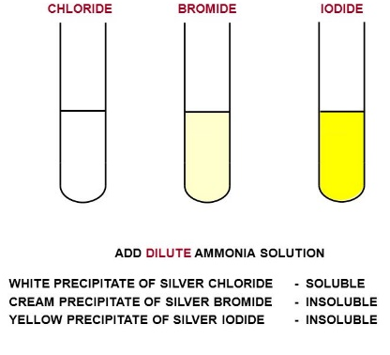
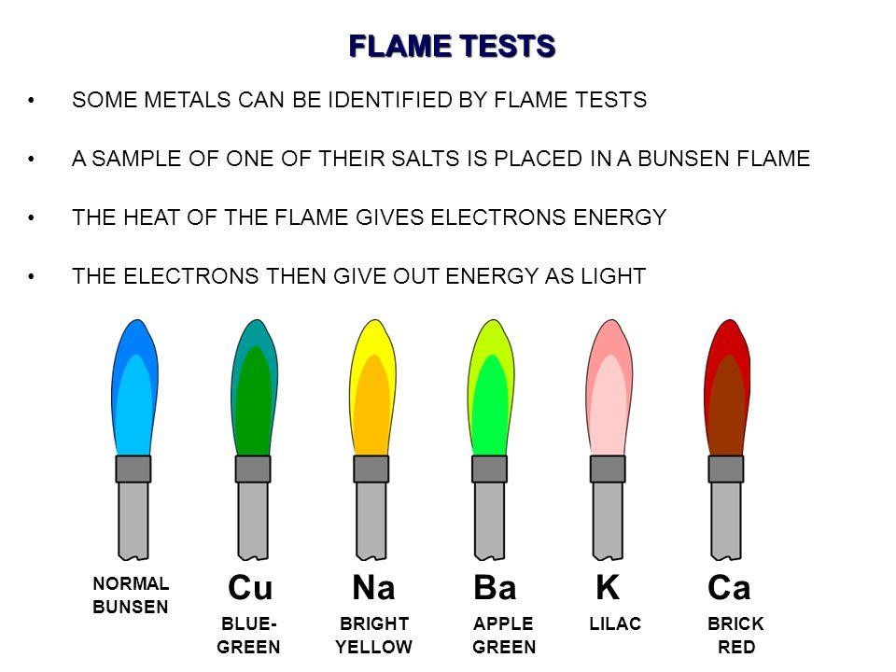
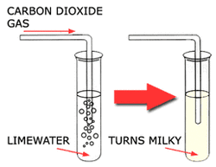
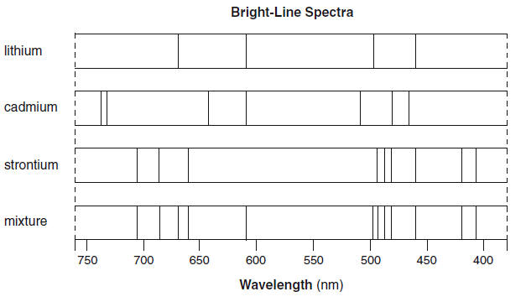
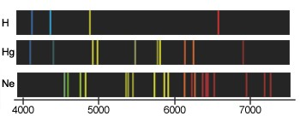
C8 part 2 Chemical Analysis
3.3 to 3.5 Negative ions
3.1 Flame Tests
Halide ions (F⁻,Cl⁻,Br⁻)
Carbonate ions (CO₃²⁻)
Clean a metal loop in hydrochloric acid
Did loop in a metal salt.
Heat in roaring Bunsen flame.
Metal | Colour of flame
Lithium | Crimson
Sodium | Yellow
Potassium | Liliac
Calcium | Red
Copper | Green
Add any acid
Bubble any gas that is made through Limewater
RESULT – if the limewater goes milky then the gas was carbon dioxide which means the sample WAS a carbonate
Sulphate ions (SO₄²⁻)
Only works for pure samples as in mixtures some colours can “mask” others
Add dilute hydrochloric acid
Add Barium Chloride solution
3.2 Metal Hydroxides
RESULT – white precipitate of Barium Sulphate
Add the solution you are testing into a test tube.
Add sodium hydroxide to the solution.
The colour of the precipitate tells you which cation was present
Cu(OH) ₂ + Na₂SO₄
Cu ²⁺ + OH ⁻ → Cu(OH)₂
3.6 & 3.7 Instrumental Methods
More accurate, more sensitive and quicker!!!
Metal ion | Colour
Iron (III), Fe²⁺ | Pale green
Iron (II), Fe ³⁺ | Brown
Copper (II), Cu ²⁺ | Blue
Calcium, Ca²⁺ | White
Magnesium, Mg²⁺ | White
Aluminium, Al ³⁺ | White
White precipitates?
Add more sodium hydroxide and the Aluminium Hydroxide will dissolve.
Use a flame test and the calcium will give a brick red flame.
The remaining white precipitate is magnesium
A sample is placed in a flame and as the ions in the sample heat up they transfer energy as light.
This light passes through a spectroscope and produces a line spectrum.
The line spectrum can be used to identify the metal ions in the solution as well as their concentrations.
Example Reactions:
CuSO₄ + NaOH → Cu(OH) ₂ + Na₂SO₄
Cu ²⁺ + OH ⁻ → Cu(OH)₂

Slide 2
1 | Describe how to carry out a flame test?
2 | What are the positive results of a flame test for sodium, Lithium and Potassium?
3 | Why will the flame test not work for mixtures of different compounds?
4 | Describe how to use sodium hydroxide to test for metal ions?
5 | Which 3 cations form white precipitates and how could you correctly identify each of them?
6 | What is the test and positive results for the three halide ions?
7 | How would you test a compound to see if it contains a carbonate ion?
8 | What result would you get if you added barium chloride to a compound containing a sulphate ion?
9 | What is flame spectroscopy?
10 | State 3 advantages of using instrumental methods of analysis?
Cation | A positively charged ion
Anion | A negatively charged ion
Instrumental method | Elements and compounds can be detected and identified using instrumental methods. Advantages of using an instrumental technique rather than a chemical test: its quicker, more sensitive and more accurate.
Flame Test | A simple test to identify cations based on the colour that a compound causes in a Bunsen flame
Precipitate | A solid formed when two liquids are mixed
Flame spectroscopy | An instrumental method that can identify ions

