Slide 1

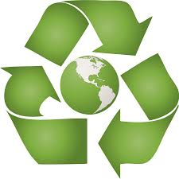
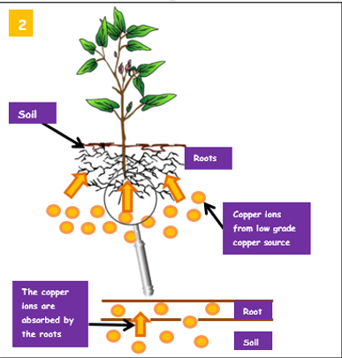

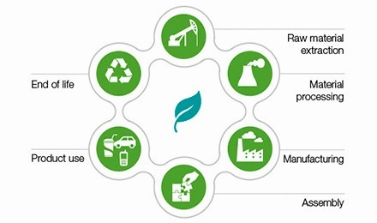

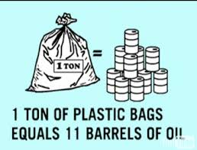
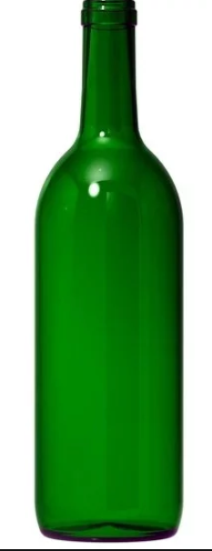
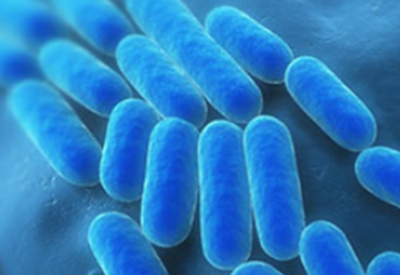
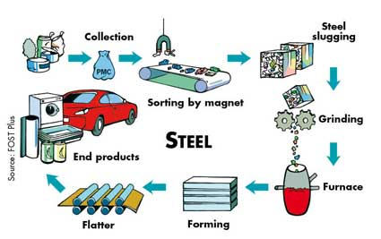
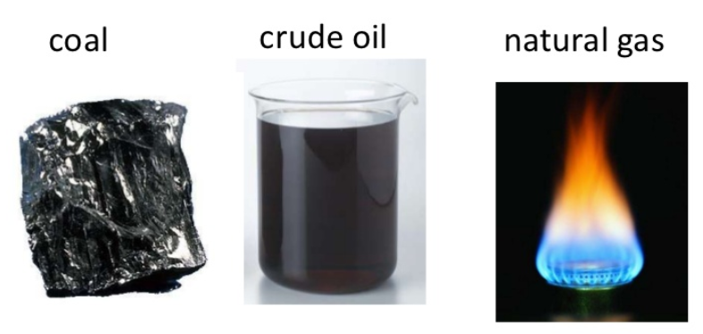

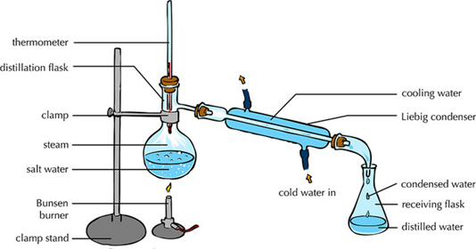
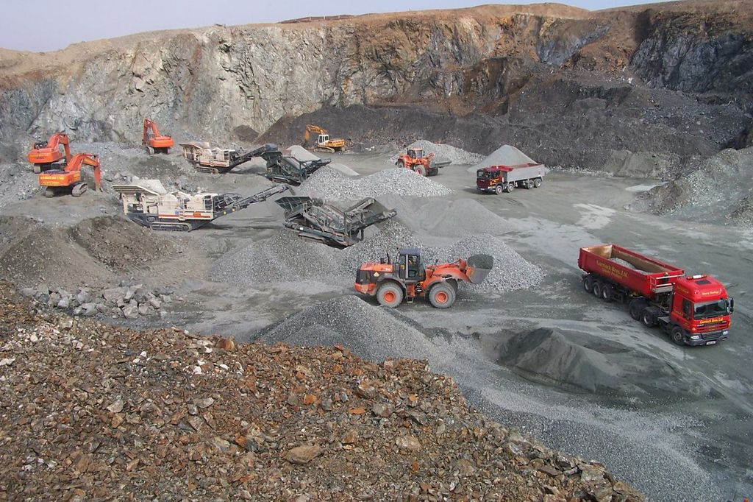
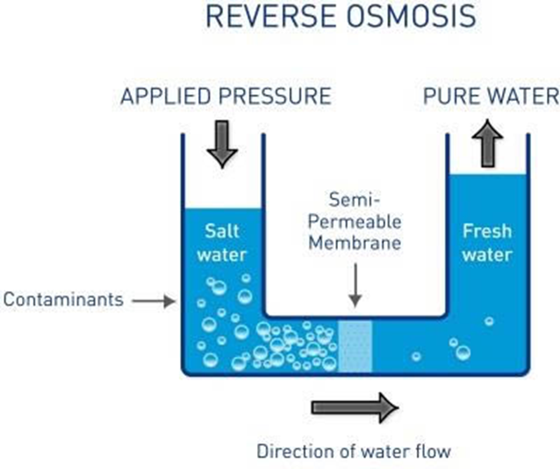
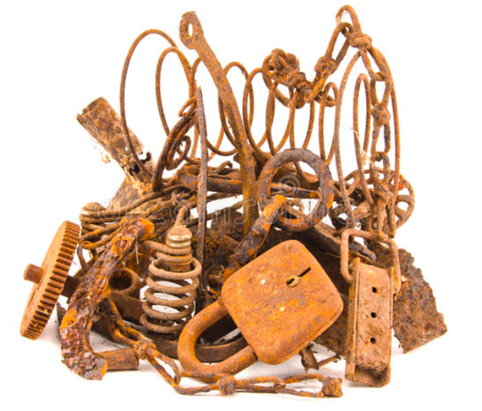
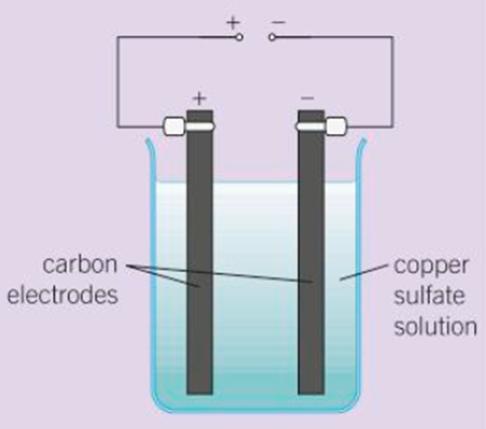
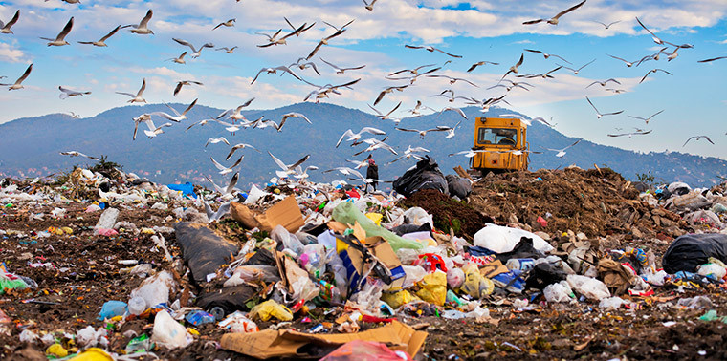
C10 Using Resources
1.2 & 1.3 Treating water
HIGHER ONLY
Potable water must have low levels of SALTS and MICROBES (it isn’t PURE water)
1.4 Alternative Metal Extraction
1.1 Finite and Renewable
2.1 & 2.2 LCA and RRR
What do the words mean??
Finite = Will run out eventually
Renewable= We can replace them as we use them
Sustainable = meets the needs of the current generation without compromising he ability of future generations to meet their needs.
Why bother?
Running out of metal ores
Life Cycle Assessments
Rainwater in lakes, rivers and reservoirs
Sewage
Phytomining
Water
Resources
Energy sources
Screening and grit removal
Plants take in copper
Filter
BURN plants
React ASH with sulphuric acid
What do we use the earth’s resources for?
Warmth
Shelter
Food
Transport
Why? To remove insoluble solids
Sedimentation
Sterilise – chlorine, ozone, or UV light
Anaerobic digestion of sludge
Waste
We can use them as natural resources or process them.
Why? To kill microbes
Aerobic treatment of effluent
Bioleaching
Reducing use of resources
‘Natural resources’ + agriculture provides
Food
Timber
Clothes
Finite resources are processed to get us
Energy
materials
Bacteria feed on metal ore
Why bother?
Reduce…use of limited resources
Industrial and agricultural waste water – remove organic matter and harmful chemicals
‘leachate solution’ contains copper compounds
e.g. Cotton is natural and we grow cotton plants. OR we can use synthetic materials e.g. nylon
Salt water
How to get the copper from the compound
e.g. Coal, oil and gas are used for energy.
e.g. metal ores are mined to get metals.
Why bother?
Reduce…use of energy resources
Desalination
Distillation
Reverse osmosis
Displacement using scrap iron
Electrolysis
Why bother? Reduce…waste and environmental impacts
mining
☹ Both use a lot of energy
landfill

Slide 2
1 | What is a finite resource? (also called non-renewable resources)
2. | What is a renewable resource?
3 | What is potable water?
4 | State the sterilising agents use to make water potable in the UK
5 | What is desalination?
6 | Describe the process of distillation
7 | Describe the process of reverse osmosis
8 | State the stages in waste water treatment
9 | HT ONLY – Describe phytomining
10 | HY ONLY – Describe bioleaching
11 | What is a life cycle assessment (LCA)?
Finite resource | A resource that cannot be replaced once it has been used.
Renewable resource | A resource that we can replace once we have used it.
Sustainable development | Using resources to meet the needs of people today without preventing people in the future from meeting theirs.
Life cycle assessment | An examination of the impact of a product on the environment throughout its life.
Value judgement | An assessment of a situation that may be subjective, based on a persons opinion and / or values.
Desalination | Process to remove dissolved substances from sea water to make it potable
Ore | A rock from which a metal can be extracted for profit.
Phytomining | The use of plants to absorb metal compounds from soil as part of metal extraction.
Bioleaching | The use of dilute acid to produce soluble metal compounds from insoluble metal compounds.
Leachate | A solution produced by leaching or bioleaching.
Aerobic digestion | Process used to treat the effluent from sewage – requires oxygen
Potable water | Water that is safe to drink
Reverse osmosis | Process used to remove salt from sea water – uses lots of energy because a high pressure is needed
Distillation | Process used to create potable water from sea water by heating it to evaporate and then condensing it. Uses lots of heat energy.
Anaerobic digestion | Process used to treat the sludge from sewage in the absence of oxygen
Disinfection | Process used to kill microbes to make water safe to drink (UV light or chlorine are often used)
Screening | Removal of large solids
Sedimentation | Removal of small solids by letting them settle

