Slide 1

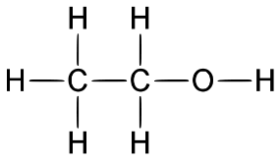
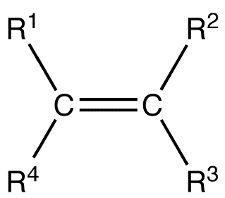
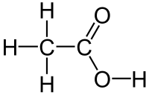

C7 part 2 – Organic Chemistry (Triple)
2.3 Reactions of Alcohols
2.1 & 2.2 Alkenes
Functional group of -OH
Hydrocarbons with a functional group of a double bond, C=C.
methanol CH₃OH
ethanol C₂H₅OH
propanol C₃H₇OH
butanol C₄H₉OH
2.4 Carboxylic Acids
Functional group -COOH
Unsaturated
C_{n}H_{2n}
methanoic acid, HCOOH
ethanoic acid, CH₃COOH
propanoic acid, C₂H₅COOH
butanoic acid, C₃H₇COOH
Reaction with:
Ethene C₂H₄
Propene C₃H₆
Butene C₄H₈
Pentene C₅H₁₀
Sodium
Fizz – give off Hydrogen gas
Water
WEAK ACIDS
Chemical Reactions:
Dissolve
Reactions
Oxygen (air)
As all ACIDS
Combustion - same as alkanes, but smokier flames due to more incomplete combustion.
Combustion to make carbon dioxide and water
C₂H₅OH + 3O₂ → 2CO₂ + 3H₂O
e.g. react with carbonates to form a salt, carbon dioxide and water
React with hydrogen, water and the halogens, by the addition of atoms across the double carbon-carbon bond to give a carbon-carbon single bond.
Oxidising agents
(potassium dichromate)
Form Carboxylic acids. Also made slowly if alcohols left in air (sour wine!)
2CH₃COOH + Na₂CO₃ →
2CH₃COONa + CO₂ + H₂O
Water
Used as:
Dissolve to form acids with pH around 4.0
Ni, 150 ºC
Solvents (eg perfumes)
C₂H₄ + H₂ → C₂H₆
C₂H₄ + Br₂ → CH₂BrCH₂Br
(orange) (colourless)
C₂H₄ + H₂O → C₂H₅OH
(steam)
Fuels
Acohols
Room temp
Mouthwash
React to make esters
Alcoholic drinks
Ethanoic acid + ethanol
→ ethyl ethanoate + water
Catalyst H₃PO₄
Made by:
300 ºC, 60-70 atm
Fermentations of sugar – using yeast at 35ºC
CH₃COOH + C₂H₅OH → CH₃COOC₂H₅ + H₂O
C₆H₁₂O₆ → 2 C₂H₅OH + 2CO₂
Or from alkenes

Slide 2
1 | Explain how alkenes differ from alkanes?
2 | Name and give the formulae of the first 4 alkenes?
3 | What is the product of reacting Ethene with phosphoric acid?
4 | What is the functional group of an alcohol?
5 | Name the first four alcohols?
6 | Give three uses of alcohols?
7 | What are the reagents and conditions for producing ethanol by fermentation?
8 | What is the functional group of a carboxylic acid?
9 | What are the products of reacting a carboxylic acid with a metal carbonate?
10 | How are esters made?
Hydrocarbon | A molecule made of hydrogen and carbon atoms only
Homologous Series | a group of organic chemicals with similar chemical properties and the same general formula.
Alcohols | A homologous series with the functional group –OH
General formula | This shows the number of atoms of each element in a substance which has ‘n’ carbon atoms.
Saturated | Molecule containing no double bonds.
Unsaturated | Molecule containing double bond(s).
Cracking | The process of using heat to turn large hydrocarbons into smaller, more useful molecules.
Alkenes | A group of unsaturated hydrocarbons, with the general formula C_{n}H_{2n}
Unsaturated | When hydrocarbons like alkenes have a double bond and so have the potential to bond with extra hydrogen atoms.
Bromine water | Used to test for alkenes – turns from orange to colourless.
Polymers | A long molecule made of lots of monomers joined together.
Carboxylic Acid | A homologous series containing the functional group – COOH
Esters | A homologous series containing the functional group –COO- made by reacting an alcohol and a carboxylic acid

