Slide 1

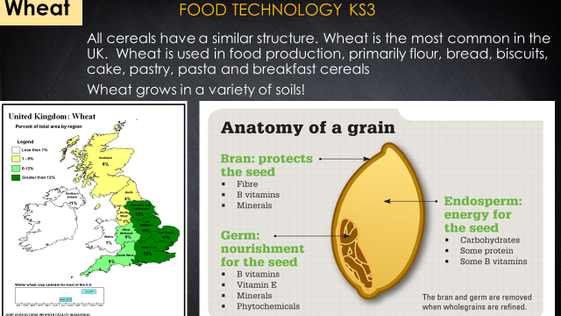
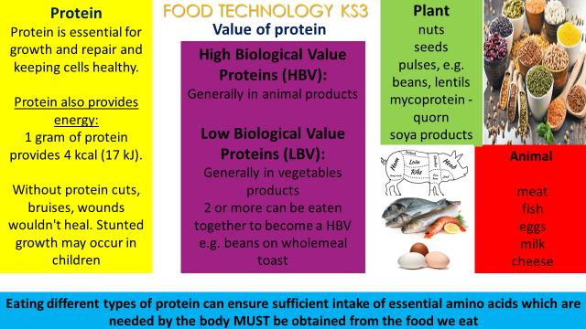
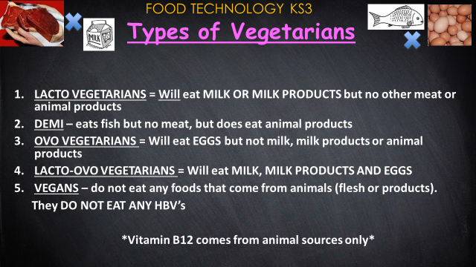
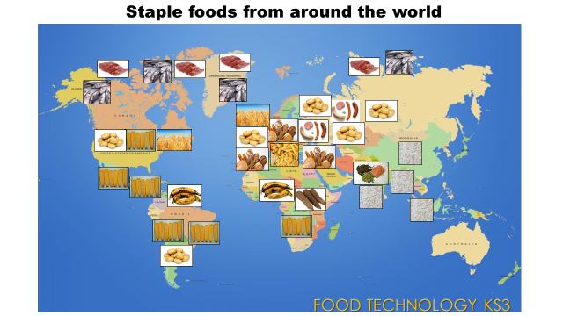
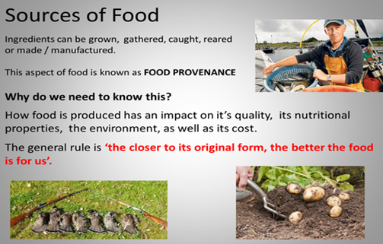
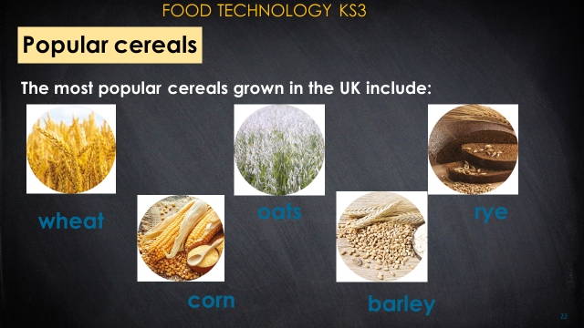
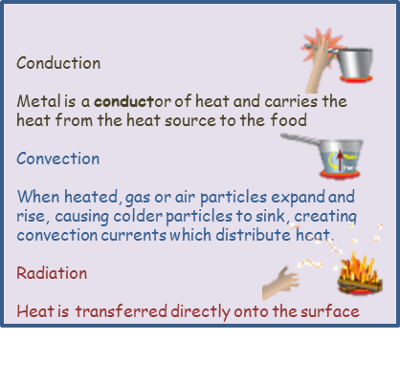
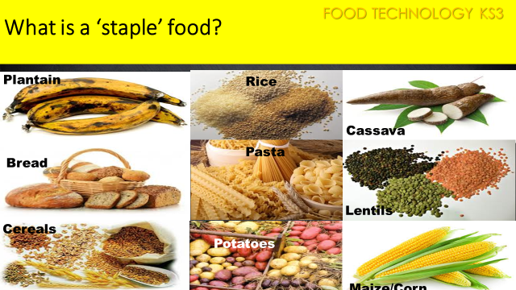
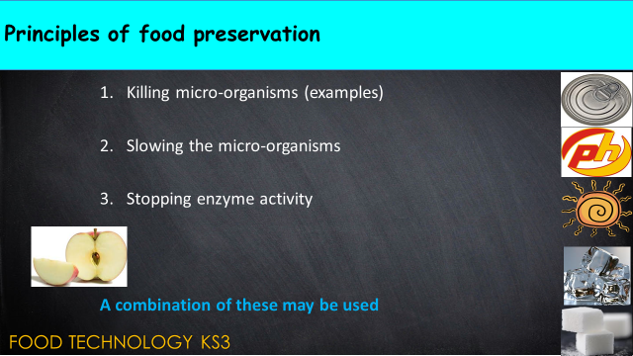
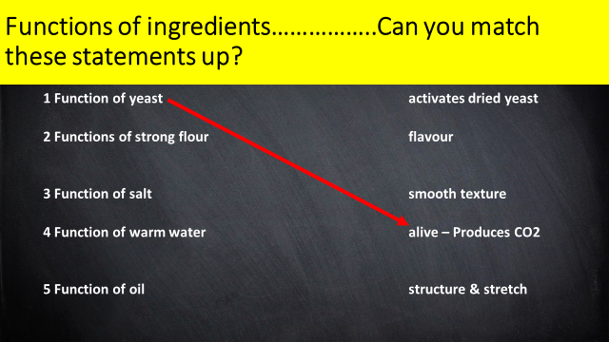
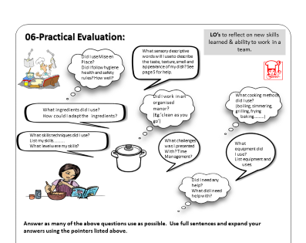
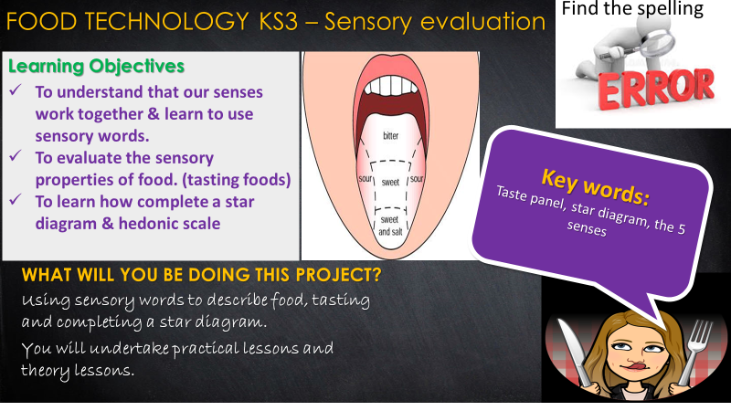
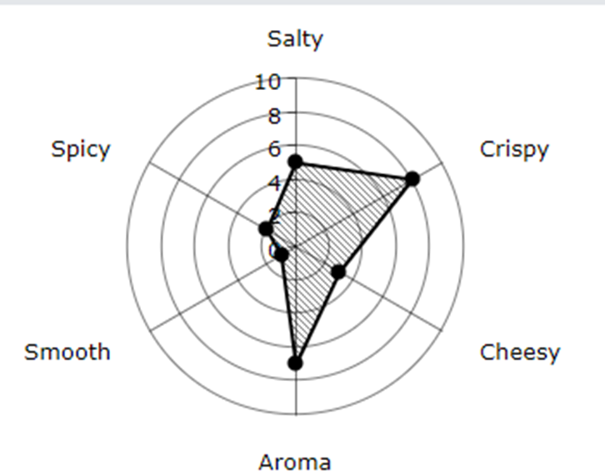
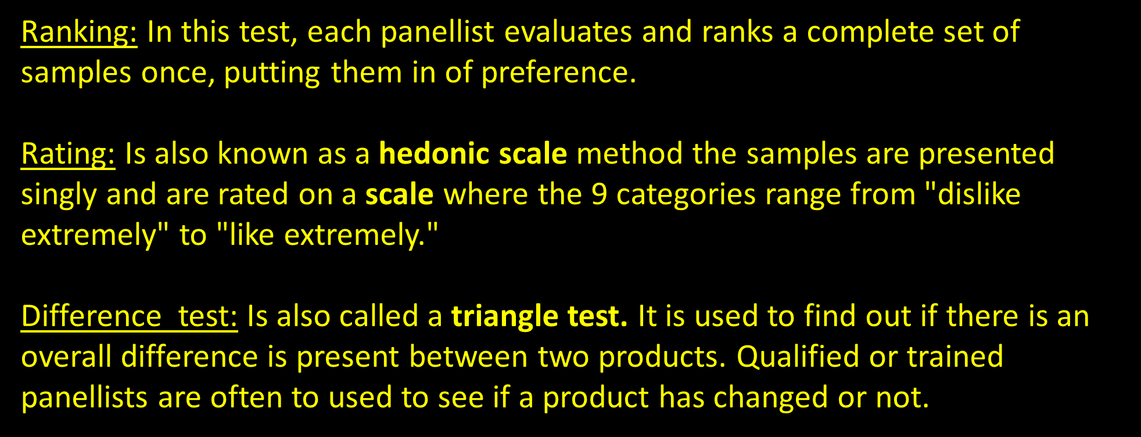
FOOD TECHNOLOGY KS3 – Food choices, sensory evaluation, commodities & functions of ingredients

Slide 2
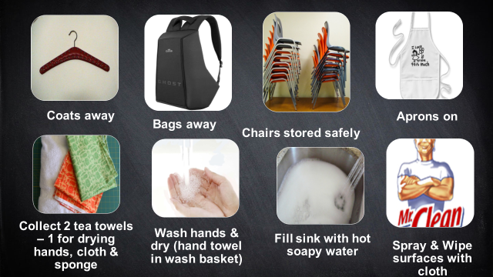
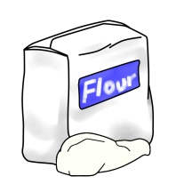
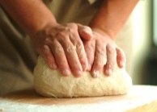
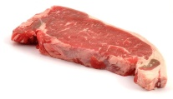
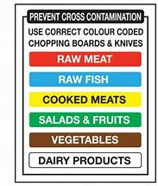
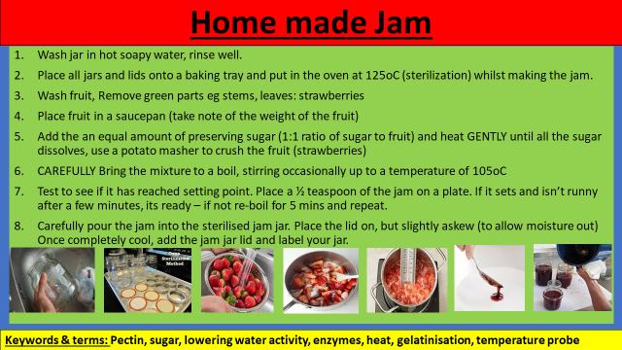
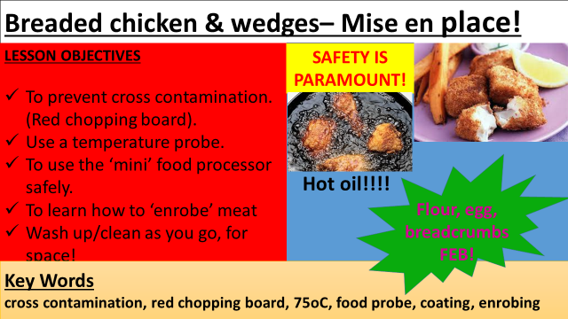
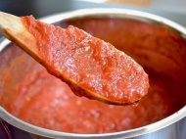
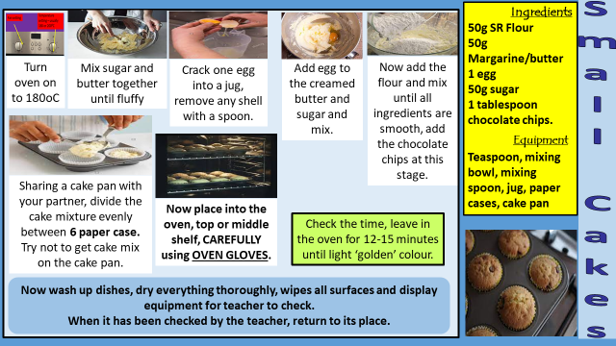
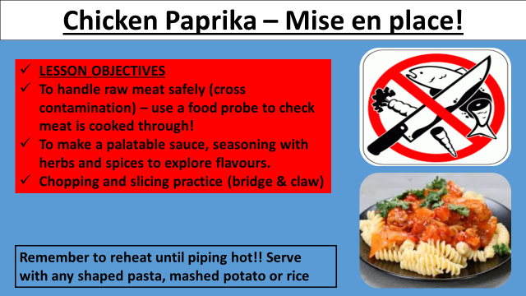
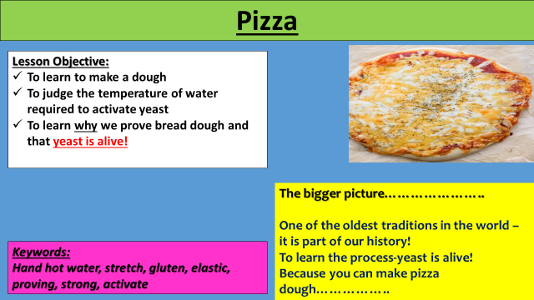
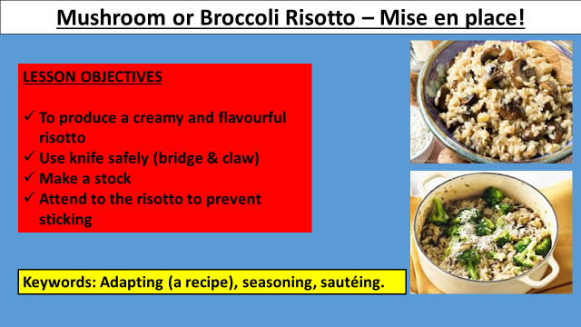
FOOD TECHNOLOGY KS3 – Practical lessons!
Supports food theory lessons and cultivates a love of cooking
Develops fine motor skills
Fosters collaborative learning & team work
Includes numeracy and literacy (new vocabulary and descriptive terminology)
Incorporates problem solving and improves listening skills
Promotes time management skills during a fast paced lesson
Brings organic chemistry to life in the classroom
KEY PROCESSES:
Kneading-
to work dough, to develop
the gluten that is found in
flour, this gives baked
goods their structure and
texture. When making
dough, the flour and other
dry ingredients are
combined with the wet
ingredients, usually warm
water, along with yeast.
Handling Raw Meat -
Always wash hands with
warm water and soap for
20 seconds before and
after handling raw meat.
Don't cross-contaminate!
Keep raw meat, poultry,
fish, and their juices away
from other food. Wash
cutting board, utensils,
and countertops with hot,
soapy water after use.
Reducing – heating up a
sauce based product to
evaporate the water and
making the sauce thicker
in consistency.

