Slide 1
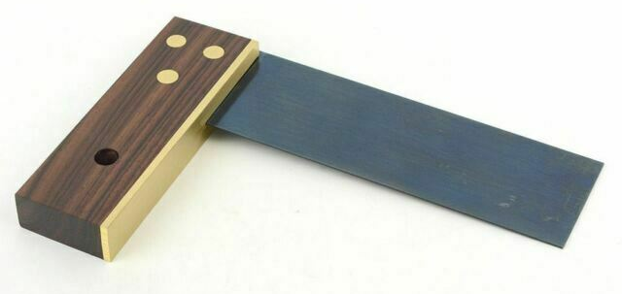
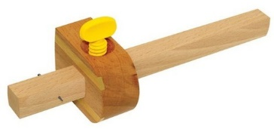
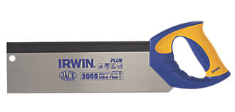
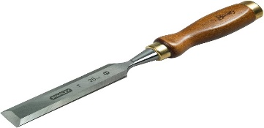
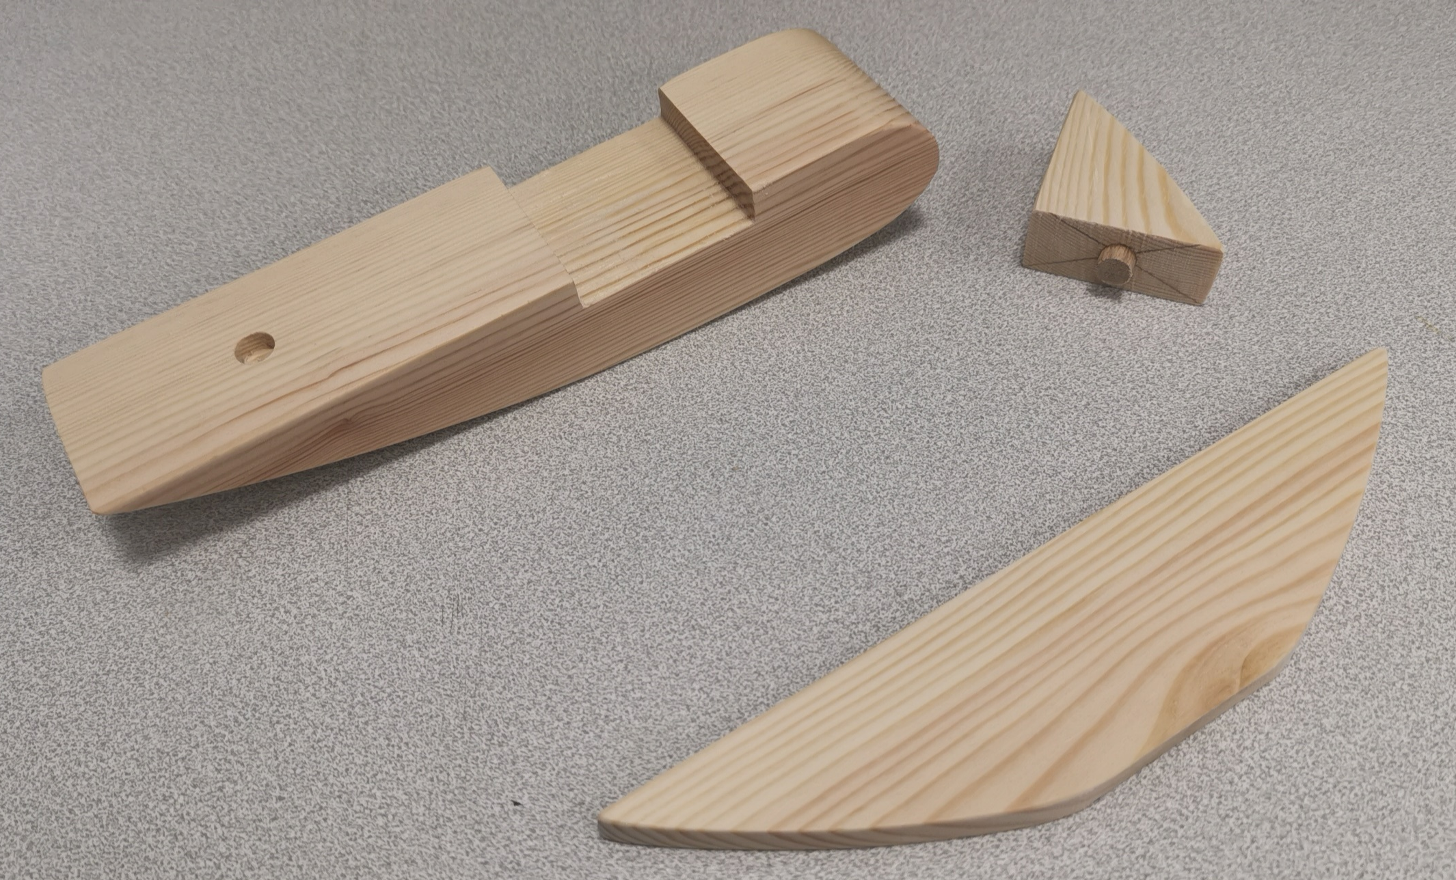
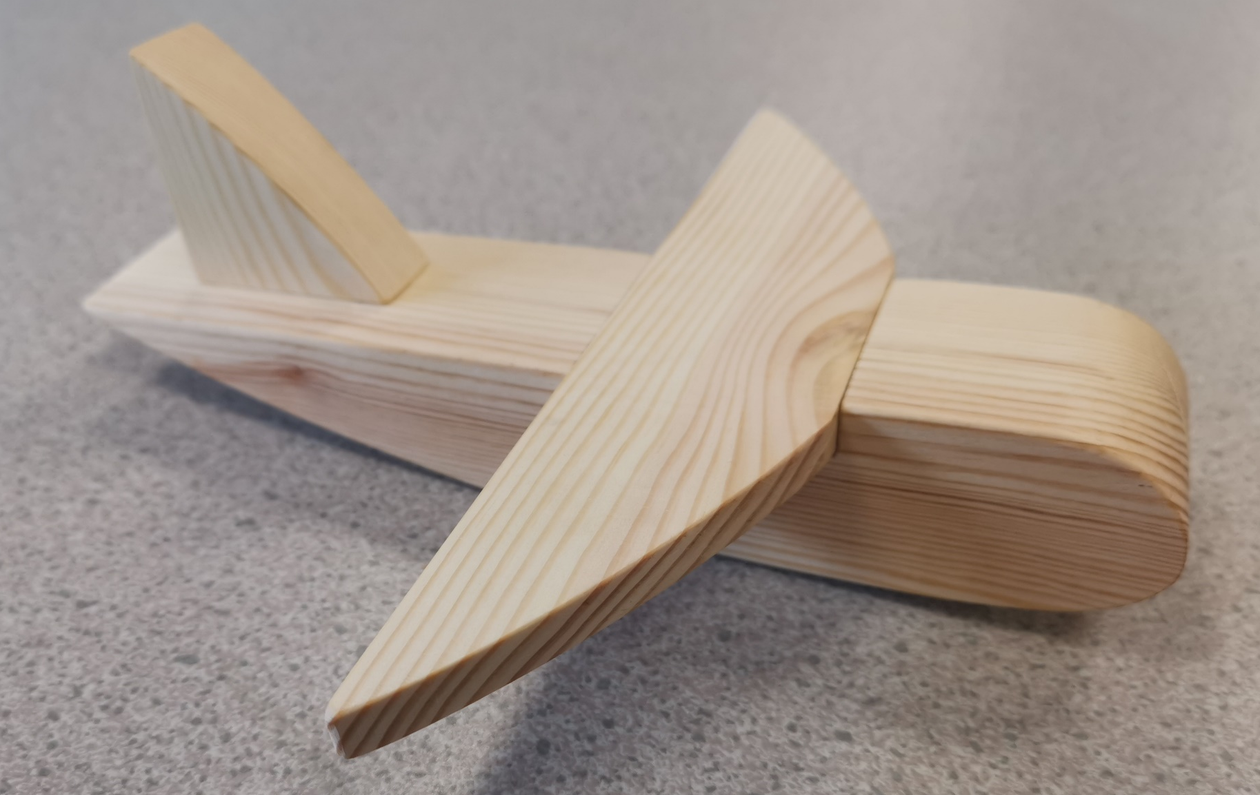
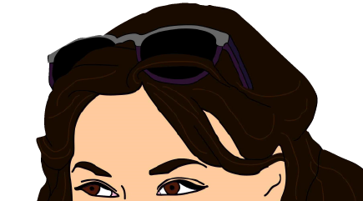
Knowledge Organiser
KS3 DESIGN AND TECHNOLOGY
Tri Square - Used to mark a line 90° to a face edge and can be used to check an angle is at 90°
YEAR 8 TOY PLANE PRACTICAL SKILLS
Learning Objectives
In this topic you will learn about:
How to measure and mark out timbers
How to remove material and shape timber
How to join timbers together using different joints
How to apply a surface finish
How to create a manufacturing diary
How to evaluate your product
Marking Gauge - Used to mark a parallel line to an edge
Tri Square - Used for cutting straight lines accurately. Blade is hardened and tempered
WHAT WILL YOU BE DOING THIS PROJECT?
We will learn how to manufacture a toy plane from timber. We will complete a manufacturing diary each week to show a step by step process that will include our health and safety precautions in the workshop. We will learn how to use different tools to measure, mark out and make a housing joint and a dowel joint to assemble our toy plane. We will then shape our plane and apply a finish to enhance the grain.
Chisel - Used to shape wood by slicing off shavings

