Slide 1
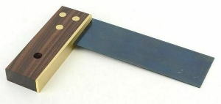
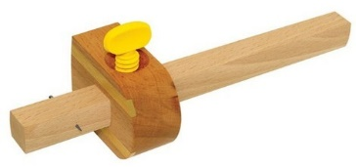
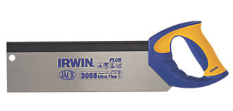
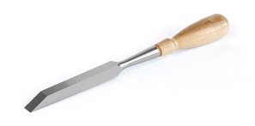
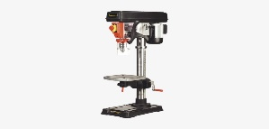
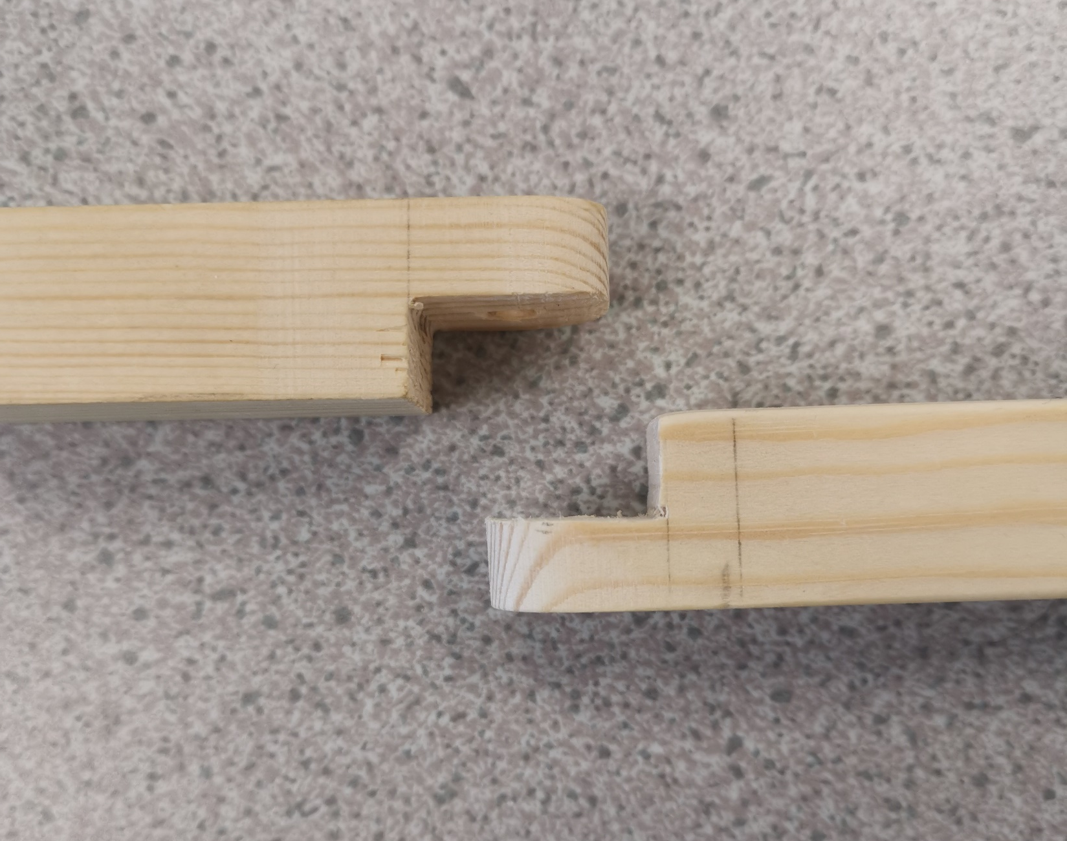
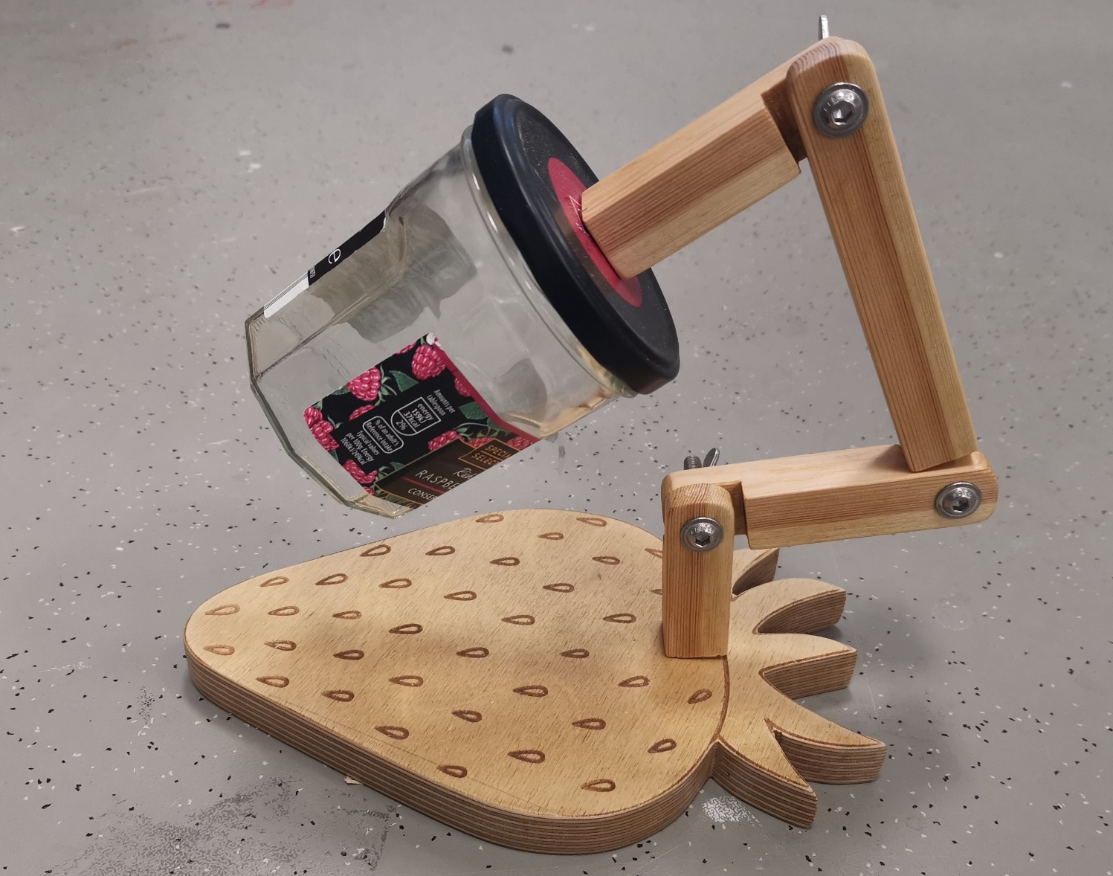
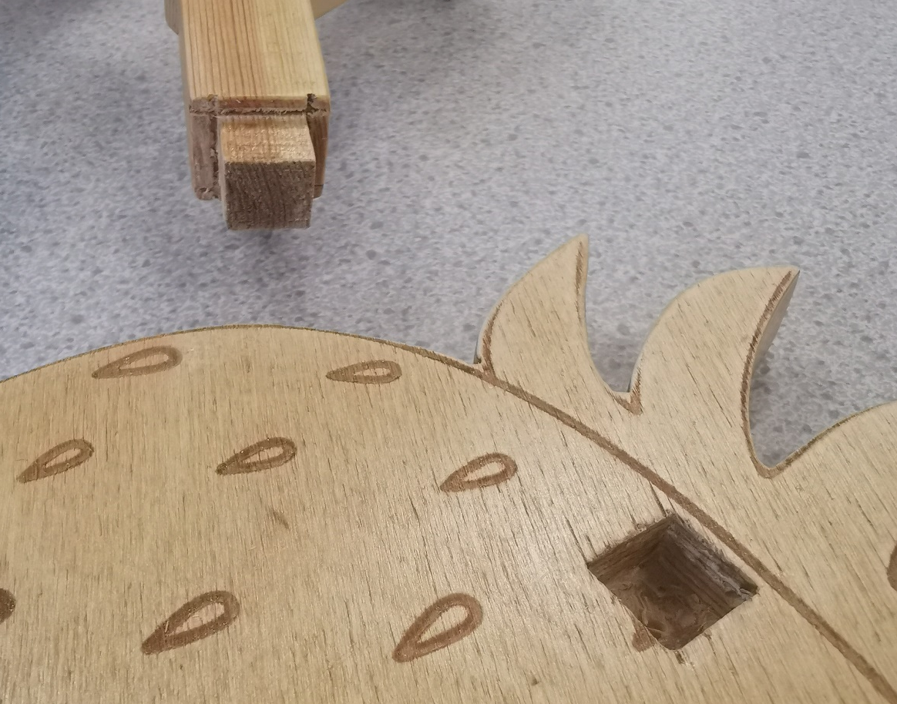
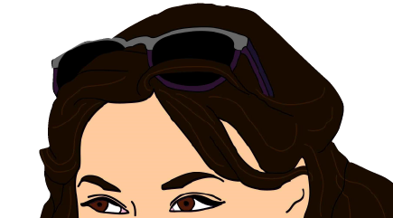
Knowledge Organiser
KS3 DESIGN AND TECHNOLOGY
Tri Square - Used to mark a line 90° to a face edge and can be used to check an angle is at 90°
YEAR 9 DESK LAMP PRACTICAL SKILLS
Learning Objectives
In this topic you will learn about:
How to measure and mark out timbers
How to remove material and shape timber
How to join timbers together using different joints
How to apply a surface finish
How to create a manufacturing diary
How to evaluate your product
Marking Gauge - Used to mark a parallel line to an edge
Tenon Saw - Used for cutting straight lines accurately. Blade is hardened and tempered
Mortise chisel - Thicker blade than other chisels and has a leather washer in between the blade and hand so that timber can be struck harder.
WHAT WILL YOU BE DOING THIS PROJECT?
We will learn how to manufacture a desk lamp from timber. We will complete a manufacturing diary each week to show a step by step process that will include our health and safety precautions in the workshop. We will learn how to use different tools to measure, mark out and make halving joints and a mortise and tenon joint to assemble our desk lamp. We will then shape our lamp, apply a finish to enhance the grain and use an reusable object to create our sustainable lamp shade.
Pillar Drill - Speed can be adjusted, generally a large drill bit and hard materials require a slow speed and small drill bits and a soft material require a fast speed

