Slide 1
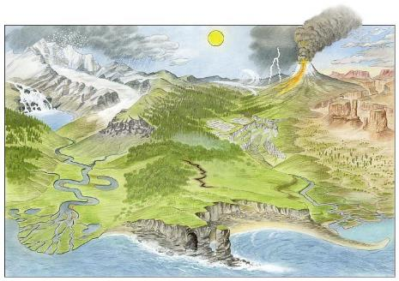
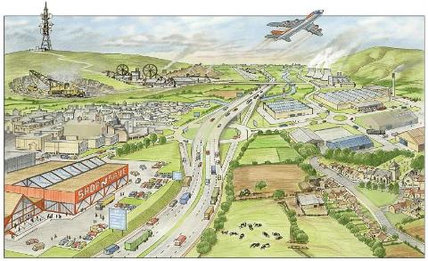
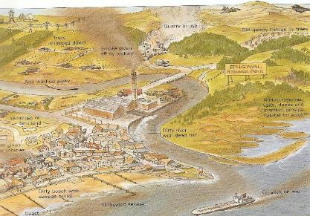
Year 7 Connections Knowledge Organiser – different types of Geograph
Physical Geography
Human Geography
oil leaks​ | climate​
settlement​ | communications​
population​ | mining​
rivers​ | global warming​
farming​ | soil​
mountain​ | recycling​
motorway​ | shopping centre​
pollution​ | volcano​
earthquakes​ | weather​
desert​ | deforestation​
Definitions:
1. Physical Geography
B. The study of natural features of the land.
2. Human Geography
C. The study of man-made features in the world.
3. Environmental Geography
The study of the impact people have on nature.
Match the words to each type of Geography, the first 8 have been completed…
Environmental Geography (can be positive and negative)

Slide 2


