Slide 1
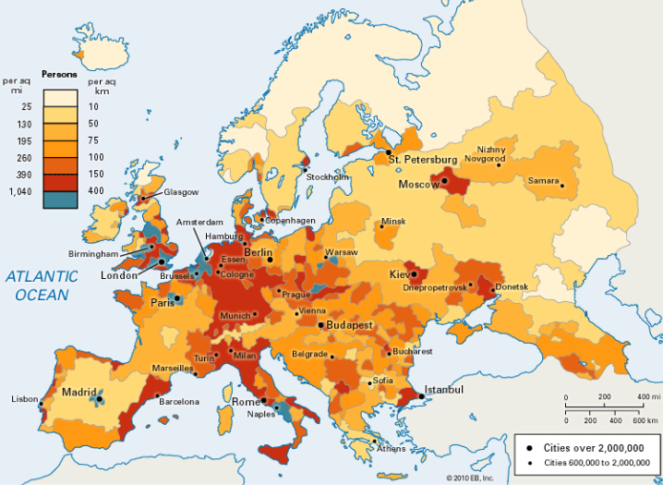
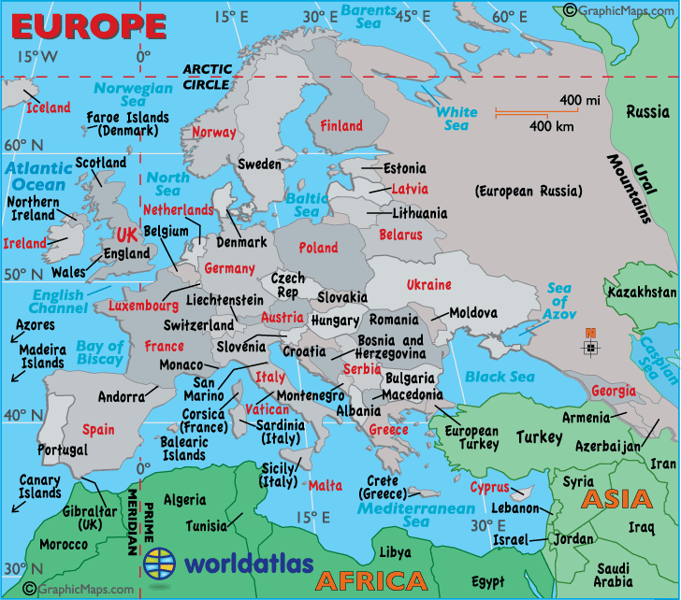
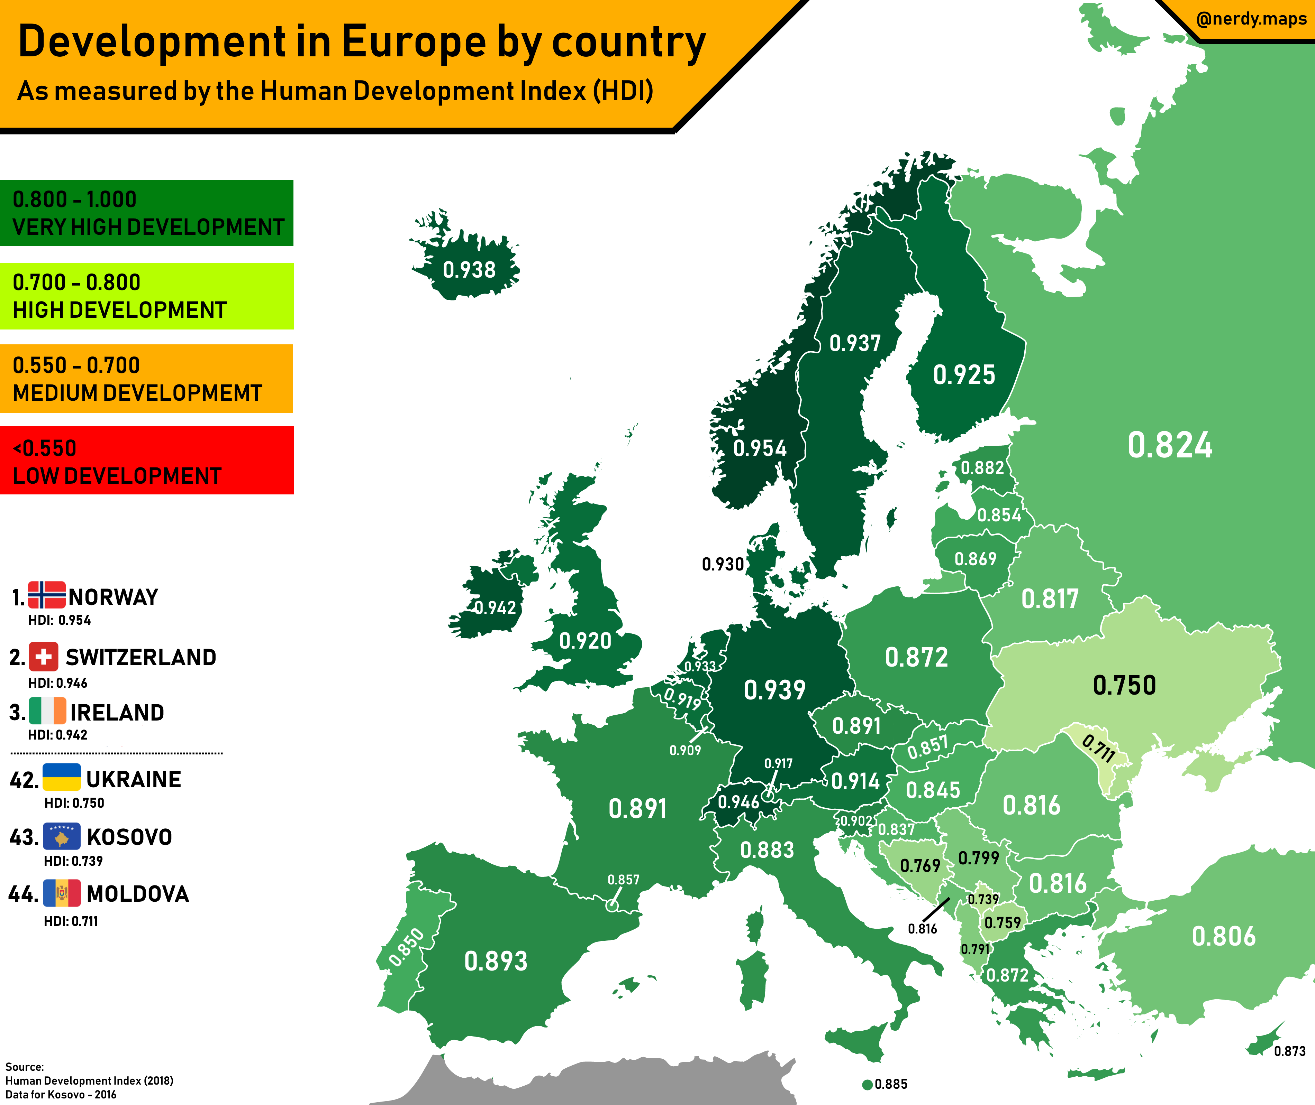
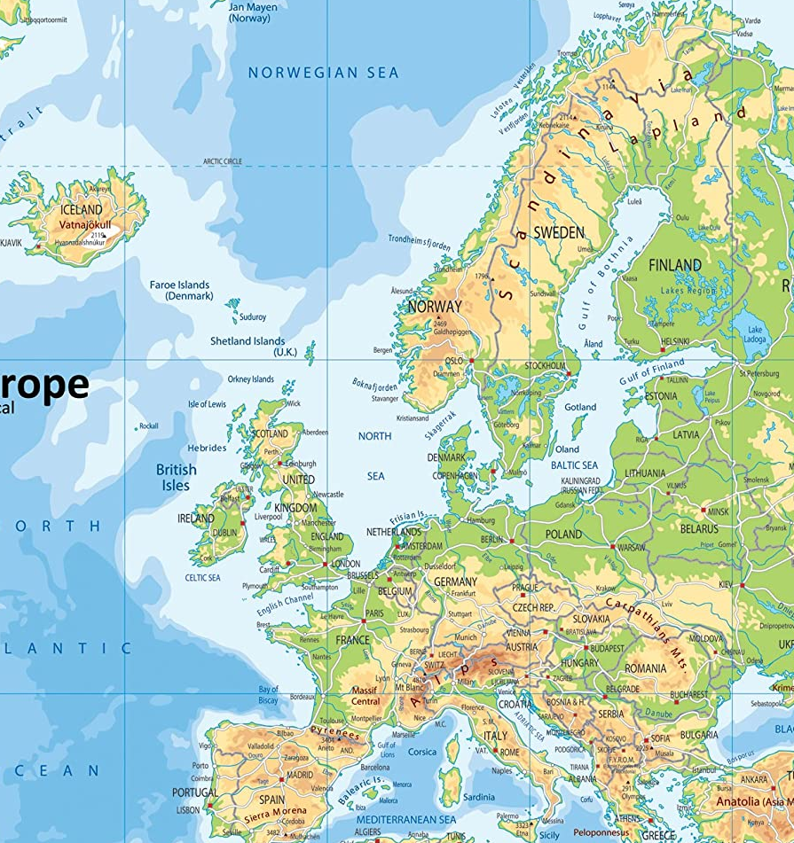

Exploring Europe Knowledge Organiser
What do we know about Europe?
Will understand where Europe is located using 4+ pieces of map information including lines of latitude.
Will identify 20+ of 50 countries and capitals in Europe.
Where do people live in Europe?
Suggest 2 reasons for high or low population densities across Europe? (4 marks)
Example PEE paragraph:
P - In Western Europe there are high population densities.
Ev – For example in the SE of the UK has a population density of over 400 people / km².
Ex – This could be explained by it being a low land area which is easier to build-on, a major river and a long coastline which is good for trade.
Challenge: Compare with human reasons such larger economies and more opportunities, can you suggest reasons for high or low population densities.?
Example PEE paragraph:
P - In Western Europe populations are increasing such as in the UK, France and Spain.
Ev – For example France’s population has increased by 15% and the UK’s almost 19% since the 1990s.
Ex – This could be explained by the UK and France being the 2nd and 3rd largest economies in Europe and having strong international links attracting people for economic opportunities.
What is the UK like?
Know the 5 countries make-up the British Isles and 4 that make-up the UK, the 4 capitals of each country, the 6 major mountain chains and 5 major rivers in the British Isles.
Why is Europe so developed?
Physical factors | Human factors
1. Small continent 2. Mainly temperate climate | 4. Economic links 5. Transport links 6. Communication links 7. Colonial legacy

Slide 2
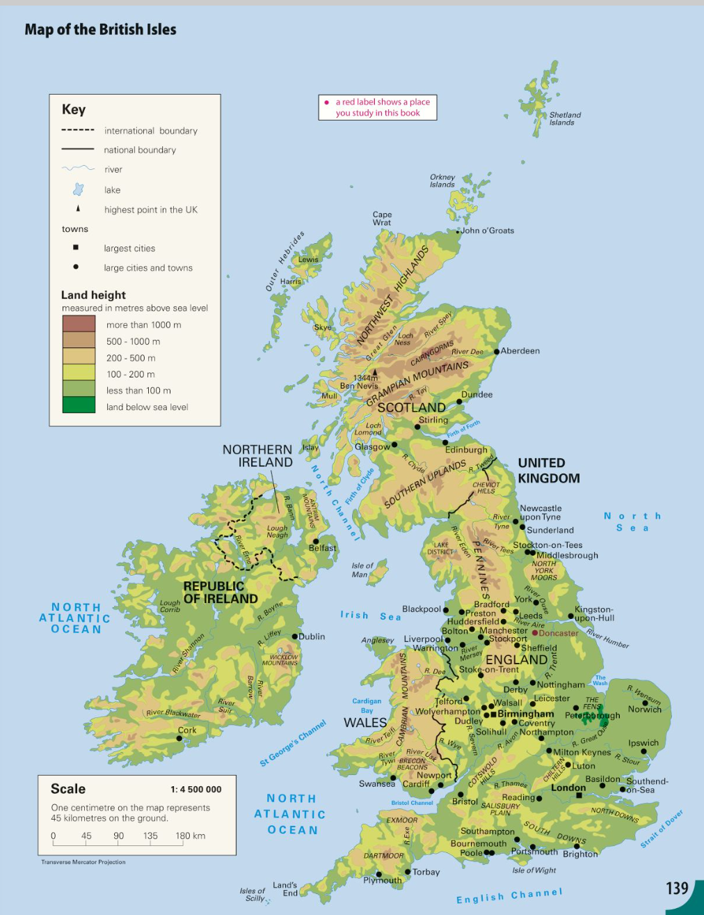
Exploring Europe Knowledge Organiser – Map Knowledge

