Slide 1
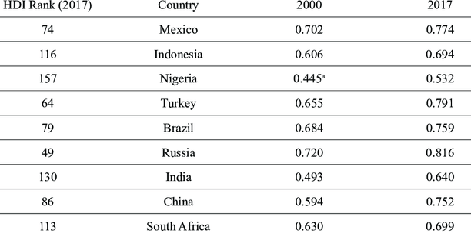
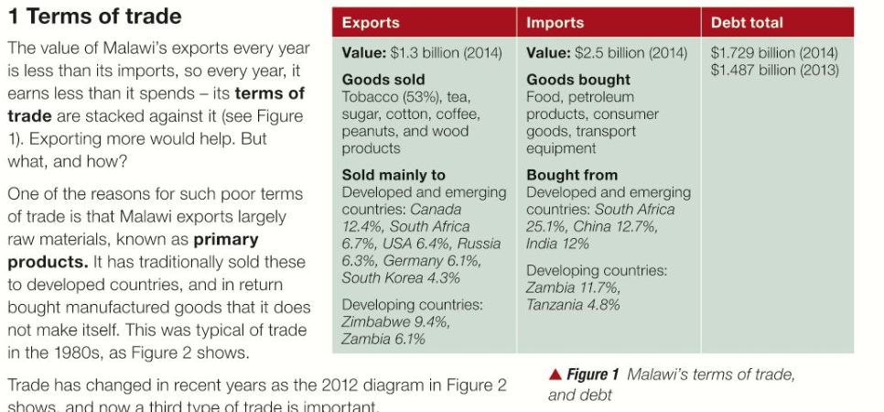
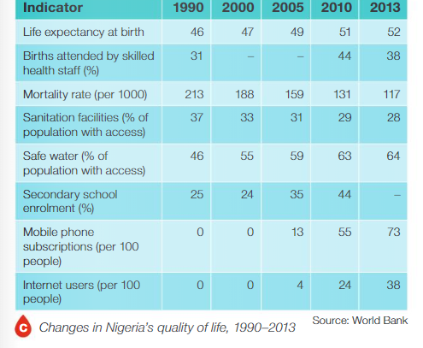
Amazing Africa A3 – Knowledge Organiser
Box 3: Explain why Nigeria has grown so rapidly. (Reasons: 1. Raw materials, 2. Location, 3. Population and workforce, 4. Political changes, 5. Education, 6. TNCs in Nigeria).
Nigeria has grown rapidly because of its huge amounts of oil (1), this means it creates huge profits that can be invested back into improving roads, schools and universities to attract more FDI. (1).
Nigeria has invested in education in English speaking schools and universities in major cities such as Lagos (1), this means Nigeria produces large numbers of English-speaking graduates which attracts more FDI from TNCs. (1).
Box 1: What do we know about Africa?
List the 5 largest countries in Africa and their capital cities.
Algeria (919,352 square miles), Democratic Republic of Congo (905,115 square miles), Sudan (728,022 square miles), Libya (679,192 square miles), Chad (495,624 square miles), Niger (489,062 square miles), Angola (481,226 square miles), Mali (478,714 square miles), South Africa (47,320 square miles), Ethiopia (426, 260 square miles)
Box 2: Where do people live in Africa?
Explain 2+ physical or human reasons to explain where people live in Africa.
Example answer:
P - In West Africa there are high population densities, Ev – For example Lagos in Nigeria has a population density of over 100 people / km² (1). Ex – This could be explained by having lots of natural resources such as oil and gas (1), which can be traded and used for economic development. Oil is a major resource in the world economy. (1). 3 marks – long explain chain.
P - In West Africa there are high population densities, Ev – For example Lagos in Nigeria has a population density of over 100 people / km² (1). Ex – This could be explained by it being a low land area which is easier to build-on (1), by a major river which is good for growing crops (1) and a coastline which is good for trade (1). 3 marks max – long explain chain.
Box 5: How developed is Nigeria, as an emerging country.
Explain 3+ points that show how developed Nigeria is from: Ethnic groups, Female literacy rates, HDI levels, Environments, Poverty rates, Rich-Poor divide or any other factors you have researched.
Box 3: Explain 2+ challenges parts of Africa face, using the example of Malawi.
Physical factors – 1 Being landlocked, 2 Rural areas are very isolated, 3 A changing climate
Human factors – 1 Terms of trade, 2 Colonialisation and cash crops, 3 Global trade
Africa Key terms: What words or terms are important?
Landlocked: surrounded by other countries with no access to a sea or ocean to trade
Isolated: rural areas far away from major population areas, cities, towns and therefore facilities/ trade etc
Changing climate: How climates are changing to experience more extreme and unpredictable weather
Terms of trade: How countries demand raw materials/ cash crops from developing countries, adding tariffs to stop countries manufacturing their own raw materials
Colonialisation: Typically legacy from the C18th-C19th European countries exploited and creating countries despite of ethnic, religious, cultural, linguistic differences.
Cash crops: Crops grown in warmer climates on large scales such as sugar, coffee, tea, flowers, bananas and other fruit.
Raw materials: Such as metal ores in rocks e.g. Bauxite is mined and processed into aluminium. Countries look to exploit other countries with many raw materials.
Global trade: How goods and services are traded around the world, this is not a fair flow as more wealth continues to leave Africa.
Exploit: Take advantage of an environment, its plants and/ or animals.
FDI: Foreign Direct Investment is when once country invests in another country to gain access to resources, new markets and gain profits.
STAR: Research answers for 2 of your own simple or complex enquiry questions and record on the back of sheet.

Slide 2
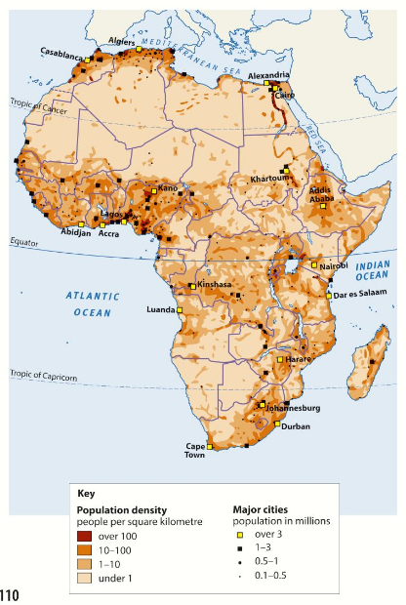
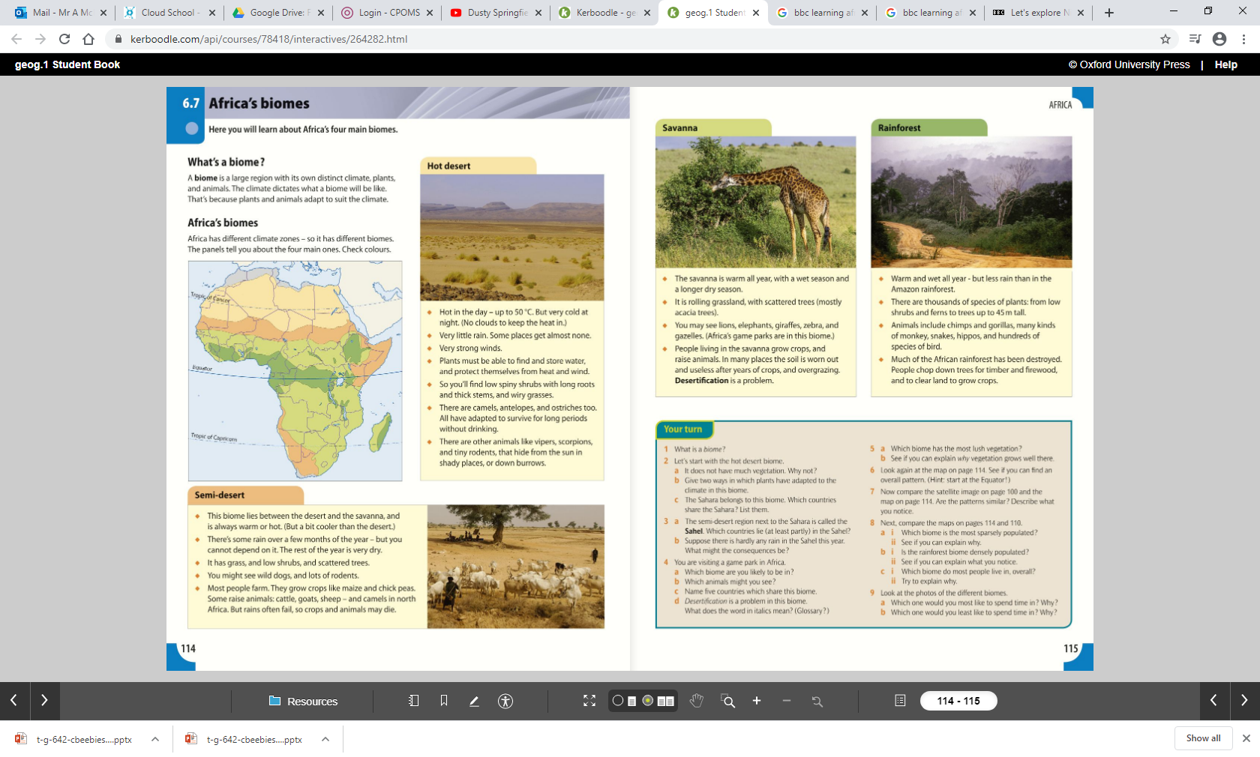
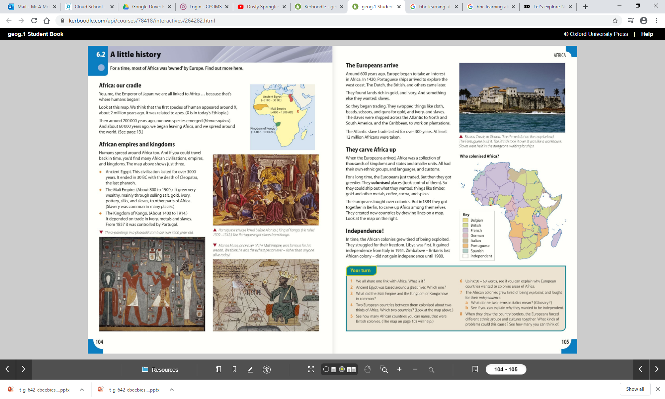
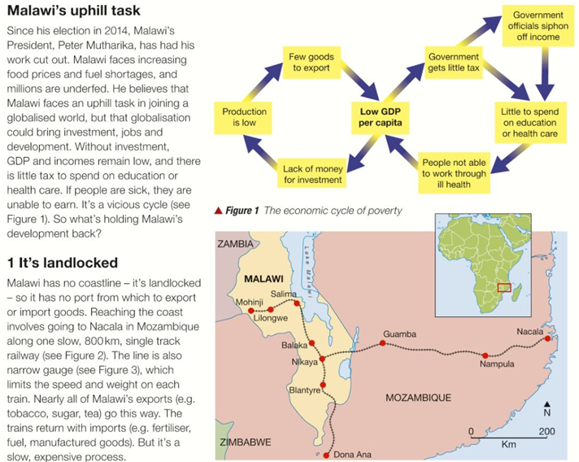
Amazing Africa A3 – Knowledge Organiser lesson images and resources

