Slide 1

GCSE Physical Education Paper 1 Section 1a
Knowledge Organiser
R | I am not confident with this work I am completely unsure what to do next I have tried to find help independently using the text book and internet but still need help
A | I am almost confident with this work I need to clarify exactly what to do next I have tried seeking additional help, but would like further advice
G | I am confident with this work I know what I need to do next I have all the additional help I need
Paper 1 Topics | Covered | R | A | G
Chapter 1a Applied Anatomy and Physiology
Bones
The Structure of the Skeleton
The Functions of the Skeleton
Synovial Joints
Muscles
Joints

Slide 2
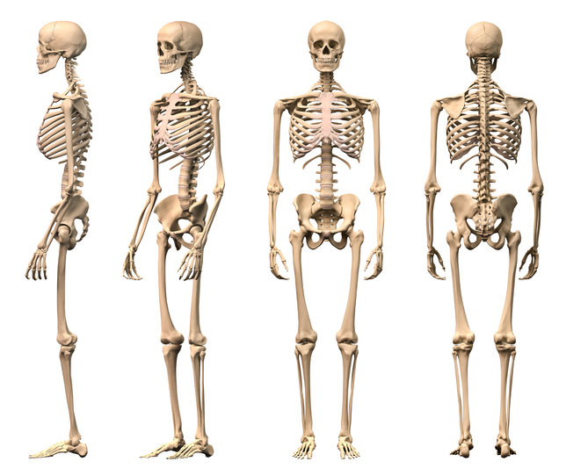
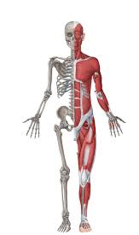
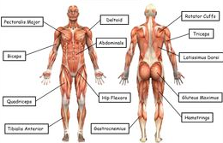
The Structure and Function of the Musculoskeletal System
Reference | AO1 Key Term | Definition
1 | Support | Bones keep us upright and hold muscles and organs in place
2 | Protection | Some bones surround and protect vital organs from damage
3 | Long Bones | The bones of the leg and arms. Long bones support the weight of the body and help with gross movements
4 | Movement | Muscles contract to pull bones of the skeleton
5 | Red Blood Cells | Carry Oxygen to muscles
6 | White Blood Cells | Fight infection
7 | Joint | Place where two or more bones meet
8 | Synovial Joint | Type of joint commonly found in the limbs; contains a synovial membrane which produces synovial fluid
9 | Cartilage | Covers ends of bones providing a smooth, friction free surface
10 | Synovial Fluid | Produced by the synovial membrane to lubricate the joint
11 | Capsule | Tough fibrous tissue – surrounds synovial joints; usually supported by ligaments
12 | Ligaments | Join bone to bone
13 | Dislocation | When the bones of a joint separate from their normal positon
14 | Bursae | Fluid-filled bag that helps reduce friction in a joint
15 | Tendon | Attaches muscles to bones
16 | Hinge Joint | Joint that allows flexion and extension
17 | Flexion | Movement where angle between bones is reduced
18 | Extension | Movement where angle between bones increases
19 | Vertebrae | Bones that form the spine or backbone
20 | Ball and Socket Joint | Joint that allows many movements – flexion and extension; abduction and adduction; and rotation
21 | Range of Movement | A measure of the flexibility of a joint in terms of the different movements allowed
22 | Abduction | Movement where limbs are moved away from the body
23 | Adduction | Movement where limbs are moved towards the body
24 | Rotation | Turning a limb along its long axis
25 | Meniscus | Cartilage acting as a shock absorber between the tibia and femur in the knee joint
26 | Cruciate Ligaments | Attach tibia to femur in the knee joint
27 | Plantar Flexion | Movement at the ankle joint where the toes are pointed towards the ground
28 | Dorsiflexion | Movement at the ankle where the toes are pulled up towards the knee

Slide 3
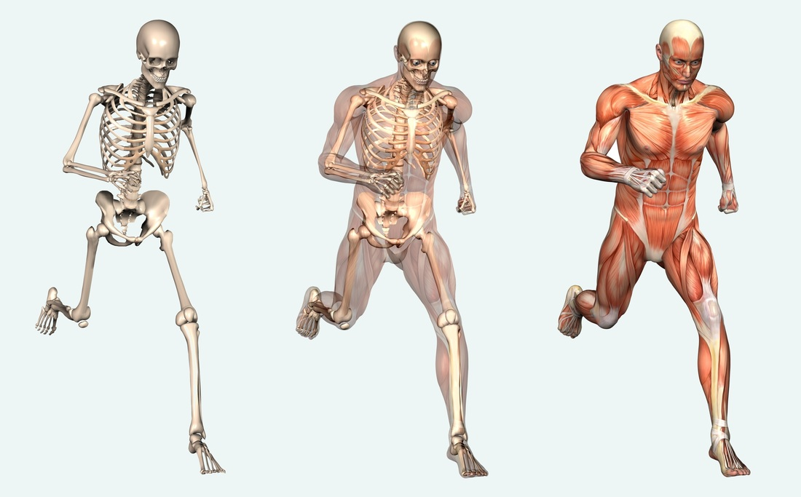
The Structure and Function of the Musculoskeletal System
Reference | A02 / A03 Progress Check – Formative assessment | Marks
 | Skeleton
1,2,3,4,5 | What do we need the support of the skeleton for? | 3
1,2,3,4,5 | How does the skeleton provide movement? | 3
4 | How do muscles cause movement? | 2
7,8,9,10,11 | Explain how different parts of a synovial joint provide support to stabilise the joint. | 4
8,9,10,11 | Explain how different parts of a synovial joint help it to move freely. | 4
7,15 | What is the function of tendons? | 1
 | Synovial Joints
16 | Name the bones that form the elbow joint. | 2
8,16,17,18,20 | Which type of synovial joint allows the greatest range of movement? Give an example | 2
16,27,28 | What movements are possible at the ankle joint? | 2
16,17,18 | Name the bones that form the knee joint. | 2
16 | Identify three different hinge joints. | 3
20,21,22,23,24 | What movements are possible at the shoulder joint? | 4
 | Exam Practice Questions
 | What are the main functions of ligaments? | 1
 | What is the main function of cartilage ? | 1
 | What is the main function of the synovial membrane? | 1
 | Explain the difference between plantar flexion and dorsi flexion. | 2
 | What is the correct term for straightening the knee ? | 1
 | 3Explain the difference between abduction and adduction. | 1
The Structure and Function of the Musculoskeletal System
Reference | A02 / A03 Progress Check – Summative assessment | Marks
1-28 | A 6 and or 9 mark question can be set by your subject teacher
1-28 | Zig Zag Topic Test
1-28 | Exampro Topic Test

