Slide 1

GCSE Physical Education Paper 1 Section 2
Knowledge Organiser
R | I am not confident with this work I am completely unsure what to do next I have tried to find help independently using the text book and internet but still need help
A | I am almost confident with this work I need to clarify exactly what to do next I have tried seeking additional help, but would like further advice
G | I am confident with this work I know what I need to do next I have all the additional help I need
Paper 1 Topics | Covered | R | A | G
Chapter 2 Movement Analysis
Levers
Mechanical advantage
Muscle action
Muscle contraction for movement
Planes and axes
Movement analysis
Movement in the frontal plane about a sagittal axis
Movement in the transverse plane about the longitudinal axis
Analysis of selected movements

Slide 2
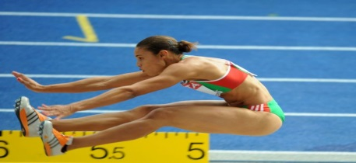
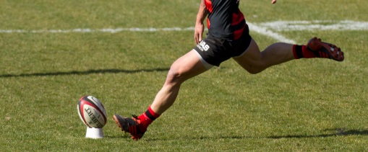
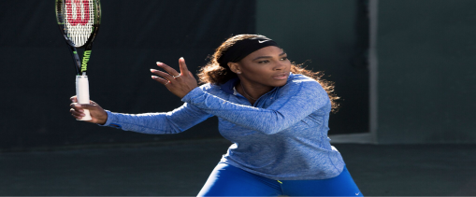
Movement analysis
Reference | AO1 Key Term | Definition
1 | Fulcrum | The part of a lever system that pivots; joints are the fulcrums in the body’s lever systems
2 | Resistance | The load to be moved by a lever system; usually this involves weight when the body’s lever system is involved
3 | Effort | The force applied to move the resistance or weight; in the body, the effort is provided by muscles exerting a force
4 | First Class Lever | Found at the elbow joint, where the triceps causes extension of the lower arm
5 | Second Class Lever | Found at the ankle, where the gastrocnemius causes plantar flexion
6 | Third Class Lever | The majority of the body’s joints act as third class levers; for example, the biceps acting at the elbow to cause flexion acts as a third class lever system
7 | Mechanical Advantage | The benefit to a lever system of having either a short effort arm or a short resistance arm
8 | Agonist | The prime mover – muscle that causes movement
9 | Antagonist | Muscle that relaxes to allow the agonist to contract
10 | Tendons | Attach muscles to bones
11 | Isotonic | Muscle action where the muscle changes length – causing movement
12 | Isometric | Muscle action where the muscle stay the same length – used in balances
13 | Concentric | Isotonic contraction where the muscle shortens
14 | Eccentric | Isotonic contraction where the muscle lengthens – used to control downwards movements
15 | Sagittal Plane and Transverse Axis | Plane and axis for forwards and backwards movements- direction for extension and flexion
16 | Frontal Plane and Sagittal Axis | Plane and axis for side to side movements – direction for abduction and adduction
17 | Transverse Plane and Longitudinal Axis | Plane and axis for rotating movements – direction for rotations and spins
18 | Deltoid | Muscles causing flexion at the shoulder
19 | Latissimus Dorsi | Muscle causing extension at the shoulder
20 | Bicep | Muscle causing flexion at the elbow
21 | Triceps | Muscle causing extension at the elbow
22 | Hamstrings | Group of muscles causing flexion at the knee
23 | Quadriceps | Group of muscles causing extension at the knee
24 | Hip Flexors | Main agonists at the hip during hip flexion
25 | Tibialis Anterior | Main agonist at the hip during extension
26 | Gastrocnemius | Muscle causing dorsiflexion at the ankle
27 | Rotator Cuff | Muscle causing plantar flexion at the ankle

Slide 3
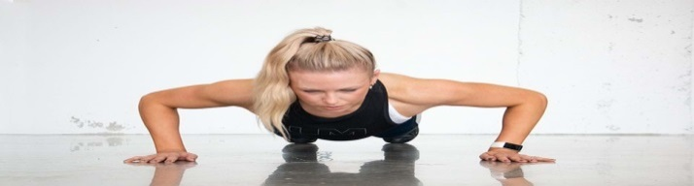
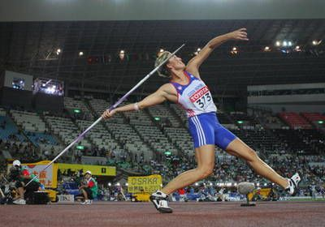
Movement analysis
Reference | A02 / A03 Progress Check – Formative assessment | Marks
 | Levers
1-6 | Name, sketch and label the lever system operating at the knee during running. | 3
1-6 | Name, sketch and label the lever system operating at the elbow during a football throw-in or an overhead pass in Netball. | 3
1-6 | Name, sketch and label the lever system operating at the ankle during running. | 3
7 | State TWO mechanical advantages of the lever system that is used at the ankle joint. | 2
 | Muscle Contractions
11,12,13,14 | What is the difference between and isotonic and an isometric muscle contraction? | 1
11,12,13,14 | What is the difference between a concentric and an eccentric muscle contraction? | 1
11,12,13,14 | Give three examples of an isometric muscle contraction in three different physical activities. | 3
 | Planes and Axis
15,16,17 | When a performer runs during a 100m sprint, through which plane and in which axis do their legs move? | 2
15,16,17 | When a hammer thrower performs their throw, in which plane and in which axis does their movement occur? | 2
15,16,17 | As part of a training programme a performer completes star jumps. State in which plane and axis these movements are performed? | 2
18,19 | What is the main agonist causing extension at the shoulder? | 1
20,21 | Name the movement caused by the triceps at the elbow. | 1
11,12,13,14 | What type of muscle contraction is occurring during the downward phase of a push –up ? Name the main agonist. | 1
25,26 | Explain the difference between plantar flexion and dorsi | 1
22,23 | Describe the movements occurring at the knee and name the agonist involved in the action of kicking the ball. | 2
11,12,13,14 | What type of muscle contraction is occurring during the downward phase of a squat ? Name the main agonist. | 2
 | Exam Practice Questions
1-28 | Name the main agonist and antagonist at the elbow joint as the gymnast moves up and down in a press up? | 4
1-28 | Name the planes and axis in different movements/sporting actions | 3
Movement analysis
Reference | A02 / A03 Progress Check – Summative assessment | Marks
1-28 | A 6 and or 9 mark question can be set by your subject teacher
1-28 | Zig Zag Topic Test
1-28 | Exampro Topic Test

