Slide 1
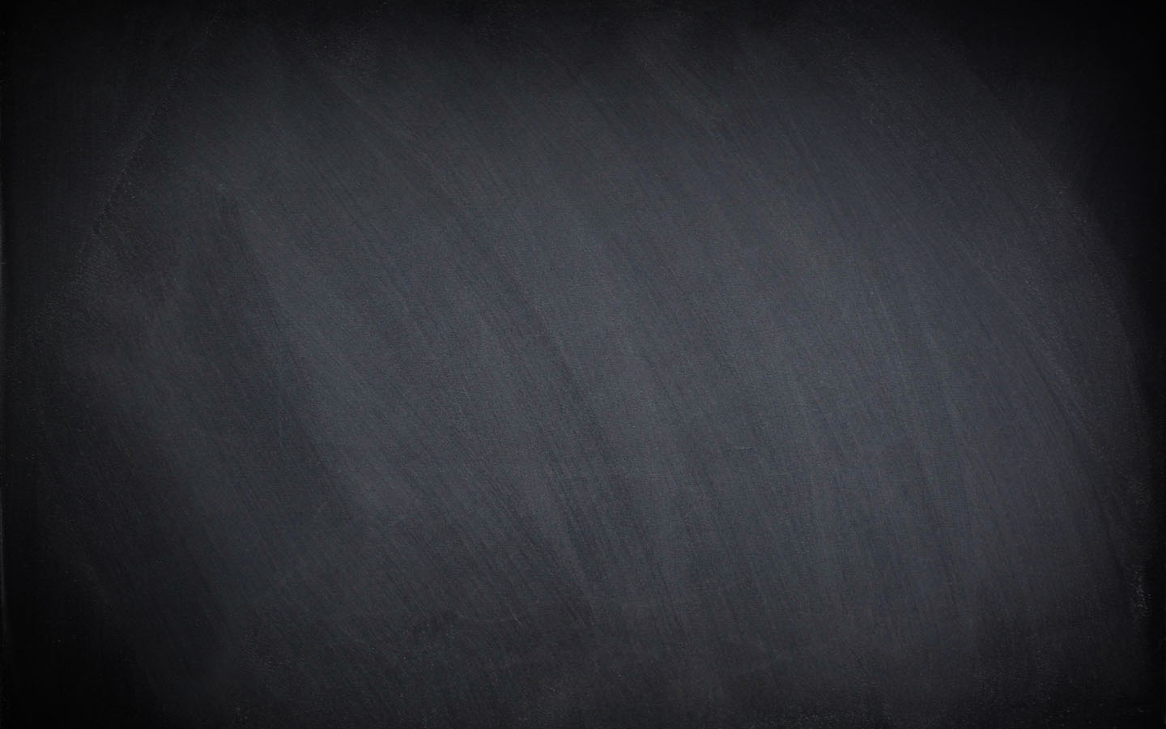
GCSE Physical Education Paper 1 Section 1b
Knowledge Organiser
R | I am not confident with this work I am completely unsure what to do next I have tried to find help independently using the text book and internet but still need help
A | I am almost confident with this work I need to clarify exactly what to do next I have tried seeking additional help, but would like further advice
G | I am confident with this work I know what I need to do next I have all the additional help I need
Paper 1 Topics | Covered | R | A | G
Chapter 1b The Structure and Function of the Cardio-Respiratory System
The Respiratory System
Gaseous Exchange
Breathing
Lung Volumes
Blood Vessels
Structure of the Heart
Cardiac Cycle
Cardiac Output

Slide 2
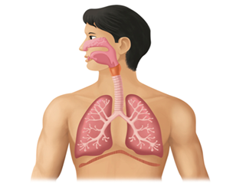
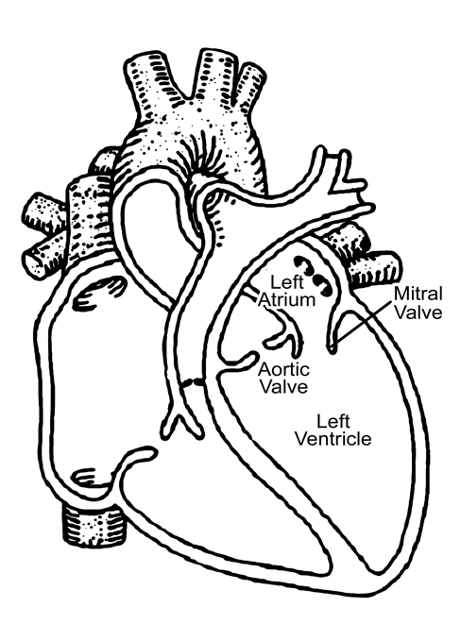
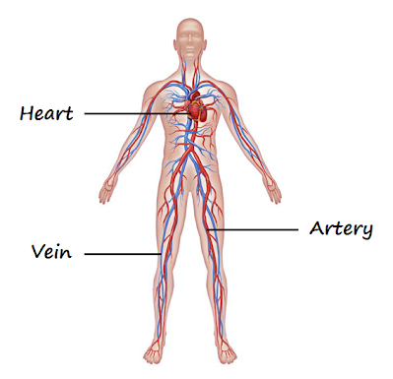
The Structure and Function of the Cardio-Respiratory System
Reference | AO1 Key Term | Definition
1 | Trachea | (or windpipe) Carries air from the mouth and nose to the lungs
2 | Bronchi | Carries air from the trachea into the lungs
3 | Bronchioles | Carries air from the bronchi to the alveoli
4 | Lungs | Pair of large, spongy organs optimised for gas exchange between our blood and the air
5 | Alveoli | Many tiny air sacs in the lungs which allow for rapid gaseous exchange
6 | Haemoglobin | The red pigment found in red blood cells
7 | Oxyhaemoglobin | Formed when oxygen combines with haemoglobin
8 | Abdominal Muscles | The muscles which help force air out of the lungs and so speed up expiration
9 | Tidal Volume | The volume of air breathed in (or out) during normal breath at rest
10 | Expiratory Reserve Volume (ERV) | The additional air that can be forcibly exhaled after expiration of a normal tidal volume
11 | Inspiratory Reserve Volume (IRV) | The additional air that can be forcibly inhaled after the inspiration of a normal tidal volume
12 | Residual Volume | The volume of air that remains in the lungs after a maximal expiration
13 | Artery | Blood vessel carrying blood away from the heart
14 | Vein | Blood vessel carrying blood towards the heart
15 | Capillaries | Very thin blood vessels that allow gas exchange to happen
16 | Vasoconstriction | Reducing the diameter of small arteries to reduce blood flow to tissues
17 | Vasodilation | Increasing the diameter of small arteries to increase blood flow to tissues
18 | Atria | Upper chambers of the heart that collect blood from the veins
19 | Ventricles | Lower chambers of the heart which pump blood out of the heart to the arteries
20 | Cardiac Cycle | Sequence of events that occur when the heart beats
21 | Systole | Term used to describe the contraction phase of the cardiac cycle
22 | Diastole | Term used to describe the relaxation phase of the cardiac cycle

Slide 3
The Structure and Function of the Cardio-Respiratory System
Reference | A02 / A03 Progress Check – Formative assessment | Marks
 | Lungs
2,3 | What is the difference between bronchi and bronchioles ? | 2
1 | What is the function of the rings of cartilage in the trachea? | 1
4,5 | What is the function of the alveoli? | 1
5,6,7 | Explain why oxygen diffuses in the blood. | 2
1,2,3,4,5,6,7 | Name four factors that assist gas exchange. | 4
6,7 | What is the function of haemoglobin? | 1
8 | Name the breathing muscles used to inspire air during rest | 1
8 | Name the breathing muscles used to inspire air during exercise. | 1
8,9,10 | How is air expired during rest ? | 1
9 | What is the Tidal Volume? | 1
9,10,11,12 | Which Lung Volume is used to increase the amount of air breathed in? | 1
9,10,11,12 | What is the name of the amount of air left in the lungs after a full expiration? | 1
 | Heart / Blood vessels
13 | What is the function of the elastic tissue in arteries ? | 1
13,14,15 | Which type of blood vessel contains valves ? | 1
16,17 | What is vasodilation? | 1
15 | Why are the capillaries thin-walled? | 1
21,22 | Distinguish between Systole and Diastole. | 1
18,19,20 | What is the function of the heart (atrioventricular) valves? | 1
18,19,20 | Describe the passage of blood from the right atrium to the lungs. | 2
18,19,20 | Describe the passage of blood from the lungs to the left ventricle. | 2
 | Practice Exam Questions
 | Name the structures that air moves through as it passes from the mouth to the alveoli | 3
 | Describe the process of diffusion that occurs in the lungs | 2
 | Describe the mechanics of inhalation at rest. | 2
 | Describe how the mechanics of breathing change during exercise | 2
 | Explain what happens to the following during exercise : Tidal Volume, Inspiratory reserve volume, Expiratory Reserve Volume | 6
 | Describe the passage of blood from it leaving the right atria to it eventually reaching the left ventricle. | 4
 | Briefly ‘explain’ the terms ‘cardiac output’ and ‘stroke volume’ and the relationship between them. | 3
The Structure and Function of the Cardio-Respiratory System
Reference | A02 / A03 Progress Check – Summative assessment | Marks
1-28 | A 6 and or 9 mark question can be set by your subject teacher
1-28 | Zig Zag Topic Test
1-28 | Exampro Topic Test

