Slide 1

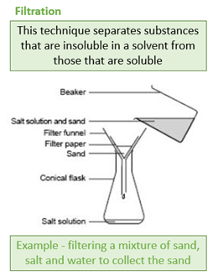
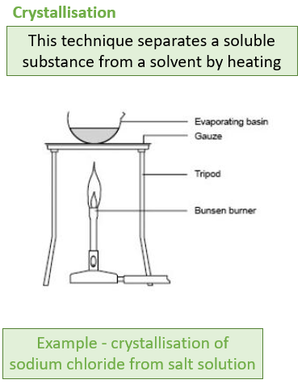
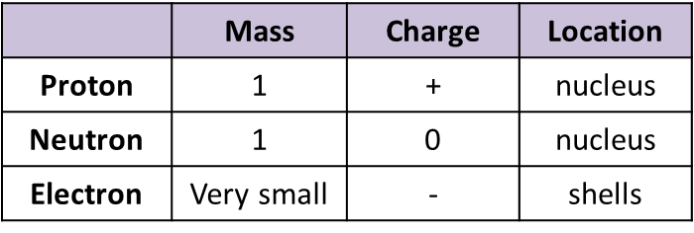
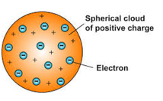
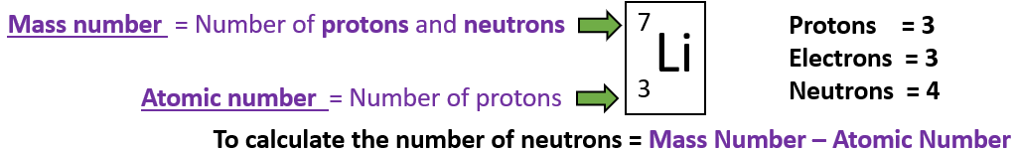
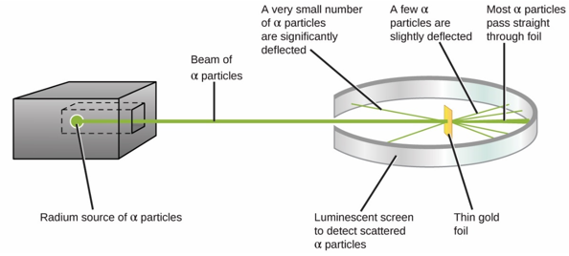
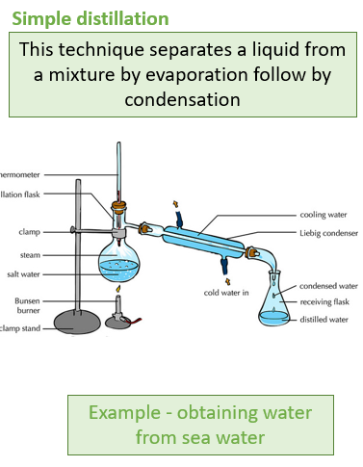
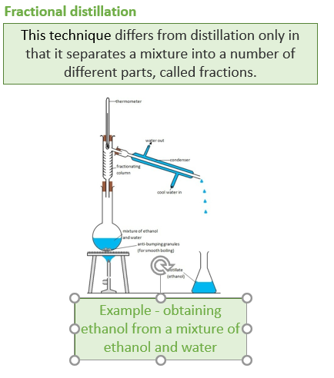
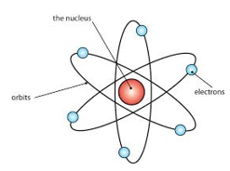
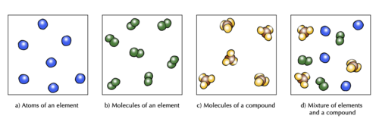
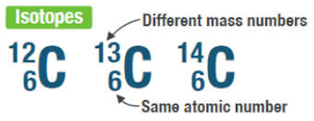
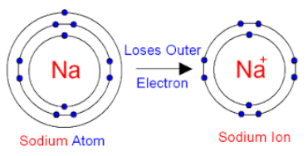
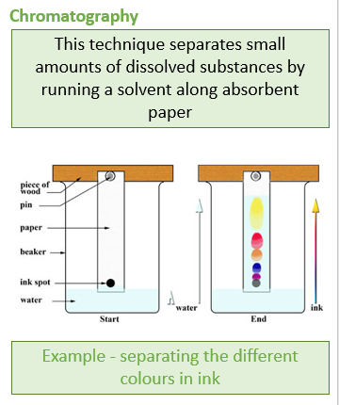
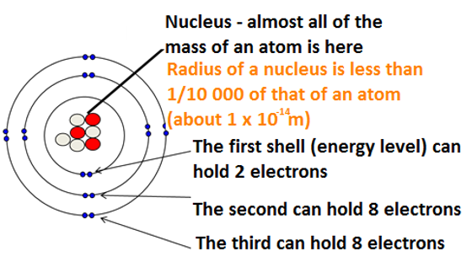
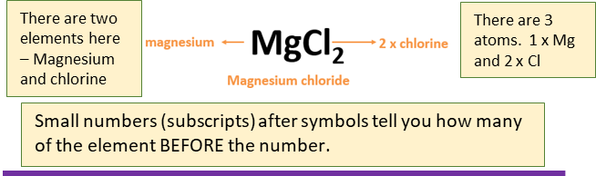
C1 - Atomic Structure
1.2 Separating mixtures
1.3 Development of Atomic Model
1.1 Atoms, elements and compounds
A mixture consists of two or more elements or compounds not chemically combined together.
Dalton – atoms can’t be divided
1.4 &1.5 Subatomic Particles
All substances are made of atoms that cannot be chemically broken down. It is the smallest part of an element.
Elements are made of only one type of atom. Each element has its own symbol.
e.g. Na is sodium.
JJ Thompson discovered electrons – Plum pudding model
+1
1/1840
-1
Compounds contain more than one type of atom.
Naming compounds-
Two elements = ide
e.g. Na₂S Sodium sulphide
Two or more including oxygen = ate
e.g. Na₂SO₄ = sodium sulphate
Number of protons(+) = Number of electrons (-)
Number of neutrons =
mass number – atomic number
Geiger-
Marsden The Nuclear Model of the Atom
Bohr – electrons in shells
Atoms lose or gain electrons to form ions
Chadwick – the neutron
Atomic radius
= 0.1nm
1nm = 1x10⁻⁹m

Slide 2
1. | Define a compound
2. | Define a mixture
3. | State the approximate radius of an atom
4. | Describe the current model of the atom
5. | What does the atomic number of an atom represent?
6. | What does the mass number of an atom represent?
7. | Describe the plum pudding model of the atom
8. | State the conclusions of the alpha scattering experiment
9. | How did Niels Bohr adapt the model of the atom?
10. | What did James Chadwick do to change the model of the atom?
11. | State the electrical charges of each subatomic particle
12. | State the relative mass of each subatomic particle
Atom | All substances are made of atoms! They are the smallest part of an element that can exist (about 0.1 nm in size)
Element | A substance made of only one type of atom. Atoms of each element have a chemical symbol, eg O is oxygen.
Electron | negatively charged subatomic particle found in shells around the nucleus of an atom.
Element | A substance containing only one type of atom. Cannot be broken down into anything simpler by chemical methods
Energy level (shell) | the region an electron occupies surrounding the nucleus inside an atom
compound | contain two or more elements chemically combined in fixed proportions and can be represented by formulae using the symbols of the atoms from which they were formed.
mixture | consists of two or more elements or compounds not chemically combined together.
Atomic no. | Number of protons in an atom. Atoms of the same element have the same number of protons.
Mass no. | The sum of protons and neutrons in an atom
Isotopes | Atoms of the same element with a different number of neutrons.
Relative atomic mass | The average mass of an atom of an element, taking into account the % of each isotope.

