Slide 1
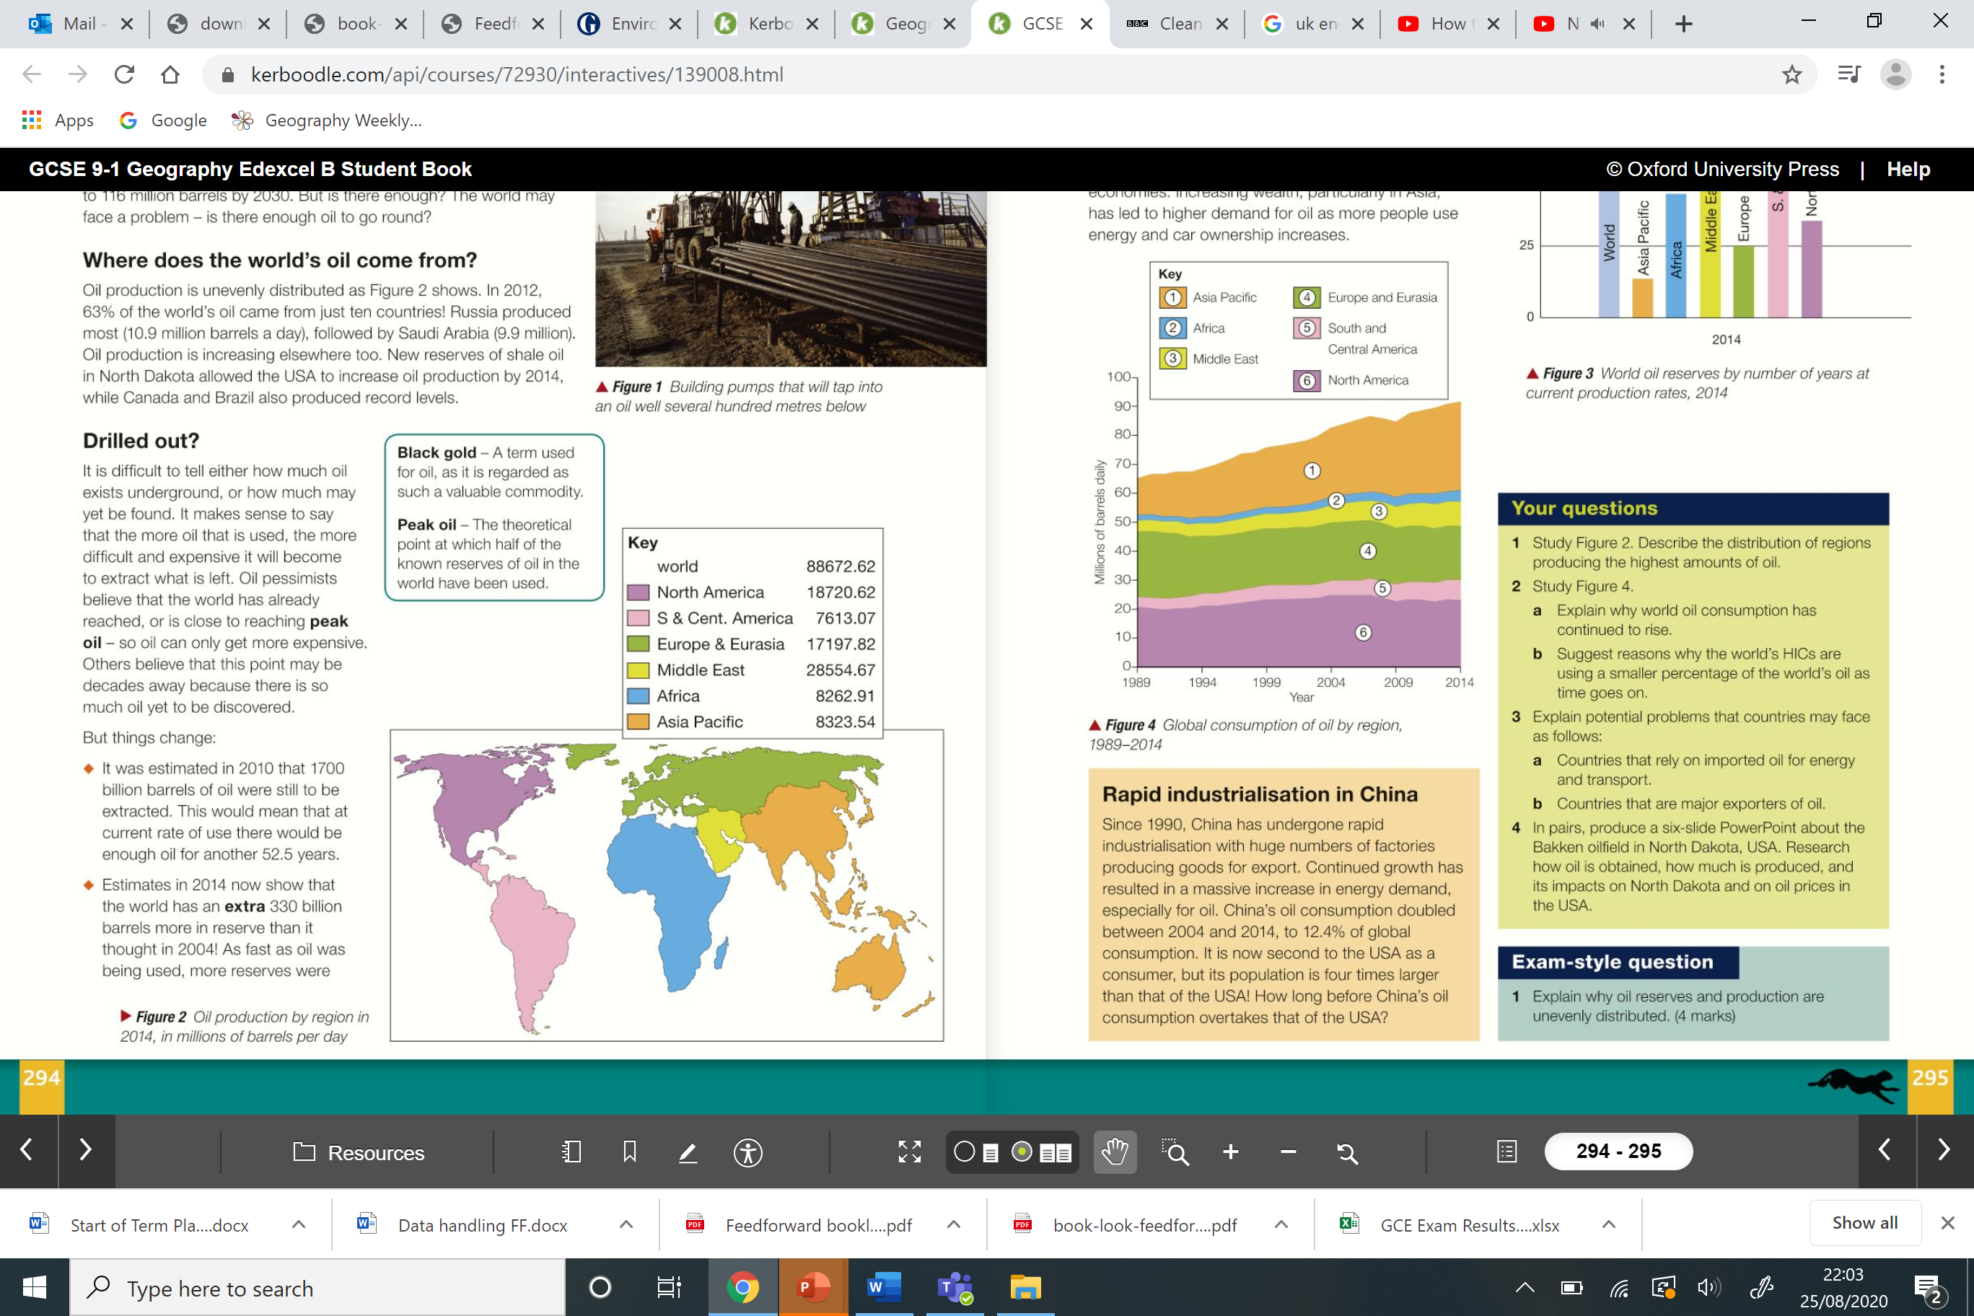
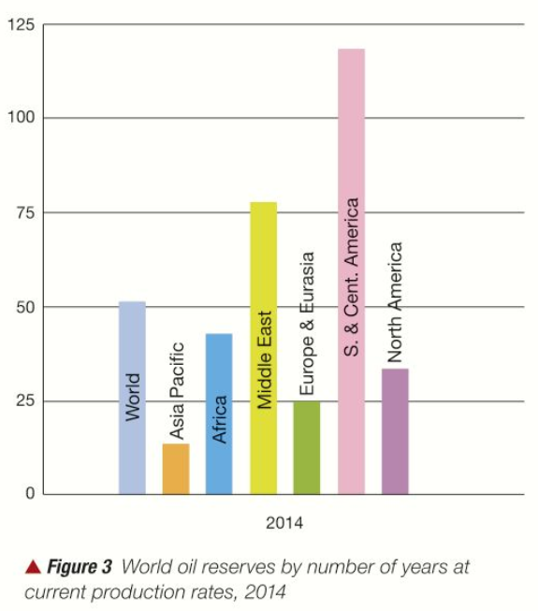
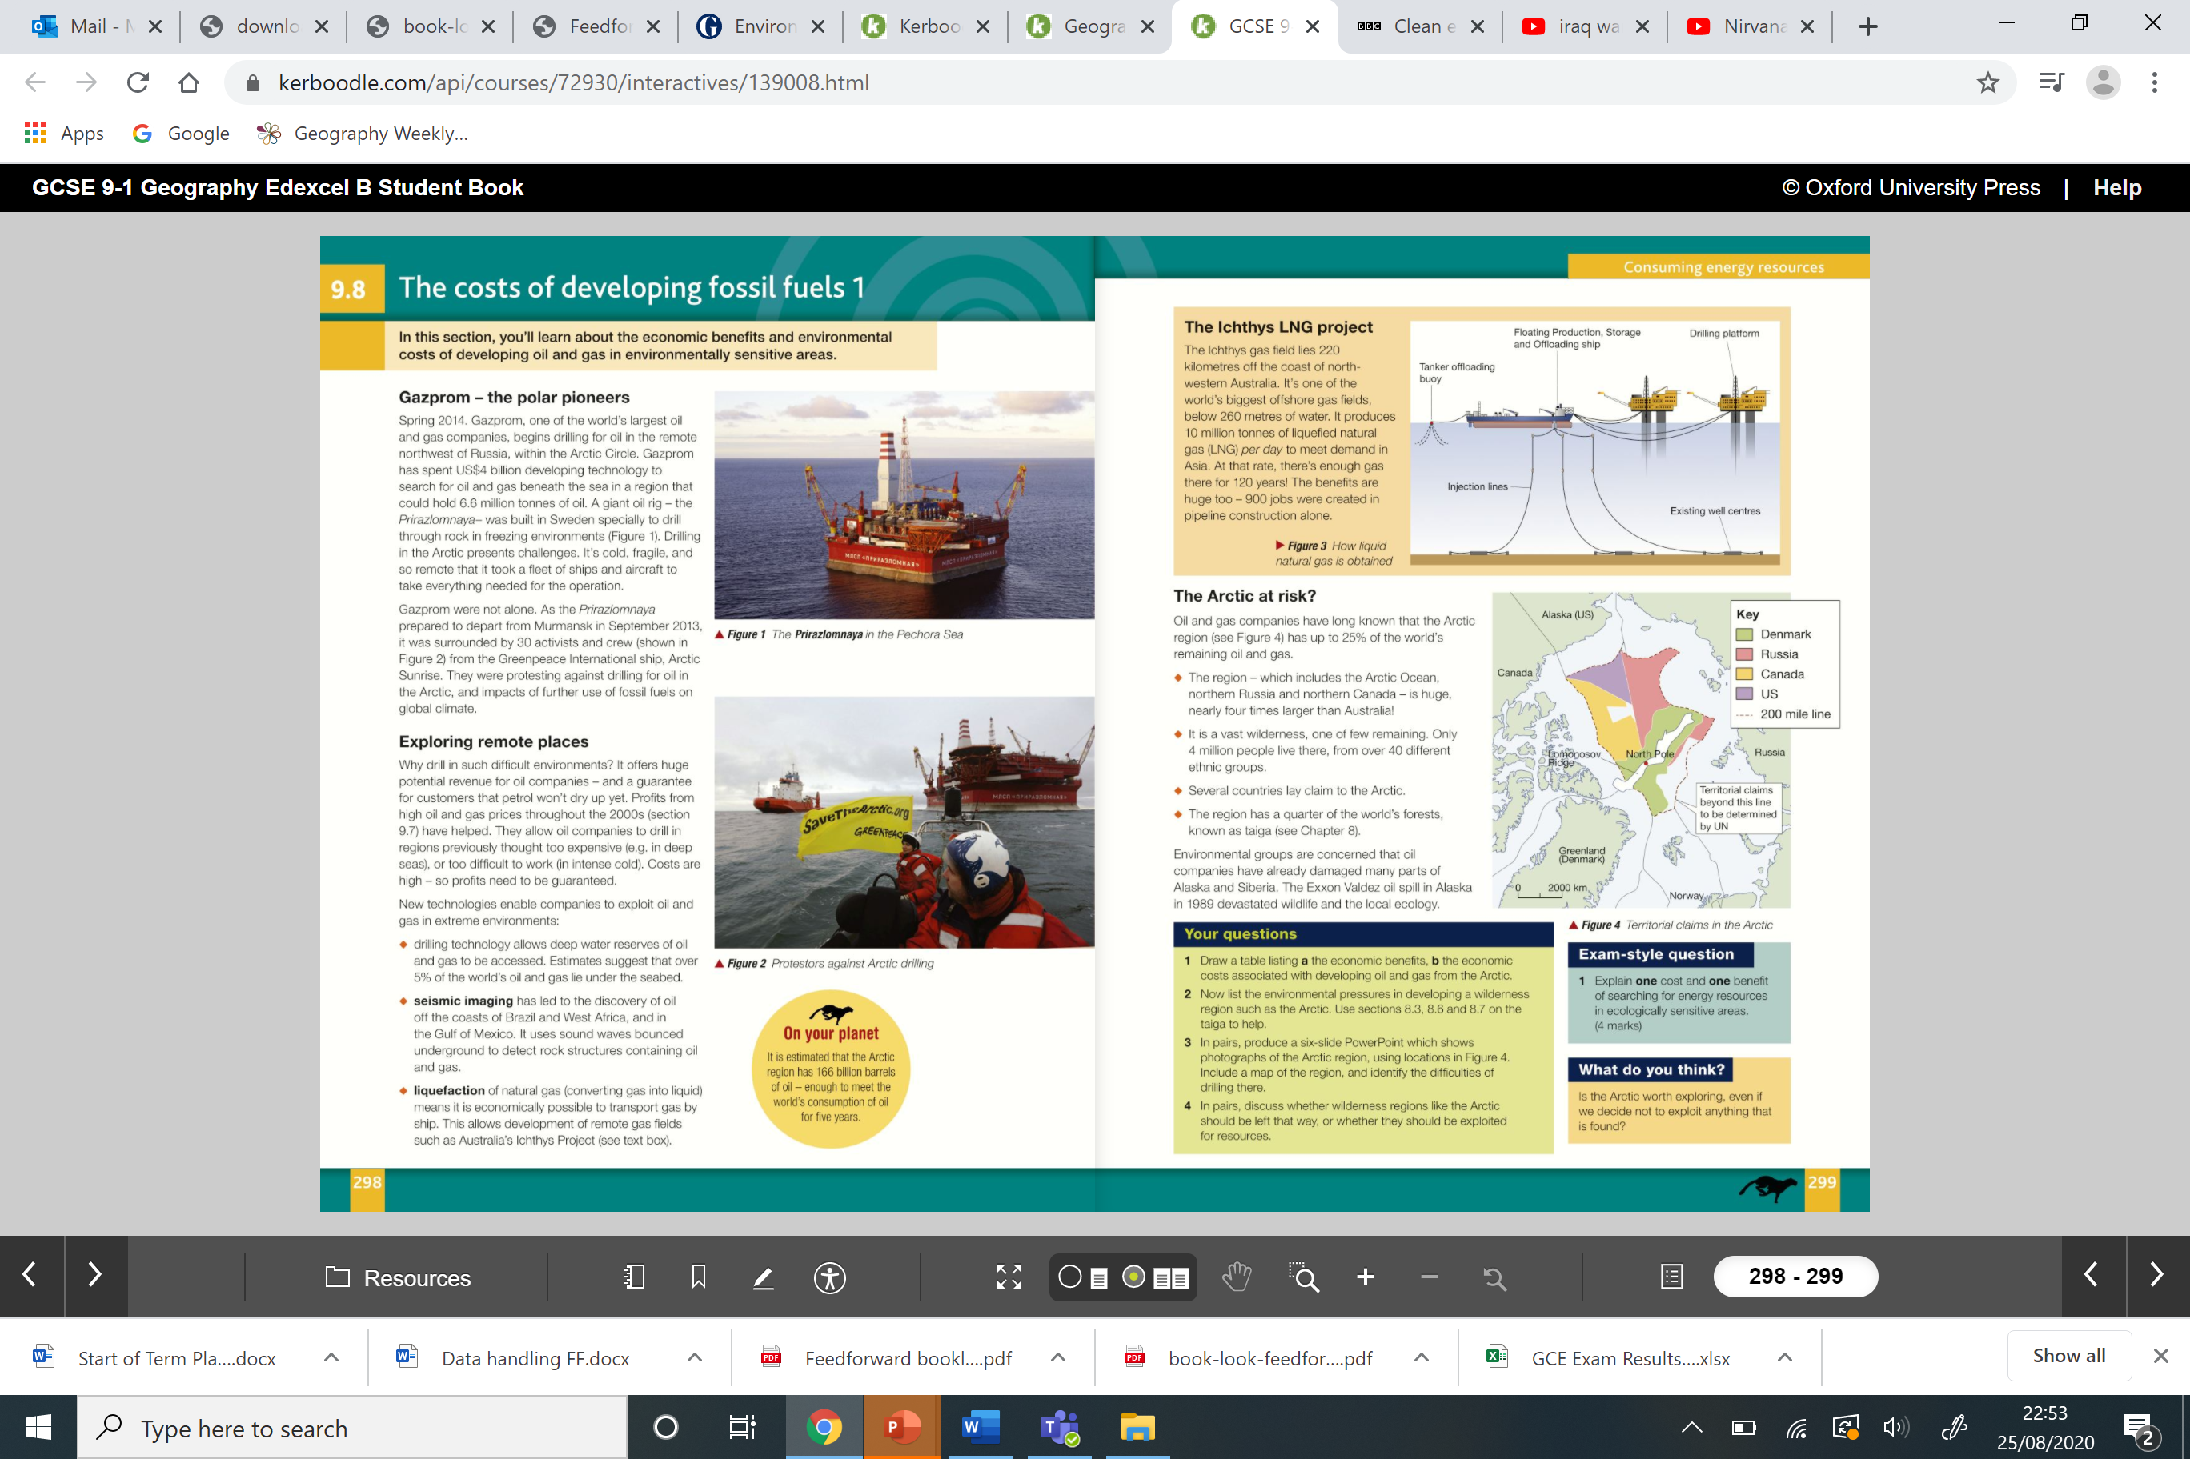
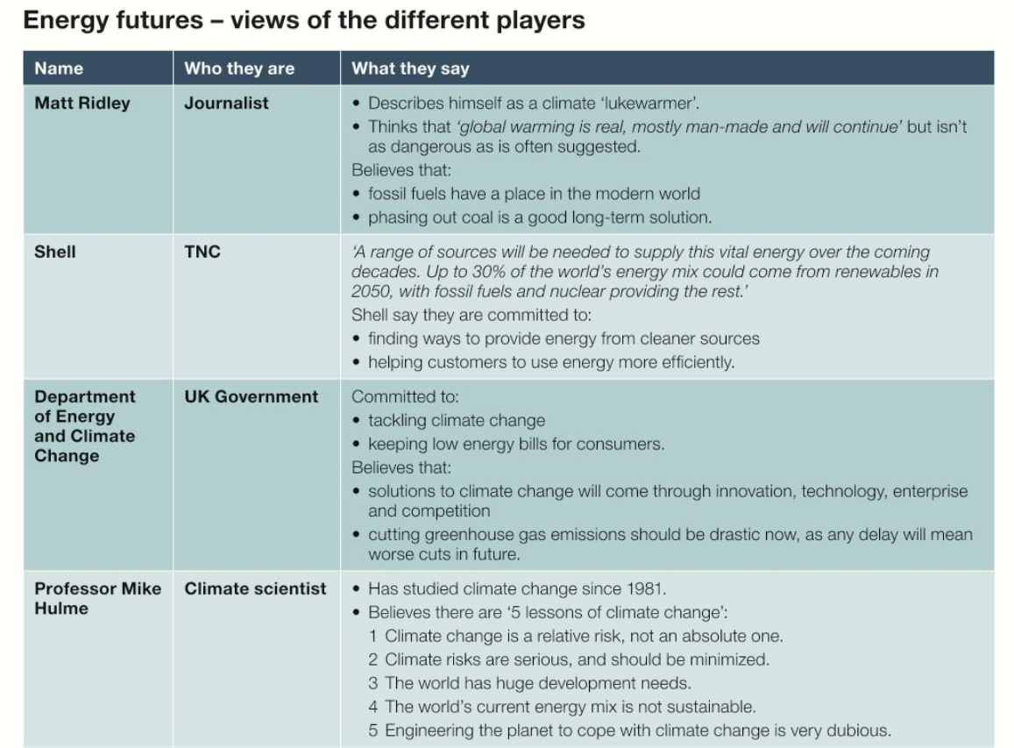
Energy Issues A3 Knowledge Organiser
Box 3: How much oil is there?
Explain 2 reasons for changes in supply and demand of oil.
What is the future for new or unconventional fossil fuels?
Box 1: Energy issues in the C21st
Explain 2+ costs and benefits of chosen non-renewable energy sources.
Coal. Carbon-based liquid formed from fossilised animals. Lakes of oil are found between seams of rock in the earth.
Oil is a ready-made fuel which is cheap to extract and convert into energy. It is used in industry and transport.
When burned, oil gives off atmospheric pollutants, including greenhouse gases. There is a limited supply of oil.
Explain 2+ costs and benefits of chosen renewable energy sources.
Wind turbines (modern windmills) turn wind energy into electricity.
Can be found singularly, but usually many together in wind farms. Wind is a potentially infinite energy supply.
Manufacture and implementation of wind farms can be costly. Some local people object to on-shore wind farms, arguing that it spoils the countryside.
Explain one major energy issue in the C21st.
Energy consumption is increasing – more GHG emission – global warming, Finite fossil fuels/ non-renewables, Coal is cheap and easily accessed. There is a lot in China and India so they keep using it, Renewable energy is becoming cheaper, easier to access and more popular. E.g wind, HEP. Convenience of fossil fuels, Fracking causes earthquakes and water pollution, Rise of Asia – increasing affluence, Oil wars eg. Oil Crisis 1970s.
Box 4: What are the costs of new or unconventional sources of fossil fuels
(Social, Economic and Environmental costs)
Source one:
SEE costs:
Source two:
SEE costs:
Overall, what do you think about unconventional sources of fossil fuels and why?
Box 2: Energy resource in the UK.
State what energy resources are used currently in the UK (from coal, oil, gas, biomass, solar, wind, wave, nuclear etc).
The UK government wants to reduce its carbon dioxide emissions. It also wants to increase the amount of energy which comes from renewable sources.
By 2020 European Union targets state that 20% of energy must come from renewable sources. Each member state of the EU may have a different target, as 20% is an average figure for the EU.
The UK has a target of 15% of its energy consumption being sourced from renewable energy. (In 2009 only 3% of energy came from renewable sources in the UK). Sweden has a target of nearly 50% whereas Malta has a target of 10%.
The EU also aims to reduce greenhouse gas emissions by 80-95% below 1990 levels by 2050.
There are two ways the energy use can change in the UK:
Reducing the demand for energy
Increasing the supply of renewable energy
What energy mix do you think the UK will move to in the future of the C21st?
Box 5: The future for energy.
Which energy scenario do
think is most likely and why?
Energy Key terms: What words or terms are important? (renewable, non-renewable, fossil fuels, sustainable, OPEC, energy mix, unconventional fossil fuels, tar sands, fracking, deep-water drilling…)
Fossil fuel, Renewable, Non-renewable, Tidal power, Unconventional fossil fuel, TNC, Raw materials, Exploit, Turning point, Business as usual.
STAR: Research answers for 2 of your own simple or complex enquiry questions and record on the back of sheet.

