Slide 1

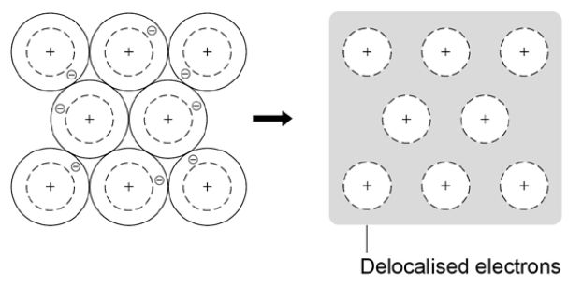
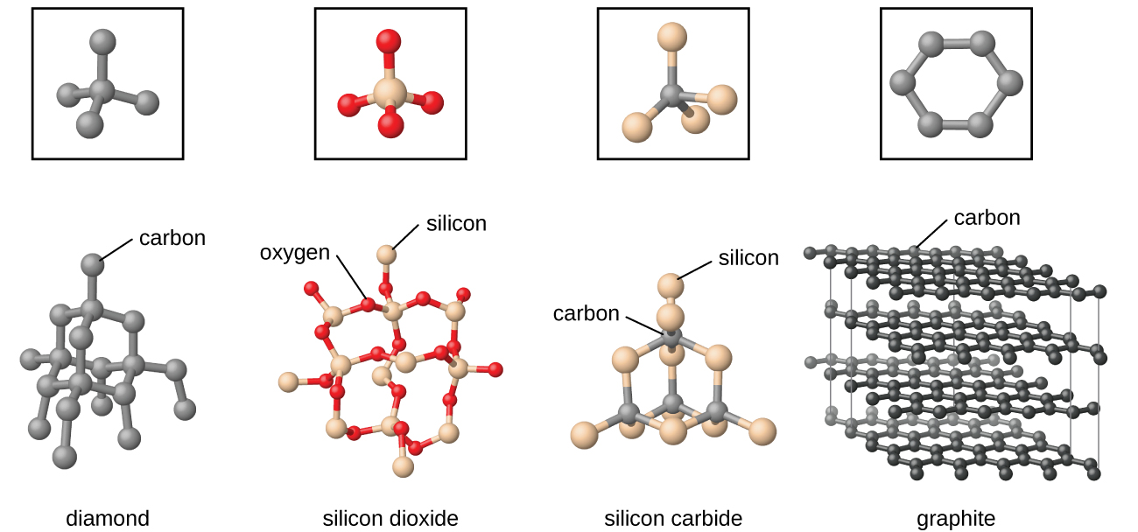
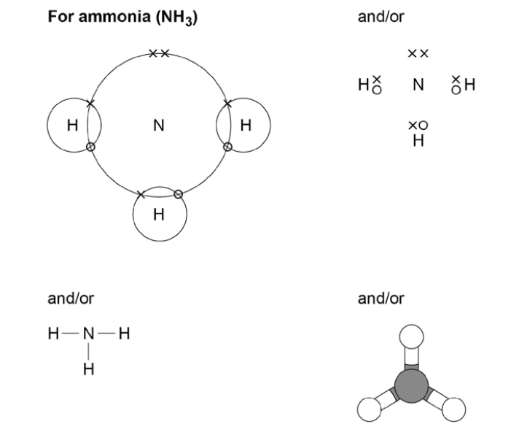
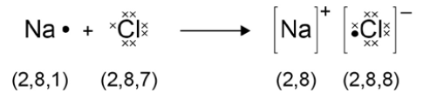
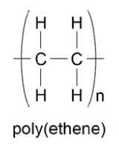
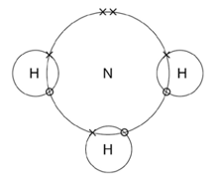

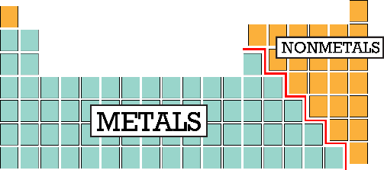
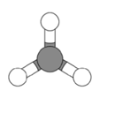
C2.1 Structure and Bonding
1.4 Covalent Bonding
Two non-metals will SHARE pairs of electrons
STRONG bond formed.
1.5 Metallic bonding
1.2 Ionic bonding
Metals LOSE ELECTRONS to form POSITIVE IONS
Metals LOSE ELECTRONS to form POSITIVE IONS
Non-metals GAIN ELECTRONS to form NEGATIVE IONS
Small molecules
A small group of atoms sharing electrons
Giant Structures
Many atoms sharing electrons
Electrons are transferred from metal to non-metal
GIANT structures of atoms in a REGULAR pattern
Ions have electronic structure of a noble gas
polymers
Delocalised electrons are free to move.
What is an ionic bond?
STRONG electrostatic force of attraction between oppositely charged ions
What is a metallic bond?
Sharing delocalised electrons – STRONG metallic bonds.
What is a covalent bond? The attraction of positive nuclei to the shared pair of electrons
How do we quickly work out the charges on ions?
Limitations of these models
Model | Limitations
Dot and cross | Looks like electrons aren’t identical Electrons look like they are in fixed positions
Displayed formula | Doesn’t show true shape of the molecule
Ball and stick | Can attempt to show 3D shape but doesn’t show electrons. Sticks don’t exist in actual structure
Which type of bonding is it?
Group | Electrons in outer shell | Charge on ion
1 | 1 | 1+
2 | 2 | 2+
6 | 6 | 2-
7 | 7 | 1-
M:M
Metallic
NM:NM
Covalent
M:NM
Ionic

Slide 2
1. | Describe covalent bonding
2. | Draw a diagram of a covalently bonded molecule
3. | Describe ionic bonding
4. | Draw a diagram of the ionic bonding of sodium and chlorine
5. | Draw a diagram of the metallic bonding
6. | Describe metallic bonding
7. | Why is graphite brittle?
8. | Name three models that can be used to show bonding?
9. | Name the two types of covalent structures?
10. | What charged ions would an element in group 2 and one in group7 make?
Stretch and Challenge
Watch the video at https://www.youtube.com/watch?v=PKA4CZwbZWU . How do we predict whether a compound will be ionic or covalent?
Follow this link to more videos and questions
AQA GCSE Chemistry Topic 2: Bonding, Structure, and The Properties of Matter Revision - PMT (physicsandmathstutor.com)
Ion | a positive or negative charged particle formed when an atom loses or gains electrons
Electrostatic attraction | attraction between positively and negatively charged particles
Ionic Bond | electrostatic force of attraction between positively and negatively charged ions
Covalent Bond | the strong attraction between two non-metal atoms that share one or more pairs of electrons
Delocalised Electrons | electrons from an element’s outer shell that is free to move through a structure
Metallic bond | strong attraction between the nucleus of a metal atoms and delocalised electrons occurring in metal elements and alloys
Polymer | a very large molecules made up of many repeating units, with atoms linked by strong covalent bonds
Molecule | particle made from atoms, joined together by covalent bonds
Giant Covalent Structure | covalently bonded structure where many atoms are joined together by many strong covalent bonds e.g. diamond or silicon dioxide

