Slide 1

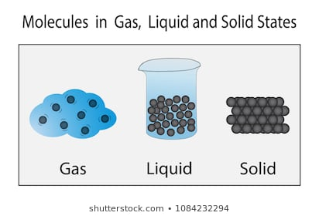
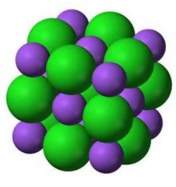
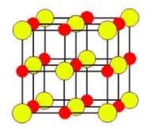
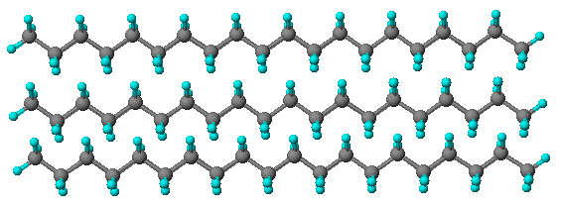
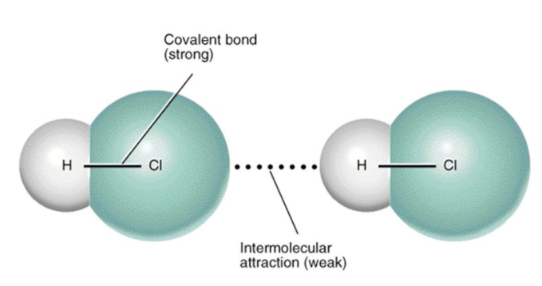
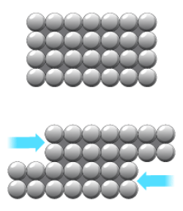
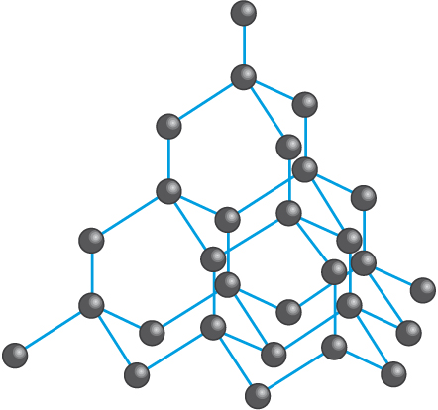
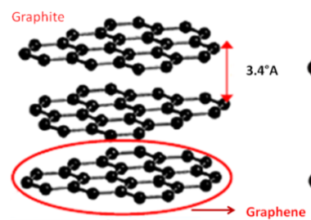
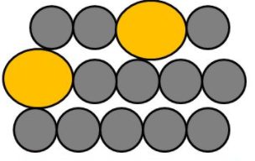
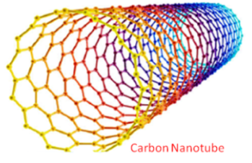
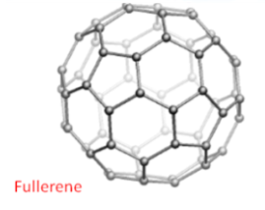
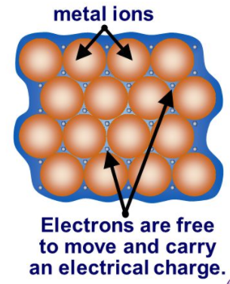
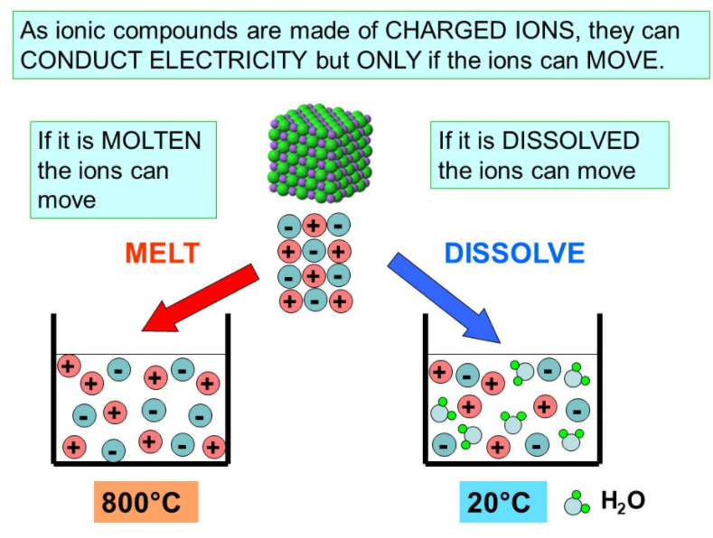
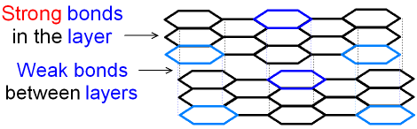
C2.2 Structure and Bonding
2.1 States of Matter
Properties of Covalent substances
Solid – (s)
Liquid – (l)
Gas – (g)
Aqueous (aq)
2.3 Properties of Ionic Substances
2.7 Properties of Metallic Substances
2.4 Small molecules
Metals have high melting and boiling points
because…
Ionic compounds have high melting and boiling points because…
2.6 Giant Structures
Small molecules have relatively low melting and boiling points
because…
…they are giant structures of atoms with strong metallic bonding
Polymers are solids at room temperature
because…
Giant covalent compounds have high melting and boiling points
because…
Can be bent or shaped
because…
…intermolecular forces increase with the size of the molecules and polymer molecules are very large.
…all of the atoms linked by strong covalent bonds.
…atoms are arranged in LAYERS which can SLIDE over each other
…they are giant structures of atoms (giant ionic lattice) with strong electrostatic forces of attraction in ALL DIRECTIONS between oppositely charged ions.
A large amount of energy is needed to break the many strong bonds.
…intermolecular forces are overcome on melting and boiling and these are weak forces.
Diamond is very hard, has a very high melting and boiling point and doesn’t conduct electricity
because…
Graphene is strong, light and an excellent conductor of thermal energy and electricity.
because…
Alloys are harder than pure metals
because…
The bigger the size of the molecule the higher the melting and boiling point
because…
…each carbon is bonded to 4 other carbons by strong covalent bonds. There are no free electrons.
Alloys are a mixture of two or more elements, at least one of which is a metal
Only conduct electricity when melted or dissolved in water
because…
…it is a single layer of graphite so has free electrons.
…intermolecular forces increase with the size of the molecules.
…the layers are DISTORTED so can’t slide over each other
…the ions are free to move and so charge can flow.
Graphite is very hard, has a very high melting and boiling point and does conduct electricity
because…
Fullerenes (e.g. carbon nanotubes) are extremely strong and are excellent conductors of thermal energy and electricity
because…
Don’t conduct electricity
because…
Metals are good conductors of electricity and thermal energy
Because…
…the molecules have no overall electric charge.
…each carbon is bonded to 3 other carbons by strong covalent bonds. It forms layers of hexagonal rings with no covalent bonds between layers. There are free electrons.
… they have strong covalent bonds and free electrons.
…the electrons are free to move and carry thermal energy and charge

Slide 2
1. | If the size of a small covalent molecule increases, what effect does this have on the boiling points
2. | Explain why ionic compounds have high melting and boiling points
3. | Explain why ionic compounds can conduct electricity when melted or dissolved in water
4. | What form do ionic compounds take?
5. | How many covalent bonds are their between atoms in diamond and graphite
6. | Why is diamond hard and has very high melting and boiling points?
7. | Name three
8. | Why are pure metals soft?
9. | Why are alloys harder than pure metals?
10. | Why are metals good conductors?
11. | Why do small molecules have low melting and boiling points?
Stretch and Challenge
Watch the video at https://www.youtube.com/watch?v=YpEQ-NWxKBc . Make a table summarising the different properties of each of the 4 structure types.
Follow this link to more notes and questions
AQA GCSE Chemistry Topic 2: Bonding, Structure, and The Properties of Matter Revision - PMT (physicsandmathstutor.com)
Fullerene | a form of the element carbon that can exist as cage-like or tubular structures based on hexagonal rings of carbon atoms
Delocalised Electron | bonding electron that is no longer associated with any one particular atom
Giant Covalent Structure | a huge 3D network of covalently bonded atoms
intermolecular forces | the attraction between the individual molecules in a covalently bonded substance
Diamond | a form of the element carbon where each carbon atom is covalently bonded to 4 others
Graphite | a form of the element carbon where each carbon atom is covalently bonded to 3 others
Graphene | a form of the element carbon where each atom is covalently bonded to 3 others AND is only one atom thick
Ionic lattice | a giant 3D structure of alternating positive and negative ions, held together by strong electrostatic attraction

