Slide 1

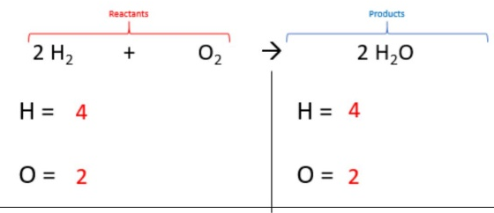
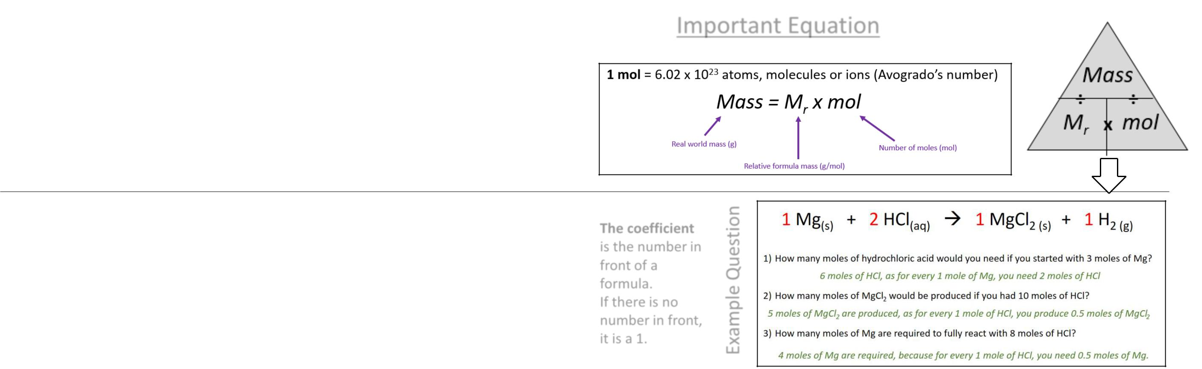
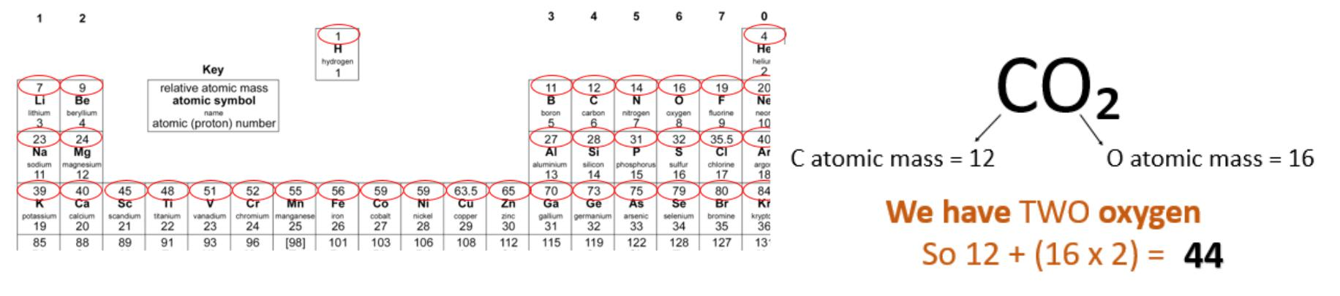
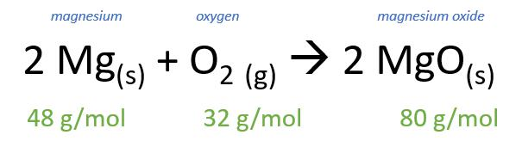
C3 - Quantitative Chemistry – Part 1
1.1 Conservation of Mass
Balancing Equations: same number of atoms on both sides
HIGHER ONLY
The law of conservation of mass states that no atoms are lost or made during a chemical reaction so the mass of the products equals the mass of the reactants
2.1 Moles
Chemical amounts are measured in moles (mol).
The sum of reactants = The sum of products
One mole of a substance contains the same number of the stated particles, atoms, molecules or ions as one mole of any other substance.
1.2 Relative Formula Mass
The number of atoms, molecules or ions in a mole of a given substance is the Avogadro constant. The value of the Avogadro constant is 6.02 x 10²³ per mole.
The relative formula mass (M_{r}) of a
compound is the sum of the relative
atomic masses of the atoms in the
numbers shown in the formula
Use the relative atomic mass from the periodic table (top number).
1.3 Mass changes
Some reactions may appear to involve a change in mass but this can usually be explained because a reactant or product is a gas and its mass has not been taken into account.

Slide 2
1. | State the law of conservation of mass
2. | Define relative formula mass (RFM)
3. | If mass appears to be loss or gained in a reaction, what is the most likely cause?
4. | How do you calculate relative formula mass?
5. | HT ONLY – What is a mole?
6. | HT ONLY – What is the Avogadro constant?
7. | HT ONLY – How is the mass number linked to the number of moles?
8. | HT ONLY – How many moles of carbon dioxide are in 66g?
9. | What is the RFM of water, H₂O?
Stretch and Challenge
Watch the video at https://www.youtube.com/watch?v=74-X94OP2XI . How many atoms will there be in 4.4kg of carbon dioxide?
Follow this link to more notes and questions
AQA GCSE Chemistry Topic 3: Quantitative Chemistry Revision - PMT (physicsandmathstutor.com)
Avogadro constant | the number of atoms, molecules, or ions in a mole of any substance (i.e., 6.02 × 10⁻²³ per mol)
Mole | the amount of substance in the relative atomic or formula mass of a substance in gram The symbol for the unit mole is mol
Concentration | the amount of a substance dissolved in a given volume of liquid
Limiting reactant | the reactant in a chemical reaction that when used up causes the reaction to stop
Relative formula mass RFM | the total of the relative atomic masses, added up in the ratio shown in the chemical formula, of a substance
Relative atomic mass A_{r} | the average mass of the atoms of an element compared with carbon-12 (which is given a mass of exactly 12). (Found on the periodic table)

