Slide 1

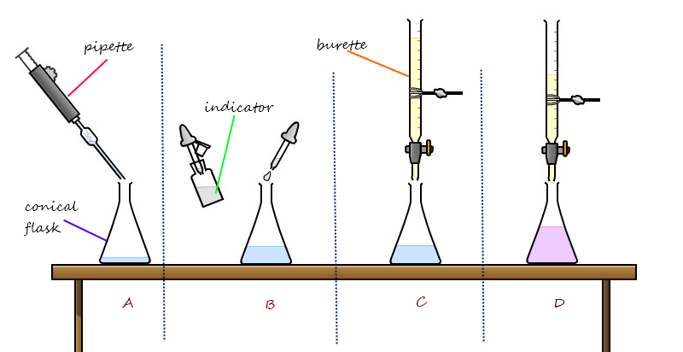
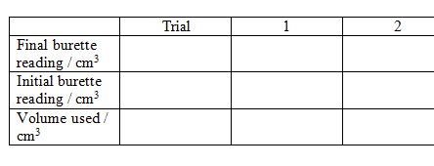
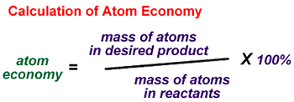

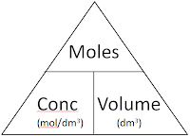
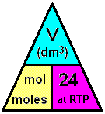
C3 - Quantitative Chemistry – Part 3 – TRIPLE only
3.1&3.2 Percentage Yield & Atom Economy
Titrations (Required Practical)
Percentage Yield
Atom Economy
The volumes of acid and alkali solutions that react with each other can be measured by titration using a suitable indicator.
The amount of product made is called the “yield”.
Usually we do not make as much product in a chemical reaction as our reacting mass calculations suggest
Measures how much of the starting materials (reactants) become USEFUL products
Burette measures a variable volume
All volumes to 2 dp
Add a few drops of indicator
High atom economy is important for sustainable development and economic reasons
Because:
DROPWISE near endpoint
Reaction is not complete
Product is lost
Different reactions happen
Pipette measures a set volume
Endpoint when 1 drop changes the colour
5.1 Volumes of Gases
4.1 Titration calculations
1 mole of ANY gas at room temperature (and pressure will take up a volume of 24dm³
Example:
2NaOH(aq) + H₂SO₄ (aq)→ Na₂S0₄ (aq) + 2H₂O(l)
It takes 12.20cm³ of sulfuric acid to neutralise 24.00cm³ of sodium hydroxide solution, which has a concentration of 0.50mol/dm³ . Calculate the concentration of the sulfuric acid in mol/dm³
Conc = moles
volume
 | 2NaOH | + | H₂SO₄ | → | Na₂S0₄ | + | 2H₂O
Ratio | 2 | : | 1
Con | 0.50 |  | Ans = 0.49
Vol | 24.00/1000 |  | 12.20/1000
Mol | 0.012 | ÷2 | 0.006
Volume = moles
conc
The MOLAR volume
Concentration of acid:
0.006 mol x (1000/12.2) dm³ =0.49mol/dm3
Moles = conc X volume
0.5 mol/dm3 x (24/1000) dm³ = 0.012 mol of NaOH
Ratio is 2:1 so DIVIDE moles of NaOH by 2

Slide 2
1. | Give the mathematical formula for calculating the percentage yield of a reaction.
2. | Give 3 reasons why it is very rare to achieve 100% yield.
3. | If 25g of a substance are made and the theoretical yield was 75g, what was the percentage yield?
4. | In a reaction where there is only one product, what is the atom economy? Explain why.
5. | In 6 bullet points describe how to carry out a titration.
6. | How many moles of methane gas are there in a volume of 48dm³
7. | What is the mathematical formula for calculating the concentration of a substance in mol/dm³
8. | What is the mathematical formula for calculating the volume of a substance in dm³
9. | How do you convert cm³ to dm³
Stretch and Challenge
Watch the video at https://www.youtube.com/watch?v=8B_9nVR2Xlw . Work out the atom economy for producing copper sulfate from copper oxide, and from copper carbonate. Why is the atom economy lower for the second reaction?
Follow this link to more notes and questions
AQA GCSE Chemistry Topic 3: Quantitative Chemistry Revision - PMT (physicsandmathstutor.com)
Avogadro constant | the number of atoms, molecules, or ions in a mole of any substance (i.e., 6.02 × 10⁻²³ per mol)
Mole | the amount of substance in the relative atomic or formula mass of a substance in gram The symbol for the unit mole is mol
Concentration | the amount of a substance dissolved in a given volume of liquid
Titration | A process used to accurately calculate the volume of one substance needed to fully react with another.
Titre | The volume added from the burette in a titration
Burette | Used to accurately measure variable volumes of liquids
Pipette | Used to measure a set volume o a liquid
Indicator | Changes colour with one drop of reactant when the reaction is at it’s endpoint
End point | The point at which an acid has exactly neutralised and alkali and NEITHER is in excess.
Molar volume | The volume that 1 mole of any gas occupies at room temperature and pressure = 24dm

