Slide 1

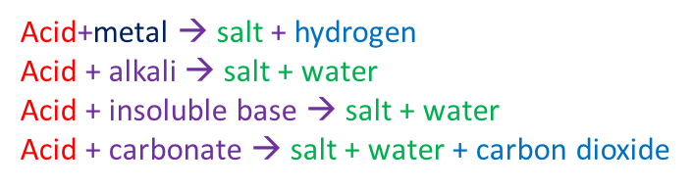
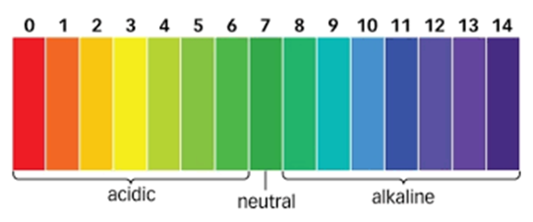
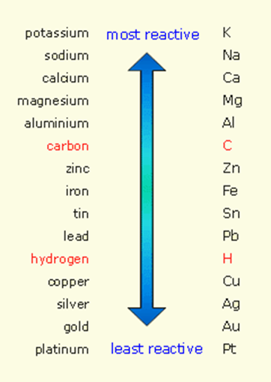
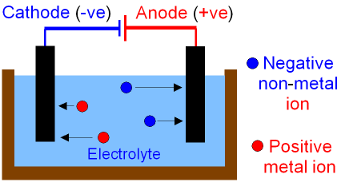
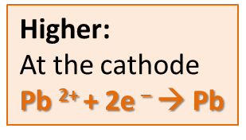
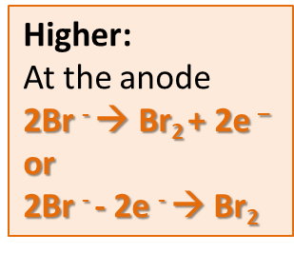
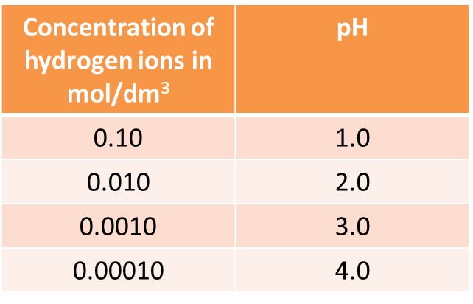
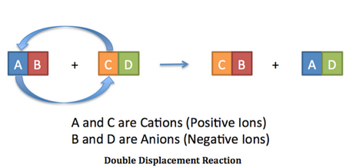
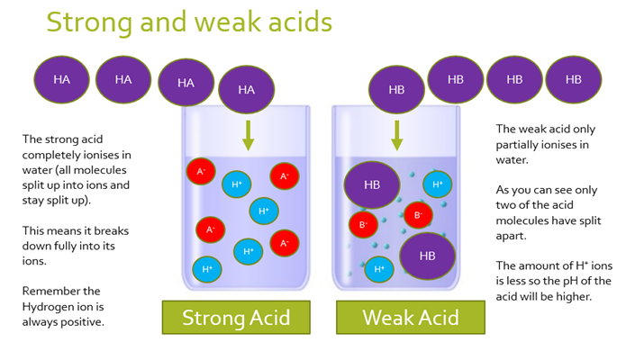
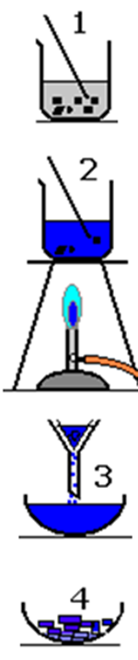
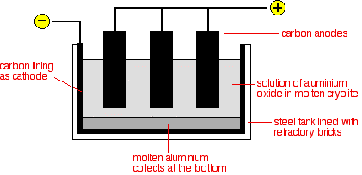
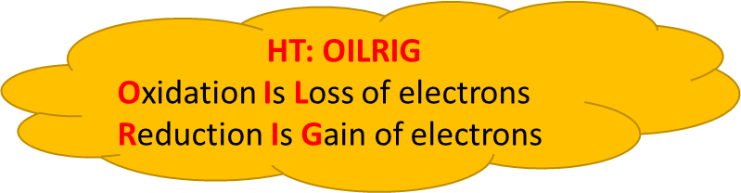
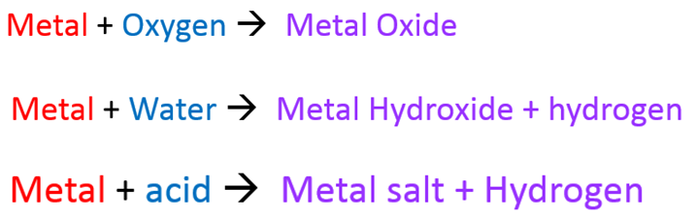
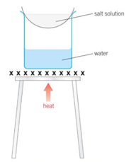
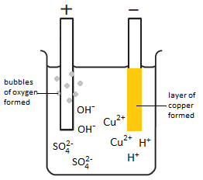
C4 Chemical Changes part 1
2.1-2.3 Reactions of acids
2.4 Neutralisation
1.1 Displacement reactions and metal extraction
3.1 Electrolysis
..of molten:
HT: OILRIG
e.g. 2HCl + Mg → MgCl₂ +H₂
Magnesium is oxidised
Mg → Mg²⁺ +2e⁻
Acids produce H⁺ ions
Alkalis produce OH⁻ ions
H⁺_{(aq)} + OH⁻_{(aq)} → H₂O_{(l)}
Hydrochloric Acid → Chlorides
HCl
Nitric Acid → Nitrates
HNO₃
Sulphuric Acid → Sulphates
H₂SO₄
HIGHER ONLY
HIGHER ONLY
HT: Strong and Weak acids
Reactivity depends on tendency to form metal ion
RP: Preparation of a dry sample of a soluble salt
..to extract aluminium:
A more reactive metal will DISPLACE a less reactive metal
Oxygen goes to anode → Carbon electrode reacts with it → CO₂ (needs replacing)
Choose correct acid
Add base to excess
warm
Cyolite reduces the melting point
Evaporate off water
..of solutions:
Unreactive metals can be found in the Earth as themselves (eg Gold)
At the anode:
Halide (Gp7)
Oxygen
At the cathode:
Least reactive
Carbon Reduction: Extracting metals less reactive than carbon –
Oxygen is taken away = reduction
Filter off excess

Slide 2
1. | What is produced when metals react with oxygen? Give an example
2. | What happens to a metal when it reacts with different substances?
3. | How are unreactive metals found?
4. | How are metals less reactive than carbon extracted?
5. | How are metals more reactive than carbon extracted?
6. | What are oxidation and reduction reactions?
7. | Describe electrolysis
8. | Which ion moves to which electrode in electrolysis?
9. | Draw an labelled diagram of the set up needed for simple electrolysis
10 | What is produced when a metal reacts with an acid?
11 | What makes a chemical an acid?
12 | State the general equation for the reaction between an acid and an alkali
13 | Describe the steps to make a soluble salt
Stretch and Challenge
Watch the video at https://www.youtube.com/watch?v=dRtSjJCKkIo . Explain how hydrogen, chlorine and sodium hydroxide are produced by electrolysis of brine (sodium chloride solution). Why is it not possible to electrolyse pure water?
Follow this link to more notes and questions
AQA GCSE Chemistry Topic 4: Chemical Changes Revision - PMT (physicsandmathstutor.com)
Reactivity series | An arrangement of metals in order of reactivity
Displacement reaction | Reaction where a more reactive element takes the place of a less reactive element in a compound
Oxidation | A reaction in which a substance loses electrons (gains oxygen)
Reduction | Reaction in which a substance gains electrons (loses oxygen)
Ore | A rock from which a metal can be extracted for profit
Acid | Solution with a pH less than 7; produces H⁺ ions in water
Alkali | Solution with a pH more than 7; produces OH⁻ ions in water
Aqueous | Dissolved in water
Strong acid | Acid in which all the molecules break into ions in water
Weak acid | Acid in which only a small fraction of the molecules break into ions in water
Dilute | A solution in which there is a small amount of solute dissolved
Concentrated | A solution in which there is a lot of solute dissolved
Neutralisation | A reaction that uses up some or all of the H⁺ ions from an acid
Electrolysis | Decomposition of ionic compounds using electricity
Electrolyte | A liquid that conducts electricity
Discharge | Gain or lose electrons to become electrically neutral
Inert electrodes | Electrodes that allow electrolysis to take place but do not react themselves

