Slide 1

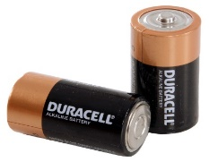
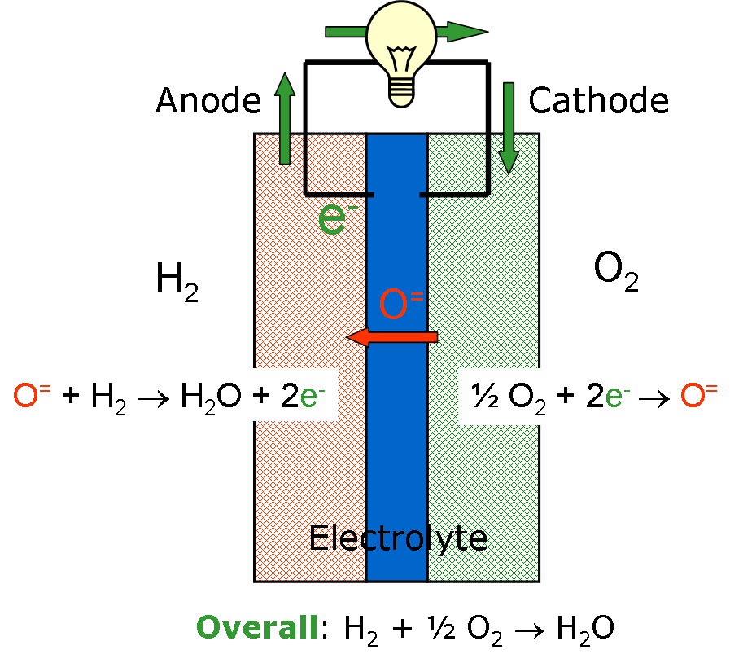
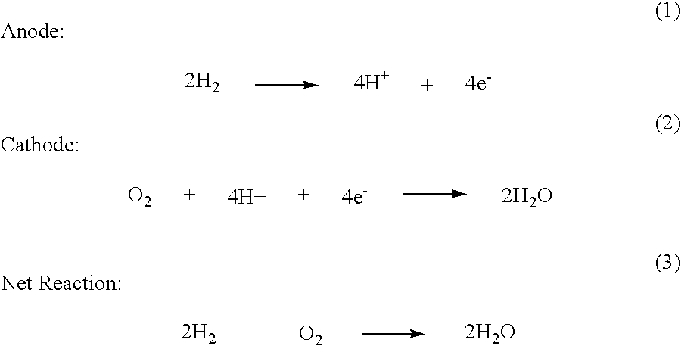
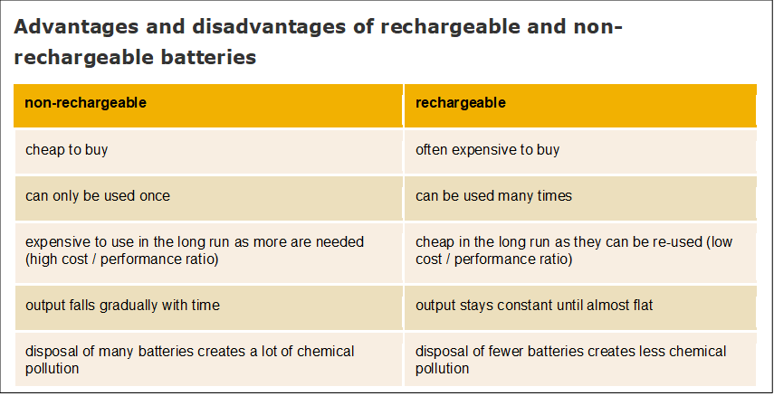
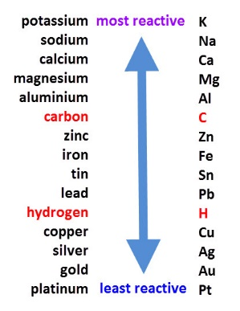
C5.2 Cells (Triple Only)
2.1 Cells and Batteries
2.2 Fuel Cells
Cells contain chemicals which react to produce electricity.
An efficient way of producing electricity.
Electrolyte - A solution or molten substance broken down during electrolysis
Supplied with external source of fuel and oxygen
Electrode - an electrical conductor used in a cell
Fuels is oxidised electrochemically to produce voltage (potential difference)
The voltage of a cell can be changed by changing the electrode or electrolyte
In a hydrogen fuel cell the overall reaction makes only water.
Batteries consist of two or more cells connected together in series to provide a greater voltage.
HIGHER ONLY
Potential alternative to rechargeable cells and batteries
Non-rechargeable cells and batteries –
Stops producing electricity as the chemical reactions stop when one of the reactants has been used up
Rechargeable Batteries –
The chemical reaction can be reversed using an external electrical current
Batteries can be reused
Alkaline Batteries are non rechargeable
The bigger the difference in reactivity of the metals used in the electrodes, the higher the voltage from the cell

Slide 2
Stretch and Challenge
1 | Explain the difference between a cell and a battery.
2 | What is meant by the terms electrode and electrolyte
3 | How can the reactivity series be related to the voltage obtained from a cell.
4 | What is meant by “rechargeable”?
5 | State 3 advantages and 3 disadvantages of rechargeable and non rechargeable batteries
6 | What is a fuel cell?
7 | What is the only waste product from a hydrogen fuel cell?
8 | Higher tier – Write an half equations for the reactions at each electrode in the hydrogen fuel cell.
9 | Write an overall balanced symbol equation for the chemical reaction that occurs in a hydrogen fuel cell
Watch the video at https://www.youtube.com/watch?v=fkX-H24Chfw . What are the potential advantages and drawbacks of using hydrogen as a fuel?
Follow this link to more notes and questions
AQA GCSE Chemistry Topic 5: Energy Changes Revision - PMT (physicsandmathstutor.com)
Cell | Contain chemicals that react to make electricity
Battery | Two or more cells placed in series to provide a greater voltage
Electrode | An electrical conductor used in a cell or in electrolysis
Rechargeable | Batteries or cells in which the chemical reaction can be reversed by applying an external electrical current
Reactivity Series | A list of metal elements in order of most reactive at the top and least reactive at the bottom. (Often including Hydrogen and Carbon aswell)
Fuel Cell | A cell in which a fuel reacts fully with oxygen to produce electricity. The overall reaction is the same as combustion, but no heat or flames are generated – only electricity.
Hydrogen Fuel Cell | A Fuel cell in which Hydrogen is used as the fuel. The only product therefore is water.
Electrolyte | A solution or molten substance broken down during electrolysis or used up in a cell

