Slide 1

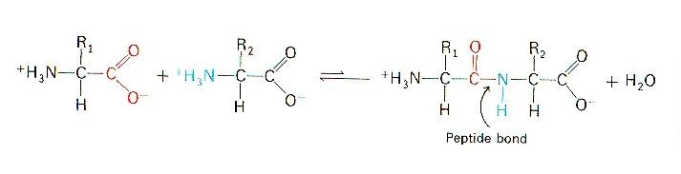

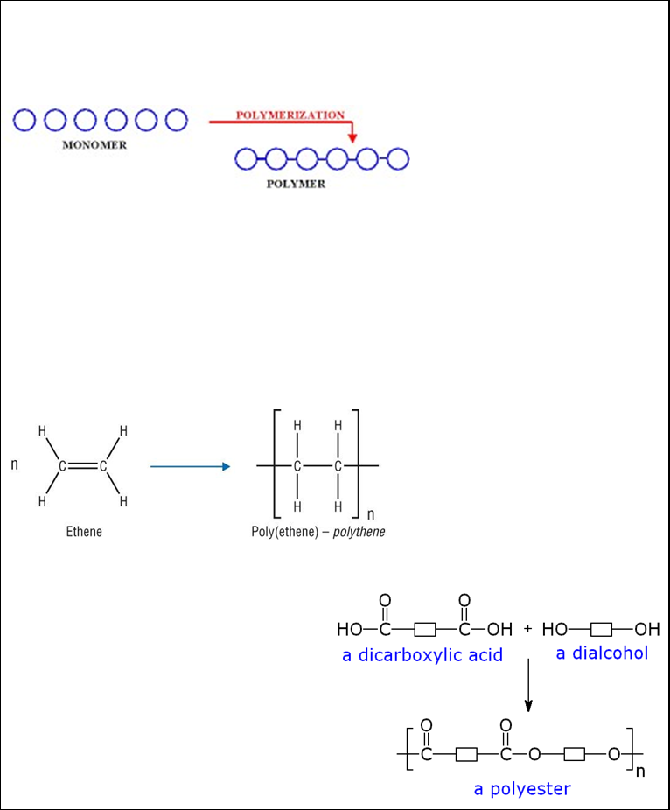
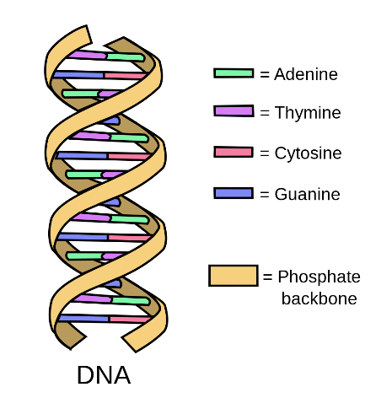
C7 part 3 – Organic Chemistry (Triple)
HIGHER ONLY
3.3 Amino Acids
Amino acids have two different functional groups in their structure.
3.1 Addition Polymerisation
An amine group
An acid group
A polymer is a long carbon chain which has been made from many very small molecules (monomer) joining together
3.2 Condensation Polymerisation
Amino acids react by condensation polymerisation to produce polypeptides.
-NH₂
-COOH
Alkenes can react together to form long chains with no other products being produced this is called addition polymerisation.
Condensation polymers are produced when two functional groups are involved in the reaction to produce a polymer
Polypeptides make proteins
Naming:
HIGHER ONLY
Monomer Polymer
Ethene Poly(ethane)
Propene poly(propene)
etc
3.4 DNA
Deoxyribonucleic acid
Large natural polymer
Usually another small molecule (water) is also made
Monomers are called “nucleotides”
Forms a Double Helix
Diols and dicarboxylic acids can react to produce polyesters:
Other Natural Polymers:
Identifying :
Protein, Starch and cellulose
In addition polymers the monomer has a DOUBLE BOND, but the polymer does not.
Glucose is the monomer in starch and cellulose

Slide 2
1 | What type of reactants can undergo addition polymerisation?
2 | Name the polymer made from Butene?
3 | What monomer would be used to make poly(propene)
4 | What two reactants can undergo condensation polymerisation to make polyesters?
5 | As well as a polymer, what is also made in condensation polymerisation?
6 | Higher Tier - What 2 functional groups do amino acids contain?
7 | Higher Tier - Amino acids react by condensation to make what?
8 | Higher Tier – What are the monomers called that make up DNA?
9 | What shape does DNA form?
10 | Name 3 other naturally occurring polymers?
Stretch and Challenge
Watch the video at https://www.youtube.com/watch?v=jFM-iMyvg4c about the nylon rope trick. What are the 2 monomers? Why is this nylon 6,10? Why is this a condensation reaction?
Follow this link to more notes and questions
AQA GCSE Chemistry Topic 7: Organic Chemistry Revision - PMT (physicsandmathstutor.com)
Monomers | Small molecules; building blocks of polymers.
Polymers | A long molecule made of lots of monomers joined together.
Polymerisation | The chemical reaction that makes polymers from monomers.
Alkenes | A group of unsaturated hydrocarbons, with the general formula C_{n}H_{2n}
Unsaturated | When hydrocarbons like alkenes have a double bond and so have the potential to bond with extra hydrogen atoms.
Polypeptide | A naturally occurring polymer made from amino acids
DNA | A naturally occurring polymer where the monomers are called nucleotides
Addition polymerisation | When monomers containing double bonds react to form a polymer that does not contain double bonds
Condensation polymerisation | When 2 different monomers, usually a di–alcohol and a di-carboxylic acid react to form a polymer and a small molecule like water.

