Slide 1

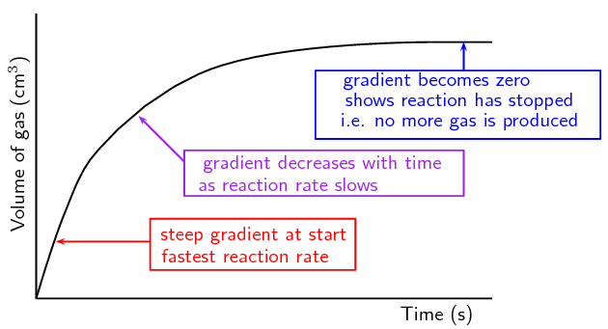
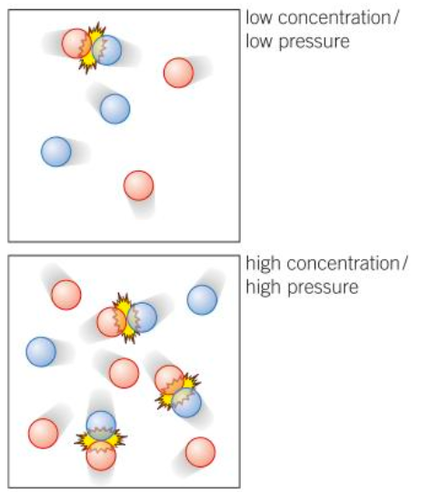
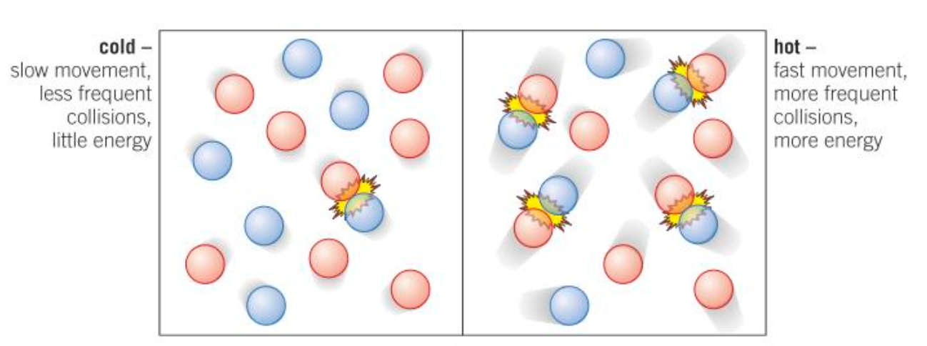
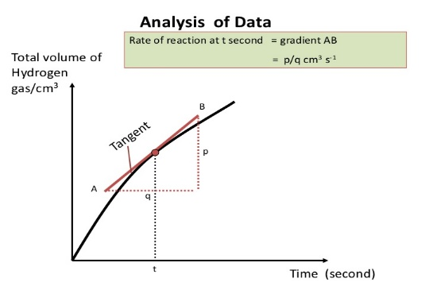
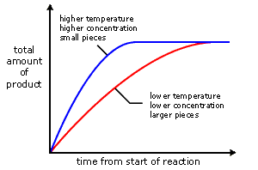
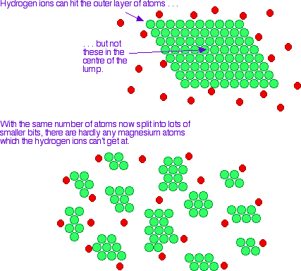
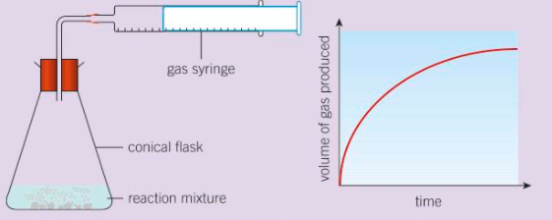
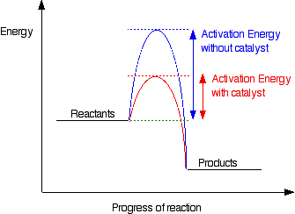
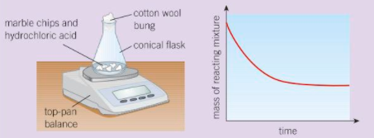
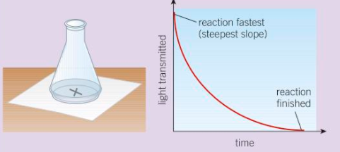
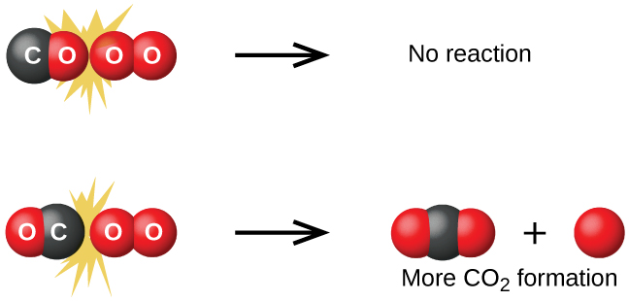
C6 part 1 - Rates
1.2 Factors affecting rate
1.1 Calculating Rates of Reaction
Concentration and Pressure
Temperature
rate of reaction = quantity of reactant used
time taken
Particles move faster.
So they collide more frequently.
Particles collide with more energy.
So more of the collisions are successful.
More particles in the same space.
More frequent collisions
OR
rate of reaction = quantity of product made
time taken
HIGHER ONLY
The quantity of reactant or product can be measured by the mass in grams or by a volume in cm³.
The units of rate of reaction may be g/s or cm³/s.
Surface area
More particles available to react.
More frequent collisions
1.1b Measuring Rate
e.g. Measure volume of gas made
1.4 Catalysts
To measure the rate of a reaction you can:
Measure how fast the reactants are used up
Measure how fast the products are made
Lower the energy needed for successful collisions. (Activation energy)
Not used up.
Biological catalysts are called enzymes
e.g. Measure mass lost due to gas formed
e.g. Measure time for insoluble product to form
1.3 Collision theory
A successful collision is one that leads to a reaction
For a reaction to happen reactants must:
collide with enough energy (activation energy)
So to increase the rate of a reaction you must either
Increase the frequency of collisions
Increase the energy of the collisions
Decrease the energy needed for a collision to be successful

Slide 2
Quick-fire questions
1. | State the 2 possible equations for mean rate of reaction
2. | State the factors that can affect the rate of a chemical reaction
3. | What are the requirements for a chemical reaction to occur?
4. | Explain why increasing the surface area, concentration or pressure affect the rate of reactions
5. | Explain why increasing the temperature affects the rate of reaction
6. | Define activation energy
7. | How do catalysts increase the rate of reaction?
8. | What is a catalyst?
9. | Sketch a reaction profile to show how catalysts increase the rate of reaction
10. | What is a reversible reaction?
11. | What is equilibrium in terms of a reversible reaction?
Stretch and Challenge
Watch the video at https://www.youtube.com/watch?v=GmDpLfgDA5g to learn how to find the gradient of a curve
Follow this link to more notes and questions
AQA GCSE Chemistry Topic 6: The Rate and Extent of Chemical Change Revision - PMT (physicsandmathstutor.com)
Key words and their definitions
Rate of reaction | The speed at which a reaction takes place. This can be worked out in two ways: Mean rate of reaction = quantity of reactant used ÷ time Mean rate of reaction = quantity of product formed ÷ time
Activation energy | The minimum energy particles must have to react
Catalyst | A substance that speeds up a chemical reaction by lowering the activation energy
Enzymes | Molecules that act as catalysts in biological systems
Closed system | A system where no substances can get in or out
Dynamic equilibrium | System where both the forward and reverse reactions are taking place simultaneously and at the same rate

