Slide 1


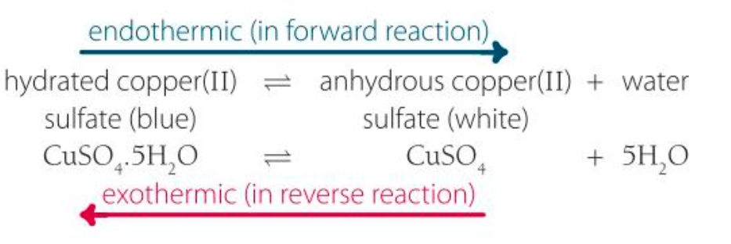
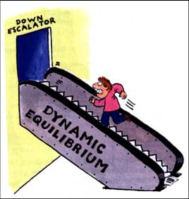
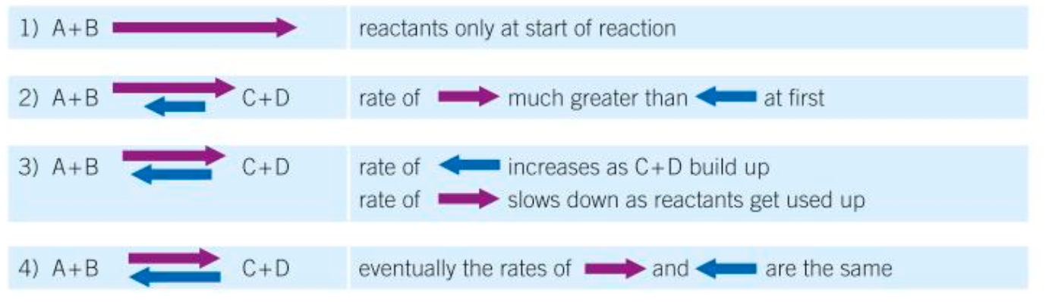
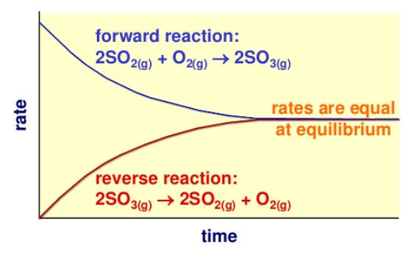
C6 part 2 – Reversible Reactions and Equilibria
HIGHER ONLY
HIGHER ONLY
2.4 The Effect of changing conditions on equilibrium
2.5 Changing Concentration
2.1 & 2.2 Reversible reactions
If the concentration of a reactant is increased, the system is no longer at equilibrium, and according to Le Chatelier’s principle, the system will respond by reducing the concentration of reactants again; more products will be made until equilibrium is reached again.
Chemical reactions that can go in both directions.
The relative amounts of reactants and products at equilibrium depend on the conditions of the reaction.
If the concentration of a product is decreased, the system is no longer at equilibrium, and according to Le Chatelier’s principle, the system will respond by increasing the amount of product; more reactants will react until equilibrium is reached again.
If a reaction is exothermic in one direction it is endothermic in the other direction.
Le Chatelier’s principle
“if a system is at equilibrium and a change is made to any of the conditions, then the system responds to counteract that change.”
2.6 Changing Temperature
if the forward reaction is exothermic… | if the forward reaction is endothermic…
…an increase in temperature decreases the amount of products formed. | …an increase in temperature increases the amount of products formed.
…a decrease in temperature increases the amount of products formed. | …a decrease in temperature decreases the amount of products formed.
2.3 Equilibria
In a closed system (where nothing can get in or out) an equilibrium is reached where the rate of reaction is the same in both directions.
2.7 Changing Pressure
if the forward reaction produces more molecules of gas….. | If the forward reaction produces fewer molecules of gas…..
…an increase in pressure decreases the amount of product formed. | …an increase in pressure increases the amount of product formed.
…a decrease in pressure increases the amount of product formed. | …a decrease in pressure decreases the amount of product formed.
At equilibrium:
Rate of forward reaction = rate of reverse reaction.
Mount of products and reactants don’t change.

Slide 2
1. | What is this symbol '⇌' used to represent?
2. | What term is used to describe a chemical reaction in which the forward and reverse reaction rates are the same?
3. | What is produced in the backward reaction in this equilibrium, when the reaction goes from right to left: NH₃Cl(s) ⇌ NH₃(g) + HCl(g)?
4. | If the forwards reaction is endothermic, what can be deduced about the reverse reaction?
5. | When a reversible reaction is at equilibrium, which of these statements is true?
6. | The equation for the Haber process is: N₂ + 3H₂ ⇌ 2NH₃. What gases will be present at equilibrium?
7. | Higher Tier - One of the stages in sulfuric acid production is described by this equation: 2SO2(g) + O2(g) ⇌ 2SO3(g). What will happen to the yield of SO3 if the pressure is increased?
8. | Higher Tier - If the forward reaction in a reversible reaction is endothermic, what will be the effect of decreasing the temperature?
9. | Higher Tier - What is the effect of decreasing the pressure on the following equilibrium 2NO(g) + O2(g) ⇌ 2NO2(g)?
10. | Higher Tier - What effect on the equilibrium position is produced by adding a catalyst to a system in equilibrium?
Stretch and Challenge
Watch the video at https://www.youtube.com/watch?v=BPDkl92NCUs for Le Chatelier’s principle and the Haber Process.
Follow this link to more notes and questions
AQA GCSE Chemistry Topic 6: The Rate and Extent of Chemical Change Revision - PMT (physicsandmathstutor.com)
equilibrium | In chemical reactions, a situation where the forward and backward reactions happen at the same rate, and the concentrations of the substances stay the same.
equilibrium position | A measure of the relative concentrations of substances in an equilibrium, showing if there are more reactants or products at equilibrium.
reversible reaction | A chemical reaction which can go both ways.
Le Chatelier’s Principle | “if a system is at equilibrium and a change is made to any of the conditions, then the system responds to counteract that change.”
Exothermic | Reaction in which energy is given out to the surroundings. The surroundings then have more energy than they started with so the temperature increases
Endothermic | Reaction in which energy is taken in. The surroundings then have less energy so the temperature decreases

