Slide 1

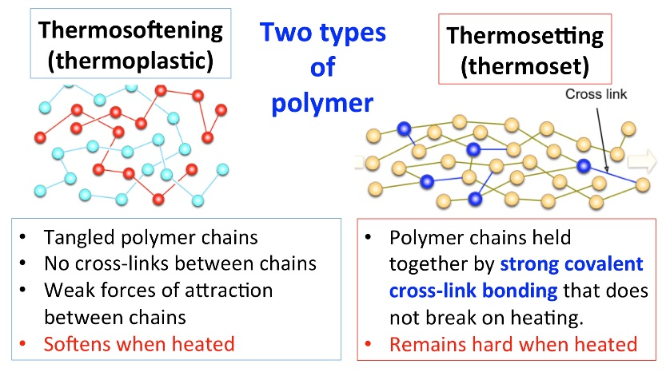
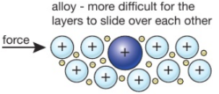
C10 Using Resources – Part 2 – TRIPLE only
3.1 Corrosion and it’s prevention
3.3 Ceramics Polymers and Composites
Corrosion is when a metal is destroyed by chemical reactions with other substances in the environment. (rusting is just one example of this)
Glass
Both Oxygen and air are needed for Iron to rust
Glass is made by melting a mixture of sand (silicon dioxide), limestone and sodium carbonate.
This is called soda-lime glass. Soda-lime glass is used for window panes, glass jars and bottles.
Borosilicate glass contains boron trioxide. It has a higher melting point than soda-lime glass.
How to stop corrosion:
Physical Barriers:
Paint
Coat with plastic
Oil or grease
Electroplating
Use electrolysis to coat a VERY THIN layer of an unreactive metal over the surface.
Ceramics
Ceramics made from clay include china, porcelain and brick. Wet clay is shaped and then placed into a furnace where it is heated to a high temperature. Crystals form in the clay and join it together.
Sacrificial protection
Put the metal in contact with a MORE REACTIVE metal (e.g. zinc) – the zinc is “sacrificed”
Polymers
Composites
Galvanising
Coat the metal in zinc which is then BOTH a physical barrier and a “sacrifice”
Properties depend on 2 things:
Made of 2 materials:
The monomer they are made from
3.2 Alloys
Alloys are mixtures of 2 or more metals (sometimes including carbon)
The conditions when they are made
Reinforcement (Fibres or particles) that are bound together by the matrix
E.g. Fibre glass, Concrete and carbon Fibre
Name of Alloy | Component Metals | Uses
bronze | copper and tin | bells coins statues
brass | copper and zinc | locks taps instruments door hinges door knobs
gold | Alloyed with other metals such as silver, zinc and copper. | Jewellery
High carbon steel | Iron and a high amount of carbon | Construction industry (hard and brittle)
Low Carbon Steel | Iron and a small amount of carbon | Car body panels (soft and easily shaped)
Stainless steel | Iron, chromium and nickel | Cutlery (hard and dos not corrode)
E.g. High density Poly(ethene) and Low density Polyethene)
Alloys are usually harder and stronger than pure metals

Slide 2
1 | Give three types of physical barrier that can be used to protect a metal from corrosion.
2 | Give 2 other methods that can be used to protect metals and explain how they work
3 | What is an alloy?
4 | How are the properties of alloys different to pure metals
5 | Name 2 types of glass and give a use for each
6 | Explain what ceramic is and give a use
7 | Explain what a composite is and give 3 examples
8 | State the meaning of Thermosetting
9 | State the meaning of thermosoftening
10 | Explain the differences in properties between thermosetting and thermosoftening polymers
Stretch and Challenge
Watch the video at https://www.youtube.com/watch?v=lNS7TwWmlrg . What are the differences between thermosetting and thermosoftening plastics?
How are NASA using different composite materials? https://www.youtube.com/watch?v=tZhH2B-EI1I
Corrosion | When a metal is destroyed by chemical reactions with other substances in the environment
Alloy | A mixture of two or more metal elements – usually harder or stronger than the elements on their own
Composite | consists of two or more materials with different properties. They are combined to produce a material with improved properties.
Ceramic | Made from wet clay which is shaped and then heated in a furnace
Polymer | Made from many monomers joined together to form a long chain
Thermosoftening | Polymer that melts when heated
Thermosetting | Polymer that does not melt when heated. These will char or burn instead due to the strong crosslinks
Haber process | Process used for the manufacture of ammonia
Ammonia | Compound formed from nitrogen and hydrogen with the formula NH₃
Electroplating | Using electrolysis to coat a very thin layer of metal over another less expensive metal
Sacrificial protection | Process where a more reactive metal is used to protect another metal. The more reactive metal will be used up
Galvanising | Coating a metal with zinc in order to protect it.
Follow this link to more notes and questions
AQA GCSE (9-1) Chemistry Revision - PMT (physicsandmathstutor.com)

