Slide 1
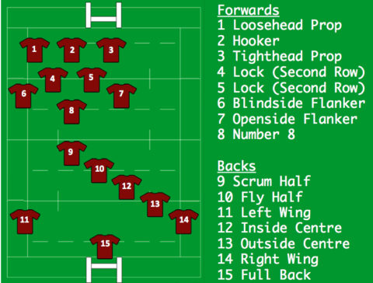
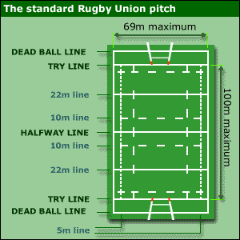
Subject Knowledge Organiser
Rugby – Laws, Player Positions & Pitch Dimensions
Laws
The rugby game is broken down into two 40-minute halves with a 10-minute rest period in between.​
The time during a game can be stopped for an incident. Therefore, the game stops on exactly 80 minutes.​
The game must have one referee and two touch judges.​
The game is stopped if a player is fouled and there is no subsequent advantage. Unlike most sports, a referee can wait to see how an incident unfolds before deciding whether the attacking had an advantage.​
A tackle cannot be made above the nipple line or by tripping a player with your feet.​
A lineout is called if the ball travels past the side-line.​
A lineout consists of up to seven players and players can be lifted in order to catch the ball.​
At a lineout, both teams can compete to win the ball.​
To successfully covert a kick, the ball must travel the top section of the goal.​
If a ball, when kicked, hits the post and bounces in field, then play can continue.​
In order to stay onside in rugby, the attacking players must remain behind the ball of the player passing to them.​
A referee may award a foul if they believe an unfair act is committed by a player. A foul contravenes the laws of the game and can be for a range of offences (kicking the player, offside, dropping the ball).​
In cases of foul play, a referee can award players with either a yellow or red card. A yellow card provides a player with a warning about their conduct (sin binned for 10 minutes) and a red card requires them to leave the pitch immediately.
Player Positions
Pitch Dimensions
https://www.bbc.com/bitesize/topics/zp2m7hv

Slide 2
Subject Knowledge Organiser
Rugby – Tackle, Grubber Kick, Spin Pass & High Ball Catch
Tackle​
The tackle is an essential skill for winning the ball back in rugby or stopping an attacking player. It is very important to complete it with good timing and technique to prevent injury or accidents.​
Position your body to the opponent's right-hand side (safe side).​
Position your left foot forward into a slight opposition.​
Make contact by putting your right shoulder into the opponent's mid-right thigh.
​Make sure your head is on the other side of the ball carrier so their body is between your shoulder and head.​
Bring your arms up and wrap them around the ball carrier, just above their knees (do not lock your hands together).​
Squeeze your arms and pull the ball carrier into your body.​
As you squeeze, push your shoulder into the ball carrier, as though you are trying to push him away with your head.​
Continue pushing until both you and the ball carrier fall to the ground.​
Keep your head as close as you can to their thigh throughout.​
Spin pass​
A spin pass enables a team to quickly pass a ball and help maintain possession.​
Stand on balls of feet in opposition (left foot forward), knees slightly bent with body facing forward.​
Hold the ball out in front of you with extended arms.​
Put the right hand on the bottom half of the right hand side of the ball.​
Point the thumb up along the seam of the ball and spread the fingers around the side of the ball.​
Put the left hand on the top half of the left hand side of the ball. ​
Point the thumb up along the seam of the ball and spread the fingers around the side of the ball.​
Bring the ball in towards your waist and flex your elbows at a 90° angle.​
Rotate your shoulders round until your left shoulder is pointing forward.​
Draw the ball back across to the right hip, keeping your elbows slightly bent.​
Sweep the ball across your body, keeping the elbows close to your body and shift your weight from your back leg to your front foot.​
Release the ball when arms are nearly fully extended with a flick of the wrists and fingers.​
Follow through with your fingers pointing to the target.
Grubber Kick​
The grubber kick is a simple low kick that aims to move the ball past defences for attacking players to try and retrieve. It is very good at breaking defensive positions and forces defenders to turn around and chase.​
Stand in opposition on the balls of your feet, with the non-kicking foot in front.​
Lean forward so the head and chest should be comfortably over the ball. ​
Hold the ball vertically at waist height, with hands either side of the ball.​
Extend arms fully so the ball is half a metre out in front.​
Drop the ball and point toes towards the ground.​
Keep the knee bent and over the ball.​
Strike the upper half of the ball with the laces, just before it bounces.​
Extend the leg through so it is straight, with toes pointing at the target.
High ball catch​
A high ball catch is an attacking and defending skill. It is useful for attackers when completing an up and under kick or as a defender to stop an attacking team’s momentum by safely winning possession back.​
Call for the ball.​
Get in line with the ball's path and keep your eyes on the ball at all times.​
Move towards the ball and extend your arms out in front of you at chest height.​
Slightly bend your elbows and have your palms facing up and fingers spread.​
Jump up off one foot.​
As you are about to catch the ball, turn slightly to one side, so the side of the body is pointing downfield.​
Raise the other knee up towards the waist to generate additional upward momentum.​
Catch the ball with the hands at or above eye level.​
Bring the ball into your body.​
Secure the ball against your body as you land on the ground.​
Land on one to two feet.
https://www.bbc.com/bitesize/topics/zp2m7hv

