Slide 1


CREATING YOUR
NEA PORTFOLIO
GCSE DESIGN & TECHNOLOGY
Non-Exam Assessment (NEA)

Slide 2
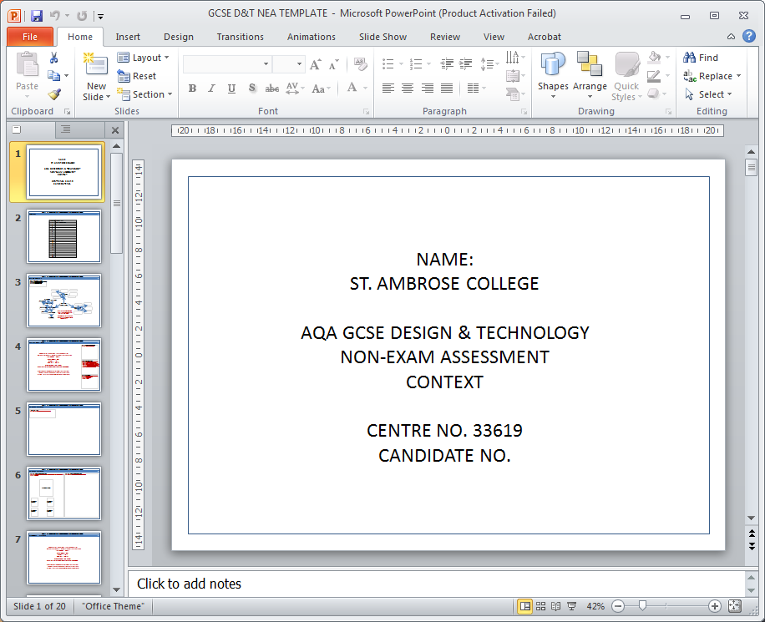
NEA GCSE DESIGN & TECHNOLOGY
Getting started
Locate the file on the shared area entitled ‘GCSE D&T NEA TEMPLATE’.
This is a PowerPoint document that you should use for your portfolio.
Save this file in your documents or on a USB memory stick. Remember to make regular back-ups of this file.
NOTE: Many of the pages in this document contain guidance on how to complete the work. However, this is only guidance and should not be followed too rigidly.

Slide 3
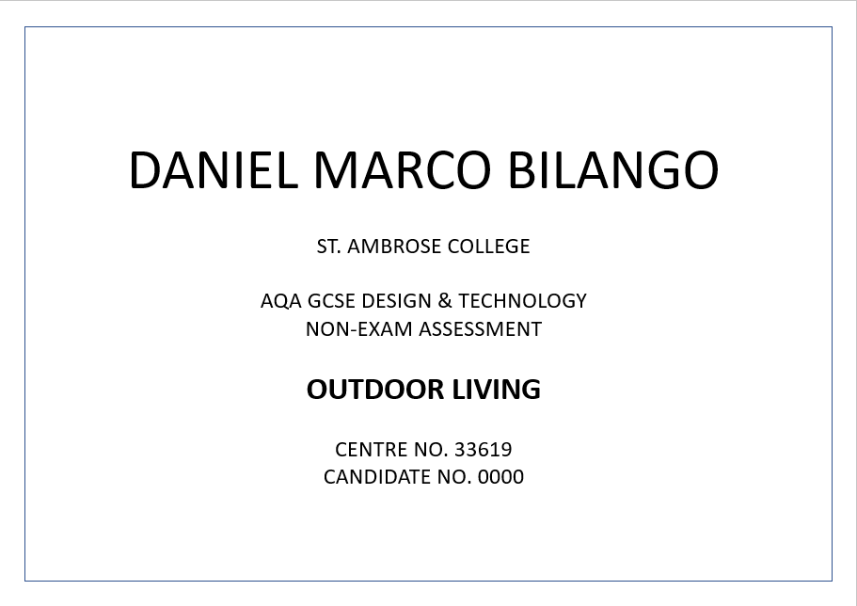


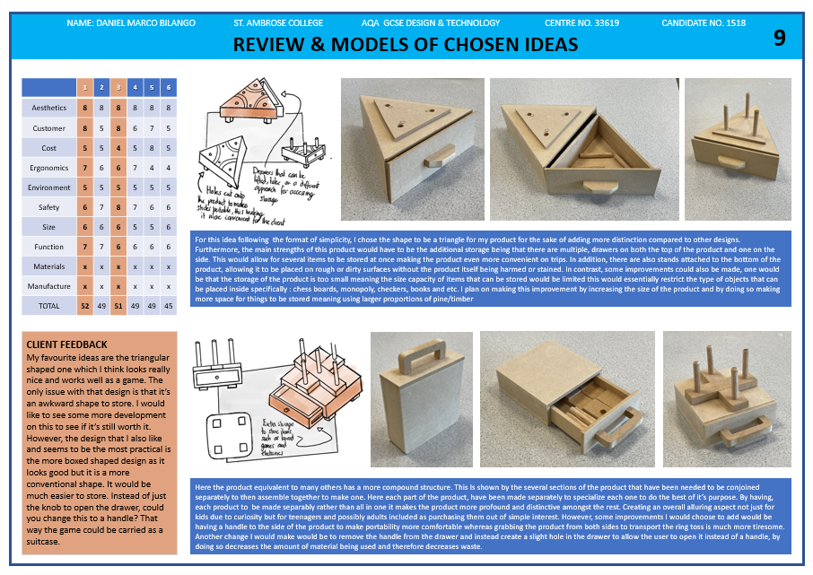
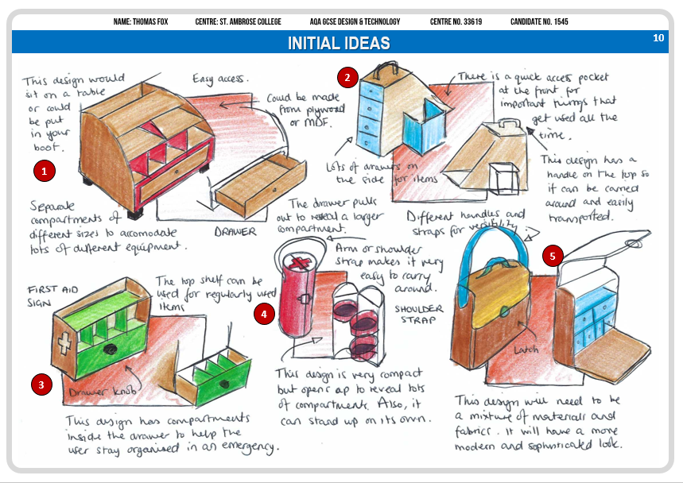
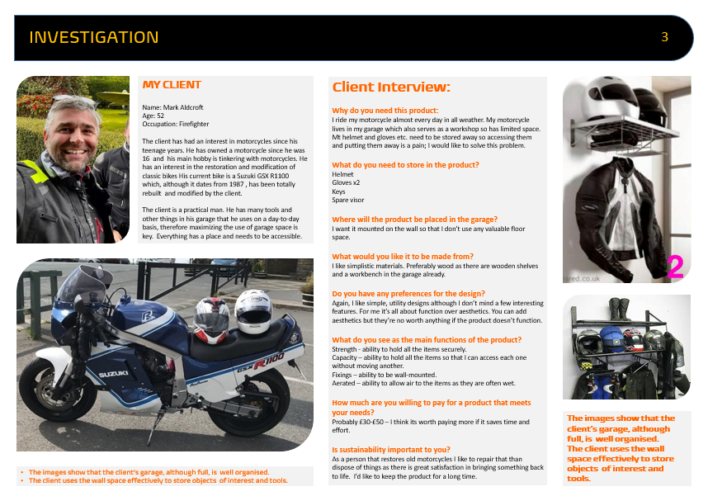
NEA GCSE DESIGN & TECHNOLOGY
EXAMPLES

Slide 4
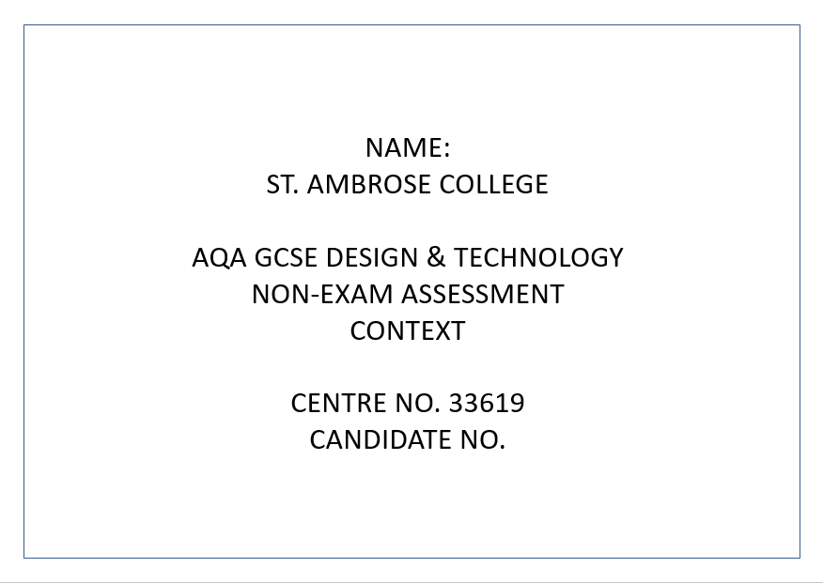
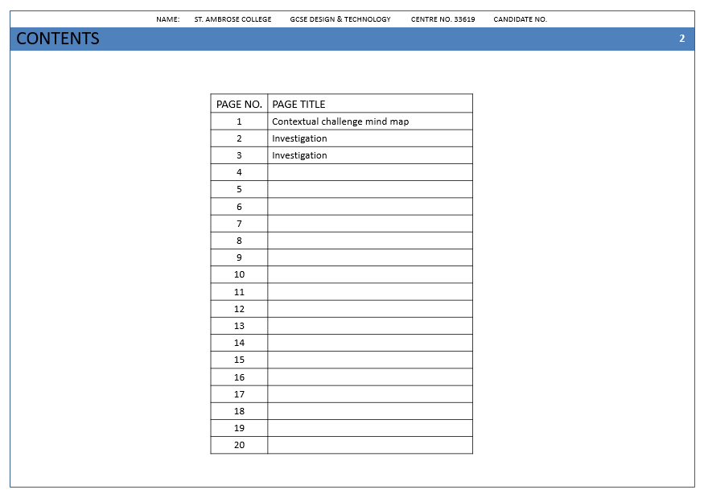
Getting started
A front cover
Contents page
Pages for content
White background
Small border that doesn’t take up too much space on the page.
Simple but well designed

Slide 5


