Slide 1


Choosing your design challenge
GCSE DESIGN & TECHNOLOGY
Non-Exam Assessment (NEA)

Slide 2
NEA GCSE DESIGN & TECHNOLOGY
Design Challenge
Your NEA will be based on one of the following contextual challenges:
Caring for animals
Souvenir from a place of interest
Studying or working at home
To complete the NEA you will need to design and make a prototype that fulfils its purpose and meets the needs of the intended users.

Slide 3
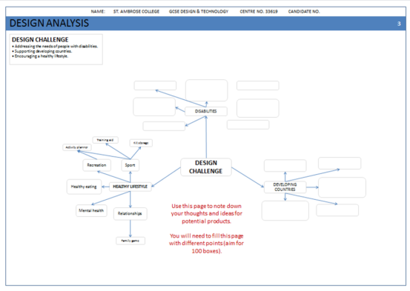
NEA GCSE DESIGN & TECHNOLOGY
Mind-mapping the Contextual Challenges
You’ll need to produce a mind map to help you explore design possibilities.
Use this slide to note down your thoughts and ideas for potential products.
You will need to fill this page with different points (aim for 100 boxes).
A product that allows the user to prepare healthy meals using fresh ingredients while away from home.
Training aid
Kit storage
Activity planner
Food preparation
Recreation
Sport
Example… this is not one of the contextual challenge options… it’s just an example!
Healthy eating
CONTEXTUAL
CHALLENGE
Food carrier
HEALTHY LIFESTYLE
Healthy snack bar
Mental health
Relationships
A new healthy snack bar and packaging. The snack bar would need to taste good and contain healthy ingredients. Packaging would need to promote the snack bar.
Family game

Slide 4
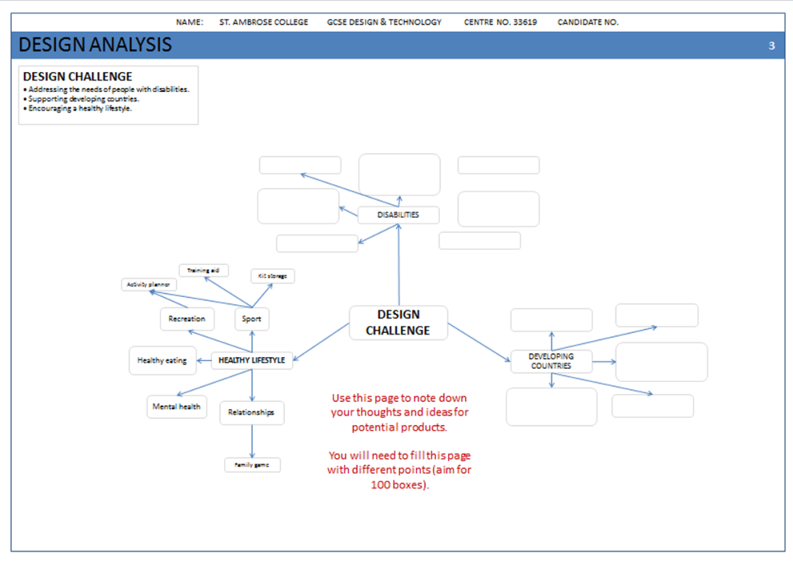
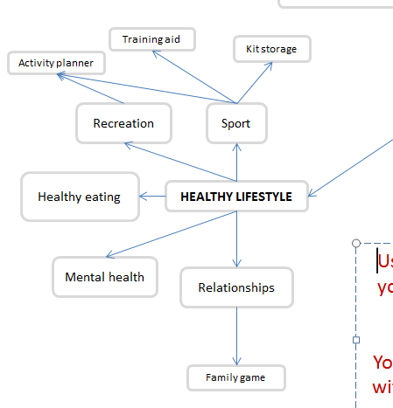
NEA GCSE DESIGN & TECHNOLOGY
In the example shown, it starts by considering all the different aspects of the design challenge. In this case, what aspects would fit under the title of healthy living?
Sport
Recreation
Healthy eating
Mental health
Relationships
From this point you can break each point down into further categories, such as individual sports (rugby, basketball, tennis),
OR you can begin to suggest ideas for products.
Identifying & investigating design possibilities

Slide 5
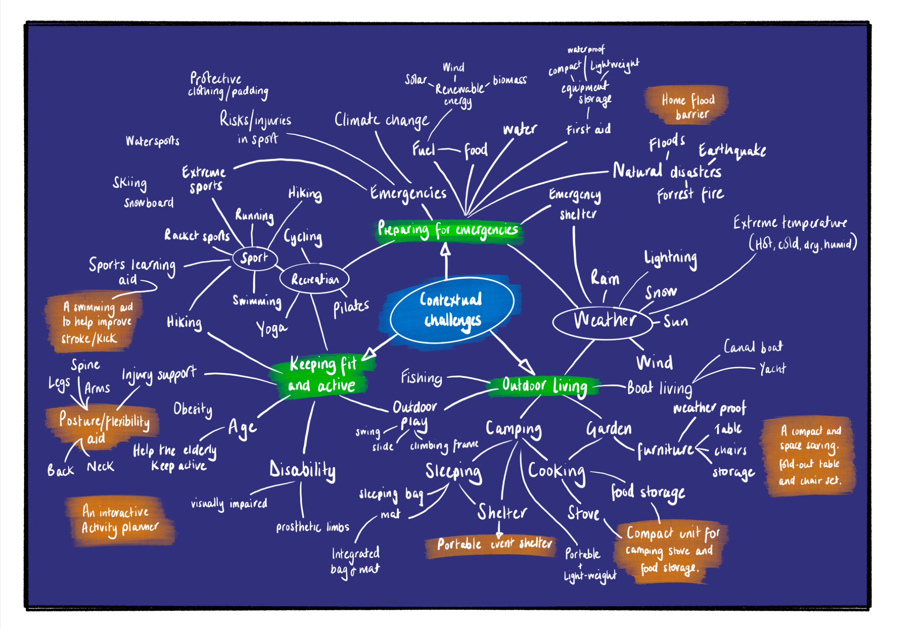
Don’t just rely on templates given by your teacher.
Reading the criteria will help you better understand what is required.
Don’t just rely on templates given by your teacher.
Reading the criteria will help you better understand what is required.
Don’t just rely on templates given by your teacher.
Reading the criteria will help you better understand what is required.
Don’t just rely on templates given by your teacher.
Reading the criteria will help you better understand what is required.

