Slide 1


INVESTIGATION
GCSE DESIGN & TECHNOLOGY
Non-Exam Assessment (NEA)

Slide 2
NEA GCSE DESIGN & TECHNOLOGY
Section A Identifying and investigating design possibilities
There will be assessment criteria for each section of your NEA.
Section A carries a total of 10 marks.
In order to achieve full marks for this section, your work will need to fulfil the criteria shown in the table.
Section A Assessment Criteria
Design possibilities identified and thoroughly explored, directly linked to a contextual challenge demonstrating excellent understanding of the problems/opportunities.
A user/client has been clearly identified and is entirely relevant in all aspects to the contextual challenge and student has undertaken a comprehensive investigation of their needs and wants, with a clear explanation and justification of all aspects of these.
Comprehensive investigation into the work of others that clearly informs ideas.
Excellent design focus and full understanding of the impact on society including; economic and social effects.
Extensive evidence that investigation of design possibilities has taken place throughout the project with excellent justification and understanding of possibilities identified.
Don’t just rely on templates given by your teacher.
Reading the criteria will help you better understand what is required.

Slide 3
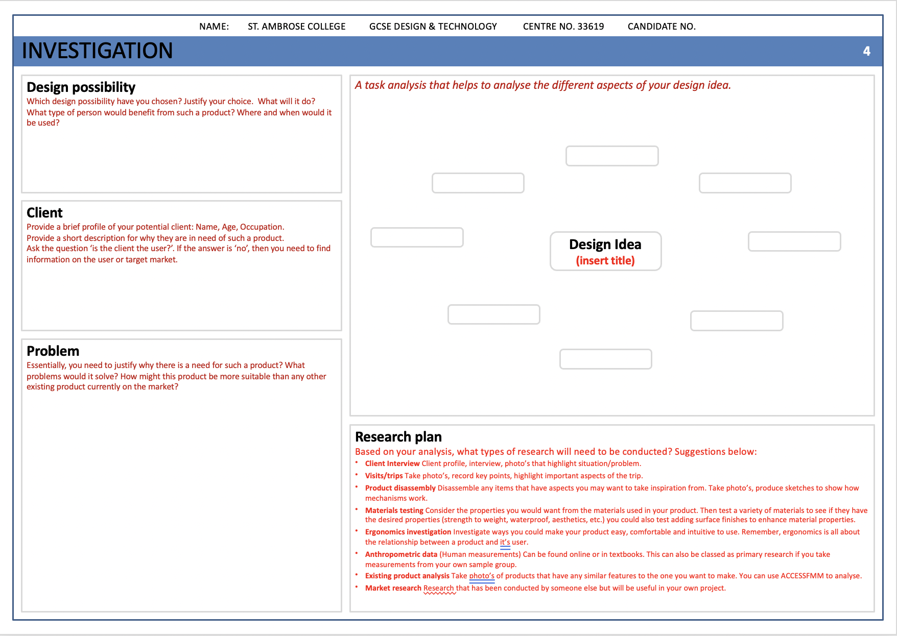
Following the mind map, this is the next page to complete.
Here you will choose the most suitable design possibility to go with for your NEA.

Slide 4
Investigating your design idea
Design possibility
Here, you need to state which design possibility you have chosen? Justify your choice. What will it do? What type of person would benefit from such a product? Where and when would it be used?
Client
Provide a brief profile of your potential client: Name, Age, Occupation. Provide a short description for why they are in need of such a product. Ask the question ‘is the client the user?’. If the answer is ‘no’, then you need to find information on the user or target market.
Problem
Essentially, you need to justify why there is a need for such a product? What problems would it solve? How might this product be more suitable than any other existing product currently on the market?

Slide 5
Investigating your design idea
Analysis of design idea
Here, you need to state which design possibility you have chosen? Justify your choice. What will it do? What type of person would benefit from such a product? Where and when would it be used?
Research plan
You need to plan out the different areas of research that you need to conduct.
What do I research?
Your analysis should have raised thoughts and questions that you don’t yet know the answers to, or that need to be explored. This is why the role of research is so important!

Slide 6
Investigating your design idea
Analysis of design idea
Here, you need to state which design possibility you have chosen? Justify your choice. What will it do? What type of person would benefit from such a product? Where and when would it be used?

Slide 7
NEA GCSE DESIGN & TECHNOLOGY
Research Plan
You should now have a breakdown of the research tasks you will need to carry that will help to design a successful product.
Within your research YOU MUST ENSURE that:
A user/client has been clearly identified and is entirely relevant.
You have undertaken a comprehensive investigation of the clients needs and wants.
You have a comprehensive investigation into the work of others that clearly informs ideas.
You demonstrate a full understanding of the impact on society including; economic and social effects.
AREA OF INVESTIGATION |  | DESCRIPTION
Client investigation | Client profile, interview, photo’s that highlight situation/problem. Design brief Research plan
Primary research | Existing product analysis | Take photo’s of products that have any similar features to the one you want to make. You can use ACCESSFMM to analyse.
 | Visits/trips | Take photo’s, record key points, highlight important aspects of the trip.
 | Product disassembly | Disassemble any items that have aspects you may want to take inspiration from. Take photo’s, produce sketches to show how mechanisms work.
 | Materials testing | Consider the properties you would want from the materials used in your product. Then test a variety of materials to see if they have the desired properties (strength to weight, waterproof, aesthetics, etc.) you could also test adding surface finishes to enhance material properties.
 | Ergonomics investigation | Investigate ways you could make your product easy, comfortable and intuitive to use. Remember, ergonomics is all about the relationship between a product and it’s user.
Secondary Research | Anthropometric data | (Human measurements) Can be found online or in textbooks. This can also be classed as primary research if you take measurements from your own sample group.
 | Existing product analysis | As above but using products found online or in books.
 | Market research | Research that has been conducted by someone else but will be useful in your own project.

Slide 8
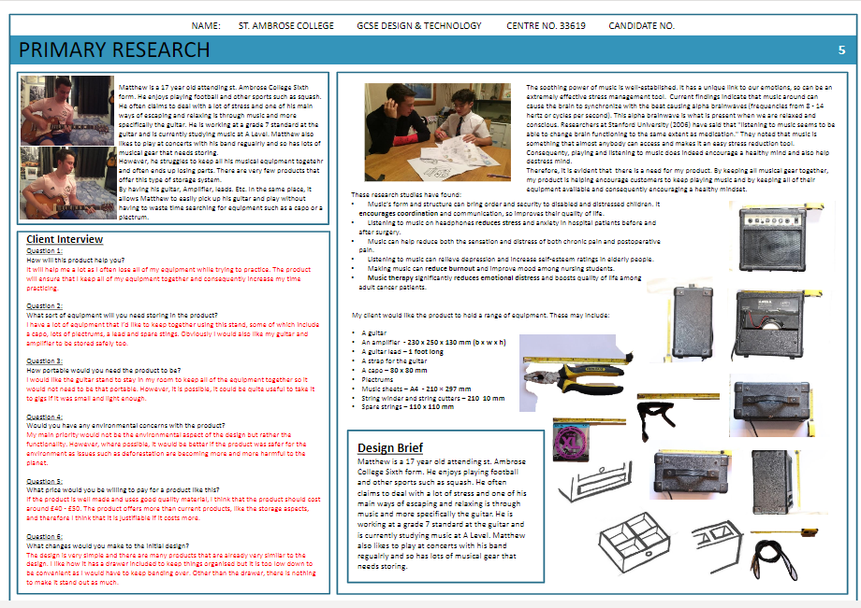
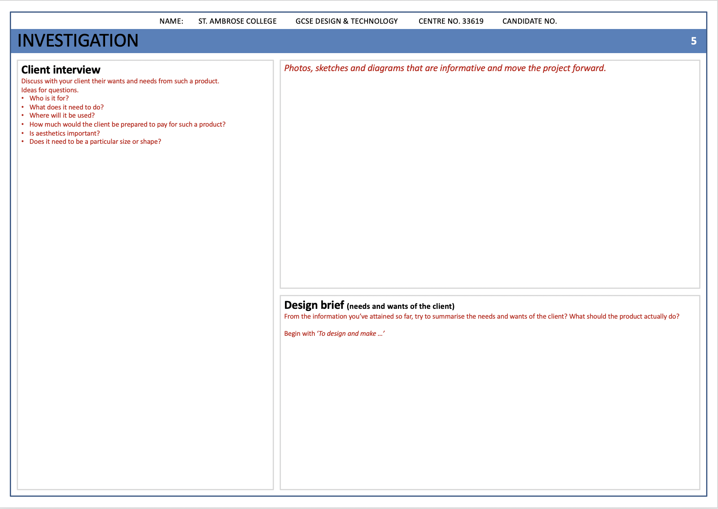
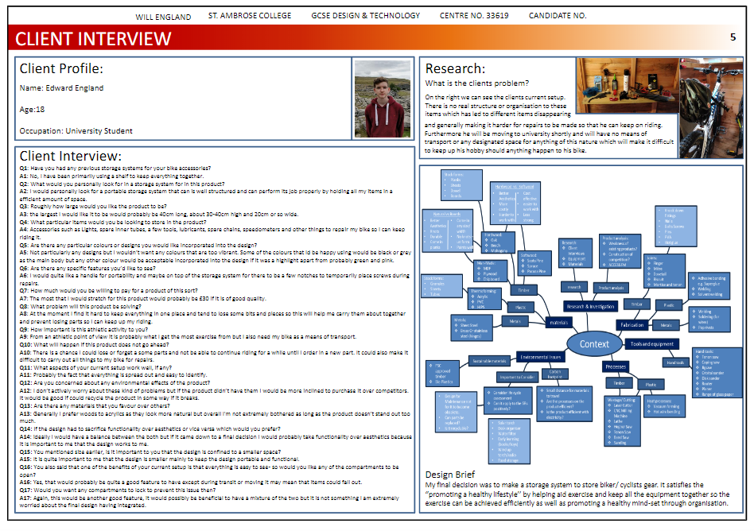
NEA GCSE DESIGN & TECHNOLOGY
Client Investigation
It is important that you are clear about who your client is and what they want and need from the product.
The client
Provide a brief profile of your client: Name, Age, Occupation.
Provide a short description for why they are in need of such a product.
Ask the question ‘is the client the user?’. If the answer is ‘no’, then you need to find information on the user or target market.
The client interview
Ideas for questions
Who is it for?
What does it need to do?
Where will it be used?
How much would the client be prepared to pay for such a product?
Is aesthetics important?
Does it need to be a particular size or shape?

Slide 9
NEA GCSE DESIGN & TECHNOLOGY
Client Investigation
It is important that you are clear about who your client is and what they want and need from the product.
The client
Provide a brief profile of your client: Name, Age, Occupation.
Provide a short description for why they are in need of such a product.
Ask the question ‘is the client the user?’. If the answer is ‘no’, then you need to find information on the user or target market.
The client interview
Ideas for questions
Who is it for?
What does it need to do?
Where will it be used?
How much would the client be prepared to pay for such a product?
Is aesthetics important?
Does it need to be a particular size or shape?

Slide 10
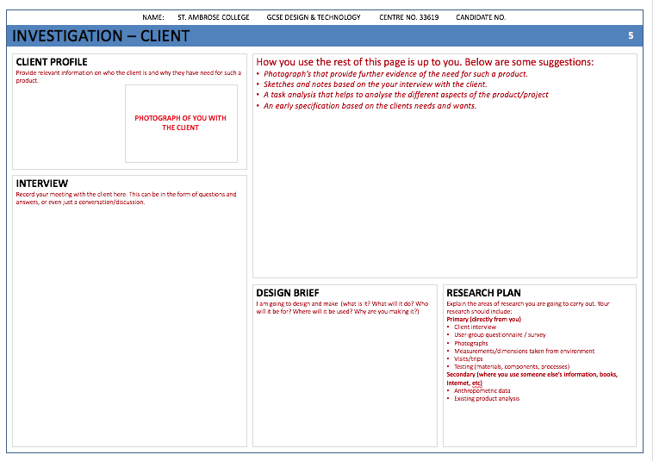
NEA GCSE DESIGN & TECHNOLOGY
Design Brief
Write your design brief:​
What are you going to design and make?​
What are the main features of the product?​
Who will it be for?​
Where will it be used?​
What different functions might it have?​
What areas do you need to research and why?​
Research Plan
Explain the areas of research you are going to carry out. Your research should include:
Primary (directly from you)
Client interview
User-group questionnaire / survey
Photographs
Measurements/dimensions taken from environment
Visits/trips
Testing (materials, components, processes)
Secondary (where you use someone else’s information, books, internet, etc)
Anthropometric data
Existing product analysis
Remember that the NEA template is there to help you plan the layout of your work.

Slide 11
NEA GCSE DESIGN & TECHNOLOGY
Design Brief
Write your design brief:​
What are you going to design and make?​
What are the main features of the product?​
Who will it be for?​
Where will it be used?​
What different functions might it have?​
What areas do you need to research and why?​
Research Plan
Explain the areas of research you are going to carry out. Your research should include:
Primary (directly from you)
Client interview
User-group questionnaire / survey
Photographs
Measurements/dimensions taken from environment
Visits/trips
Testing (materials, components, processes)
Secondary (where you use someone else’s information, books, internet, etc)
Anthropometric data
Existing product analysis
Remember that the NEA template is there to help you plan the layout of your work.

