Slide 1


PRODUCT ANALYSIS
GCSE DESIGN & TECHNOLOGY
Non-Exam Assessment (NEA)

Slide 2
NEA GCSE DESIGN & TECHNOLOGY
Section A Identifying and investigating design possibilities
Section A Assessment Criteria
Design possibilities identified and thoroughly explored, directly linked to a contextual challenge demonstrating excellent understanding of the problems/opportunities.
A user/client has been clearly identified and is entirely relevant in all aspects to the contextual challenge and student has undertaken a comprehensive investigation of their needs and wants, with a clear explanation and justification of all aspects of these.
Comprehensive investigation into the work of others that clearly informs ideas.
Excellent design focus and full understanding of the impact on society including; economic and social effects.
Extensive evidence that investigation of design possibilities has taken place throughout the project with excellent justification and understanding of possibilities identified.

Slide 3
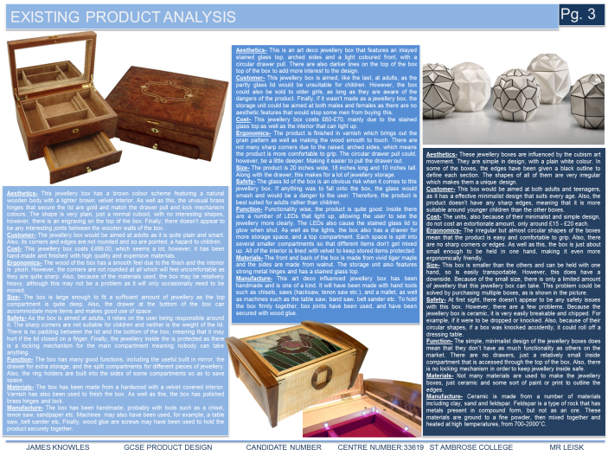
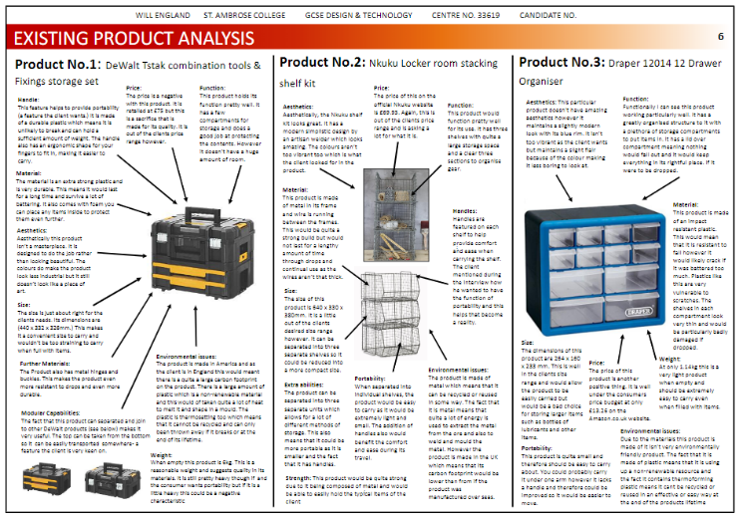
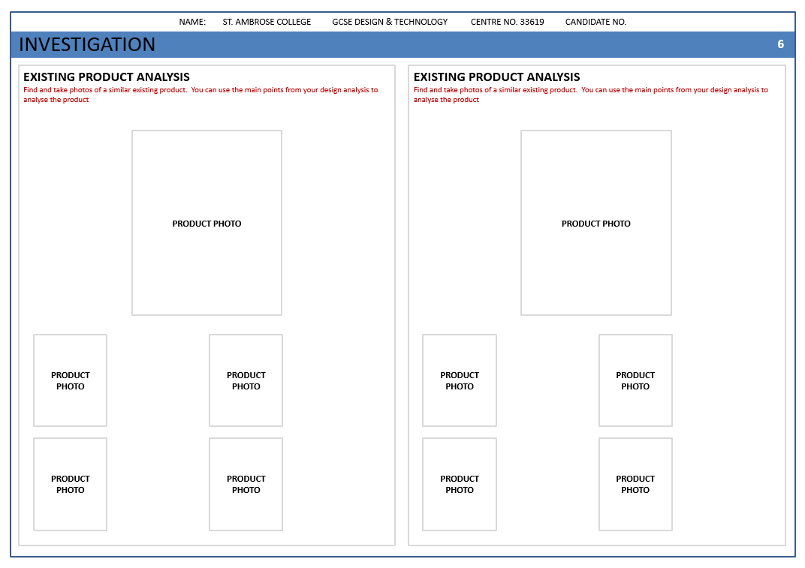
Existing Product Analysis
What is a Product Analysis
An existing product analysis is the study of existing products that have similar functions/features to the products you have been asked to design and make.
How is this helpful?
By looking at existing products we can get a better insight, using this information to produce better quality designs.
Analysis Questions…
What is the function and purpose of the product?
What are the different parts of the product and how do they work together?
How does the product use shape, form, colour, texture and decoration?
What materials and components are used to make the product?
Which processes were used to make the product?
Who would buy this product?
How well does the product do its job compared with other similar products?
What is unique about the product?

Slide 4

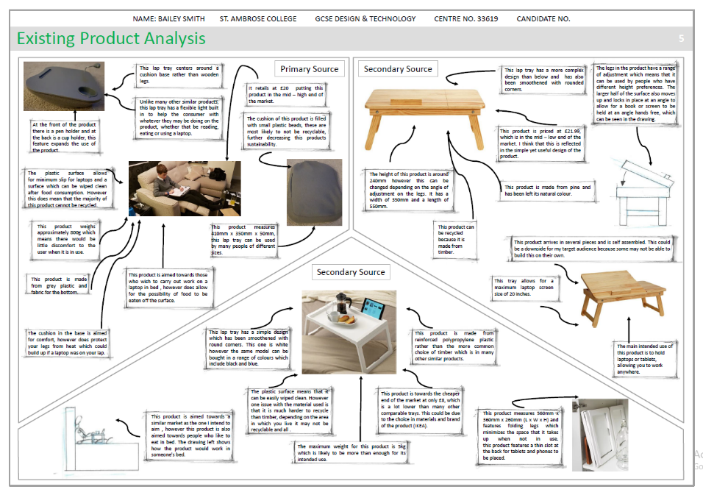
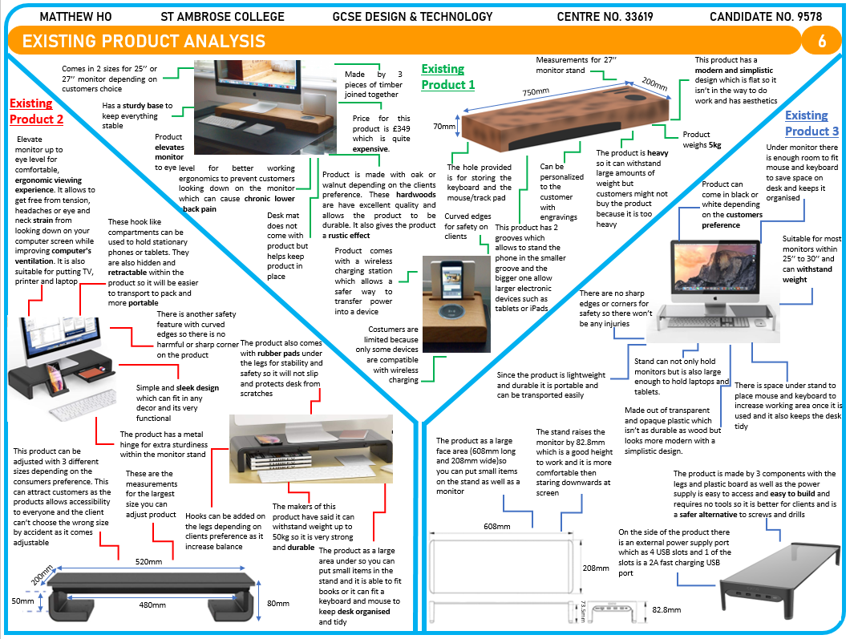
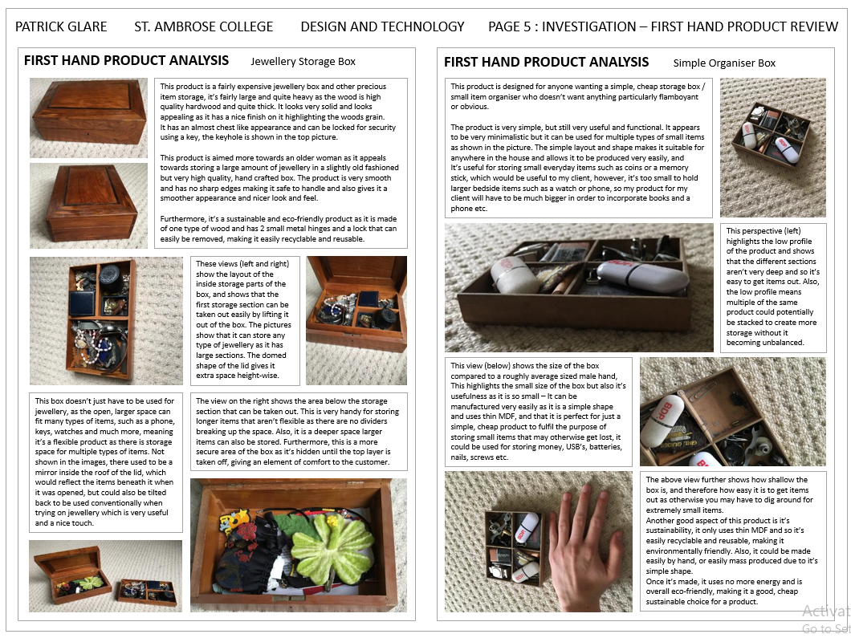
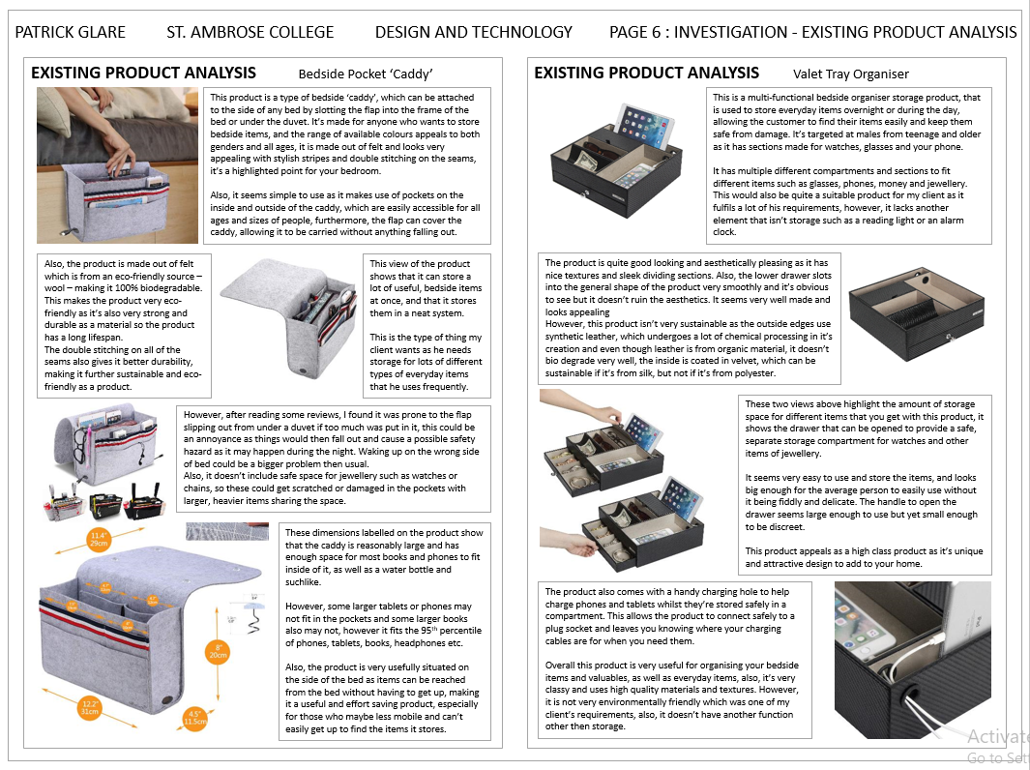
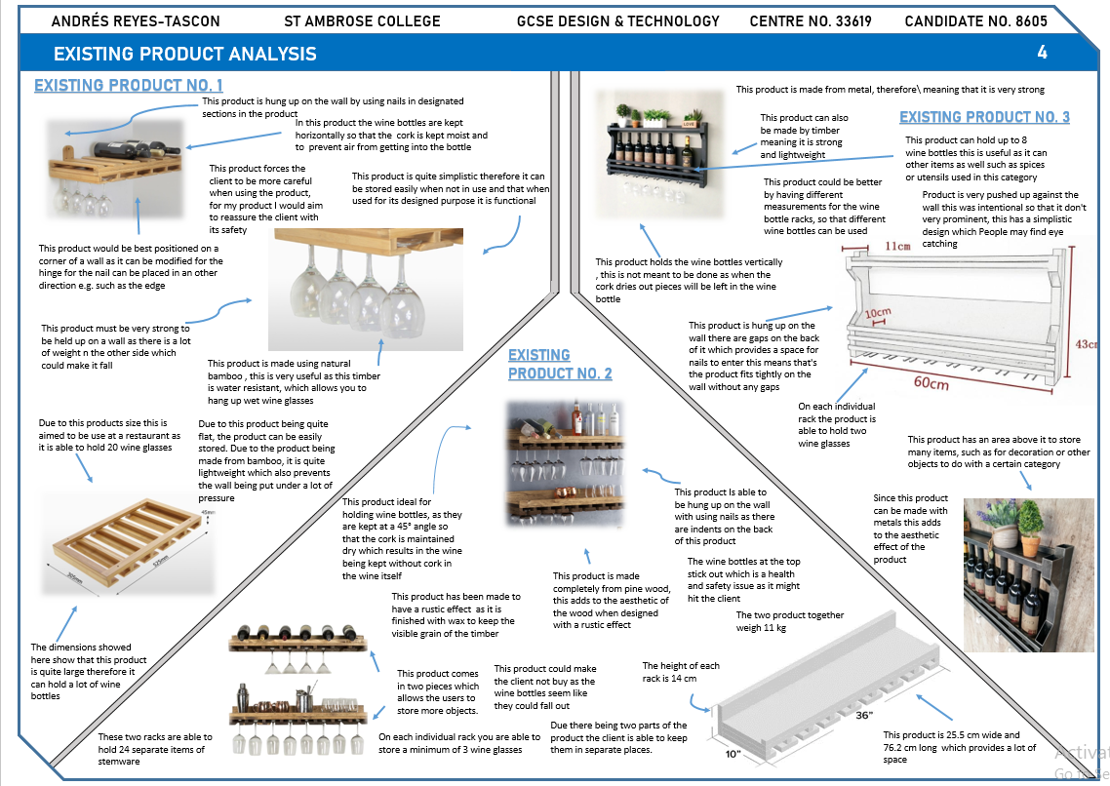
EXAMPLES

Slide 5
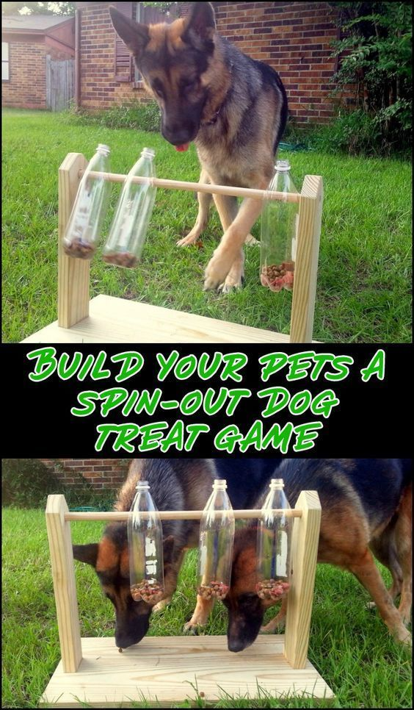
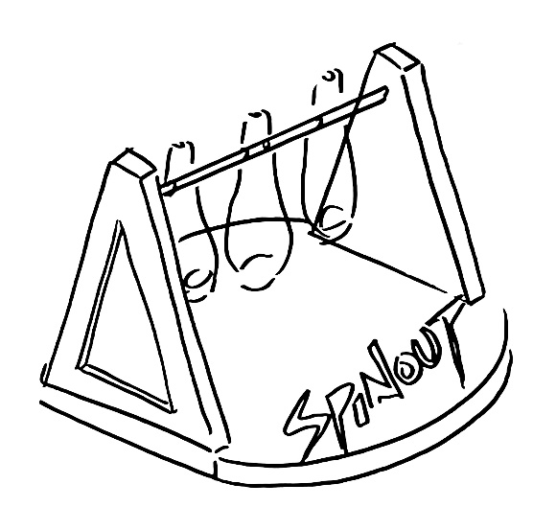
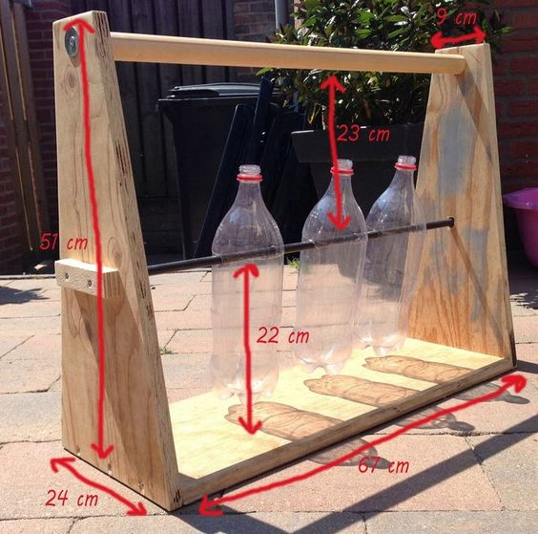
EXAMPLE
Spin-out dog treat game
This is a simple game for dogs where the incentive is to release the dog treats from the bottles. Several bottles have been connected onto an axle that allows them to rotate. Treats have been placed in the bottles and dogs have to work out how to reach the treats.
Some suggested improvements
This game has a very simple design, using standard timber planks, some dowel and recycled bottles. It has been assembled using screws. It doesn’t appear to have any surface finish.
One concern would be hygiene. Ideally, the bottles could be removed in order to be washed.
SUMMARY
Simple design and great idea
Made from pine/plywood and recycled bottles
Low quality
Poor stability
Poor durability
Top bar provides structural support
Screws allow for easy disassembly (easier to recycle)
Needs a surface finish to improve weather resistance
VERDICT
The product seems to work well but the overall quality of the product is poor. It looks homemade and probably is. This could be significantly improved by including a surface finish, adding colour and enhancing the overall shape to give it a more high quality, aesthetically pleasing look.
Base is very narrow. A wider base would provide better stability

