Slide 1


INDEPENDENT
RESEARCH
GCSE DESIGN & TECHNOLOGY
Non-Exam Assessment (NEA)

Slide 2
NEA GCSE DESIGN & TECHNOLOGY
Section A Identifying and investigating design possibilities
There will be assessment criteria for each section of your NEA.
Section A carries a total of 10 marks.
In order to achieve full marks for this section, your work will need to fulfil the criteria shown in the table.
Section A Assessment Criteria
Design possibilities identified and thoroughly explored, directly linked to a contextual challenge demonstrating excellent understanding of the problems/opportunities.
A user/client has been clearly identified and is entirely relevant in all aspects to the contextual challenge and student has undertaken a comprehensive investigation of their needs and wants, with a clear explanation and justification of all aspects of these.
Comprehensive investigation into the work of others that clearly informs ideas.
Excellent design focus and full understanding of the impact on society including; economic and social effects.
Extensive evidence that investigation of design possibilities has taken place throughout the project with excellent justification and understanding of possibilities identified.
Don’t just rely on templates given by your teacher.
Reading the criteria will help you better understand what is required.

Slide 3
NEA GCSE DESIGN & TECHNOLOGY
Research
Within your research YOU MUST ENSURE that:
A user/client has been clearly identified and is entirely relevant.
You have undertaken a comprehensive investigation of the clients needs and wants.
You have a comprehensive investigation into the work of others that clearly informs ideas.
You demonstrate a full understanding of the impact on society including; economic and social effects.
AREA OF INVESTIGATION |  |  | DESCRIPTION
Client investigation | Client profile, interview, photo’s that highlight situation/problem. Design brief Research plan
Primary research | Existing product analysis | Take photo’s of products that have any similar features to the one you want to make. You can use ACCESSFMM to analyse. | Take photo’s of products that have any similar features to the one you want to make. You can use ACCESSFMM to analyse.
 | Visits/trips | Take photo’s, record key points, highlight important aspects of the trip. | Take photo’s, record key points, highlight important aspects of the trip.
 | Product disassembly | Disassemble any items that have aspects you may want to take inspiration from. Take photo’s, produce sketches to show how mechanisms work. | Disassemble any items that have aspects you may want to take inspiration from. Take photo’s, produce sketches to show how mechanisms work.
 | Materials testing | Consider the properties you would want from the materials used in your product. Then test a variety of materials to see if they have the desired properties (strength to weight, waterproof, aesthetics, etc.) you could also test adding surface finishes to enhance material properties. | Consider the properties you would want from the materials used in your product. Then test a variety of materials to see if they have the desired properties (strength to weight, waterproof, aesthetics, etc.) you could also test adding surface finishes to enhance material properties.
 | Ergonomics investigation | Investigate ways you could make your product easy, comfortable and intuitive to use. Remember, ergonomics is all about the relationship between a product and it’s user. | Investigate ways you could make your product easy, comfortable and intuitive to use. Remember, ergonomics is all about the relationship between a product and it’s user.
Secondary Research | Anthropometric data | (Human measurements) Can be found online or in textbooks. This can also be classed as primary research if you take measurements from your own sample group. | (Human measurements) Can be found online or in textbooks. This can also be classed as primary research if you take measurements from your own sample group.
 | Existing product analysis | As above but using products found online or in books. | As above but using products found online or in books.
 | Market research | Research that has been conducted by someone else but will be useful in your own project. | Research that has been conducted by someone else but will be useful in your own project.
 | The work of others | Research different designers, design companies, artists, architects that could influence and inspire your own design work.

Slide 4
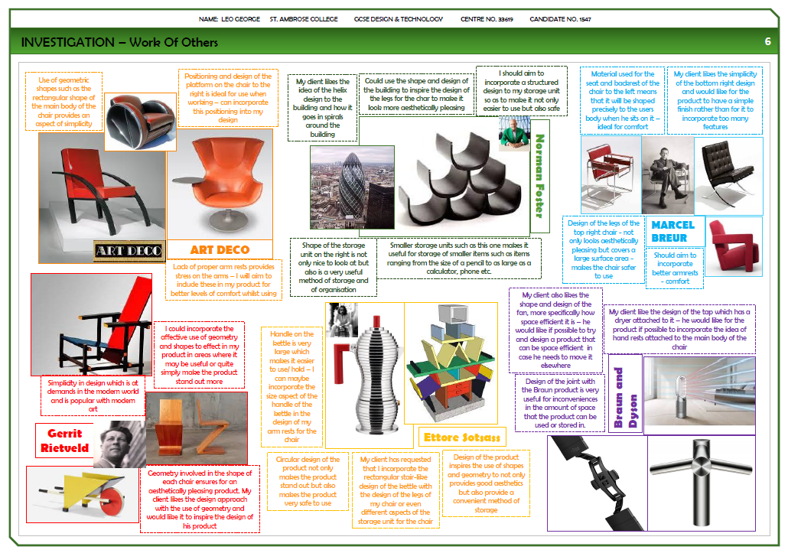
NEA GCSE DESIGN & TECHNOLOGY

Slide 5
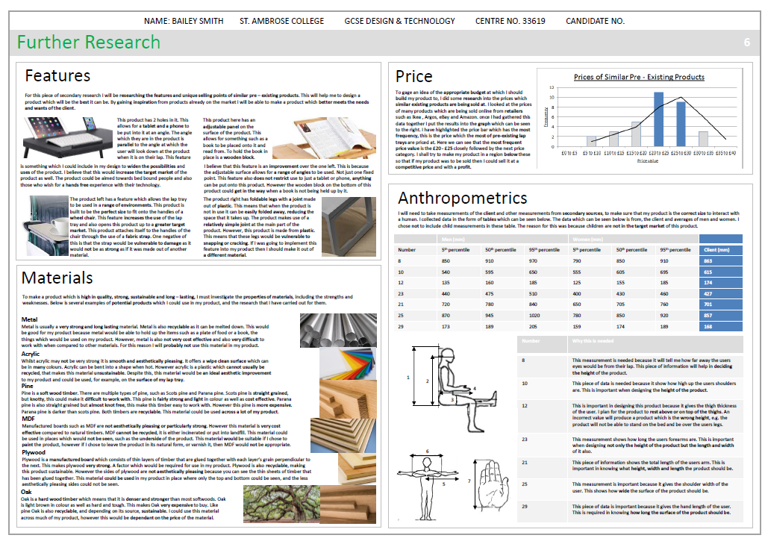
NEA GCSE DESIGN & TECHNOLOGY

Slide 6
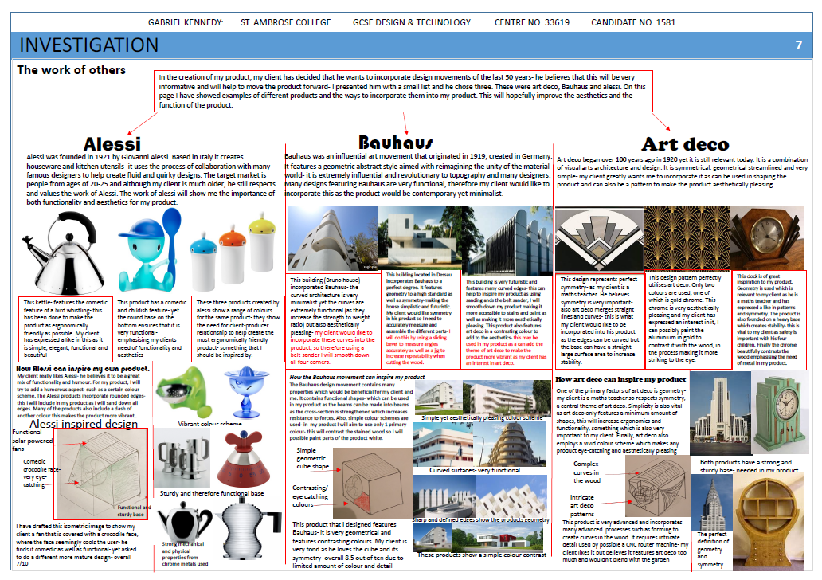
NEA GCSE DESIGN & TECHNOLOGY

Slide 7
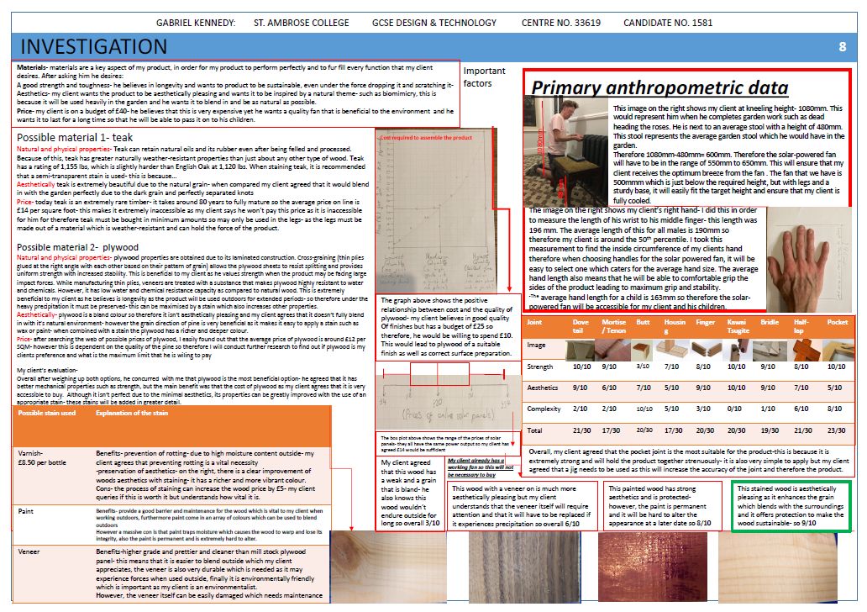
NEA GCSE DESIGN & TECHNOLOGY

Slide 8
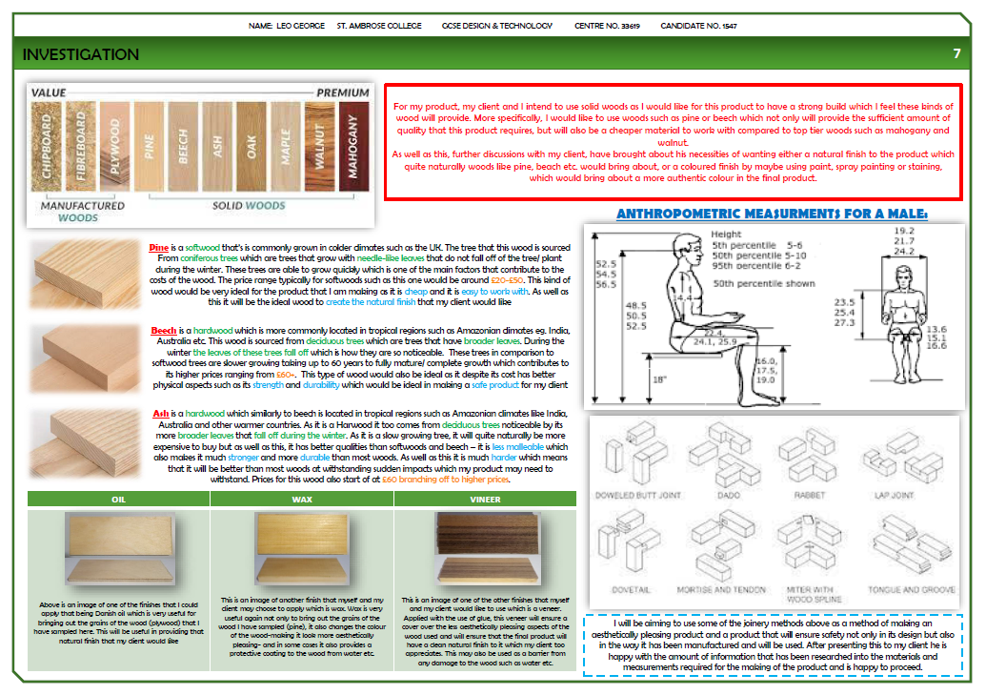
NEA GCSE DESIGN & TECHNOLOGY

Slide 9
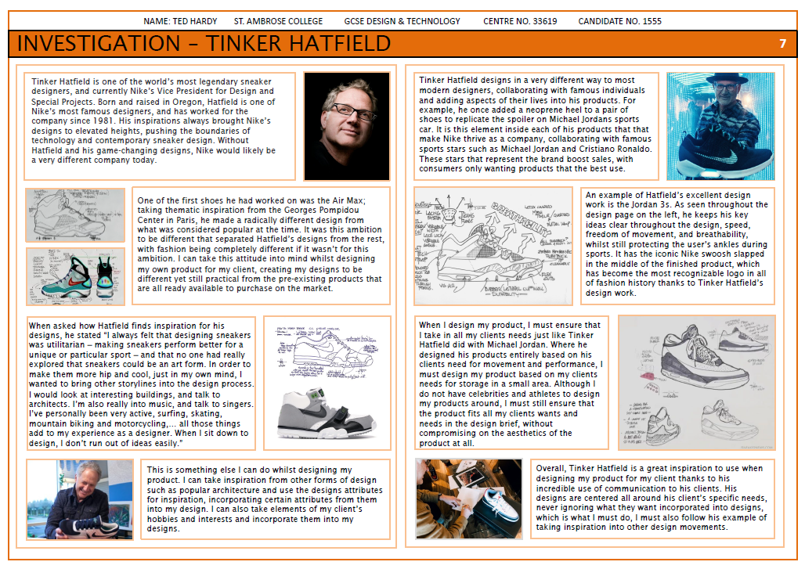
NEA GCSE DESIGN & TECHNOLOGY

Slide 10
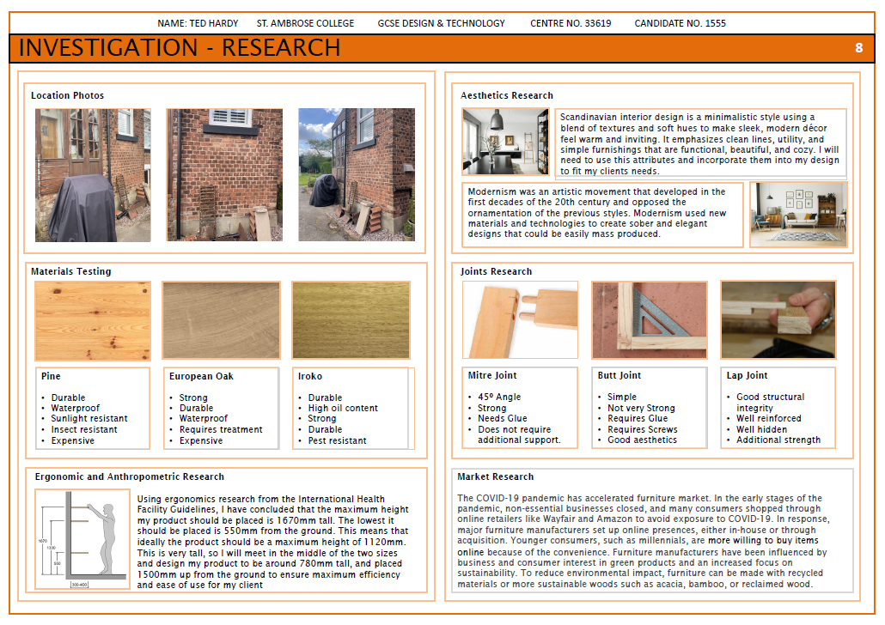
NEA GCSE DESIGN & TECHNOLOGY

