Slide 1


SPECIFICATION
GCSE DESIGN & TECHNOLOGY
Non-Exam Assessment (NEA)

Slide 2
NEA GCSE DESIGN & TECHNOLOGY
Non-Exam Assessment (NEA)
Previously referred to as controlled assessment or coursework.
It is a design a make project that includes:
A 20 page A3 design portfolio
A manufactured product
NEA Criteria
When completed you will be given a mark out of 100. There are six sections in total. Marks are allocated to each section (see table).
Timescale
The project should take 30 to 35 hours. You can finish off some work at home but the majority of work and all practical work must be completed under your teachers supervision.
Deadline: Feb half term 2019
Section | Criteria | Marks
A | Identifying & investigating design possibilities | 10
B | Producing a design brief & specification | 10
C | Generating design ideas | 20
D | Developing design ideas | 20
E | Realising design ideas | 20
F | Analysing & evaluating | 20
Total |  | 100
The maximum mark for your NEA is 100.
The table shows the criteria for the NEA as well as how marks are allocated.

Slide 3
NEA GCSE DESIGN & TECHNOLOGY
Section B Producing a design brief and specification
There will be assessment criteria for each section of your NEA.
Section B carries a total of 10 marks.
In order to achieve full marks for this section, your work will need to fulfil the criteria shown in the table.
Section B Assessment Criteria
Comprehensive design brief which clearly justifies how you have considered their user/client’s needs and wants and links directly to the context selected.
Comprehensive design specification with very high level of justification linking to the needs and wants of the client/user. Fully informs subsequent design stages.
Don’t just rely on templates given by your teacher.
Reading the criteria will help you better understand what is required.

Slide 4
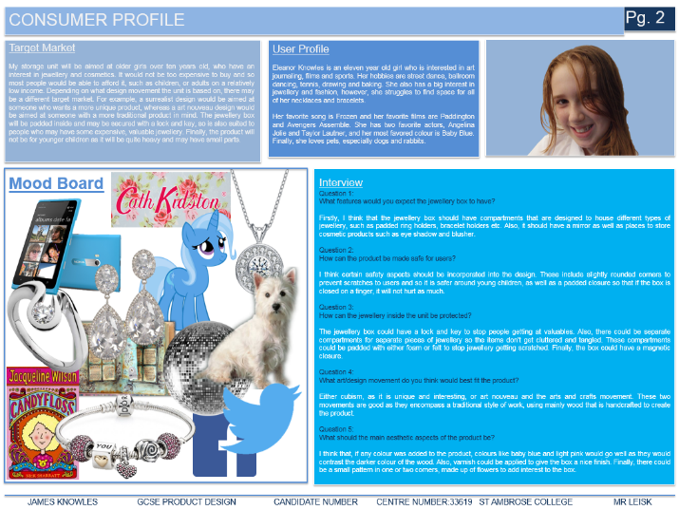
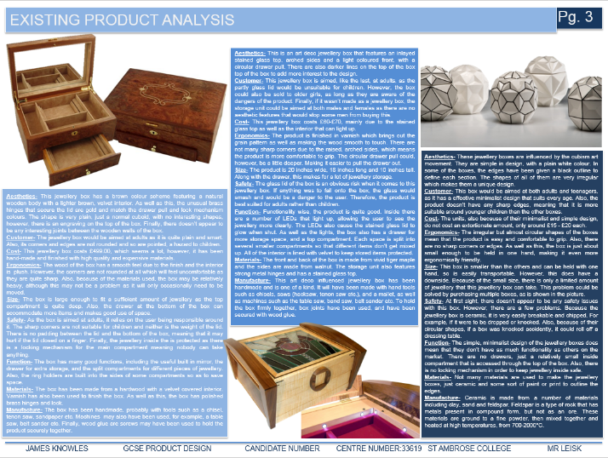
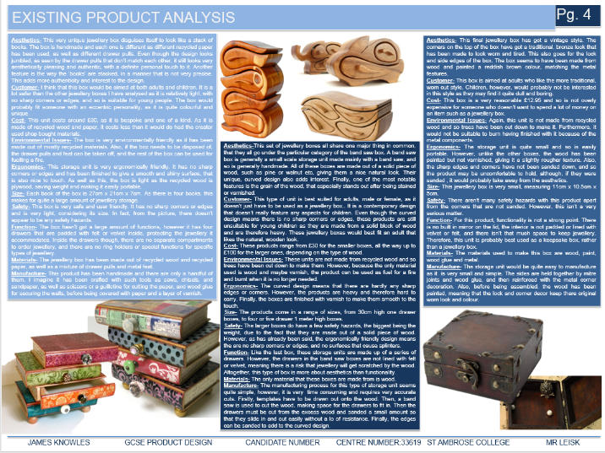
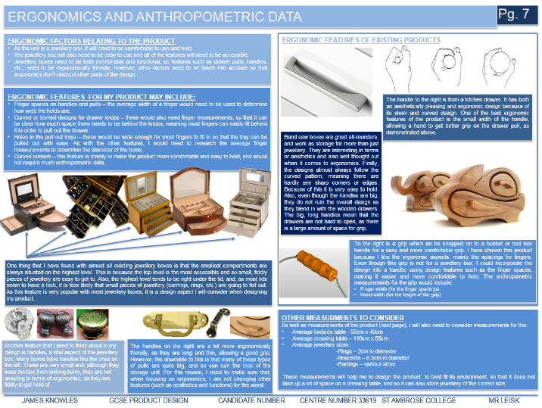
NEA GCSE DESIGN & TECHNOLOGY
Research complete…
Once you have completed all your research, you need to try and write a clear and concise list that your designs should follow.
This is called the specification and it should bring together your clients requirements and all the information you have learnt from your research.
This is an important part of the design process. The design criteria must be strictly followed.
Remember
A specification is a set of criteria that you must follow while designing your product. If you don’t stick to the criteria, you may end up designing a product that does not fit with the clients needs.

Slide 5
NEA GCSE DESIGN & TECHNOLOGY
The criteria can be easily remembered by the acronym: ACCEESSFMM, with each letter standing for a
sub-heading on your Specification
Remember this is only a guide and you may well think of more areas to add onto your Specification.
The Specification
The specification expands upon the design brief by setting out more detailed design constraints.
It generally takes the form of a list of design requirements after further thought and consideration has been given to the design brief and research carried out.
It states what design must be, must do, must have and is referred to when designing and evaluating design ideas.
It is important that the specification covers the key areas that relate to the product you are designing, and it should be composed of simple clear statements that include the following aspects.
A = Aesthetics
C = Customer
C = Cost
E = Ergonomics
E = Environmental issues
S = Safety
S = Size
F = Function
M = Materials
M = Manufacture

Slide 6
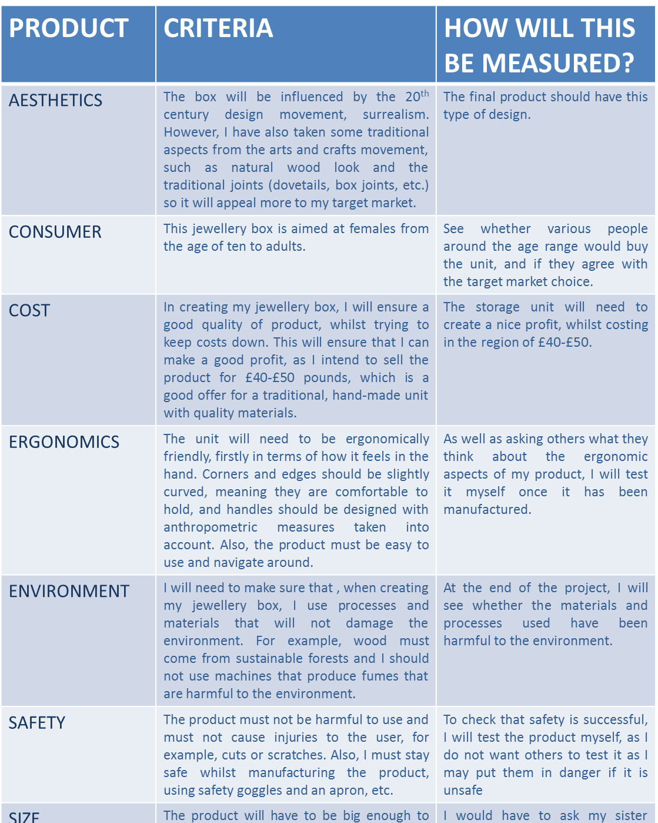
NEA GCSE DESIGN & TECHNOLOGY
A = Aesthetics – What will your product look like? What colour, shape, tone, texture and style will it be? Will the design be based on a theme?
C = Customer – who will your product be aimed at (also known as target market)? What is their age, sex, social type (e.g. student, teacher, child, professional, elderly or disabled)?
C = Cost - How much would you theoretically sell your product for, if you had to? How much do you think it will cost to make?
E = Ergonomics – will your product take into account how a human will use it? Will it be comfortable and easy to use?
E = Environmental issues – what environmental impact will your product have? How will you minimise this? Will you use any recycled materials? Will your product be able to be recycled or re-used? Does it have a secondary use?
S = Safety – will your product safe to use? Will it be safe enough to pass any recognised safety standards (CE mark or BSI mark)?
S = Size – what size will your product be?
F = Function – what will your product do?
M = Materials – what materials will you use to make your product and why/what properties do you require from the materials to be used?
M = Manufacture – what methods of manufacturing will you use? What tools/equipment will you use to make it? What joining methods will you use?

Slide 7
NEA GCSE DESIGN & TECHNOLOGY
Specification
For each area of the specification you must:
Describe the criteria what must the product do in order to meet the client/users needs. Please ensure that you justify all criteria (explain why it will be important aspect of the design)
Explain how you will measure each criteria if it’s not measurable, then you will be unable to test your product when it has been manufactured. You won’t know whether you have a successful product or not.
Describe how you will consider sustainability throughout the design process use of excess material, can it be recycled or reused, how long should the product last, can the parts be easily disassembled for recycling, will your materials come from a sustainable source?
Specification
Design brief (updated) | Has your design brief been adapted since the original version? If so, state it here.
PRODUCT | CRITERIA (with justification) | HOW THIS WILL BE MEASURED
AESTHETICS
CUSTOMER
COST
ERGONOMICS
ENVIRONMENT
SAFETY
SIZE
FUNCTION
MANUFACTURE
MATERIALS

Slide 8
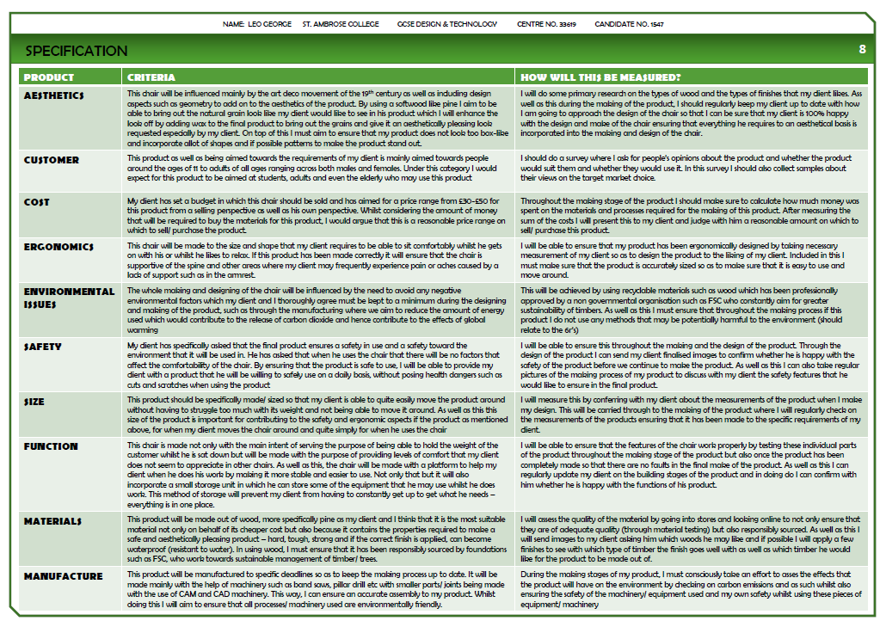

Slide 9


