Slide 1


INITIAL IDEAS
GCSE DESIGN & TECHNOLOGY
Non-Exam Assessment (NEA)

Slide 2
NEA GCSE DESIGN & TECHNOLOGY
Non-Exam Assessment (NEA)
Previously referred to as controlled assessment or coursework.
It is a design a make project that includes:
A 20 page A3 design portfolio
A manufactured product
NEA Criteria
When completed you will be given a mark out of 100. There are six sections in total. Marks are allocated to each section (see table).
Timescale
The project should take 30 to 35 hours. You can finish off some work at home but the majority of work and all practical work must be completed under your teachers supervision.
Deadline: Feb half term 2019
Section | Criteria | Marks
A | Identifying & investigating design possibilities | 10
B | Producing a design brief & specification | 10
C | Generating design ideas | 20
D | Developing design ideas | 20
E | Realising design ideas | 20
F | Analysing & evaluating | 20
Total |  | 100
The maximum mark for your NEA is 100.
The table shows the criteria for the NEA as well as how marks are allocated.

Slide 3
NEA GCSE DESIGN & TECHNOLOGY
Section C
Generating design ideas
There will be assessment criteria for each section of your NEA.
Section C carries a total of 20 marks.
In order to achieve full marks for this section, your work will need to fulfil the criteria shown in the table.
Section C Assessment Criteria
Imaginative, creative and innovative ideas have been generated, fully avoiding design fixation and with full consideration of functionality, aesthetics and innovation. Ideas have been generated, that take full account of on-going investigation that is both fully relevant and focused. Extensive experimentation and excellent communication is evident, using a wide range of techniques. Imaginative use of different design strategies for different purposes and as part of a fully integrated approach to designing.
Don’t just rely on templates given by your teacher.
Reading the criteria will help you better understand what is required.

Slide 4
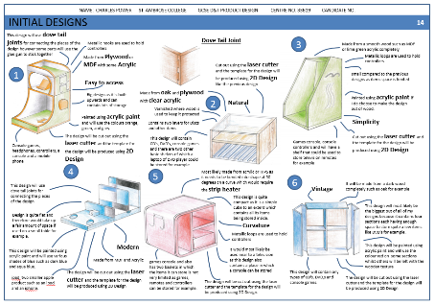
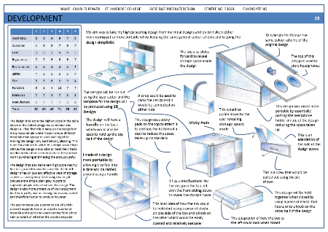
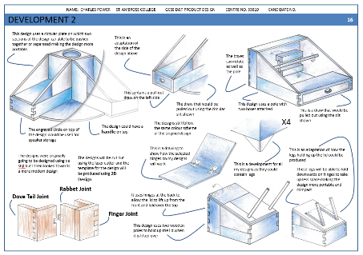
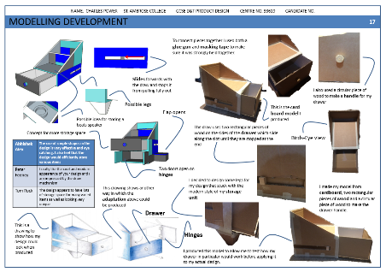
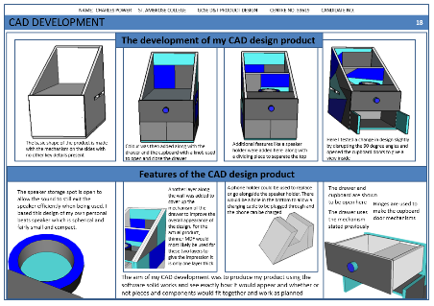
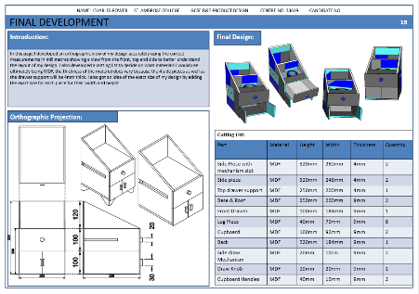
NEA GCSE DESIGN & TECHNOLOGY
Design and development of your idea
This stage of the project is likely to be 6 pages and will consist of:
Initial Ideas and review
Development sketches
Development through modelling
Computer aided design
Final design

Slide 5
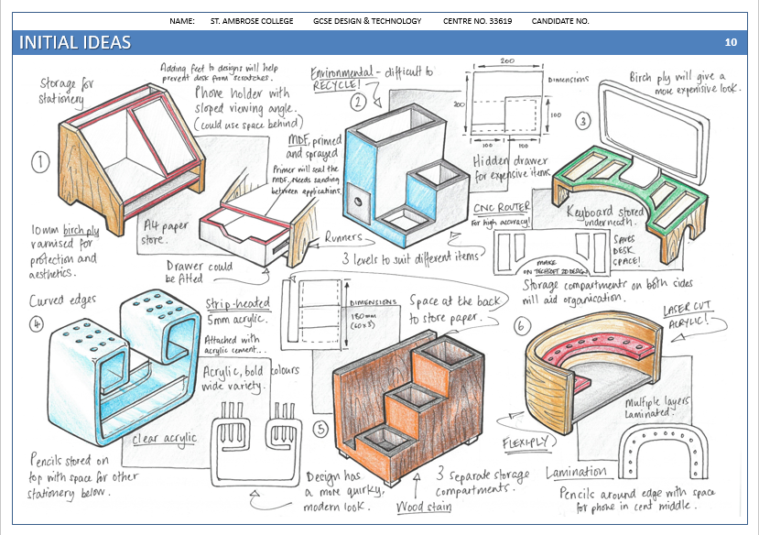
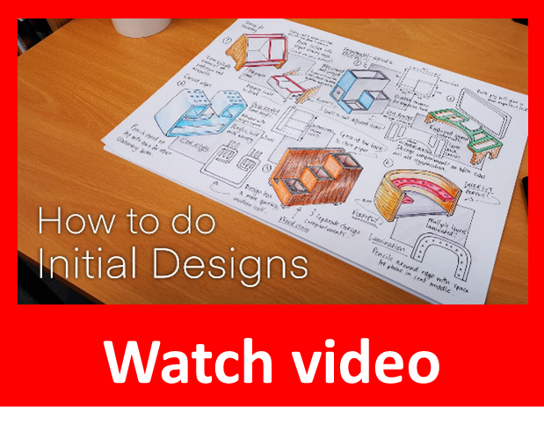
NEA GCSE DESIGN & TECHNOLOGY
Initial Ideas
You must produce 6-8 designs for your product.
Each design should have at least two sketches.
Main sketches must be coloured and fine-lined.
All ideas must be annotated to explain the design itself as well as how it meets the specification criteria.
All design choices must be justified.
Notes:
https://youtu.be/5wCH3nBUPU4

Slide 6
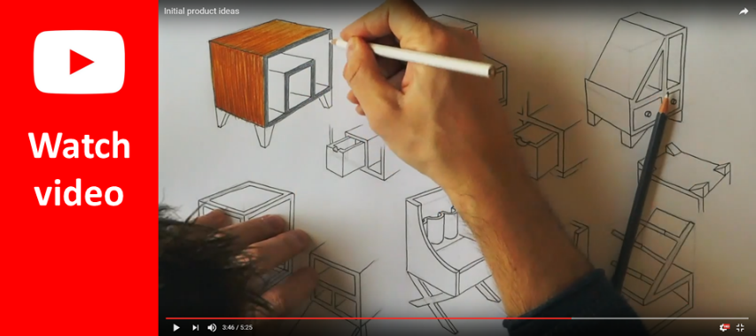
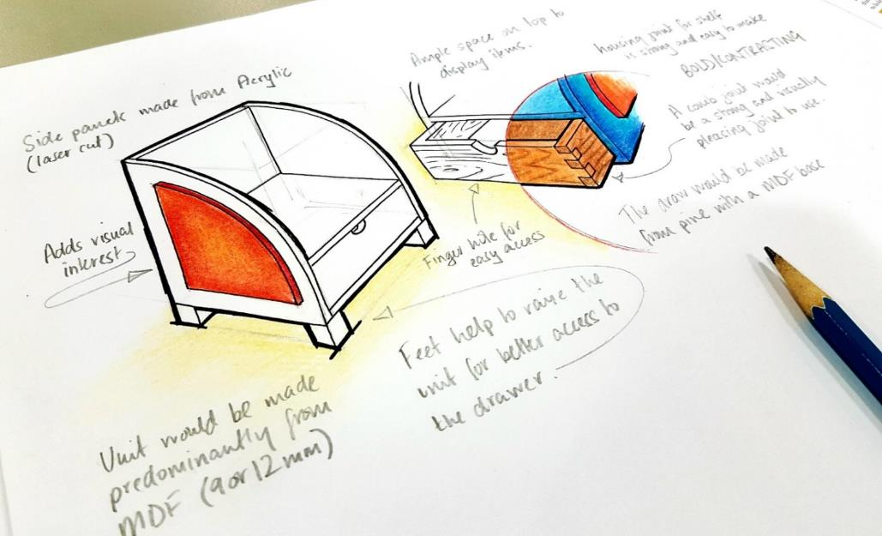
NEA GCSE DESIGN & TECHNOLOGY
Initial Ideas
You must produce 6 designs for your product.
Each design should have at least two sketches.
Main sketches must be coloured and fine-lined.
All ideas must be annotated to explain the design itself as well as how it meets the specification criteria.
All design choices must be justified.
https://www.youtube.com/watch?v=EQss_uIwNLM
Annotation – what to write:
Describe the main features of the design. (bold colours and geometric shapes are in keeping with Bauhaus style and add visual interest).
Explain how it meets the specification criteria.
State what materials and/or components would be used and why it is a suitable choice.
State the joining method of materials and why it is a suitable method. (I have used a comb joint in the drawer corners as it is strong and visually pleasing.)
State what processes would need to be used and how (e.g. a strip heater would be used to bend the acrylic into the desired shape).
Explain any sustainability issues you’ve considered.
Explain how your design appeals to the target audience.

Slide 7
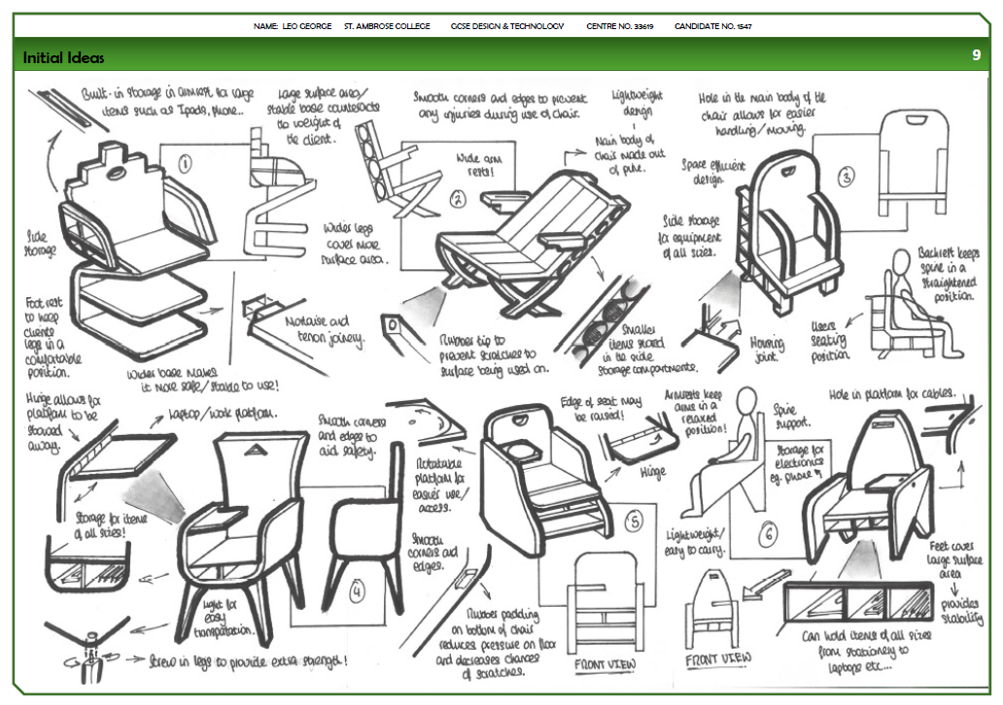
NEA GCSE DESIGN & TECHNOLOGY
EXAMPLE
This is an example showing a response to last year’s contextual challenges.
A range of ideas to suit different contexts and clients. There are multiple views of each idea to enhance clarity, which is especially important as these designs will be shown to potential clients.
NOTE: there is no feedback as this was included on a later slide.

Slide 8
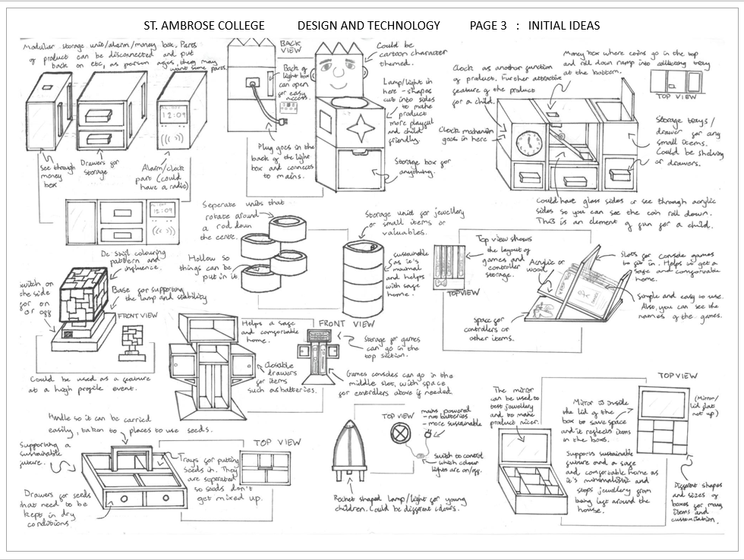
NEA GCSE DESIGN & TECHNOLOGY
EXAMPLE
This is an example showing a response to last year’s contextual challenges.
A range of ideas to suit different contexts and clients. There are multiple views of each idea to enhance clarity, which is especially important as these designs will be shown to potential clients.
NOTE: there is no feedback as this was included on a later slide.

Slide 9
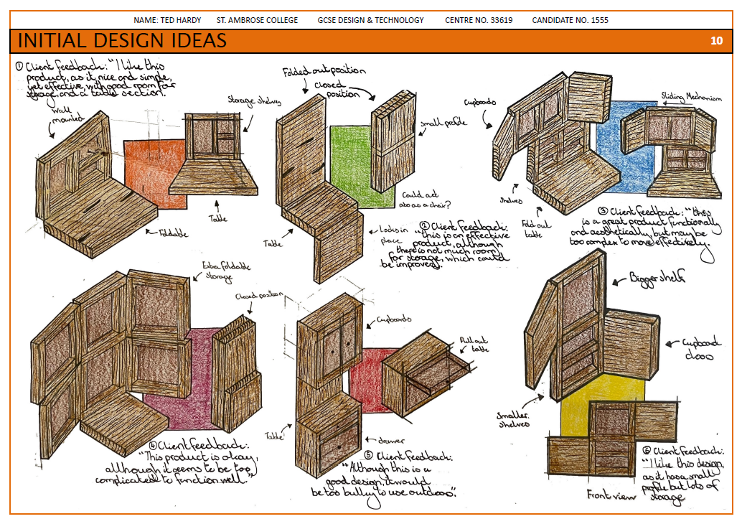
NEA GCSE DESIGN & TECHNOLOGY
EXAMPLE
This is an example showing a response to last year’s contextual challenges.
A range of ideas to suit different contexts and clients. There are multiple views of each idea to enhance clarity, which is especially important as these designs will be shown to potential clients.
NOTE: there is no feedback as this was included on a later slide.

Slide 10
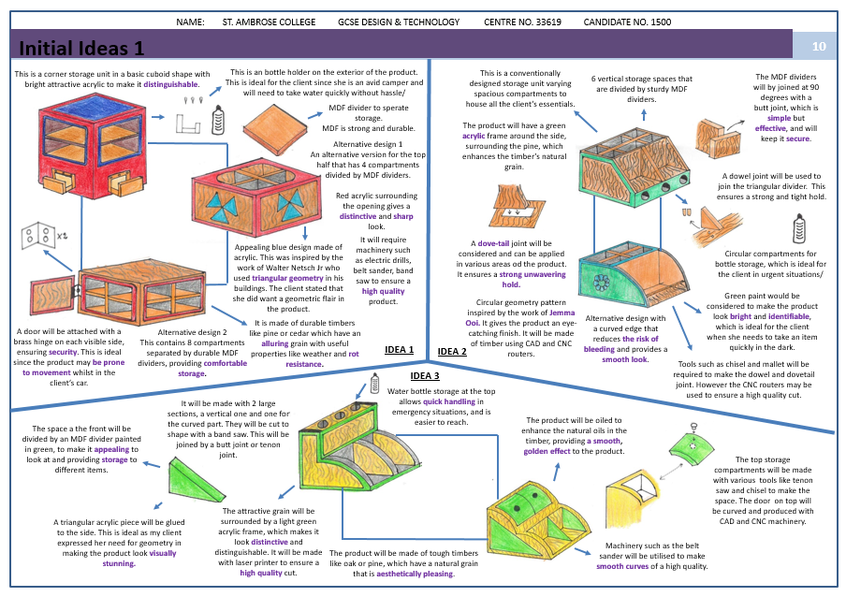
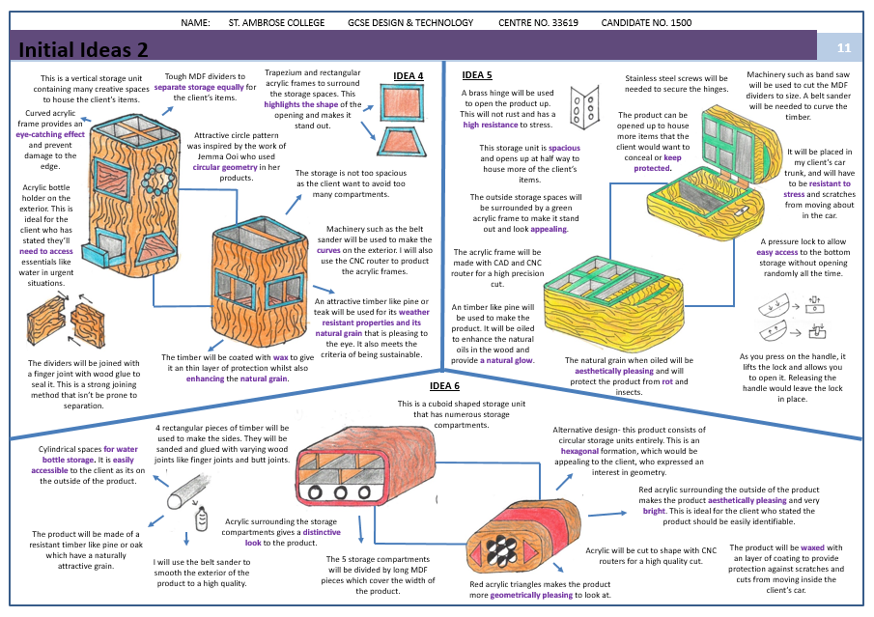
NEA GCSE DESIGN & TECHNOLOGY

Slide 11
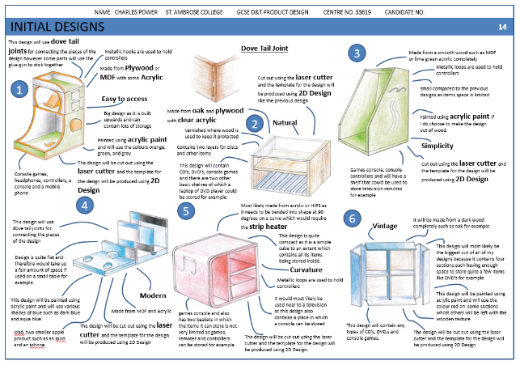
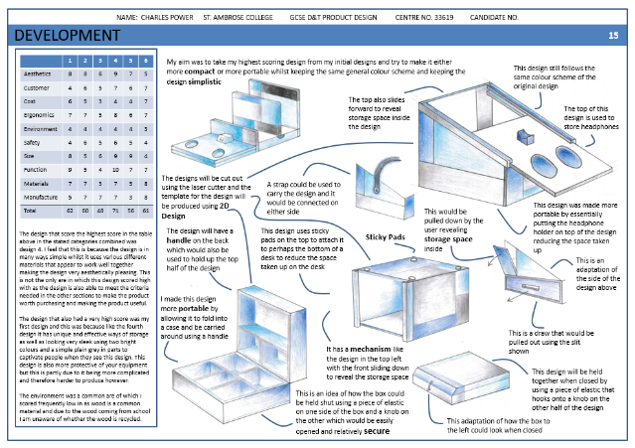
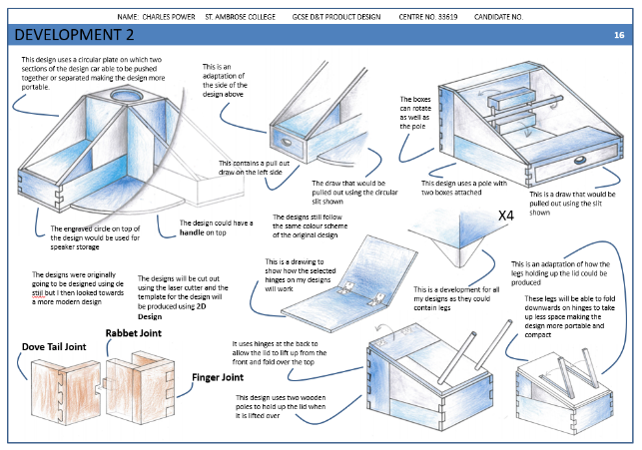
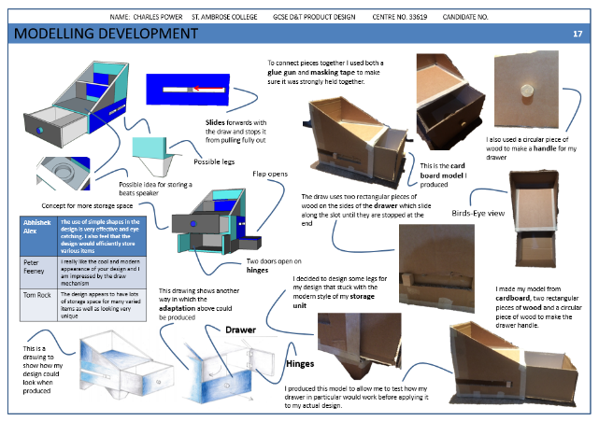
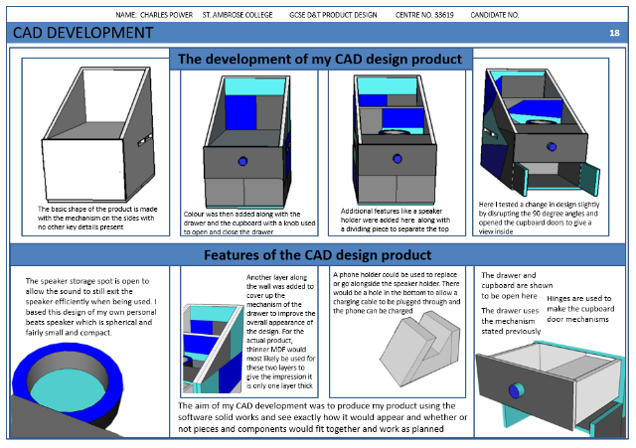
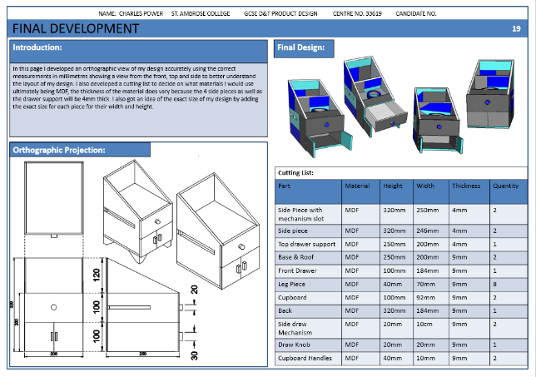
NEA GCSE DESIGN & TECHNOLOGY

Slide 12
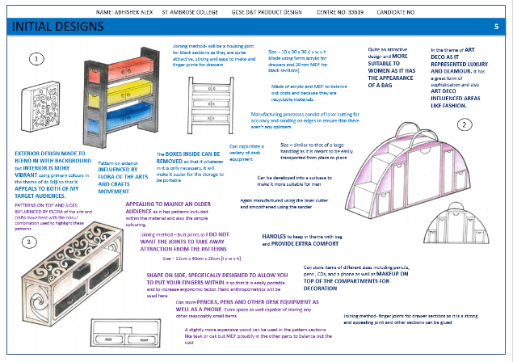
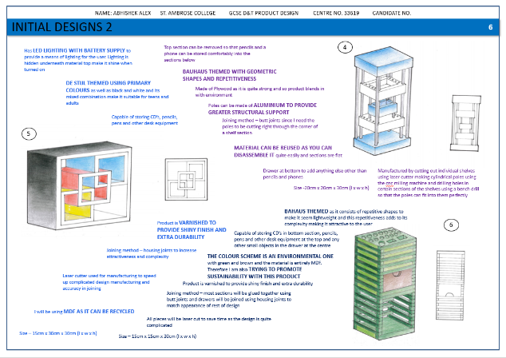
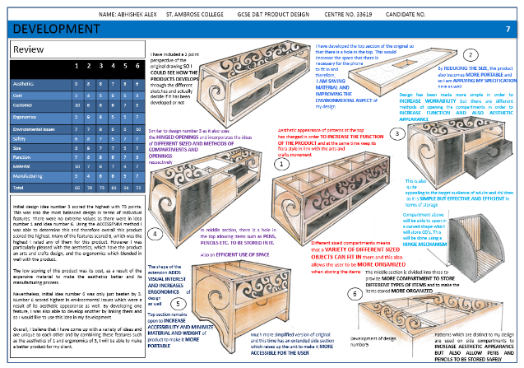
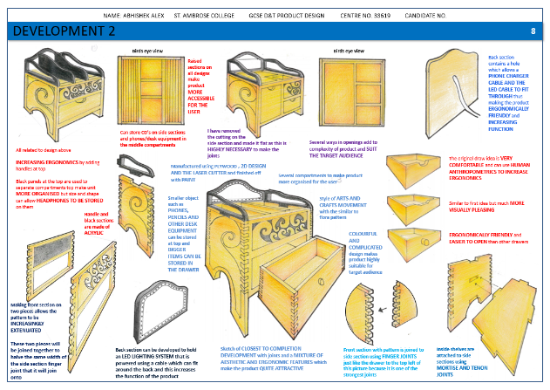
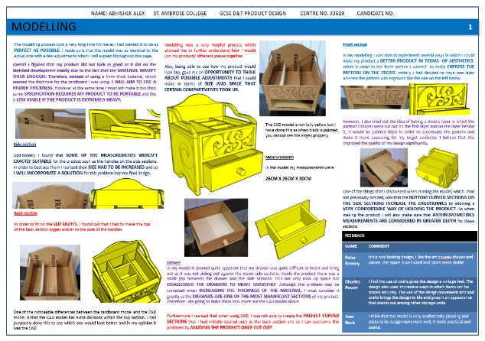
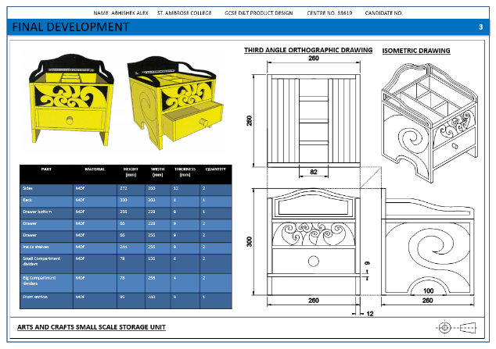
NEA GCSE DESIGN & TECHNOLOGY

