Slide 1


DESIGN
DEVELOPMENT
GCSE DESIGN & TECHNOLOGY
Non-Exam Assessment (NEA)

Slide 2
NEA GCSE DESIGN & TECHNOLOGY
Non-Exam Assessment (NEA)
Previously referred to as controlled assessment or coursework.
It is a design a make project that includes:
A 20 page A3 design portfolio
A manufactured product
NEA Criteria
When completed you will be given a mark out of 100. There are six sections in total. Marks are allocated to each section (see table).
Timescale
The project should take 30 to 35 hours. You can finish off some work at home but the majority of work and all practical work must be completed under your teachers supervision.
Deadline: Feb half term 2019
Section | Criteria | Marks
A | Identifying & investigating design possibilities | 10
B | Producing a design brief & specification | 10
C | Generating design ideas | 20
D | Developing design ideas | 20
E | Realising design ideas | 20
F | Analysing & evaluating | 20
Total |  | 100
The maximum mark for your NEA is 100.
The table shows the criteria for the NEA as well as how marks are allocated.

Slide 3
NEA GCSE DESIGN & TECHNOLOGY
Section D
Developing design ideas
There will be assessment criteria for each section of your NEA.
Section D carries a total of 20 marks.
In order to achieve full marks for this section, your work will need to fulfil the criteria shown in the table.
Section D Assessment Criteria
Very detailed development work is evident, using a wide range of 2D/3D techniques (including CAD where appropriate) in order to develop a prototype. Excellent modelling, using a wide variety of methods to test their design ideas, fully meeting all requirements. Fully appropriate materials/components selected with extensive research into their working properties and availability. Fully detailed manufacturing specification is produced with comprehensive justification to inform manufacture.
Don’t just rely on templates given by your teacher.
Reading the criteria will help you better understand what is required.

Slide 4
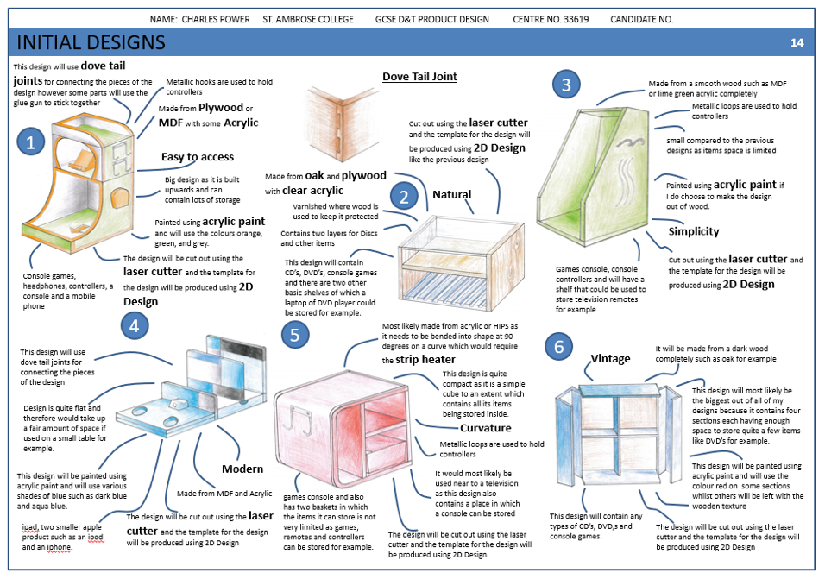
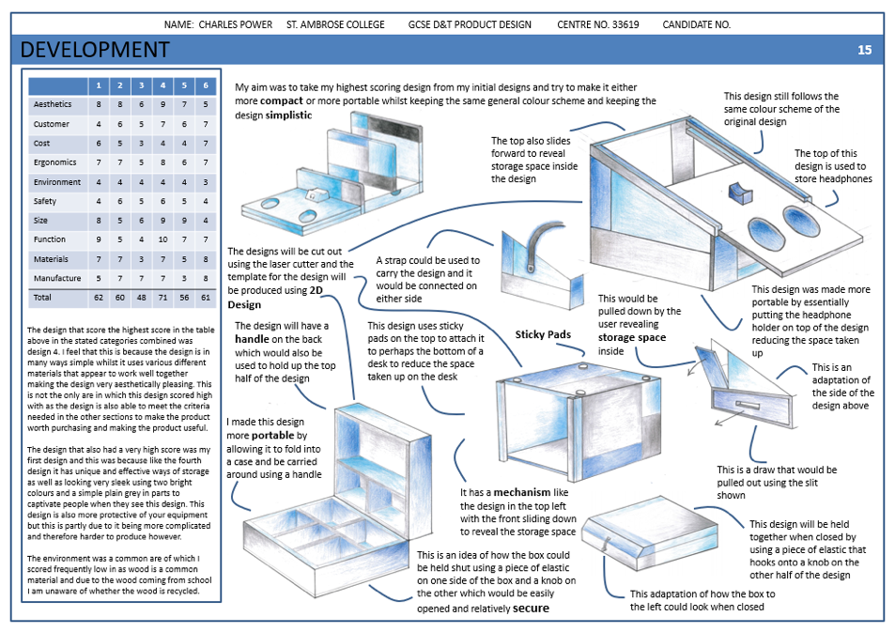
NEA GCSE DESIGN & TECHNOLOGY
Design Development
At this stage of the design process, you must now choose your best initial idea and develop it into a fully workable design, also ensuring that it meets all aspects of the specification.
During this stage of the process, you should be providing more technical detail for construction by showing:
A range of alternative improvements;
How the parts could fit together;
What processes could be used to make the different components;
What materials could be used.
INITIAL IDEAS
6-8 designs
Colour
Annotation
Key info highlighted
Clear layout
1st DEVELOPMENT
Review table
Client feedback
Conclusion
Early development sketches.
Colour & Annotation

Slide 5
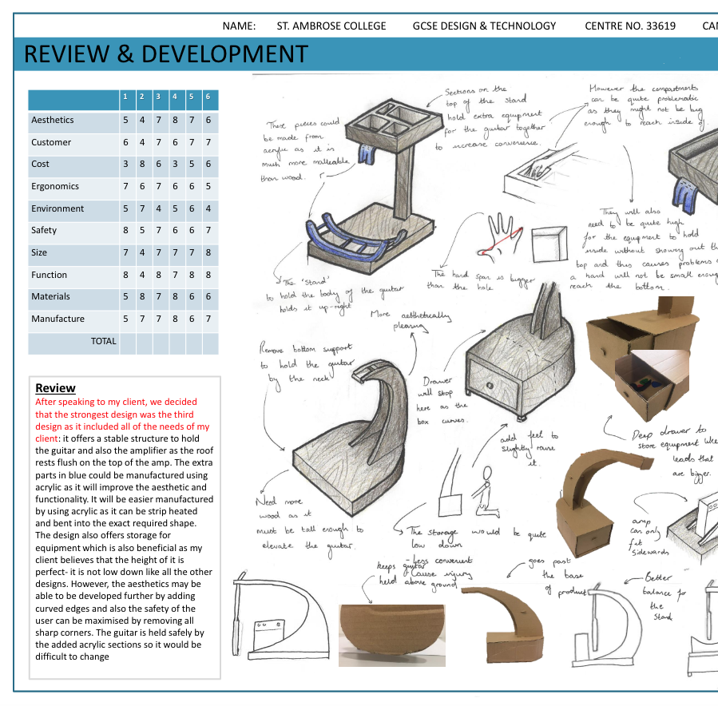
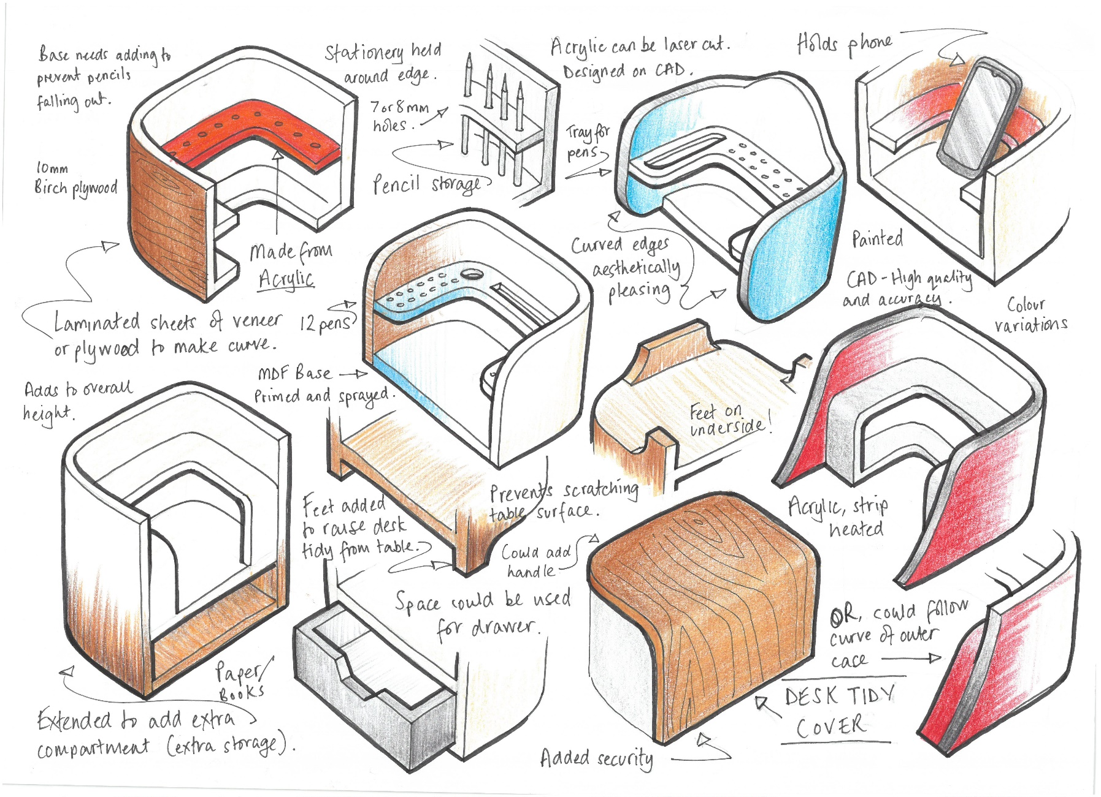
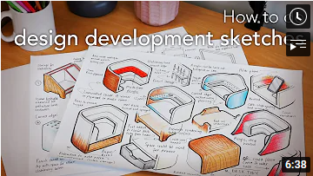
DESIGN DEVELOPMENT
Watch the video to see this page being produced

Slide 6
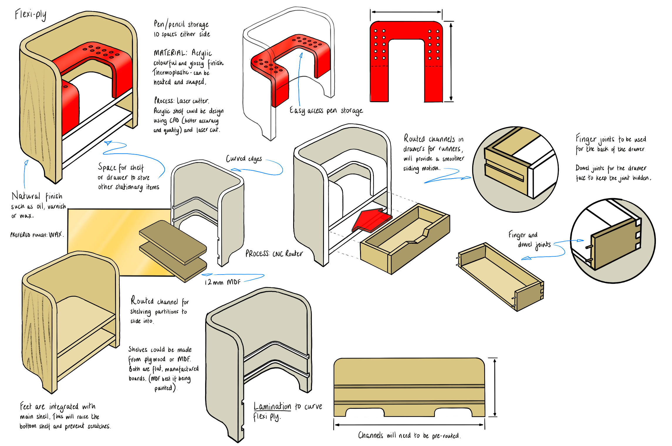
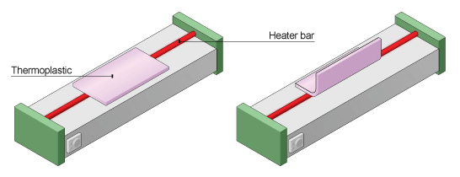
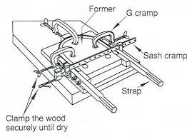
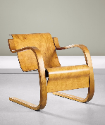

DESIGN DEVELOPMENT
Plastics such as acrylic can be formed (shaped) in different ways. One of the most popular methods of shaping plastic materials like acrylic is to fold (bend) it on a ‘strip heater’, at different angles. An example of a strip heater is shown below. A heating element extends along the length of the strip heater and gives off intense heat when it is turned on.
Watch the video to see this page being produced
Plastics such as acrylic can be formed (shaped) in different ways. One of the most popular methods of shaping plastic materials like acrylic is to fold (bend) it on a ‘strip heater’, at different angles. An example of a strip heater is shown below. A heating element extends along the length of the strip heater and gives off intense heat when it is turned on.

Slide 7
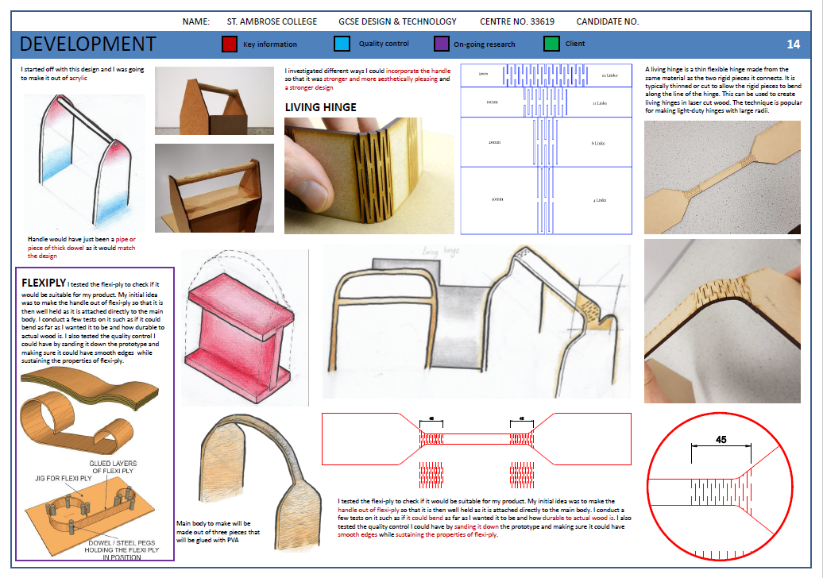
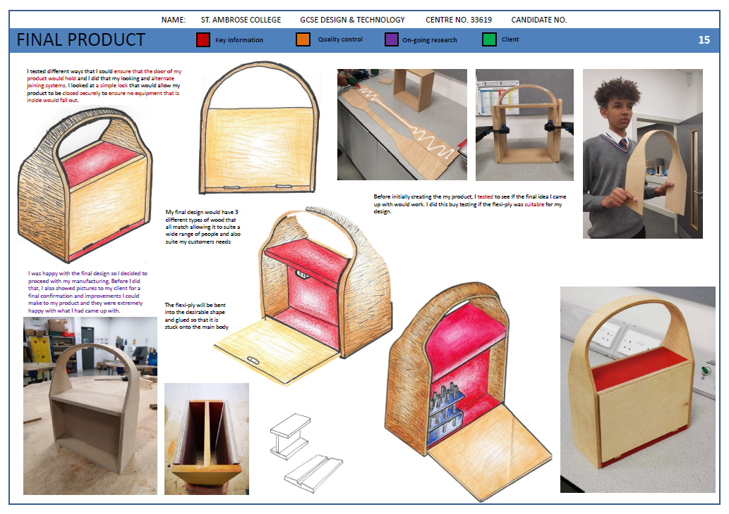
Student sketches their idea for a handle, then tests the idea by modelling.

Slide 8
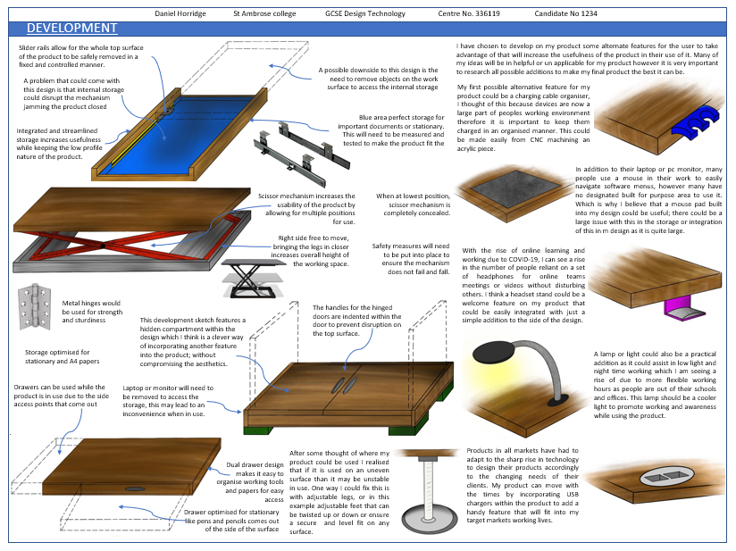
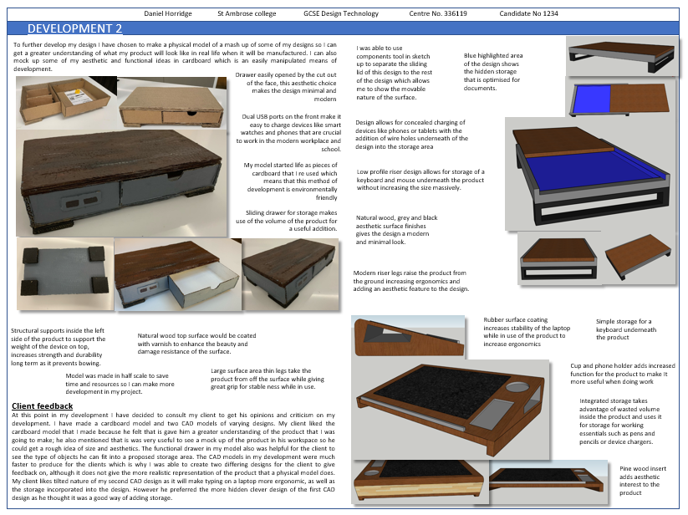
Student sketches their idea for a handle, then tests the idea by modelling.

Slide 9
NEA GCSE DESIGN & TECHNOLOGY
Review Ideas
A table like this is an easy way to review your designs. This will help you to choose which design to further develop.
At this stage, you should also include:
Evaluation against the specification
Client feedback
User-group feedback
 | 1 | 2 | 3 | 4 | 5 | 6
Aesthetics | 2
Customer | 4
Cost | 5
Ergonomics | 6
Environment | 7
Safety | 8
Size | 4
Function | 6
Materials | 8
Manufacture | 8
TOTAL
Review table
In this table, each area of the specification (ACCESSFMM) has been used to rate each design idea out of 10.

Slide 10
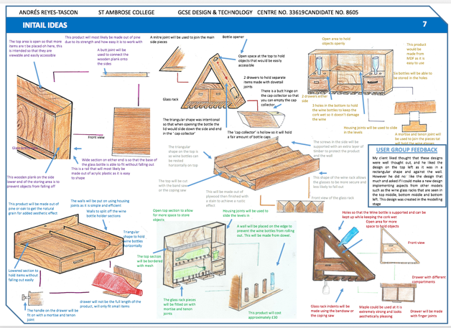
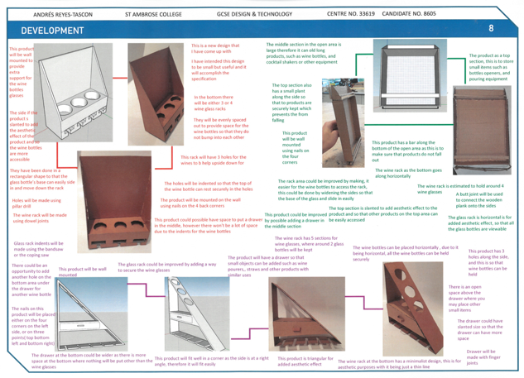
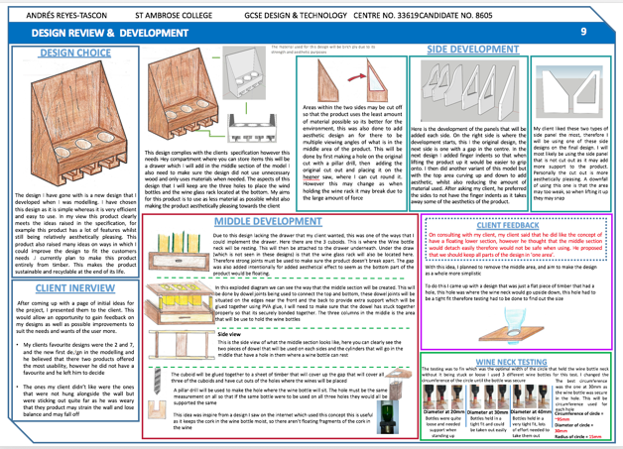
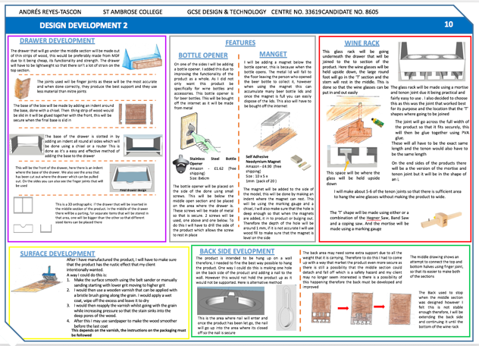
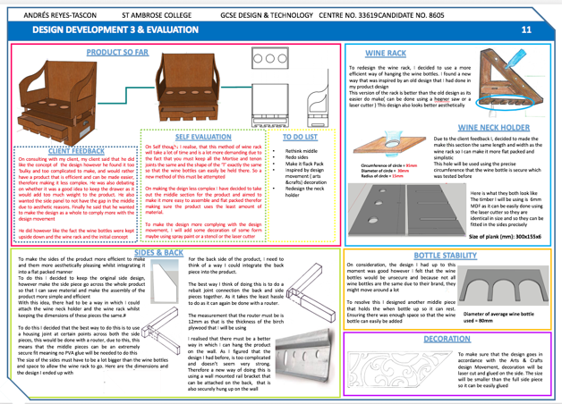
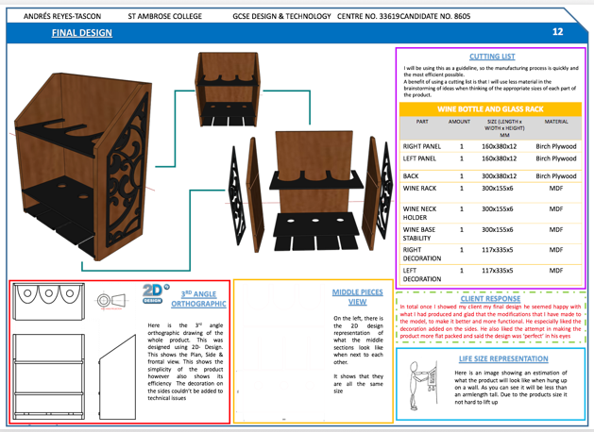
NEA GCSE DESIGN & TECHNOLOGY
Methods of Development
AQA don’t mind what form development takes. It could be Sketches, Modelling and/or CAD drawings
Different methods will suit some more than others. You might find that your sketching isn’t great but your CAD drawings are much stronger.
However, the assessment criteria states:
Very detailed development work is evident, using a wide range of 2D/3D techniques (including CAD where appropriate) in order to develop a prototype.
In this example the student follows a much more iterative approach. He utilises CAD and card modelling to test his ideas, then continues to use sketching to further develop different elements of the design.

Slide 11
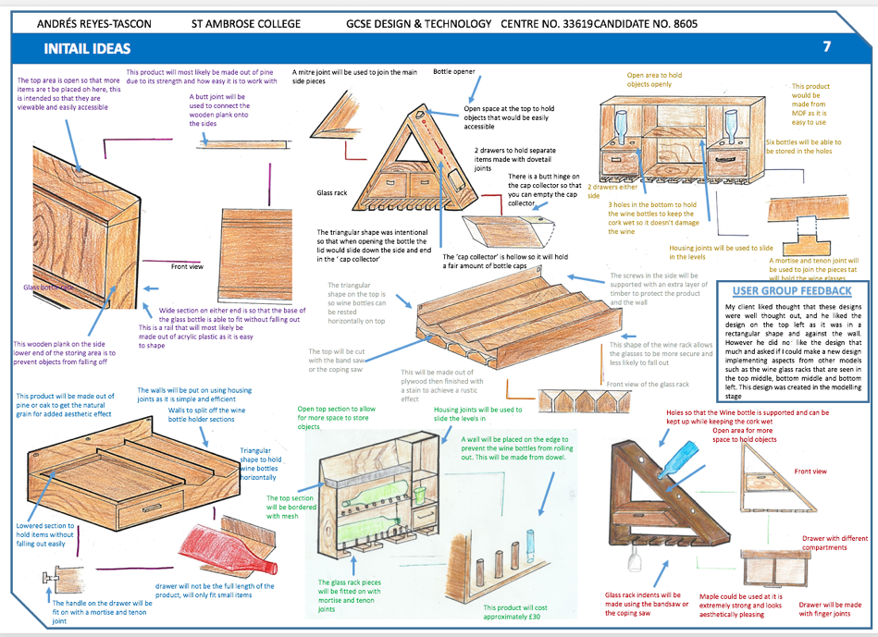


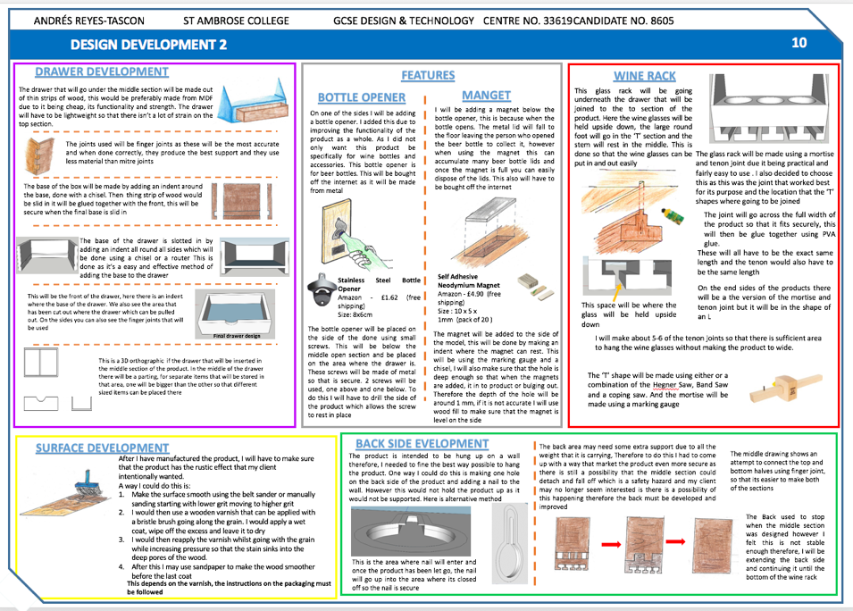

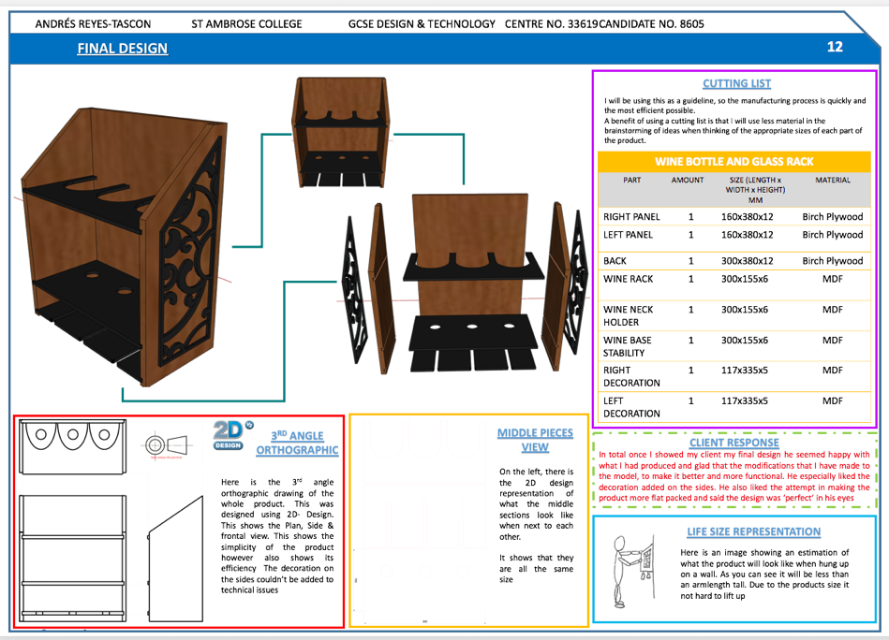
NEA GCSE DESIGN & TECHNOLOGY
EXAMPLE ONE

Slide 12
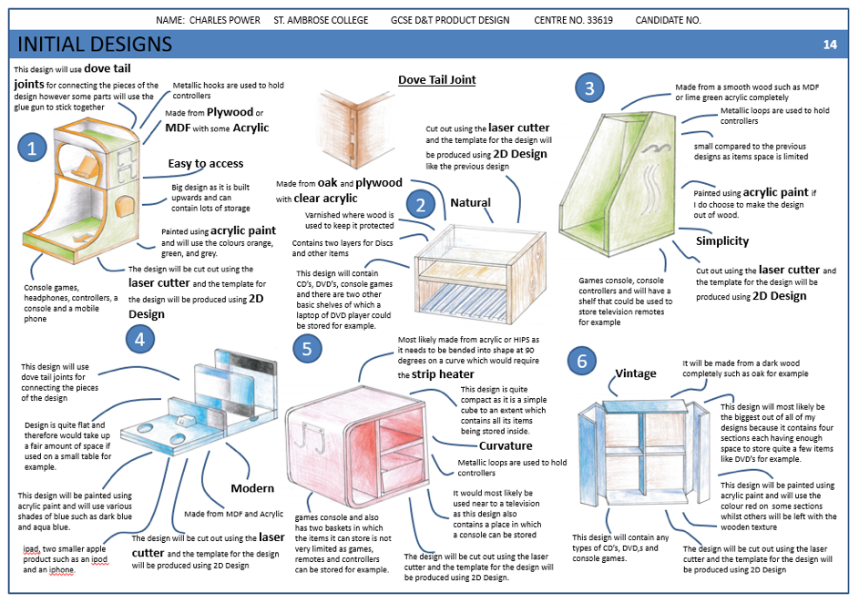

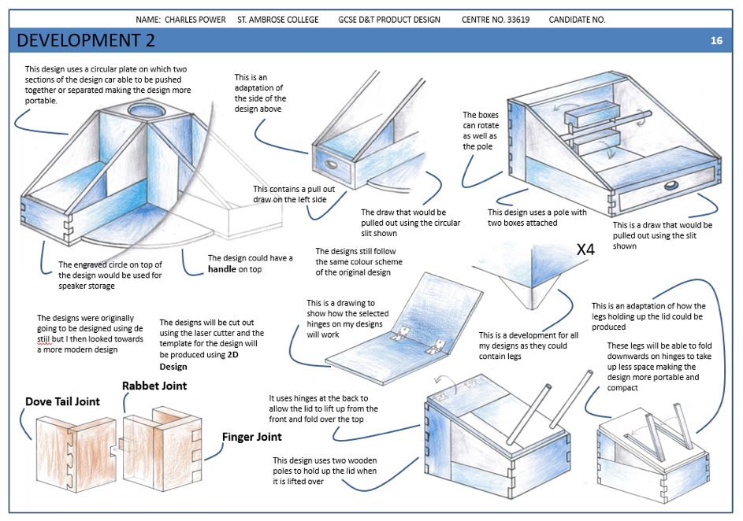
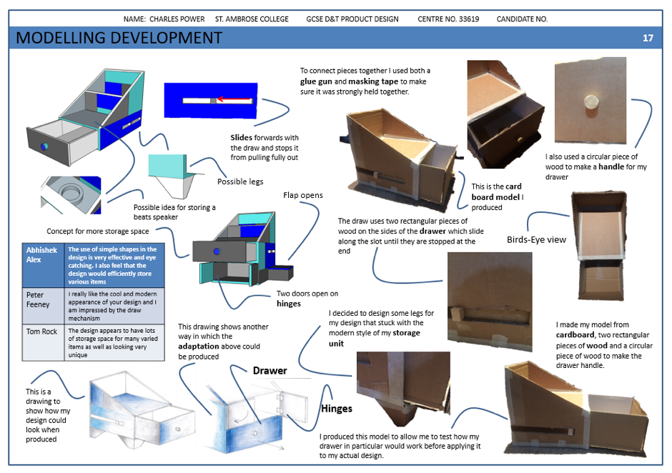
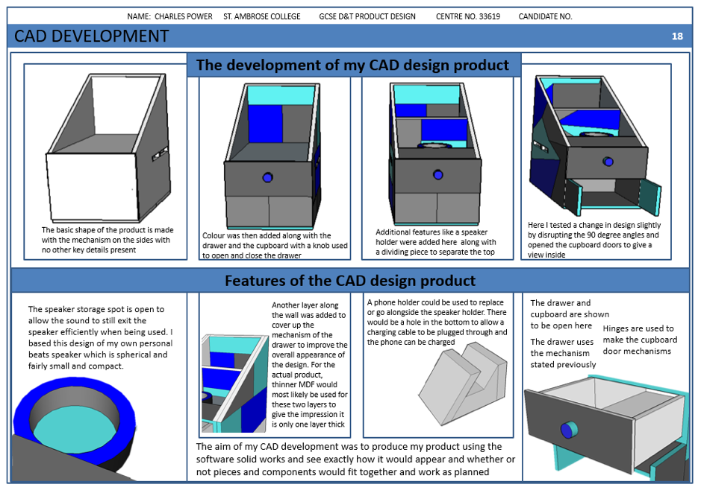
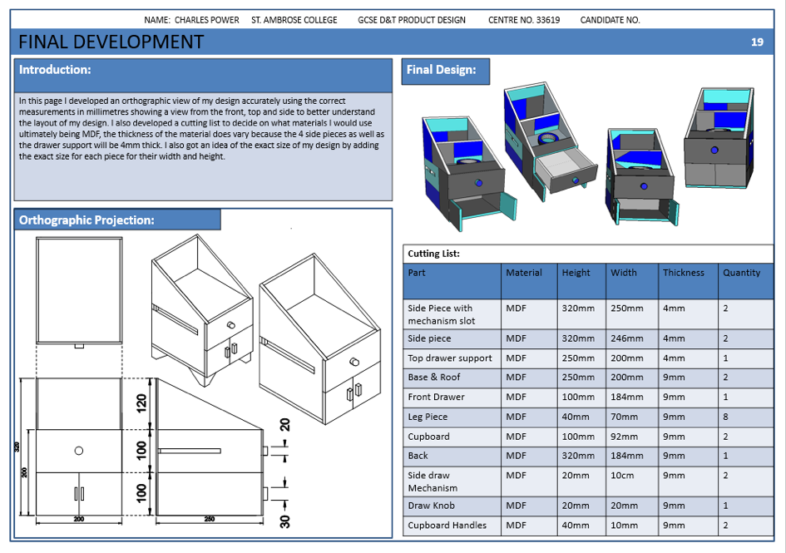
NEA GCSE DESIGN & TECHNOLOGY
EXAMPLE TWO

Slide 13
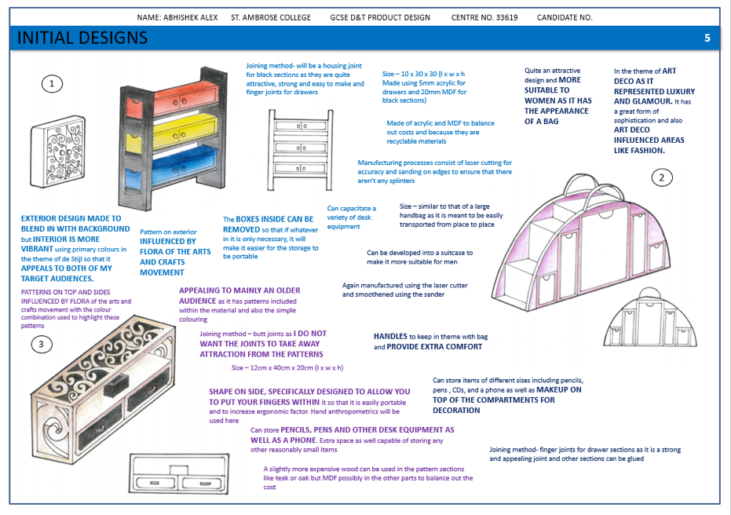
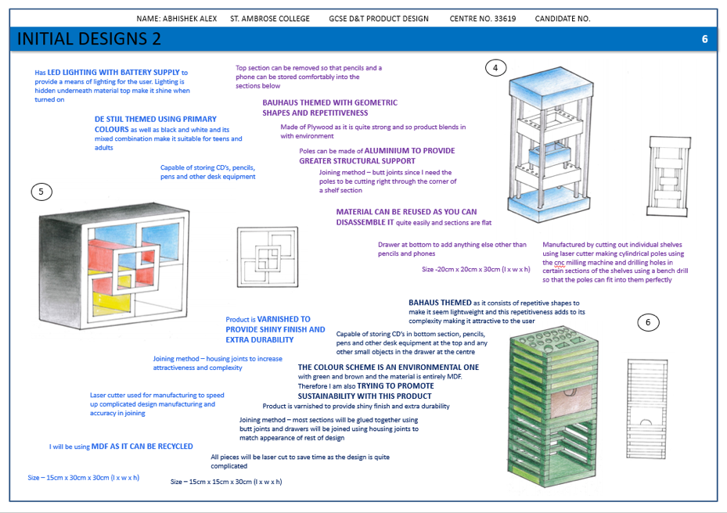
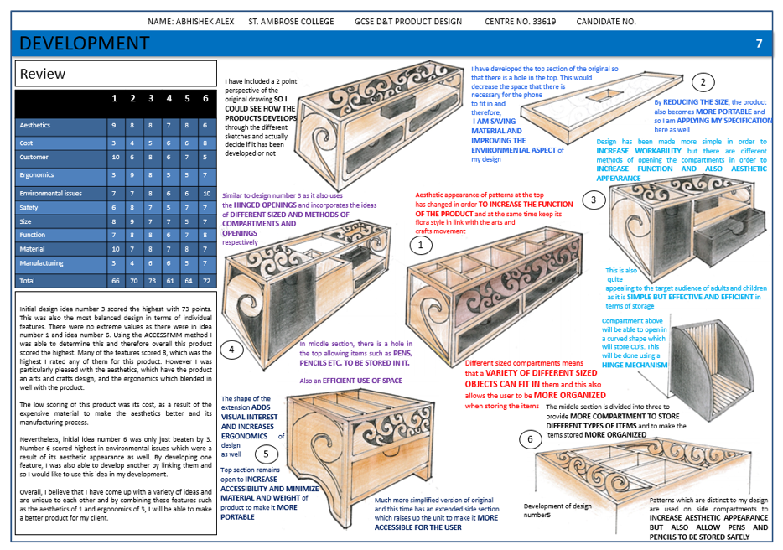
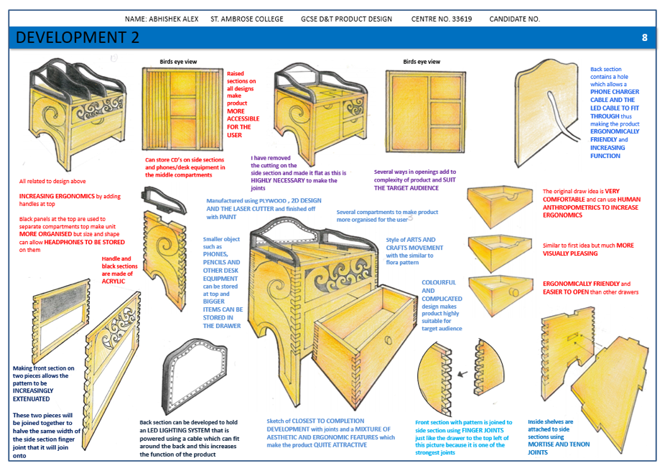
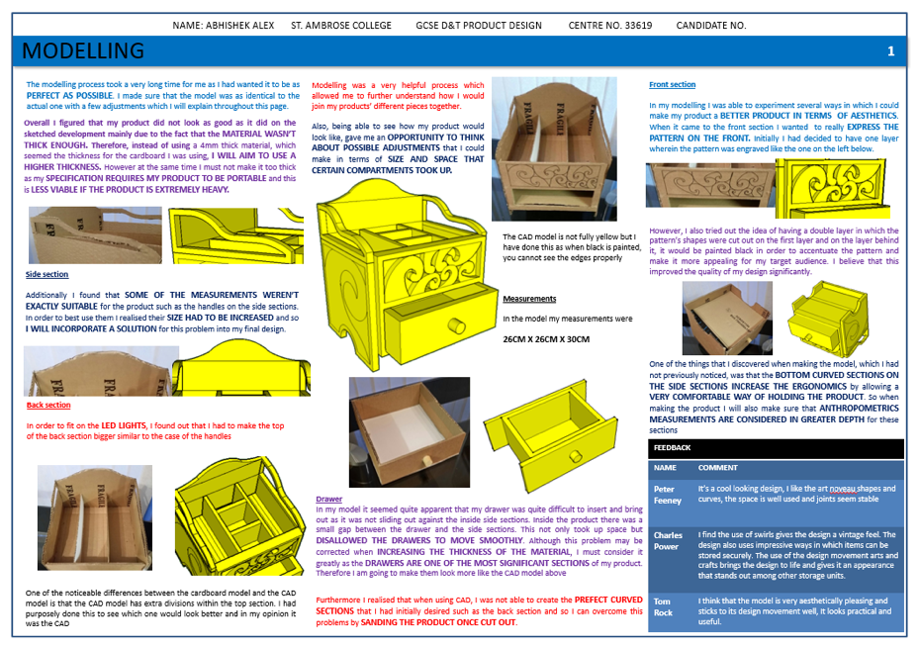
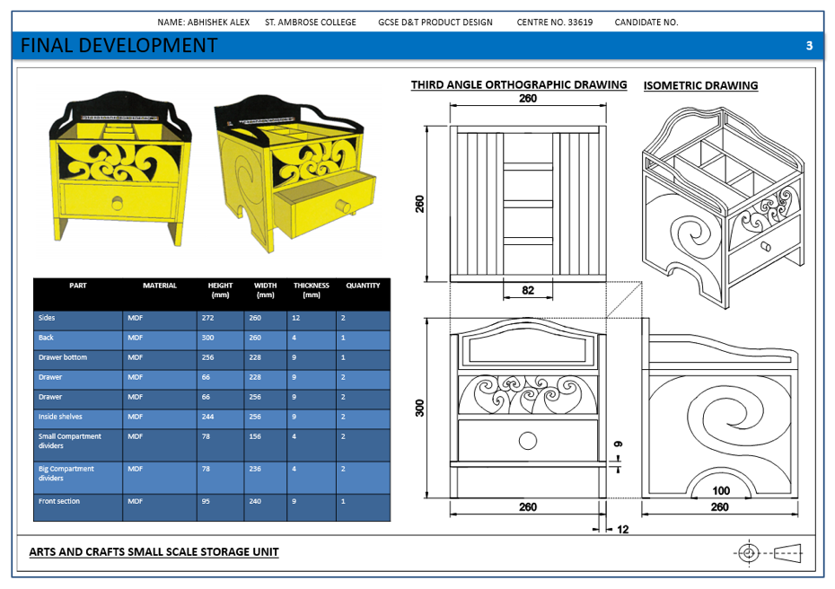
NEA GCSE DESIGN & TECHNOLOGY
EXAMPLE THREE

