Slide 1
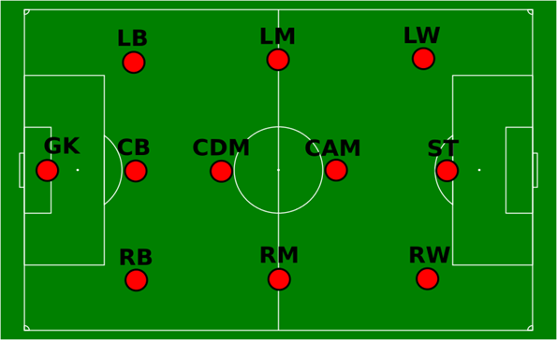
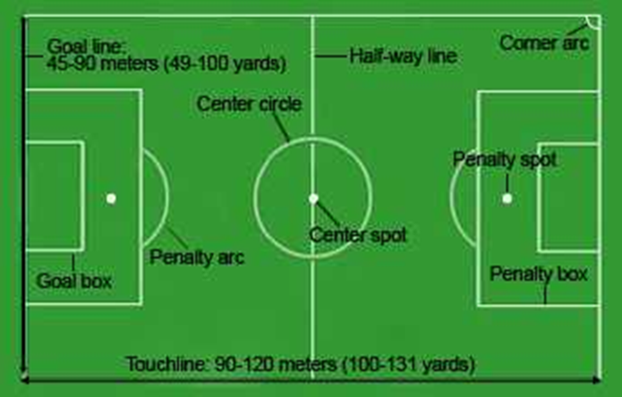
Subject Knowledge Organiser
Football – Rules, Player Positions & Pitch Dimensions
Rules
A senior football match consists of two 45-minute halves and must have a 15-minute break in the middle.
A team can start with a maximum of 11 players, of which one is the designated goalkeeper.
To continue a match, a team must have a minimum of 7 players on the field.
A team is able to make substitutions at any time of the match and are able to make a maximum of three changes.
A competitive game must be officiated by a referee and two assistant referees, also known as linesmen.
The whole ball must cross the goal line for it to constitute a goal.
A referee may award a foul if they believe an unfair act is committed by a player. A foul contravenes the laws of the game and can be given for a range of offences (for example, kicking the player, pushing, handball etc).
Fouls are punished by the award of a free kick (direct or indirect, depending on the offence) or penalty kick to the opposing team if it is committed in the penalty box.
In cases of foul play, a referee can penalise players with either a yellow or red card. A yellow card gives a player a warning about their conduct and a red card requires them to leave the pitch.
In the event that a player receives two yellow cards, the referee will automatically show a red card.
A throw-in is awarded to a team if the opposition kicks the ball over the side-lines.
A corner kick is awarded to a team if the opposition kicks the ball over the goal line and either side of the goal posts.
A player is deemed offside if they are in front of the last defender when a teammate passes the ball through to them.
Player Positions
Pitch Dimensions

Slide 2
Subject Knowledge Organiser
Football – Short/Long Pass, Control, Block Tackle, Throw In & Heading
Short pass
A short side foot pass enables a team to quickly pass a ball and help maintain possession. It is used for accuracy.
Move parallel to the ball and place your non-kicking foot to the side of the ball.
Keep your eye on the ball until you have it under your control.
Look up to see where is the best place to pass it.
On selection of your pass, maintain a strong body position.
Swing your kicking foot through and strike the ball with the inside of your foot.
Aim to hit the middle of the ball to ensure it stays close to the ground.
Keep looking at your target.
Follow your kicking leg through towards the intended target.
The speed of the kicking leg will direct how hard you kick the ball.
Block tackle
The block tackle is an essential skill for winning the ball back in football. It is mainly used when confronting an opponent head on and it is important to complete it with good timing and technique to prevent injury or fouls.
Close down your opponent quickly but do not rush uncontrolled at them.
Try to reduce any space around you and monitor for passing options.
Stay on the balls of your feet, arms slightly out to jockey your opponent.
Keep your eye on the ball and wait for a clear view of the ball.
When you can see most of the ball, transfer your weight from your back to front foot and move the inside of your foot towards the ball.
Maintain a strong body position.
Throw-in
The throw-in is the legal way to restart the game if the ball has gone out of play from either of the side-lines.
Hold the ball with both hands and ensure that the thumbs are behind the ball and fingers are spread.
Hold the ball behind the head with relaxed arms and elbows bent.
Keep your feet shoulder-width apart.
Face your target.
Lean back with both feet in contact with the ground.
Slightly bend your knees and arch your head, neck, shoulders and trunk.
When ready, propel yourself forward and release the ball just as it passes your head.
Once the ball is released, bring your strongest leg forward and out in front of you for balance.
Long pass
A long pass is an attacking skill that allows players to switch the direction of the attack very quickly to create space, find a teammate or to catch out the opposition.
Move parallel to the ball and place your non-kicking foot to the side of the ball.
Keep your eye on the ball until you have it under your control.
Look up to see where is the best place to pass the ball.
On selection of your pass, maintain a strong body position.
Explosively bring your kicking foot through and strike the ball with laces of your football boot.
Aim to hit the middle of the ball to ensure it stays close to the ground or the lower half of the ball if you want to lift it over opposition players.
Keep looking at your target.
Follow your kicking leg through towards the intended target and your body over the ball.
The speed of the kicking leg will direct how hard you kick the ball.
Control
Good control of the football is an essential skill to maintain possession of the ball from the opposition and, if done accurately, gives the player more time to make the correct next decision.
Keep your eye on the ball at all times.
On contact with the ball, withdraw the foot slightly to take the momentum out of the ball (this is known as "cushioning").
Aim to contact the middle of the ball to ensure that it stays close to the ground and does not bounce up.
Once under control, move the ball out of your feet to allow the next decision to be made.
Heading
The header can be an attacking or defensive skill and is used to try and win the ball when it is in the air.
Keep your eyes on the ball.
Use your forehead to make contact with the bottom of the ball for a defensive header or the top of the ball for an attacking header.
For a defensive header it is importing to get good height and distance but for an attacking header you need power and accuracy.
You can also use flick headers to pass to a team mate.

