Slide 1
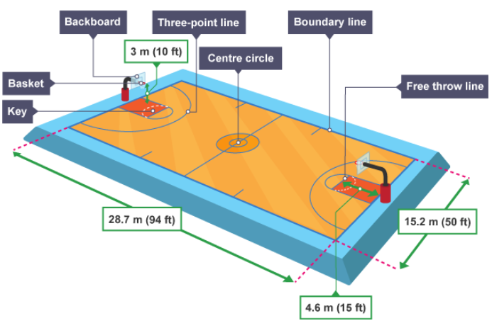
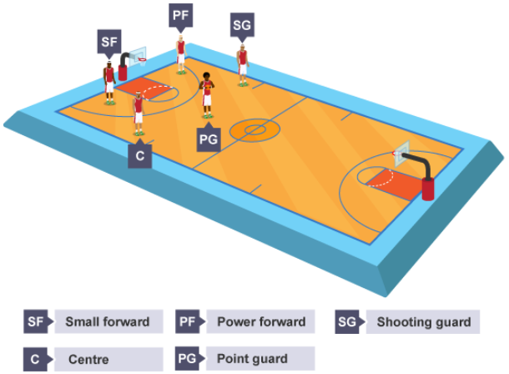
Subject Knowledge Organiser
Basketball – Rules, Scoring, Officials, Court Dimensions & Player Positions
Rules
A basketball team can have a maximum of five players on the court.
Player substitutions can be made at any time and there is no restriction on the number of substitutions made.
A ball can travel through dribbling or passing.
A player is no longer able to dribble with the ball once the player puts two hands on the ball. At this point, a player must either pass or shoot.
If a team wins possession back in their own half, they have ten seconds to get it into their opponent's end or a foul will be called.
An attacking team has 24 seconds from gaining possession of the ball to shoot
After the shot is taken, the clock is restarted for another 24 seconds.
After a team scores a basket, the ball is returned back to the opposition to start again.
All fouls that are committed throughout a game are to be accumulated and when a certain number is reached, the umpire will award a free throw.
Depending on where a technical foul is committed, the umpire may award a number of free throws a player will receive.
Violations can be awarded by the officials in basketball for player handling errors. These include travelling, double dribble, goal-tending and back court violation.
Court Dimensions
Player Positions
Scoring
In a game of basketball there are three clear ways to score points. If a shot is successfully scored from outside of the three-point line, three points are awarded. If a shot is successfully scored from inside of the three-point line, two points are awarded. If a team is awarded a technical foul then they will receive between one and three free shots. Each shot scored will be awarded with one point.
Officials
During a competitive game of basketball there are two referees, a scorekeeper, timekeeper and a shot clock operator. To ensure that everybody is aware of a decision made, the referees perform a series of hand and arm signals.

Slide 2

Subject Knowledge Organiser
Basketball – Bounce Pass, Chest Pass, Jump Shot & Lay-up
Bounce Pass
A bounce pass is a short pass that enables the player to find a teammate in a crowded area. The height of the ball makes it difficult for the opposition to intercept.
Stage one
Feet shoulder width apart in opposition, with knees bent.
Place hands each side and slightly behind the ball, with the fingers comfortably spread. Hold the ball at waist level, with elbows tucked in.
Stage two
Step in the direction of the pass, through extending your legs, back and arms. The wrist and fingers should be forced through the ball releasing it off the first and second fingers of both hands. Follow through with the arms fully extended, fingers pointing at the target and thumbs pointing to the floor.
Chest Pass
A chest pass is a very fast and flat pass. This enables a team to move quickly up a court in a precise and accurate fashion.
Stage one
Stand with feet shoulder width apart, on the balls of your feet with back straight and knees slightly bent. Place hands on the sides of the ball with the thumbs directly behind the ball and fingers comfortably spread. The ball should be held in front of the chest with the elbows tucked in.
Stage two
Step in the direction of the pass by extending your legs, back and arms. Push the ball from the chest with both arms (not from one shoulder). Fingers are rotated behind the ball and the thumbs are turned down. The back of the hands face one another with the thumbs straight down.
Stage three
Make sure the ball is released off the first and second fingers of both hands. Follow through to finish up with the arms fully extended, fingers pointing at the target and thumbs pointing to the floor.
Jump shot
The purpose of the jump shot is to allow the shooter to take aim from a higher position and therefore prevent a defender from blocking it.
Stage one
Place feet shoulder width apart, toes pointing straight ahead, and knees bent. Place non-shooting hand on the side of the ball and the shooting hand at the back of the ball, with the elbow tucked in. Hold the ball at chest height.
Stage two
Extend the legs/ankles by jumping straight up. Whilst in flight, extend back, shoulders and elbow. Flex the wrist and fingers forwards and release the ball at the highest point. After release, fingers should be pointed at the target, with the palm facing down.
Lay-up
A lay-up provides a player with the opportunity to drive at the opponent's basket, jump close to the target and release the ball safely at the backboard. When used effectively it has the highest percentage chance of scoring points.
Stage one
Dribble to the side of net. When a few metres away from the basket, hold the ball with both hands on the shooting hands side of the body.
Place the non-shooting hand on the side of the ball, and shooting hand on top of the ball.
Stage two
The last step before the lay-up jump should ensure that take off foot is opposite to the shooting hand (left foot/right hand). Flex the knee at take-off.
Stage three
Whilst jumping, extend the shooting knee and raise the ball up. Bring the ball between the shoulder and ear. Direct the wrist and fingers straight at the basket and release the ball at the highest point. Complete the follow through with the arm up and palm facing down, and hold until the ball has reached the basket.

