Slide 1
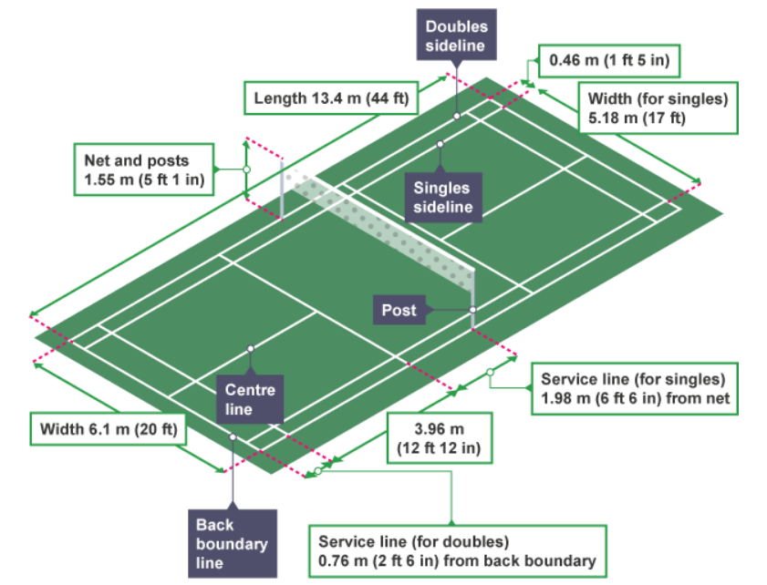
Subject Knowledge Organiser
Badminton – Rules, Scoring & Officials
Rules
A match consists of the best of three games of 21 points.
The player/pair winning a rally adds a point to its score.
At 20-all, the player/pair which first gains a 2-point lead wins that game.
At 29-all, the side scoring the 30th point wins that game.
The player/pair winning a game serves first in the next game.
A badminton match can be played by two opposing players (singles) or four opposing players (doubles).
A competitive match must be played indoors utilising the official court dimensions.
A point is scored when the shuttlecock lands inside the opponent's court or if a returned shuttlecock hits the net or lands outside of the court the player will lose the point.
At the start of the rally, the server and receiver stand in diagonally opposite service courts.
A legal serve must be hit diagonally over the net and across the court.
A badminton serve must be hit underarm and below the server's waist height with the racquet shaft pointing downwards, the shuttlecock is not allowed to bounce. After a point is won, the players will move to the opposite serving stations for the next point.
The rules do not allow second serves.
During a point a player can return the shuttlecock from inside and outside of the court.
A player is not able to touch the net with any part of their body or racket.
A player must not deliberately distract their opponent.
A player is not able to hit the shuttlecock twice.
A 'let' may be called by the referee if an unforeseen or accidental issue arises.
A game must include two rest periods. These are a 90-second rest after the first game and a 5-minute rest after the second game.
Court Dimensions
Scoring
In recent years, badminton has changed how players can score a point. In 2006, the rules were changed to a rally point system and this now allows both players to score a point during a rally, regardless of who served.
In competitive adult matches, all games are played to a best of three games. To win a game, a player must reach 21 points. However, if the game is tied at 20-20 (or 20-all) then you are required to win by two clear points. Unlike most sports, however, if the score becomes 29-29 (or 29-all), the player or team to score the 30th point will win the game.

Slide 2

Subject Knowledge Organiser
Badminton – Forehand Clear, Forehand Drop Shot & Forehand Smash
Forehand Clear
The forehand clear shot enables players to move their opponent to the back of the court, creating space in the mid and front court to exploit.
Stage one
Stand in position on the balls of your feet, with knees slightly bent. Turn sideways with your left foot pointing towards the target and your right foot parallel to the baseline. The left shoulder and fully extended elbow will be pointing towards the shuttlecock. The racket elbow should be extended backwards behind the head at 90ᵒ with the face of the racket above head height. Transfer weight onto the back foot.
Stage two
Keep your eyes on the shuttlecock. Flex your wrist and elbow backward until the racket is parallel with the floor. Rotate your body and step forward towards the shuttle with your racket leg, transferring your weight through the shot. Extend your racket elbow upwards into a throwing position.
Stage three
Keep your eyes on the shuttlecock. Extend your racket elbow quickly towards the shuttlecock, with the non-racket arm rotating backwards. Make contact with the shuttlecock as high as possible in front of your body. Extend your elbow and flex your wrist on contact, to allow for a 'whip' action. Drive the shuttlecock with a high trajectory towards the back of the court.
Stage four
Your body should have fully rotated with your racket foot now bearing all the weight and facing towards the target. The racket will follow through finishing to the left hand side of your body. Return back to ready position for the next shot.
Forehand Drop Shot
The forehand drop shot enables players to move their opponent to the front court to either win a point or create space in the mid and back court to exploit.
Stage one
As the shuttlecock is returned, stand in position on the balls of your feet, with knees slightly bent. Turn sideways with your left foot pointing towards the target and your right foot parallel to the baseline. The left shoulder and fully extended elbow will be pointing towards the shuttlecock. The racket elbow should be extended backwards behind the head at 90ᵒ with the face of the racket above head height. Transfer weight onto the back foot.
Stage two
Keep your eyes on the shuttlecock. Flex your wrist and elbow backward until the racket is parallel with the floor. Rotate your body and step forward towards the shuttlecock with your racket leg, transferring your weight through the shot. Extend your racket elbow upwards into a throwing position.
Stage three
Keep your eyes on the shuttlecock. Extend your racket elbow towards the shuttlecock, with non-racket shoulder rotating backwards. Make contact with the shuttlecock as high as possible in front of your body. Extend your elbow and flex your wrist on contact. Slice across the shuttlecock with the face of the racket slightly open, or just before contact, slow the speed of the racket down, tapping the shuttle gently over the net. Hit the shuttlecock at a flat trajectory, allowing it to drop just over the net.
Stage four
Your body should have fully rotated with your racket foot now bearing all the weight and facing towards the target. The racket will follow through, finishing to the left hand side of your body. Return back to ready position.
Forehand Smash
The forehand smash shot is hit with power and speed downward into the opponent's court. The angle/steepness of the shuttlecock's trajectory make it hard for the opponent to return.
Stage one
As the shuttlecock is returned, stand in position on the balls of your feet, with knees slightly bent. Turn sideways with your left foot pointing towards the target and your right foot parallel to the baseline. Left shoulder and fully extended elbow will be pointing towards the shuttlecock. The racket elbow should be extended backwards behind the head at 90ᵒ with the face of the racket above head height. Transfer weight onto the back foot.
Stage two
Keep your eyes on the shuttlecock. Flex your wrist and elbow backward until the racket is parallel with the floor. Rotate your body and step forward towards the shuttle with your racket leg, transferring your weight through the shot. Extend your racket elbow upwards into a throwing position.
Stage three
Keep your eyes on the shuttlecock. Extend your racket elbow quickly towards the shuttlecock, with the non-racket elbow extended and shoulder rotating backwards. Make contact with the shuttlecock as high as possible in front of your body. Extend your elbow and flex your wrist on contact, to allow for a 'whip' action. Drive the shuttlecock downwards towards the floor of your opponent's court with a low trajectory.
Stage four
Your body should have fully rotated with your racket foot now bearing all the weight and facing towards the target. The racket will follow through, finishing to the left hand side of your body. Return back to ready position for the next shot.

